Slide 1
7.4) Successive transformations

Slide 2



Worked example
Your turn
Represent as a single matrix the transformation representing a reflection in the line $y=x$ followed by a stretch parallel to the $x$-axis by a factor of 4.
Represent as a single matrix the transformation representing a rotation $90°$ anticlockwise about the point $\left(0,0\right)$ followed by a reflection in the line $x$-axis.
What single transformation is this?
Represent as a single matrix the transformation representing a reflection in the line $y=−x$ followed by a stretch parallel to the $y$-axis by a factor of 3.
Represent as a single matrix the transformation representing a rotation $270°$ anticlockwise about the point $\left(0,0\right)$ followed by a reflection in the line $y$-axis.
What single transformation is this?
$$\left(\begin{matrix}0 & −3 \\ −1 & 0\end{matrix}\right)$$
$$\left(\begin{matrix}0 & −1 \\ −1 & 0\end{matrix}\right)$$
Reflection in the line $y=−x$

Slide 3
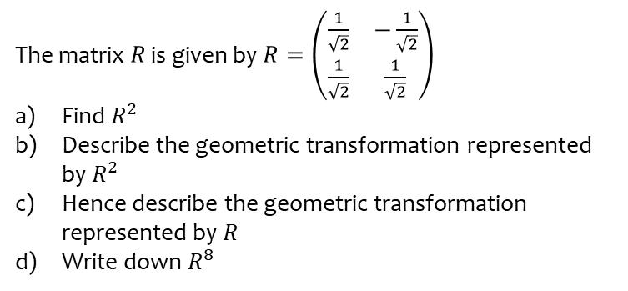
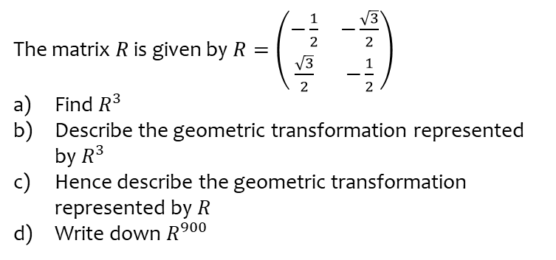
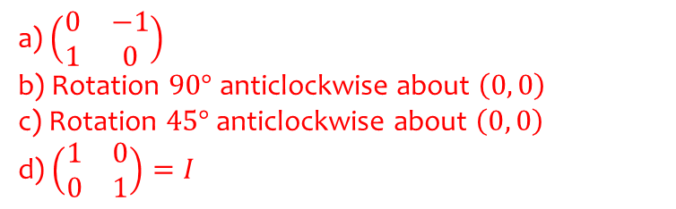
Worked example
Your turn
The matrix $R$ is given by $R=\left(\begin{matrix}−\frac{1}{2} & −\frac{\sqrt{3}}{2} \\ \frac{\sqrt{3}}{2} & −\frac{1}{2}\end{matrix}\right)$
Find $R^{3}$
Describe the geometric transformation represented by $R^{3}$
Hence describe the geometric transformation represented by $R$
Write down $R^{900}$
The matrix $R$ is given by $R=\left(\begin{matrix}\frac{1}{\sqrt{2}} & −\frac{1}{\sqrt{2}} \\ \frac{1}{\sqrt{2}} & \frac{1}{\sqrt{2}}\end{matrix}\right)$
Find $R^{2}$
Describe the geometric transformation represented by $R^{2}$
Hence describe the geometric transformation represented by $R$
Write down $R^{8}$
a) $\left(\begin{matrix}0 & −1 \\ 1 & 0\end{matrix}\right)$
b) Rotation $90°$ anticlockwise about $\left(0, 0\right)$
c) Rotation $45°$ anticlockwise about $\left(0, 0\right)$
d) $\left(\begin{matrix}1 & 0 \\ 0 & 1\end{matrix}\right)=I$

