Slide 1
Teachings for
Exercise 7C

Slide 2



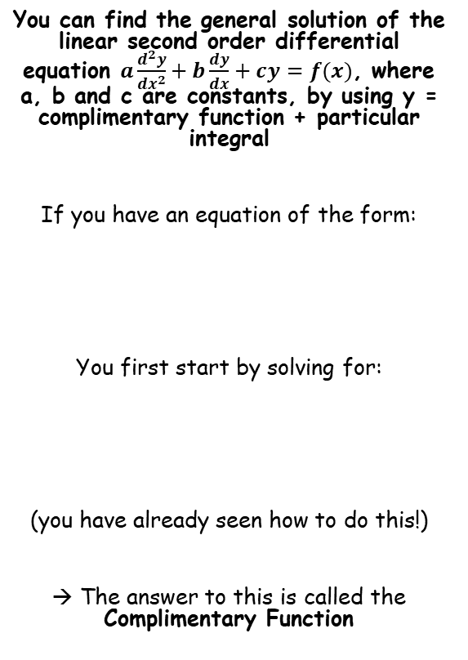





Methods in Differential Equations
You can find the general solution of the linear second order differential equation $a\frac{d^{2}y}{{dx}^{2}}+b\frac{dy}{dx}+cy=f(x)$, where a, b and c are constants, by using y = complimentary function + particular integral
If you have an equation of the form:
You first start by solving for:
(you have already seen how to do this!)
→ The answer to this is called the Complimentary Function
However, to solve an equation which is equal to a function of x, you also need to calculate the Particular Integral and add it on
You will see how to do this for these possible forms of f(x)
$$A$$
$$a\frac{d^{2}y}{{dx}^{2}}+b\frac{dy}{dx}+cy=f(x)$$
$$A+Bx$$
$$A+Bx+Cx^{2}$$
We will have a look at dealing with each of these types now!
$$ke^{px}$$
$$a\frac{d^{2}y}{{dx}^{2}}+b\frac{dy}{dx}+cy=0$$
$$kxe^{px}$$
$$Acosmx+Bsinmx$$
$$y=Complimentary Function+Particular Integral$$
7C

Slide 3





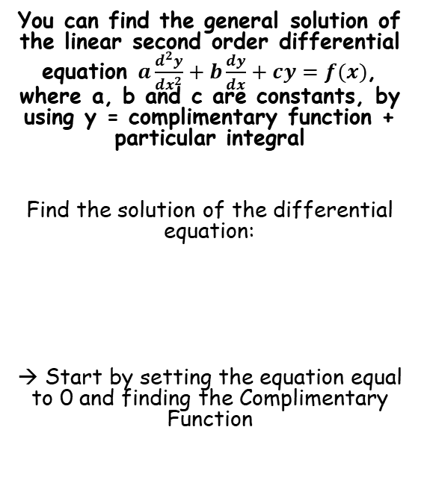






Methods in Differential Equations
$$Ae^{m_{1}x}+Be^{m_{2}x}$$
$$e^{px}\left(Acosqx+Bsinqx\right)$$
$$y=Complimentary Function+Particular Integral$$
$$(A+Bx)e^{mx}$$
Complimentary Function
You can find the general solution of the linear second order differential equation $a\frac{d^{2}y}{{dx}^{2}}+b\frac{dy}{dx}+cy=f(x)$, where a, b and c are constants, by using y = complimentary function + particular integral
Find the solution of the differential equation:
→ Start by setting the equation equal to 0 and finding the Complimentary Function
$$\frac{d^{2}y}{{dx}^{2}}−5\frac{dy}{dx}+6y=0$$
Form the auxiliary equation
$$m^{2}−5m+6y=0$$
Factorise
$$(m−2)(m−3)=0$$
Solve
$$m=2 or 3$$
$$\frac{d^{2}y}{{dx}^{2}}−5\frac{dy}{dx}+6y=3$$
Sub the two answers into the ‘real roots’ form above
$$Ae^{m_{1}x}+Be^{m_{2}x}$$
m₁ = 2 and m₂ = 3
$$Ae^{2x}+Be^{3x}$$
$$CF=Ae^{2x}+Be^{3x}$$
This is the complimentary function (sometimes abbreviated as ‘CF’)
7C

Slide 4


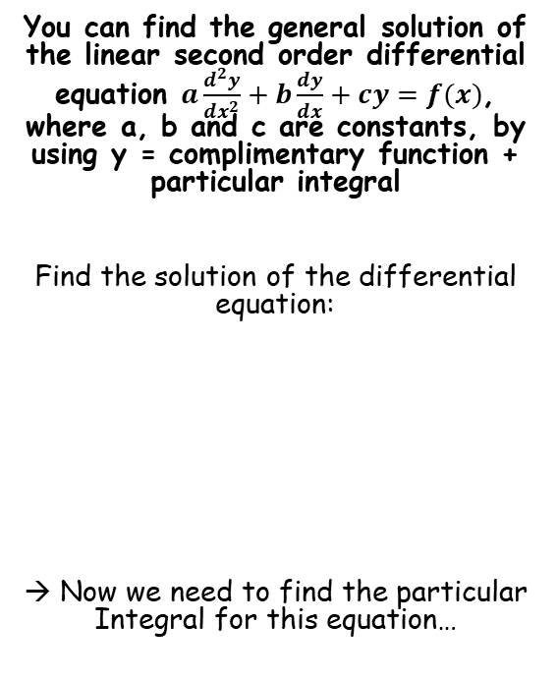








Methods in Differential Equations
$$Ae^{m_{1}x}+Be^{m_{2}x}$$
$$e^{px}\left(Acosqx+Bsinqx\right)$$
$$y=Complimentary Function+Particular Integral$$
$$(A+Bx)e^{mx}$$
Particular Integral
$$f\left(x\right)=3$$
We let y = λ as it is the same form as f(x)
You can find the general solution of the linear second order differential equation $a\frac{d^{2}y}{{dx}^{2}}+b\frac{dy}{dx}+cy=f(x)$, where a, b and c are constants, by using y = complimentary function + particular integral
Find the solution of the differential equation:
→ Now we need to find the particular Integral for this equation…
$$Let y=λ$$
→ λ represents a constant value (a number)
Now differentiate this expression for y
$$y=λ$$
$$\frac{dy}{dx}=0$$
Differentiate
$$\frac{d^{2}y}{{dx}^{2}}−5\frac{dy}{dx}+6y=3$$
$$\frac{d^{2}y}{dx^{2}}=0$$
Differentiate again
You can substitute these into the differential equation
$$CF=Ae^{2x}+Be^{3x}$$
$$\frac{d^{2}y}{{dx}^{2}}−5\frac{dy}{dx}+6y=3$$
The differentials are equal to 0 so they will be cancelled
$$6λ=3$$
$$PI=\frac{1}{2}$$
$$λ=\frac{1}{2}$$
Solve for λ
So the Particular Integral (PI) is equal to ¹/₂
7C

Slide 5

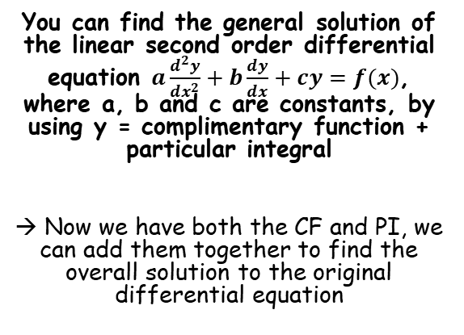



Methods in Differential Equations
$$Ae^{m_{1}x}+Be^{m_{2}x}$$
$$e^{px}\left(Acosqx+Bsinqx\right)$$
$$y=Complimentary Function+Particular Integral$$
$$(A+Bx)e^{mx}$$
$$\frac{d^{2}y}{{dx}^{2}}−5\frac{dy}{dx}+6y=3$$
You can find the general solution of the linear second order differential equation $a\frac{d^{2}y}{{dx}^{2}}+b\frac{dy}{dx}+cy=f(x)$, where a, b and c are constants, by using y = complimentary function + particular integral
→ Now we have both the CF and PI, we can add them together to find the overall solution to the original differential equation
$$CF=Ae^{2x}+Be^{3x}$$
$$PI=\frac{1}{2}$$
$$y=CF+PI$$
Replace CF and PI with the expressions we found
$$y=Ae^{2x}+Be^{3x}+\frac{1}{2}$$
The complimentary function makes the differential equation equal to 0
The particular integral makes it equal the value on the right side
Overall, we need both of these to give us the exact equation, neither will do it on their own!
We will now see that this works…
7C

Slide 6















Methods in Differential Equations
$$Ae^{m_{1}x}+Be^{m_{2}x}$$
$$e^{px}\left(Acosqx+Bsinqx\right)$$
$$y=CF+PI$$
$$(A+Bx)e^{mx}$$
$$y=Ae^{2x}+Be^{3x}+\frac{1}{2}$$
You can find the general solution of the linear second order differential equation $a\frac{d^{2}y}{{dx}^{2}}+b\frac{dy}{dx}+cy=f(x)$, where a, b and c are constants, by using y = complimentary function + particular integral
→ Checking that our answer is correct for the original differential equation
$$\frac{dy}{dx}=2Ae^{2x}+3Be^{3x}$$
Differentiate
$$\frac{d^{2}y}{dx^{2}}=4Ae^{2x}+9Be^{3x}$$
Differentiate again
Substitute these into the differential equation
$$\frac{d^{2}y}{{dx}^{2}}−5\frac{dy}{dx}+6y=3$$
$$\frac{d^{2}y}{{dx}^{2}}−5\frac{dy}{dx}+6y=3$$
Replace the differentials
$$\left(4Ae^{2x}+9Be^{3x}\right)$$
$$− 5\left(2Ae^{2x}+3Be^{3x}\right)$$
$$+ 6\left(Ae^{2x}+Be^{3x}+\frac{1}{2}\right)=3$$
Expand brackets
$$y=Ae^{2x}+Be^{3x}+\frac{1}{2}$$
$$4Ae^{2x}+9Be^{3x}$$
$$− 10Ae^{2x}−15Be^{3x}$$
$$+ 6Ae^{2x}+6Be^{3x}+3=3$$
All terms cancel except the 3!
$$3=3$$
So you can see that the process has worked!
7C

Slide 7
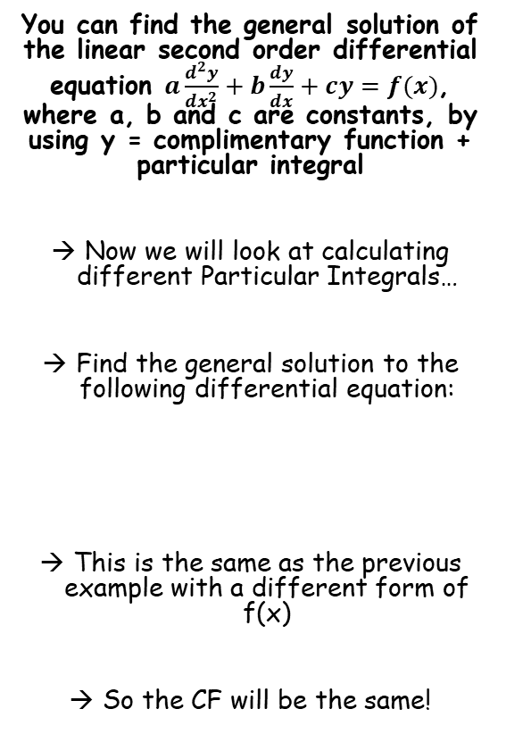

Methods in Differential Equations
$$Ae^{m_{1}x}+Be^{m_{2}x}$$
$$e^{px}\left(Acosqx+Bsinqx\right)$$
$$y=CF+PI$$
$$(A+Bx)e^{mx}$$
You can find the general solution of the linear second order differential equation $a\frac{d^{2}y}{{dx}^{2}}+b\frac{dy}{dx}+cy=f(x)$, where a, b and c are constants, by using y = complimentary function + particular integral
Now we will look at calculating different Particular Integrals…
Find the general solution to the following differential equation:
This is the same as the previous example with a different form of f(x)
So the CF will be the same!
$$\frac{d^{2}y}{{dx}^{2}}−5\frac{dy}{dx}+6y=2x$$
7C

Slide 8

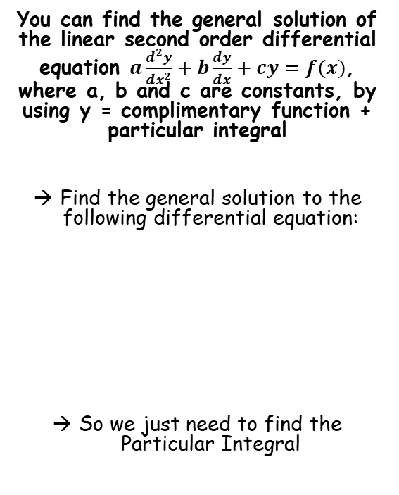







Methods in Differential Equations
$$Ae^{m_{1}x}+Be^{m_{2}x}$$
$$e^{px}\left(Acosqx+Bsinqx\right)$$
$$y=CF+PI$$
$$(A+Bx)e^{mx}$$
Particular Integral
We let y = λx + μ as it is the same form as f(x)
You can find the general solution of the linear second order differential equation $a\frac{d^{2}y}{{dx}^{2}}+b\frac{dy}{dx}+cy=f(x)$, where a, b and c are constants, by using y = complimentary function + particular integral
Find the general solution to the following differential equation:
So we just need to find the Particular Integral
$$f\left(x\right)=2x$$
$$Let y=λx+μ$$
→ λ and μ represent constant values
Now differentiate this expression for y
$$y=λx+μ$$
$$\frac{dy}{dx}=λ$$
Differentiate
$$\frac{d^{2}y}{dx^{2}}=0$$
Differentiate again
$$\frac{d^{2}y}{{dx}^{2}}−5\frac{dy}{dx}+6y=2x$$
You can substitute these into the differential equation
$$CF=Ae^{2x}+Be^{3x}$$
$$\frac{d^{2}y}{{dx}^{2}}−5\frac{dy}{dx}+6y=2x$$
The second differential will be cancelled out
$$−5λ+6(λx+μ)=2x$$
Multiply out the bracket
$$6λx+6μ−5λ=2x$$
7C

Slide 9




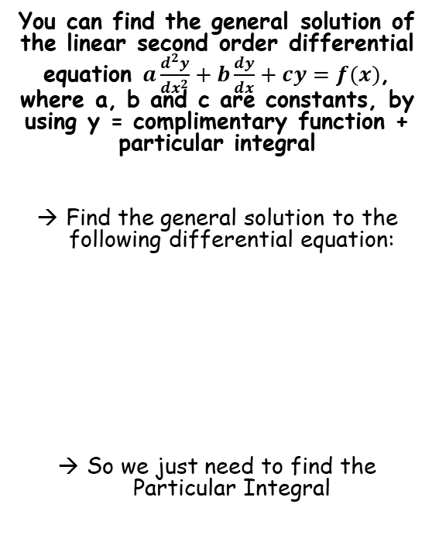





Methods in Differential Equations
$$Ae^{m_{1}x}+Be^{m_{2}x}$$
$$e^{px}\left(Acosqx+Bsinqx\right)$$
$$y=CF+PI$$
$$(A+Bx)e^{mx}$$
Particular Integral
We let y = λx + μ as it is the same form as f(x)
You can find the general solution of the linear second order differential equation $a\frac{d^{2}y}{{dx}^{2}}+b\frac{dy}{dx}+cy=f(x)$, where a, b and c are constants, by using y = complimentary function + particular integral
Find the general solution to the following differential equation:
So we just need to find the Particular Integral
$$f\left(x\right)=2x$$
$$Let y=λx+μ$$
→ λ and μ represent constant values
$$6λx+6μ−5λ=2x$$
Compare coefficients of x on each side – they must be equal…
$$6λ=2$$
$$λ=\frac{1}{3}$$
Divide by 6
$$\frac{d^{2}y}{{dx}^{2}}−5\frac{dy}{dx}+6y=2x$$
$$6λx+6μ−5λ=2x$$
Compare coefficients of the ‘constant’ on each side – they must be equal as well…
$$6μ−5λ=0$$
$$CF=Ae^{2x}+Be^{3x}$$
Sub in the value of λ that we have found
$$6μ−\frac{5}{3}=0$$
$$μ=\frac{5}{18}$$
Solve for μ
$$y=Ae^{2x}+Be^{3x}+\frac{1}{3}x+\frac{5}{18}$$
We now know the value of the Particular Integral!
$$PI=λx+μ$$
$$PI=\frac{1}{3}x+\frac{5}{18}$$
7C

Slide 10


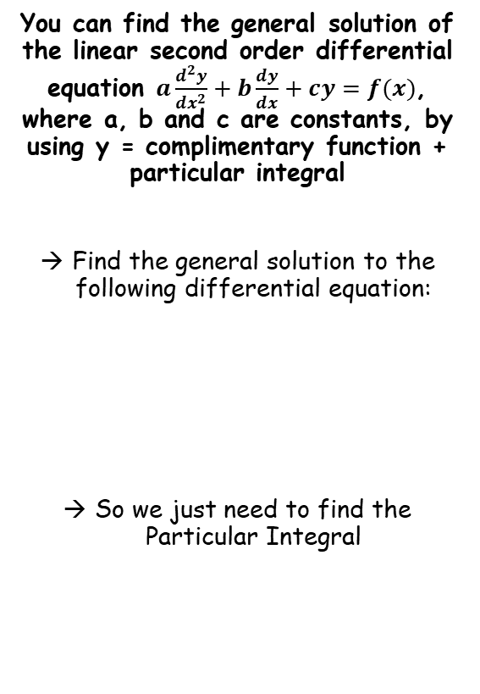





Methods in Differential Equations
$$Ae^{m_{1}x}+Be^{m_{2}x}$$
$$e^{px}\left(Acosqx+Bsinqx\right)$$
$$y=CF+PI$$
$$(A+Bx)e^{mx}$$
Particular Integral
We let y = λx² + μx + v as it is the same form as f(x)
You can find the general solution of the linear second order differential equation $a\frac{d^{2}y}{{dx}^{2}}+b\frac{dy}{dx}+cy=f(x)$, where a, b and c are constants, by using y = complimentary function + particular integral
Find the general solution to the following differential equation:
So we just need to find the Particular Integral
$$f\left(x\right)={3x}^{2}$$
$$Let y=λx^{2}+μx+v$$
→ λ, μ and v represent constant values
Now differentiate this expression for y
$$y=λx^{2}+μx+v$$
$$\frac{dy}{dx}=2λx+μ$$
Differentiate
$$\frac{d^{2}y}{dx^{2}}=2λ$$
Differentiate again
$$\frac{d^{2}y}{{dx}^{2}}−5\frac{dy}{dx}+6y=3x^{2}$$
You can substitute these into the differential equation
$$CF=Ae^{2x}+Be^{3x}$$
$$\frac{d^{2}y}{{dx}^{2}}−5\frac{dy}{dx}+6y={3x}^{2}$$
Sub in differentials
$$2λ−5\left(2λx+μ\right)+6(λx^{2}+μx+v)={3x}^{2}$$
Multiply out the brackets
$$2λ−10λx−5μ+6λx^{2}+6μx+6v={3x}^{2}$$
Group terms in x², x and constants separately
$$6λx^{2}+(6μ−10λ)x+(2λ−5μ+6v)={3x}^{2}$$
7C

Slide 11







Methods in Differential Equations
$$Ae^{m_{1}x}+Be^{m_{2}x}$$
$$e^{px}\left(Acosqx+Bsinqx\right)$$
$$y=CF+PI$$
$$(A+Bx)e^{mx}$$
Particular Integral
We let y = λx² + μx + v as it is the same form as f(x)
You can find the general solution of the linear second order differential equation $a\frac{d^{2}y}{{dx}^{2}}+b\frac{dy}{dx}+cy=f(x)$, where a, b and c are constants, by using y = complimentary function + particular integral
Find the general solution to the following differential equation:
So we just need to find the Particular Integral
$$f\left(x\right)={3x}^{2}$$
$$Let y=λx^{2}+μx+v$$
→ λ, μ and v represent constant values
$$6λx^{2}+(6μ−10λ)x+(2λ−5μ+6v)={3x}^{2}$$
Compare coefficients of x²
$$6λ=3$$
$$λ=\frac{1}{2}$$
Solve
$$\frac{d^{2}y}{{dx}^{2}}−5\frac{dy}{dx}+6y=3x^{2}$$
$$6λx^{2}+(6μ−10λ)x+(2λ−5μ+6v)={3x}^{2}$$
Compare coefficients of x
$$6μ−10λ=0$$
Use the value of λ to help solve
$$CF=Ae^{2x}+Be^{3x}$$
$$μ=\frac{5}{6}$$
$$6λx^{2}+(6μ−10λ)x+(2λ−5μ+6v)={3x}^{2}$$
Compare constants
$$PI=λx^{2}+μx+v$$
$$2λ−5μ+6v=0$$
Use the values of λ and μ to help solve
$$PI=\frac{1}{2}x^{2}+\frac{5}{6}x+\frac{19}{36}$$
$$v=\frac{19}{36}$$
7C

Slide 12

Methods in Differential Equations
$$Ae^{m_{1}x}+Be^{m_{2}x}$$
$$e^{px}\left(Acosqx+Bsinqx\right)$$
$$y=CF+PI$$
$$(A+Bx)e^{mx}$$
You can find the general solution of the linear second order differential equation $a\frac{d^{2}y}{{dx}^{2}}+b\frac{dy}{dx}+cy=f(x)$, where a, b and c are constants, by using y = complimentary function + particular integral
Find the general solution to the following differential equation:
So we just need to find the Particular Integral
$$\frac{d^{2}y}{{dx}^{2}}−5\frac{dy}{dx}+6y=3x^{2}$$
$$y=Ae^{2x}+Be^{3x}+\frac{1}{2}x^{2}+\frac{5}{6}x+\frac{19}{36}$$
$$CF=Ae^{2x}+Be^{3x}$$
$$PI=\frac{1}{2}x^{2}+\frac{5}{6}x+\frac{19}{36}$$
7C

Slide 13












Methods in Differential Equations
$$Ae^{m_{1}x}+Be^{m_{2}x}$$
$$e^{px}\left(Acosqx+Bsinqx\right)$$
$$y=CF+PI$$
$$(A+Bx)e^{mx}$$
Particular Integral
We let y = λe^{x} as it is the same form as f(x)
You can find the general solution of the linear second order differential equation $a\frac{d^{2}y}{{dx}^{2}}+b\frac{dy}{dx}+cy=f(x)$, where a, b and c are constants, by using y = complimentary function + particular integral
Find the general solution to the following differential equation:
So we just need to find the Particular Integral
$$f\left(x\right)=e^{x}$$
$$Let y=λe^{x}$$
→ λ represents a constant value
Now differentiate this expression for y
$$y=λe^{x}$$
$$\frac{dy}{dx}=λe^{x}$$
Differentiate
$$\frac{d^{2}y}{dx^{2}}=λe^{x}$$
Differentiate again
$$\frac{d^{2}y}{{dx}^{2}}−5\frac{dy}{dx}+6y=e^{x}$$
You can substitute these into the differential equation
$$CF=Ae^{2x}+Be^{3x}$$
$$\frac{d^{2}y}{{dx}^{2}}−5\frac{dy}{dx}+6y=e^{x}$$
Replace the differentials
$$λe^{x}−5\left(λe^{x}\right)+6\left(λe^{x}\right)=e^{x}$$
$$PI=\frac{1}{2}e^{x}$$
Simplify
$$2λe^{x}=e^{x}$$
$$y=Ae^{2x}+Be^{3x}+\frac{1}{2}e^{x}$$
$$λ=\frac{1}{2}$$
Find the value of λ
7C

Slide 14








Methods in Differential Equations
$$Ae^{m_{1}x}+Be^{m_{2}x}$$
$$e^{px}\left(Acosqx+Bsinqx\right)$$
$$y=CF+PI$$
$$(A+Bx)e^{mx}$$
Particular Integral
We let y = λsinx + µcosx as it is the same form as f(x) (you need both sin AND cos!)
You can find the general solution of the linear second order differential equation $a\frac{d^{2}y}{{dx}^{2}}+b\frac{dy}{dx}+cy=f(x)$, where a, b and c are constants, by using y = complimentary function + particular integral
Find the general solution to the following differential equation:
$$f\left(x\right)=13sin3x$$
$$Let y=λsin3x+μcos3x$$
→ λ and µ represent constant values
Now differentiate this expression for y
$$y=λsin3x+μcos3x$$
$$\frac{dy}{dx}=3λcos3x−3μsin3x$$
Differentiate
$$\frac{d^{2}y}{dx^{2}}=−9λsin3x−9μcos3x$$
Differentiate again
$$\frac{d^{2}y}{{dx}^{2}}−5\frac{dy}{dx}+6y=13sin3x$$
You can substitute these into the differential equation
$$CF=Ae^{2x}+Be^{3x}$$
$$\frac{d^{2}y}{{dx}^{2}}−5\frac{dy}{dx}+6y=13sin3x$$
Replace the differentials
$$−9λsin3x−9μcos3x−5\left(3λcos3x−3μsin3x\right)+6\left(λsin3x+μcos3x\right)=13sin3x$$
Multiply out the brackets
$$−9λsin3x−9μcos3x−15λcos3x+15μsin3x+6λsin3x+6μcos3x=13sin3x$$
Group terms in sin and cos
$$\left(−3λ+15μ\right)sin3x+\left(−3μ−15λ\right)cos3x=13sin3x$$
7C

Slide 15










Methods in Differential Equations
$$Ae^{m_{1}x}+Be^{m_{2}x}$$
$$e^{px}\left(Acosqx+Bsinqx\right)$$
$$y=CF+PI$$
$$(A+Bx)e^{mx}$$
Particular Integral
We let y = λsinx + µcosx as it is the same form as f(x) (you need both sin AND cos!)
You can find the general solution of the linear second order differential equation $a\frac{d^{2}y}{{dx}^{2}}+b\frac{dy}{dx}+cy=f(x)$, where a, b and c are constants, by using y = complimentary function + particular integral
Find the general solution to the following differential equation:
$$f\left(x\right)=13sin3x$$
$$Let y=λsin3x+μcos3x$$
→ λ and µ represent constant values
$$\left(−3λ+15μ\right)sin3x+\left(−3μ−15λ\right)cos3x=13sin3x$$
Compare coefficients of sin3x
$$−3λ+15μ=13$$
Compare coefficients of cos3x
$$−3μ−15λ=0$$
$$\frac{d^{2}y}{{dx}^{2}}−5\frac{dy}{dx}+6y=13sin3x$$
You can solve these equations simultaneously
$$−3λ+15μ=13$$
$$−3λ+15μ=13$$
$$CF=Ae^{2x}+Be^{3x}$$
$$−3μ−15λ=0$$
$$−15μ−75λ=0$$
Add together
Multiply by 5
$$PI=−\frac{1}{6}sin3x+\frac{5}{6}cos3x$$
$$−78λ=13$$
$$λ=−\frac{1}{6}$$
Solve
$$y=Ae^{2x}+Be^{3x}−\frac{1}{6}sin3x+\frac{5}{6}cos3x$$
Use to find µ
$$μ=\frac{5}{6}$$
7C

Slide 16


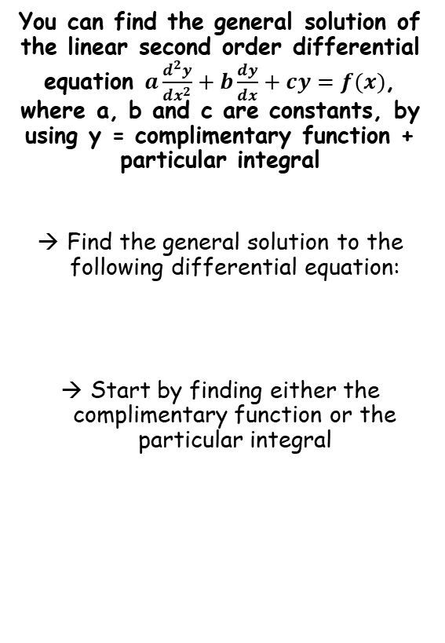






Methods in Differential Equations
$$Ae^{m_{1}x}+Be^{m_{2}x}$$
$$e^{px}\left(Acosqx+Bsinqx\right)$$
$$y=CF+PI$$
$$(A+Bx)e^{mx}$$
Complimentary Function
You can find the general solution of the linear second order differential equation $a\frac{d^{2}y}{{dx}^{2}}+b\frac{dy}{dx}+cy=f(x)$, where a, b and c are constants, by using y = complimentary function + particular integral
Find the general solution to the following differential equation:
Start by finding either the complimentary function or the particular integral
$$\frac{d^{2}y}{{dx}^{2}}−2\frac{dy}{dx}=0$$
Form the auxiliary equation
$$m^{2}−2m=0$$
Factorise
$$m\left(m−2\right)=0$$
Solve
$$m=0 or 2$$
Sub the two answers into the ‘real roots’ form above
$$\frac{d^{2}y}{{dx}^{2}}−2\frac{dy}{dx}=3$$
$$Ae^{m_{1}x}+Be^{m_{2}x}$$
m₁ = 0 and m₂ = 2
$$Ae^{0x}+Be^{2x}$$
e^{0x} = 1
$$A+Be^{2x}$$
$$CF=A+Be^{2x}$$
7C

Slide 17










Methods in Differential Equations
$$Ae^{m_{1}x}+Be^{m_{2}x}$$
$$e^{px}\left(Acosqx+Bsinqx\right)$$
$$y=CF+PI$$
$$(A+Bx)e^{mx}$$
Particular Integral
Normally, we would now let y = λ
However, if you look at the complimentary function, we already have a term of this form, ‘A’.
Therefore, the Particular Integral cannot be of this form as it has already been absorbed into the CF
In situations like this, we can introduce ‘x’ into the equation with λ in
You can find the general solution of the linear second order differential equation $a\frac{d^{2}y}{{dx}^{2}}+b\frac{dy}{dx}+cy=f(x)$, where a, b and c are constants, by using y = complimentary function + particular integral
Find the general solution to the following differential equation:
Start by finding either the complimentary function or the particular integral
$$f\left(x\right)=3$$
$$Let y=λx$$
Now differentiate this expression for y
$$y=λx$$
$$\frac{d^{2}y}{{dx}^{2}}−2\frac{dy}{dx}=3$$
$$\frac{dy}{dx}=λ$$
Differentiate
$$\frac{d^{2}y}{dx^{2}}=0$$
Differentiate again
Now substitute these into the equation to find λ
$$CF=A+Be^{2x}$$
$$\frac{d^{2}y}{{dx}^{2}}−2\frac{dy}{dx}=3$$
$$PI=−\frac{3}{2}x$$
Replace the differentials – the second one cancels
$$−2λ=3$$
$$y=A+Be^{2x}−\frac{3}{2}x$$
$$λ=−\frac{3}{2}$$
Find the value of λ
7C

Slide 18
Methods in Differential Equations
To summarise this section:
Start by finding the Complimentary Function by setting the differential equation equal to 0, then forming the auxiliary equation (as in the previous sections)
Find the Particular Integral by considering f(x) and letting y equal something of the same form. Then differentiate it and replace these in the original equation and solve for the unknowns
→ Use the table to the right (which you are NOT given…)
3) Combine the CF and PI to create the equation in y
Form of f(x) | Form of PI
k | λ
kx | λx + µ
kx² | λx² + µx + v
ke^{px} | λe^{px}
mcosax | λcosax + µsinax
msinax | λcosax + µsinax
mcosax+nsinax | λcosax + µsinax
If the form of the Particular Integral is already in the Complimentary Function, include an ‘x’ in it as well (as we did on the last example!)
7C

