Slide 1
7.3) Enlargements and stretches

Slide 2

Worked example
Your turn
Describe the effect of the following matrices:
$\left(\begin{matrix}2 & 0 \\ 0 & 2\end{matrix}\right)$
$$\left(\begin{matrix}3 & 0 \\ 0 & 3\end{matrix}\right)$$
$$\left(\begin{matrix}3 & 0 \\ 0 & 2\end{matrix}\right)$$
Describe the effect of the following matrices:
$\left(\begin{matrix}2 & 0 \\ 0 & 3\end{matrix}\right)$
Stretch parallel to $x$-axis, scale factor $2$
and
Stretch parallel to $y$-axis, scale factor 3
(not an enlargement)

Slide 3
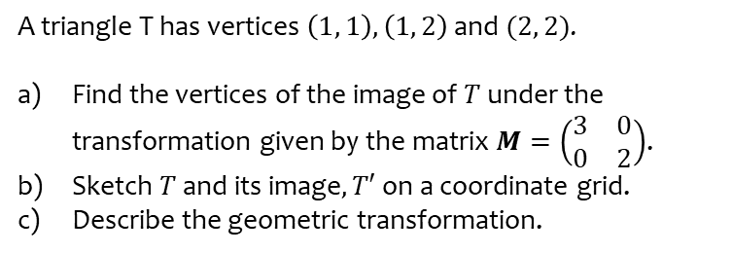
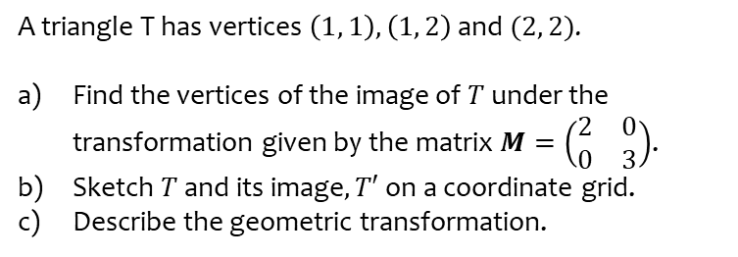
Worked example
Your turn
A triangle T has vertices $\left(1, 1\right), \left(1, 2\right)$ and $(2, 2)$.
Find the vertices of the image of $T$ under the transformation given by the matrix $M=\left(\begin{matrix}2 & 0 \\ 0 & 3\end{matrix}\right)$.
Sketch $T$ and its image$, T′$ on a coordinate grid.
Describe the geometric transformation.
A triangle T has vertices $\left(1, 1\right), \left(1, 2\right)$ and $(2, 2)$.
Find the vertices of the image of $T$ under the transformation given by the matrix $M=\left(\begin{matrix}3 & 0 \\ 0 & 2\end{matrix}\right)$.
Sketch $T$ and its image$, T′$ on a coordinate grid.
Describe the geometric transformation.
a) $\left(3, 2\right), (3,4)$ and $(6, 4)$
b) Sketch
c) The triangle has been stretched by a scale factor
of 3 parallel to the $x$-axis and by a scale factor of
$2$ parallel to the $y$-axis

Slide 4
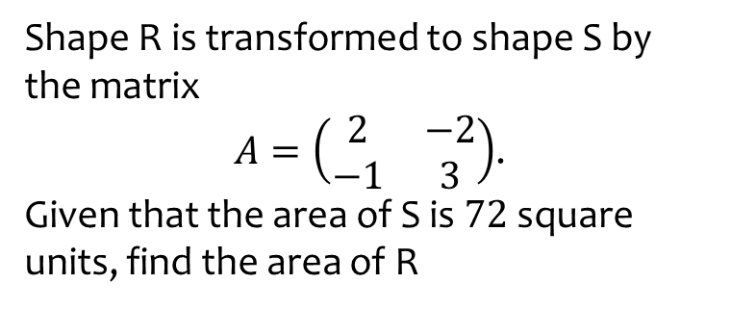
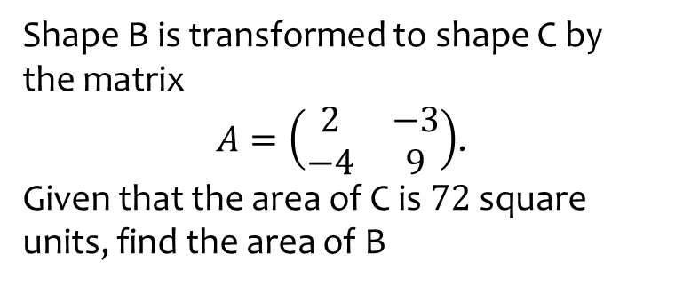
Worked example
Your turn
Shape B is transformed to shape C by the matrix
$A=\left(\begin{matrix}2 & −3 \\ −4 & 9\end{matrix}\right)$.
Given that the area of C is $72$ square units, find the area of B
Shape R is transformed to shape S by the matrix
$A=\left(\begin{matrix}2 & −2 \\ −1 & 3\end{matrix}\right)$.
Given that the area of S is $72$ square units, find the area of R
$$18$$

