Slide 1
7.2) Reflections and rotations

Slide 2



Worked example
Your turn
Find a $2×2$ matrix that represents:
A reflection in the $y$-axis.
A reflection in the line $y=x$
Find a $2×2$ matrix that represents:
A reflection in the $x$-axis.
A reflection in the line $y=−x$
$$\left(\begin{matrix}1 & 0 \\ 0 & −1\end{matrix}\right)$$
$$\left(\begin{matrix}0 & −1 \\ −1 & 0\end{matrix}\right)$$

Slide 3
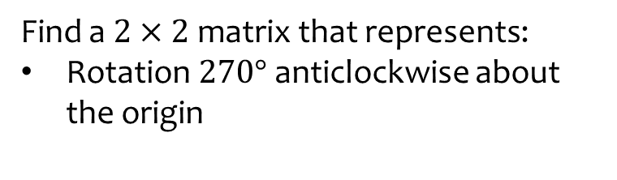


Worked example
Your turn
Find a $2×2$ matrix that represents:
Rotation $90°$ anticlockwise about the origin
Rotation $180°$ about the origin
Find a $2×2$ matrix that represents:
Rotation $270°$ anticlockwise about the origin
$$\left(\begin{matrix}0 & 1 \\ −1 & 0\end{matrix}\right)$$

Slide 4
Worked example
Your turn
Find a $2×2$ matrix that represents:
Rotation $90°$ anticlockwise about the origin
Rotation $180°$ about the origin
Find a $2×2$ matrix that represents:
Rotation $270°$ anticlockwise about the origin
$$\left(\begin{matrix}0 & 1 \\ −1 & 0\end{matrix}\right)$$

Slide 5
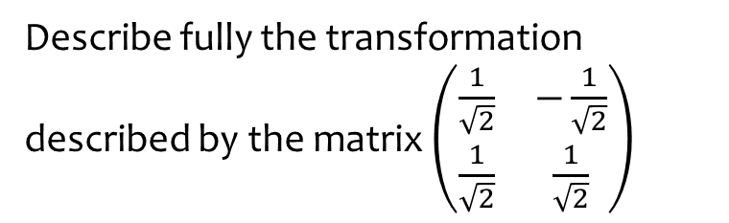
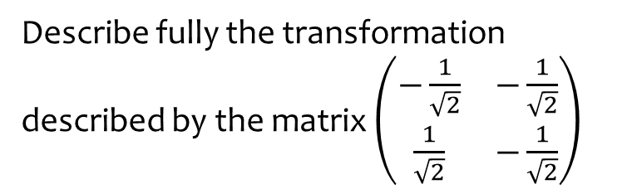

Worked example
Your turn
Describe fully the transformation described by the matrix $\left(\begin{matrix}−\frac{1}{\sqrt{2}} & −\frac{1}{\sqrt{2}} \\ \frac{1}{\sqrt{2}} & −\frac{1}{\sqrt{2}}\end{matrix}\right)$
Describe fully the transformation described by the matrix $\left(\begin{matrix}\frac{1}{\sqrt{2}} & −\frac{1}{\sqrt{2}} \\ \frac{1}{\sqrt{2}} & \frac{1}{\sqrt{2}}\end{matrix}\right)$
Rotation $45°$ anticlockwise about the origin

Slide 6



Worked example
Your turn
For these transformations, state any invariant lines/points:
reflection in the line $y=−x$
Rotation $90°$ anticlockwise about the origin
For these transformations, state any invariant lines/points:
reflection in the line $y=x$
Rotation $180°$ about the origin
Invariant lines:
$y=x$
Any straight line with gradient $−1 (y=−x+k)$
Invariant points:
All points on those lines
Invariant lines:
Any straight line through origin $(y=mx)$
Invariant points:
$$(0, 0)$$

Slide 7
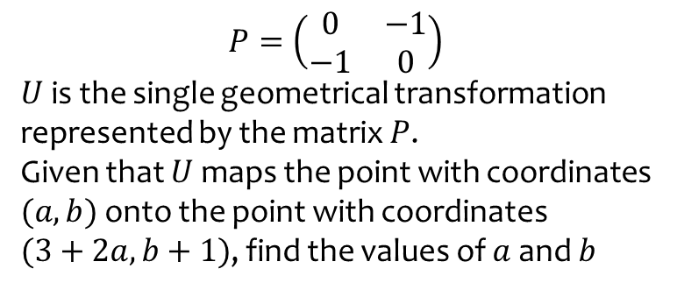
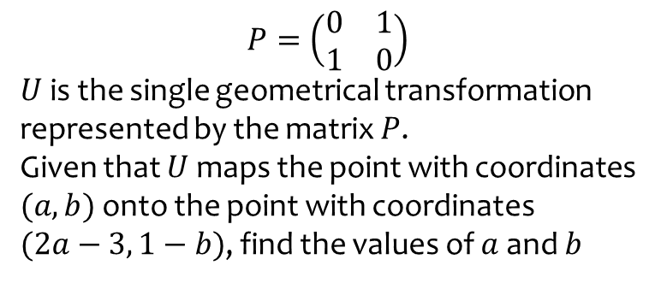
Worked example
Your turn
$$P=\left(\begin{matrix}0 & 1 \\ 1 & 0\end{matrix}\right)$$
$U$ is the single geometrical transformation represented by the matrix $P$.
Given that $U$ maps the point with coordinates $(a, b)$ onto the point with coordinates
$(2a−3, 1−b)$, find the values of $a$ and $b$
$$P=\left(\begin{matrix}0 & −1 \\ −1 & 0\end{matrix}\right)$$
$U$ is the single geometrical transformation represented by the matrix $P$.
Given that $U$ maps the point with coordinates $(a, b)$ onto the point with coordinates
$(3+2a, b+1)$, find the values of $a$ and $b$
$$a=−2, b=1$$

