Slide 1





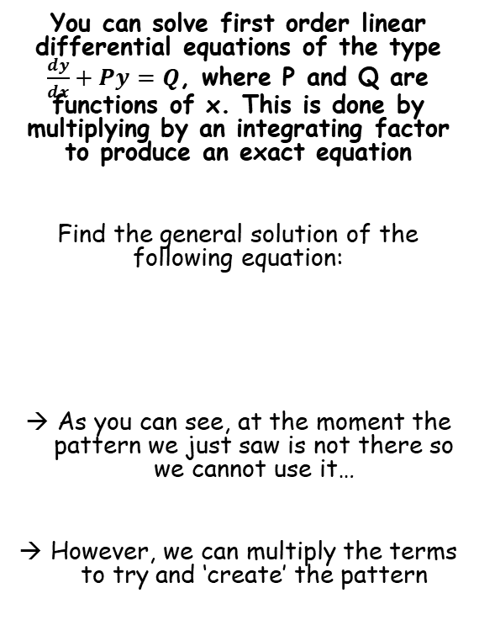



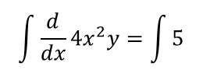



Methods in Differential Equations
$$f\left(x\right)\frac{dy}{dx}+f^{′}\left(x\right)y$$
$$f\left(x\right)g′(y)+f^{′}\left(x\right)g(y)$$
$$\frac{d}{dx}f\left(x\right)g(y)$$
$$\frac{dy}{dx}+\frac{2y}{x}=\frac{5}{{4x}^{2}}$$
You can solve first order linear differential equations of the type $\frac{dy}{dx}+Py=Q$, where P and Q are functions of x. This is done by multiplying by an integrating factor to produce an exact equation
Find the general solution of the following equation:
As you can see, at the moment the pattern we just saw is not there so we cannot use it…
However, we can multiply the terms to try and ‘create’ the pattern
Multiply all terms by 4x²
$$\left({4x}^{2}\right)\frac{dy}{dx}+\frac{2y\left({4x}^{2}\right)}{x}=\frac{5\left({4x}^{2}\right)}{{4x}^{2}}$$
Simplify each one
$${4x}^{2}\frac{dy}{dx}+8xy=5$$
Rewrite now using the pattern from the previous examples
$$\frac{d}{dx}{4x}^{2}y=5$$
$$\frac{dy}{dx}+\frac{2y}{x}=\frac{5}{{4x}^{2}}$$
Take integrals of each side
$$\int{\frac{d}{dx}{4x}^{2}y}=\int{5}$$
Calculate
$${4x}^{2}y=5x+C$$
Divide by 4x²
$$y=\frac{5x+C }{{4x}^{2}}$$
Alternative form (either is fine)
$$y=\frac{5 }{4x}+\frac{C}{{4x}^{2}}$$
7A

Slide 2
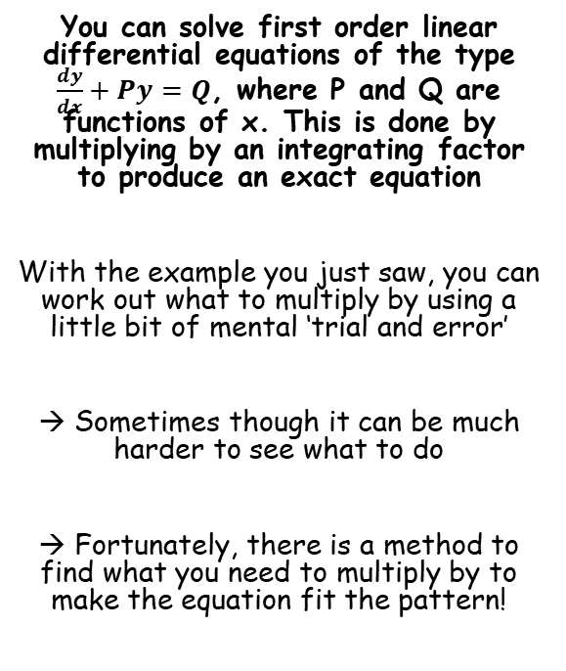
Methods in Differential Equations
$$f\left(x\right)\frac{dy}{dx}+f^{′}\left(x\right)y$$
$$f\left(x\right)g′(y)+f^{′}\left(x\right)g(y)$$
$$\frac{d}{dx}f\left(x\right)g(y)$$
You can solve first order linear differential equations of the type $\frac{dy}{dx}+Py=Q$, where P and Q are functions of x. This is done by multiplying by an integrating factor to produce an exact equation
With the example you just saw, you can work out what to multiply by using a little bit of mental ‘trial and error’
→ Sometimes though it can be much harder to see what to do
→ Fortunately, there is a method to find what you need to multiply by to make the equation fit the pattern!
7A

Slide 3



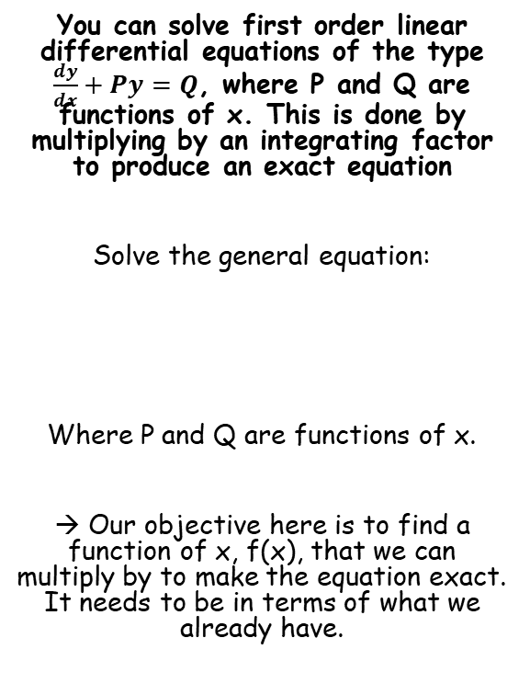





Methods in Differential Equations
$$f\left(x\right)\frac{dy}{dx}+f^{′}\left(x\right)y$$
$$f\left(x\right)g′(y)+f^{′}\left(x\right)g(y)$$
$$\frac{d}{dx}f\left(x\right)g(y)$$
You can solve first order linear differential equations of the type $\frac{dy}{dx}+Py=Q$, where P and Q are functions of x. This is done by multiplying by an integrating factor to produce an exact equation
Solve the general equation:
Where P and Q are functions of x.
→ Our objective here is to find a function of x, f(x), that we can multiply by to make the equation exact. It needs to be in terms of what we already have.
$$\frac{dy}{dx}+Py=Q$$
Multiply by f(x)
→ The idea is to produce an ‘exact’ equation which follows the pattern we know
$$f(x)\frac{dy}{dx}+f(x)Py=f(x)Q$$
Now since we have produced an exact equation, the left side must now equal the general pattern from before
$$\frac{dy}{dx}+Py=Q$$
$$f(x)\frac{dy}{dx}+f(x)Py$$
$$= f\left(x\right)\frac{dy}{dx}+f^{′}\left(x\right)y$$
The second terms must be equal if the sides are equal
$$f\left(x\right)Py=f^{′}\left(x\right)y$$
Divide by y
$$f\left(x\right)P=f^{′}\left(x\right)$$
Divide by f(x)
$$P=\frac{f^{′}\left(x\right)}{f(x)}$$
7A

Slide 4

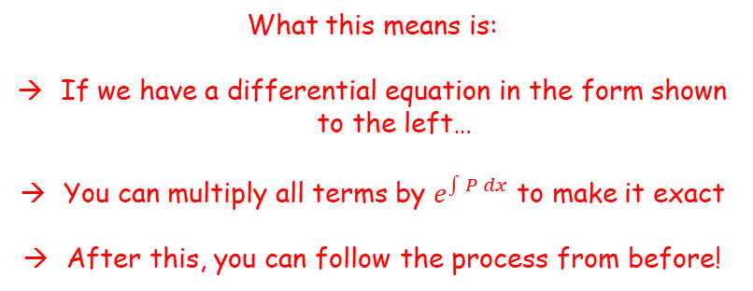
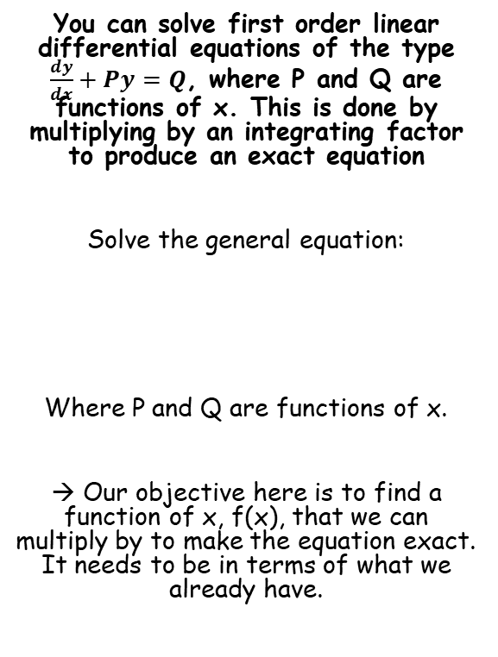
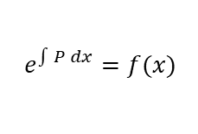
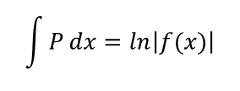
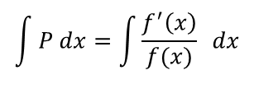
Methods in Differential Equations
$$f\left(x\right)\frac{dy}{dx}+f^{′}\left(x\right)y$$
$$f\left(x\right)g′(y)+f^{′}\left(x\right)g(y)$$
$$\frac{d}{dx}f\left(x\right)g(y)$$
$$P=\frac{f^{′}\left(x\right)}{f(x)}$$
You can solve first order linear differential equations of the type $\frac{dy}{dx}+Py=Q$, where P and Q are functions of x. This is done by multiplying by an integrating factor to produce an exact equation
Solve the general equation:
Where P and Q are functions of x.
→ Our objective here is to find a function of x, f(x), that we can multiply by to make the equation exact. It needs to be in terms of what we already have.
Take integrals of each side
$$\int{P dx}=\int{\frac{f^{′}\left(x\right)}{f(x)}} dx$$
The right side is a ‘standard pattern’
$$\int{P}dx=ln\left|f(x)\right|$$
Take exponentials of each side
$$\frac{dy}{dx}+Py=Q$$
$$e^{\int{P dx}}=f(x)$$
What this means is:
If we have a differential equation in the form shown to the left…
You can multiply all terms by $e^{\int{P dx}}$ to make it exact
After this, you can follow the process from before!
7A

Slide 5
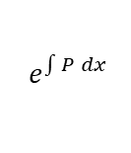


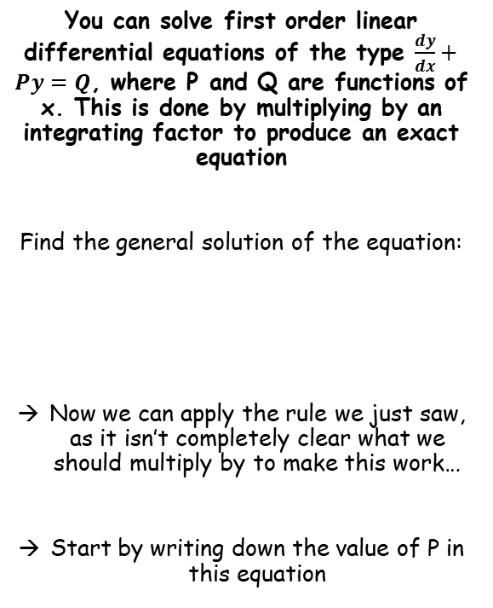




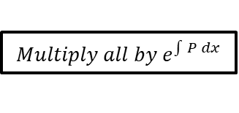
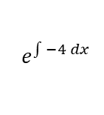
Methods in Differential Equations
$$\frac{dy}{dx}+Py=Q$$
$$Multiply all by e^{\int{P dx}}$$
$$f\left(x\right)\frac{dy}{dx}+f^{′}\left(x\right)y$$
You can solve first order linear differential equations of the type $\frac{dy}{dx}+Py=Q$, where P and Q are functions of x. This is done by multiplying by an integrating factor to produce an exact equation
Find the general solution of the equation:
Now we can apply the rule we just saw, as it isn’t completely clear what we should multiply by to make this work…
Start by writing down the value of P in this equation
$$\frac{dy}{dx}−4y=e^{x}$$
$$So P=−4$$
$$e^{\int{P dx}}$$
Sub in the value of P
$$e^{\int{−4 dx}}$$
Calculate the Integral
$$e^{−4x}$$
$$\frac{dy}{dx}−4y=e^{x}$$
So to make our differential equation exact, we need to multiply all terms by e^{-4x}
7A

Slide 6


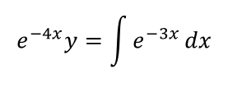
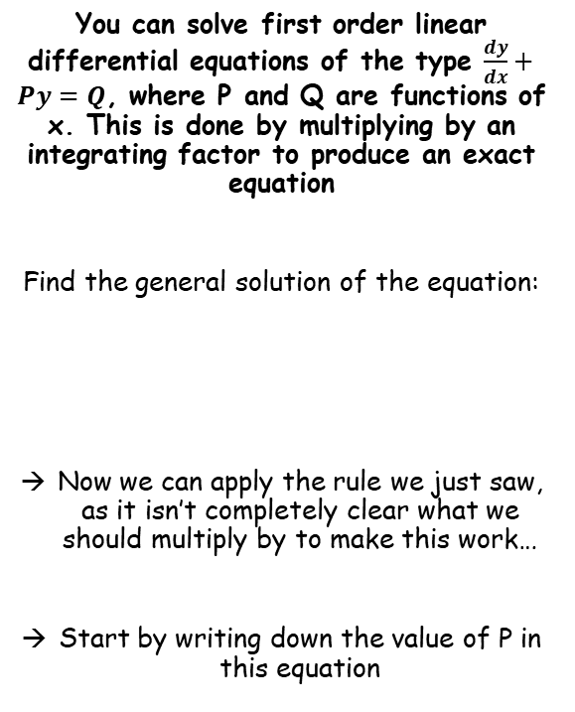




Methods in Differential Equations
$$\frac{dy}{dx}+Py=Q$$
$$Multiply all by e^{\int{P dx}}$$
$$f\left(x\right)\frac{dy}{dx}+f^{′}\left(x\right)y$$
You can solve first order linear differential equations of the type $\frac{dy}{dx}+Py=Q$, where P and Q are functions of x. This is done by multiplying by an integrating factor to produce an exact equation
Find the general solution of the equation:
Now we can apply the rule we just saw, as it isn’t completely clear what we should multiply by to make this work…
Start by writing down the value of P in this equation
So to make our differential equation exact, we need to multiply all terms by e^{-4x}
$$\frac{dy}{dx}−4y=e^{x}$$
Multiply all by e^{-4x}
$$e^{−4x}\frac{dy}{dx}−4e^{−4x}y={e^{−4x}e}^{x}$$
Differentiating e^{-4x} would give -4e^{-4x}, so you can see the left side is now an exact equation
→ Hence, we can rewrite it!
$$\frac{dy}{dx}−4y=e^{x}$$
$$\frac{d}{dx}e^{−4x}y={e^{−4x}e}^{x}$$
We can also simplify the right side
→ We are multiplying so add the powers together
$$\frac{d}{dx}e^{−4x}y=e^{−3x}$$
Integrate each side – cancels ^{d}/_{dx} on the left
$$e^{−4x}y=\int{e^{−3x}}dx$$
Calculate the integral on the right side
$$e^{−4x}y=−\frac{1}{3}e^{−3x}+C$$
Multiply by e^{4x} (same as dividing by e^{-4x})
$$y=−\frac{1}{3}e^{x}+Ce^{4x}$$
7A

Slide 7


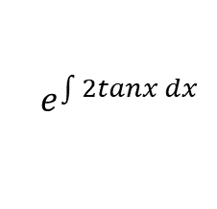
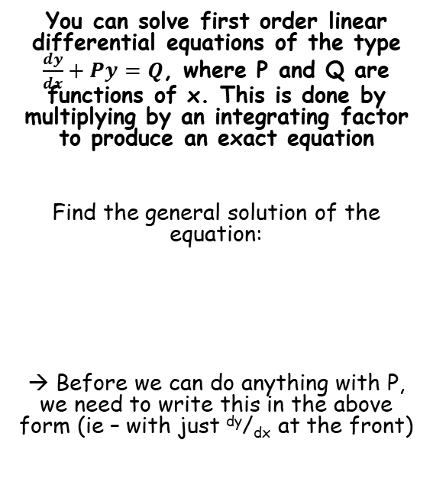
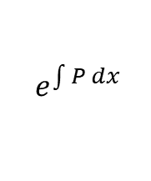




Methods in Differential Equations
$$\frac{dy}{dx}+Py=Q$$
$$Multiply all by e^{\int{P dx}}$$
$$f\left(x\right)\frac{dy}{dx}+f^{′}\left(x\right)y$$
You can solve first order linear differential equations of the type $\frac{dy}{dx}+Py=Q$, where P and Q are functions of x. This is done by multiplying by an integrating factor to produce an exact equation
Find the general solution of the equation:
→ Before we can do anything with P, we need to write this in the above form (ie – with just ^{dy}/_{dx} at the front)
$$cosx\frac{dy}{dx}+2ysinx=\cos^{4}x$$
Divide all terms by cosx
→ Sinx becomes tanx, cos⁴x becomes cos³x
$$\frac{dy}{dx}+2ytanx=\cos^{3}x$$
Now it is in the correct form, we can see the value of P is 2tanx…
$$e^{\int{P dx}}$$
$$cosx\frac{dy}{dx}+2ysinx=\cos^{4}x$$
Sub in the value of P
$$e^{\int{2tanx dx}}$$
Integrate (this one is in the formula booklet!)
$$e^{2lnsecx}$$
Use the power law
$$e^{lnsec^{2}x}$$
The e and ln cancel out (this often happens in these questions!)
$$=sec^{2}x$$
So we need to multiply each part of the equation by sec²x (at the stage where it had only ^{dy}/_{dx} at the front)
7A

Slide 8
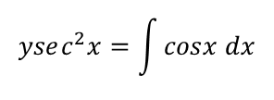


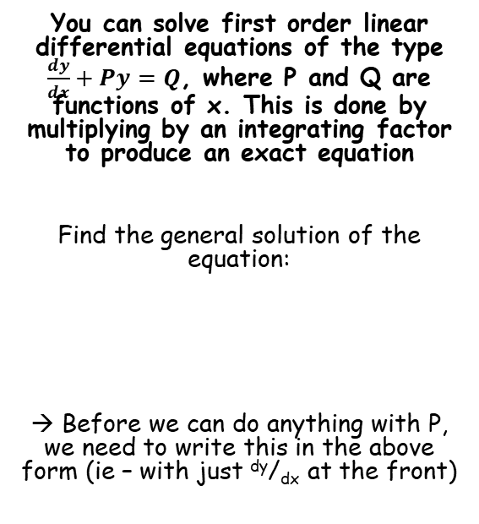




Methods in Differential Equations
$$\frac{dy}{dx}+Py=Q$$
$$Multiply all by e^{\int{P dx}}$$
$$f\left(x\right)\frac{dy}{dx}+f^{′}\left(x\right)y$$
You can solve first order linear differential equations of the type $\frac{dy}{dx}+Py=Q$, where P and Q are functions of x. This is done by multiplying by an integrating factor to produce an exact equation
Find the general solution of the equation:
→ Before we can do anything with P, we need to write this in the above form (ie – with just ^{dy}/_{dx} at the front)
$$cosx\frac{dy}{dx}+2ysinx=\cos^{4}x$$
Divide all terms by cosx
→ Sinx becomes tanx, cos⁴x becomes cos³x
$$\frac{dy}{dx}+2ytanx=\cos^{3}x$$
Multiply by sec²x
$$sec^{2}x\frac{dy}{dx}+2ytanxsec^{2}x=\cos^{3}xsec^{2}x$$
As sec²x = ¹/cos²x, the right hand side can be simplified
$$sec^{2}x\frac{dy}{dx}+2ytanxsec^{2}x=cosx$$
$$cosx\frac{dy}{dx}+2ysinx=\cos^{4}x$$
Combine the left side into a single differential as you have seen
$$\frac{d}{dx}ysec^{2}x=cosx$$
Integrate – cancels out the ^{d}/_{dx}
$$ysec^{2}x=\int{cosx dx}$$
Calculate the right side
$$ysec^{2}x=sinx+C$$
Divide by sec²x (same as multiplying by cos²x)
$$y=cos^{2}x(sinx+C)$$
7A

Slide 9




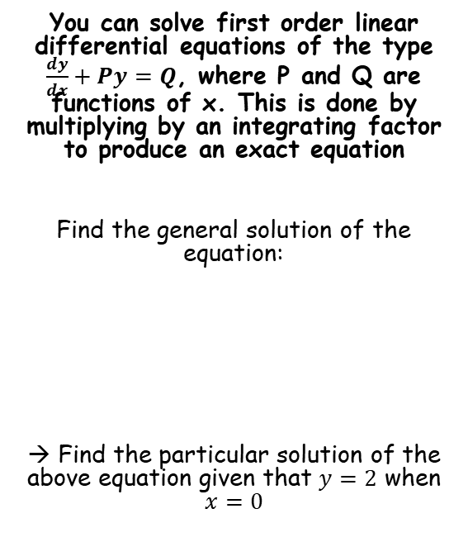



Methods in Differential Equations
$$\frac{dy}{dx}+Py=Q$$
$$Multiply all by e^{\int{P dx}}$$
$$f\left(x\right)\frac{dy}{dx}+f^{′}\left(x\right)y$$
You can solve first order linear differential equations of the type $\frac{dy}{dx}+Py=Q$, where P and Q are functions of x. This is done by multiplying by an integrating factor to produce an exact equation
Find the general solution of the equation:
→ Find the particular solution of the above equation given that $y=2$ when $x=0$
$$y=cos^{2}x(sinx+C)$$
Sub in the values we are given
$$2=cos^{2}(0)(sin⁡(0)+C)$$
Calculate $C$
$$2=C$$
Now we know $C$, we can write the particular solution!
$$y=cos^{2}x(sinx+2)$$
$$cosx\frac{dy}{dx}+2ysinx=\cos^{4}x$$
$$y=cos^{2}x(sinx+C)$$
7A

