Slide 1



Worked example
Your turn
Find general solutions to:
$$\frac{dy}{dx}+2y=e^{x}$$
$$\frac{dy}{dx}−y=e^{2x}$$
Find the general solution to:
$$\frac{dy}{dx}−4y=e^{x}$$
$$y=−\frac{1}{3}e^{x}+ce^{4x}$$

Slide 2
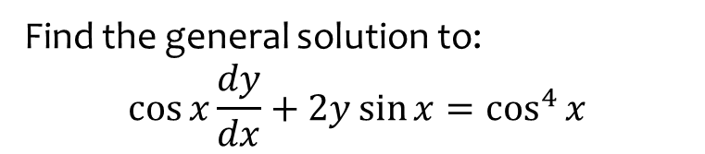

Worked example
Your turn
Find general solutions to:
$$\cos{x}\frac{dy}{dx}+y\sin{x}=1$$
Find the general solution to:
$$\cos{x}\frac{dy}{dx}+2y\sin{x}=\cos^{4}{x}$$
$$y=\cos^{2}{x}\left(\sin{x}+c\right)$$

Slide 3
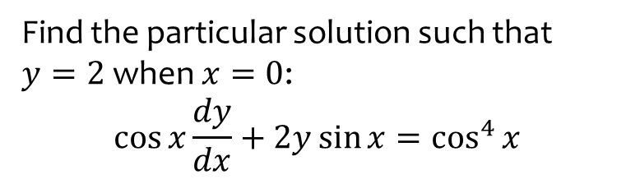
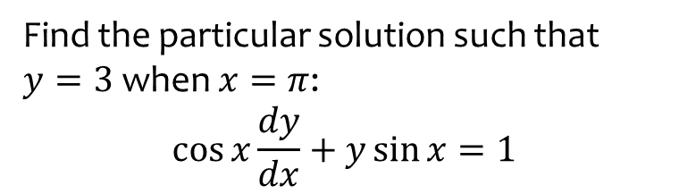

Worked example
Your turn
Find the particular solution such that $y=3$ when $x=π$:
$$\cos{x}\frac{dy}{dx}+y\sin{x}=1$$
Find the particular solution such that $y=2$ when $x=0$:
$$\cos{x}\frac{dy}{dx}+2y\sin{x}=\cos^{4}{x}$$
$$y=\cos^{2}{x}(\sin{x}+2)$$

Slide 4
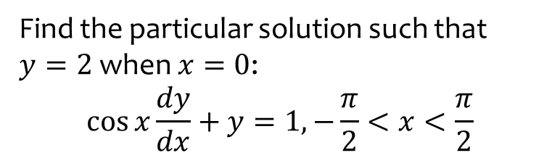
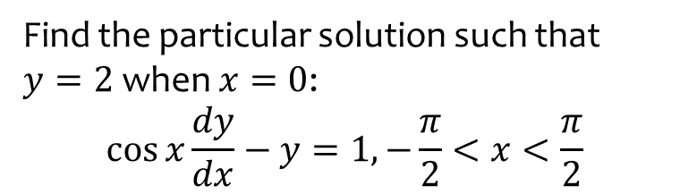

Worked example
Your turn
Find the particular solution such that $y=2$ when $x=0$:
$$\cos{x}\frac{dy}{dx}−y=1, −\frac{π}{2}<x<\frac{π}{2}$$
Find the particular solution such that $y=2$ when $x=0$:
$$\cos{x}\frac{dy}{dx}+y=1, −\frac{π}{2}<x<\frac{π}{2}$$
$$y=1+\frac{\cos{x}}{1+\sin{x}}$$

Slide 5
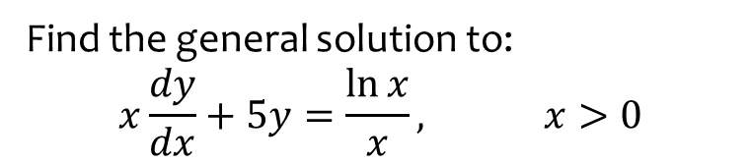
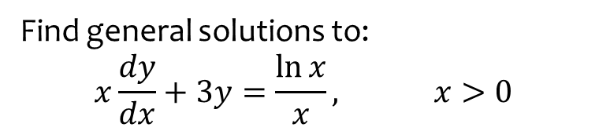

Worked example
Your turn
Find general solutions to:
$$x\frac{dy}{dx}+3y=\frac{\ln{x}}{x}, x>0$$
Find the general solution to:
$$x\frac{dy}{dx}+5y=\frac{\ln{x}}{x}, x>0$$
$$y=\frac{\ln{x}}{4x}−\frac{1}{16x}+\frac{c}{x^{5}}$$

Slide 6
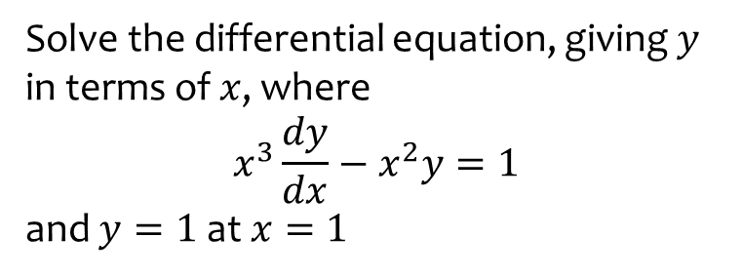
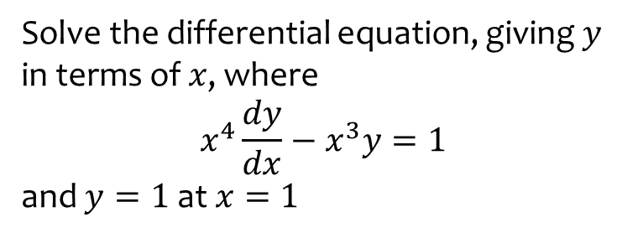

Worked example
Your turn
Solve the differential equation, giving $y$ in terms of $x$, where
$$x^{4}\frac{dy}{dx}−x^{3}y=1$$
and $y=1$at $x=1$
Solve the differential equation, giving $y$ in terms of $x$, where
$$x^{3}\frac{dy}{dx}−x^{2}y=1$$
and $y=1$at $x=1$
$$y=−\frac{1}{3x^{2}}+\frac{4x}{3}$$

