Slide 1
Methods in
Differential Equations
Twitter: @Owen134866
www.mathsfreeresourcelibrary.com

Slide 2
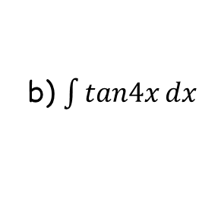
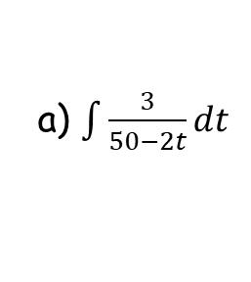
Prior Knowledge Check
1) Find the general solution to the differential equation $\frac{dy}{dx}=xe^{x}$
3) Find:
a) $\int{\frac{3}{50−2t}}dt$
$$=−\frac{3}{2}ln\left|50−2t\right|+c$$
$$y=\left(x−1\right)e^{x}+c$$
b) $\int{tan4x}dx$
2) Find the particular solution to the differential equation $\frac{dy}{dx}=−\frac{x}{y}$, given that $y=0$ when $x=2$
$$=−\frac{1}{4}ln\left|cos4x\right|+c$$
$$y^{2}=4−x^{2}$$

Slide 3
Teachings for
Exercise 7A

Slide 4
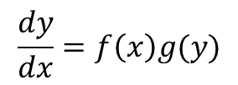
Methods in Differential Equations
You need to be able to solve differential equations by separation of variables, and sketch families of solution curves
→ A first-order differential equation contains only first differentials…
In Pure Maths 2 you have solved these equations using the ‘separation of variables’ technique
Remember what this looks like?
$$\frac{dy}{dx}=f\left(x\right)g(y)$$
Divide by g(y) and multiply by dx
$$\frac{1}{g(y)} dy=f\left(x\right)dx$$
Integrate both sides
$$\int{\frac{1}{g(y)}}dy=\int{f(x)}dx$$
Once integrated, you will be left with an equation that you can rearrange to put in different forms
Remember that the ‘+C’ part could be anything at this stage. The possible functions are known as a ‘family of solution curves’
You can also find ‘particular’ solutions if you are told information linking x and y
7A

Slide 5
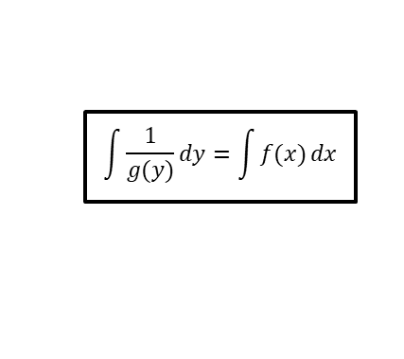
Methods in Differential Equations
$$\frac{dy}{dx}=f\left(x\right)g(y)$$
$$\int{\frac{1}{g(y)}}dy=\int{f(x)}dx$$
$$\frac{dy}{dx}=2$$
You need to be able to solve differential equations by separation of variables, and sketch families of solution curves
Find the general solution of the differential equation:
Then sketch members of the family of solution curves represented by the general solution.
Integrate with respect to x
$$y=2x+C$$
y
2
$$\frac{dy}{dx}=2$$
1
x
This is the family of solution curves for C = -2, -1, 0, 1 and 2
→ Basically a set of possible graphs we could get for certain values of C, the constant
-1
-2
7A

Slide 6
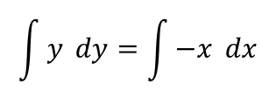
Methods in Differential Equations
$$\frac{dy}{dx}=f\left(x\right)g(y)$$
$$\int{\frac{1}{g(y)}}dy=\int{f(x)}dx$$
You need to be able to solve differential equations by separation of variables, and sketch families of solution curves
Find the general solution of the differential equation:
Then sketch members of the family of solution curves represented by the general solution.
In this case you will need to separate the variables x and y before you can Integrate
As 2C is just a number, we can think of it as being the ‘r²’ part of the circle equation
$$\frac{dy}{dx}=−\frac{x}{y}$$
Multiply by y and multiply by dx
$$y dy=−x dx$$
Integrate both sides
$$\int{y} dy=\int{−x} dx$$
$$\frac{dy}{dx}=−\frac{x}{y}$$
Calculate
$$\frac{1}{2}y^{2}=−\frac{1}{2}x^{2}+C$$
Add ¹/₂x
$$\frac{1}{2}y^{2}+\frac{1}{2}x^{2}=C$$
Multiply by 2
$$y^{2}+x^{2}=2C$$
Hopefully you recognise this as the equation of a circle!
→ r² = 2C
$$x^{2}+y^{2}=2C$$
7A

Slide 7
Methods in Differential Equations
$$\frac{dy}{dx}=f\left(x\right)g(y)$$
$$\int{\frac{1}{g(y)}}dy=\int{f(x)}dx$$
You need to be able to solve differential equations by separation of variables, and sketch families of solution curves
Find the general solution of the differential equation:
Then sketch members of the family of solution curves represented by the general solution.
Now we have the equation we can sketch some examples from this ‘family’
$$\frac{dy}{dx}=−\frac{x}{y}$$
The original equation…
$$x^{2}+y^{2}=2C$$
y
6
$$\frac{dy}{dx}=−\frac{x}{y}$$
3
2
1
x
These curves correspond to C = 0.5, 2, 4.5 and 18 respectively (as the equation has 2C in it!)
7A

Slide 8
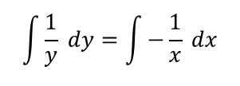
Methods in Differential Equations
$$\frac{dy}{dx}=f\left(x\right)g(y)$$
$$\int{\frac{1}{g(y)}}dy=\int{f(x)}dx$$
$$\frac{dy}{dx}=−\frac{y}{x}$$
You need to be able to solve differential equations by separation of variables, and sketch families of solution curves
Find the general solution of the differential equation:
Then sketch members of the family of solution curves represented by the general solution.
Divide by y, multiply by dx
$$\frac{1}{y} dy=−\frac{1}{x} dx$$
Integrate each side
$$\int{\frac{1}{y} dy}=\int{−\frac{1}{x} dx}$$
$$\frac{dy}{dx}=−\frac{y}{x}$$
Calculate the integrals
$$lny=−lnx+C$$
Add lnx
$$lny+lnx=C$$
Use the multiplication law
$$lnxy=C$$
Take exponentials of each side (cancels the ‘ln’ – we will explain the modulus in a moment!)
This step is common – ie) the replacing of a constant involving several letters with a single, different letter
Make sure it is clear when you do this!
Remember you cannot replace a ‘variable’ term such as ‘x’ in this way!
$$\left|xy\right|=e^{C}$$
Divide by x (remember the modulus gives a positive or negative possibility)
$$y=±\frac{e^{C}}{x}$$
Replace e^{C} with ‘A’ as e^{C} is just a constant
$$y=±\frac{A}{x}$$
7A

Slide 9
Methods in Differential Equations
$$\frac{dy}{dx}=f\left(x\right)g(y)$$
$$\int{\frac{1}{g(y)}}dy=\int{f(x)}dx$$
$$lnxy=C$$
You need to be able to solve differential equations by separation of variables, and sketch families of solution curves
Find the general solution of the differential equation:
Then sketch members of the family of solution curves represented by the general solution.
→ Both possibilities differentiate to give us the original function, so therefore we need to include the modulus or we would lose an answer!
Take exponentials of each side
$$\left|xy\right|=e^{C}$$
Why did we have to include a modulus here?
This is the equation we ended up with when using the modulus
$$y=±\frac{A}{x}$$
$$\frac{dy}{dx}=−\frac{y}{x}$$
If positive
If negative
$$y=\frac{A}{x}$$
$$y=−\frac{A}{x}$$
Rewrite
Rewrite
$$y=Ax^{−1}$$
$$y=−Ax^{−1}$$
Differentiate
Differentiate
$$\frac{dy}{dx}=−Ax^{−2}$$
$$\frac{dy}{dx}=Ax^{−2}$$
If y = ^{A}/_{x},
→A = xy
If y = -^{A}/_{x},
→A = -xy
$$\frac{dy}{dx}=−(xy)x^{−2}$$
$$\frac{dy}{dx}=(−xy)x^{−2}$$
$$\frac{dy}{dx}=−yx^{−1}$$
Group x’s
$$\frac{dy}{dx}=−yx^{−1}$$
Group x’s
$$\frac{dy}{dx}=−\frac{y}{x}$$
Rewrite
$$\frac{dy}{dx}=−\frac{y}{x}$$
Rewrite
7A

Slide 10
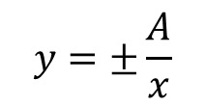
Methods in Differential Equations
$$\frac{dy}{dx}=f\left(x\right)g(y)$$
$$\int{\frac{1}{g(y)}}dy=\int{f(x)}dx$$
You need to be able to solve differential equations by separation of variables, and sketch families of solution curves
Find the general solution of the differential equation:
Then sketch members of the family of solution curves represented by the general solution.
$$y=±\frac{A}{x}$$
Increasing or decreasing the value of A (e^{C}) will move the curves in or out!
y
$$\frac{dy}{dx}=−\frac{y}{x}$$
x
7A

Slide 11
Methods in Differential Equations
$$\frac{dy}{dx}=f\left(x\right)g(y)$$
$$\int{\frac{1}{g(y)}}dy=\int{f(x)}dx$$
You need to be able to solve differential equations by separation of variables, and sketch families of solution curves
However, you will find that some differential equations cannot be solved by separation of variables…
It is possible to solve these by considering the product rule, in reverse…
7A

Slide 12
Methods in Differential Equations
$$\frac{d}{dx}\left(uv\right)=u\frac{dv}{dx}+v\frac{du}{dx}$$
You can solve exact equations where one side is the exact derivative of a product, and the other side can be integrated with respect to x
Find the general solution of the following equation:
In this example you will not be able to separate the variables easily, if at all!
→ You can use a pattern from the product rule however…
The product rule
Imagine we were finding:
$$\frac{d}{dx}x^{3}y$$
(so u = x³ and v = y)
→ We can use the product rule above
$$x^{3}\frac{dy}{dx}+{3x}^{2}y=sinx$$
$$\frac{d}{dx}\left(uv\right)=u\frac{dv}{dx}+v\frac{du}{dx}$$
$$u=x^{3}$$
$$v=y$$
Sub in the values to the right
$$\frac{du}{dx}=3x^{2}$$
$$\frac{dv}{dx}=\frac{dy}{dx}$$
$$\frac{d}{dx}x^{3}y=$$
$$x^{3}\frac{dy}{dx}$$
$$+ 3x^{2}y$$
Notice that ^{d}/_{dx}(x³y) is equivalent to the left side of the original equation
→ This means we can replace it!
$$x^{3}\frac{dy}{dx}+{3x}^{2}y=sinx$$
Replace the left hand side with equivalent expression
$$\frac{d}{dx}x^{3}y=sinx$$
7A

Slide 13
Methods in Differential Equations
You can solve exact equations where one side is the exact derivative of a product, and the other side can be integrated with respect to x
Find the general solution of the following equation:
In this example you will not be able to separate the variables easily, if at all!
→ You can use a pattern from the product rule however…
$$x^{3}\frac{dy}{dx}+{3x}^{2}y=sinx$$
Replace the left hand side with equivalent expression
$$\frac{d}{dx}x^{3}y=sinx$$
Take integrals of each side
$$\int{\frac{d}{dx}x^{3}y}dx=\int{sinx }dx$$
→ On the left side, the integral and differential cancel each other
→ On the right side calculate the integral of sinx
$$x^{3}\frac{dy}{dx}+{3x}^{2}y=sinx$$
$$x^{3}y=$$
$$−cosx+C$$
$$−\frac{1}{x^{3}}cosx+\frac{1}{x^{3}}C$$
Divide by x³
$$y=$$
Other forms of this answer, such as the one below, are also fine!
$$y=\frac{−cosx+C}{x^{3}}$$
7A

Slide 14
Methods in Differential Equations
You can solve exact equations where one side is the exact derivative of a product, and the other side can be integrated with respect to x
You can use a general pattern to see whether this is doable.
It is possible if the conditions to the right are met.
If the conditions are met, you can change the expression on the left side to:
To put this using ‘proper’ mathematical notation…
General pattern
This function of x…
… differentiates to this function of x
$$x^{3}\frac{dy}{dx}+{3x}^{2}y=sinx$$
… differentiates to this function of y (with respect to x)
This function of y…
$$\frac{d}{dx}\left(the function of x\right)(the function of y)$$
7A

Slide 15
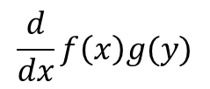
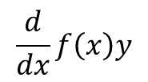
Methods in Differential Equations
$$f\left(x\right)g′(y)+f^{′}\left(x\right)g(y)$$
$$\frac{d}{dx}f\left(x\right)g(y)$$
You can solve exact equations where one side is the exact derivative of a product, and the other side can be integrated with respect to x
Using mathematical notation →
General pattern
$$f\left(x\right)g′(y)+f^{′}\left(x\right)g(y)$$
Can be written as:
$$\frac{d}{dx}f\left(x\right)g(y)$$
The most common one you’ll see is:
$$f\left(x\right)\frac{dy}{dx}+f^{′}\left(x\right)y$$
Can be written as:
$$\frac{d}{dx}f\left(x\right)y$$
7A

Slide 16
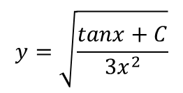
Methods in Differential Equations
$$f\left(x\right)g′(y)+f^{′}\left(x\right)g(y)$$
$$\frac{d}{dx}f\left(x\right)g(y)$$
You can solve exact equations where one side is the exact derivative of a product, and the other side can be integrated with respect to x
Find the general solution of the following differential equation:
At a first glance it might look like the pattern will not work here
6x² does not differentiate to 6x, and y² does not differentiate to y^{dy}/_{dx}
However, if we split up part of the equation, we can see that the pattern does work
$$6x^{2}y\frac{dy}{dx}+6xy^{2}=\sec^{2}x$$
Imagine the first part was split up – we can see the pattern will work!
$$(3x^{2})(2y)\frac{dy}{dx}+6xy^{2}=\sec^{2}x$$
Rewrite the left side using the rule you have seen
$$\frac{d}{dx}$$
$$3x^{2}$$
$$y^{2}$$
$$=\sec^{2}x$$
$$6x^{2}y\frac{dy}{dx}+6xy^{2}=\sec^{2}x$$
Take integrals of each side
$$\int{\frac{d}{dx}}{3x}^{2}y^{2}dx=\int{\sec^{2}x} dx$$
Calculate
$${3x}^{2}y^{2}=$$
$$tanx+C$$
Divide by 3x²
$$y^{2}=\frac{tanx+C}{3x^{2}}$$
Square root (or just leave as it is with y²!)
$$y=\sqrt{\frac{tanx+C}{3x^{2}}}$$
7A

