Slide 1
7.1) Linear transformations in two dimensions

Slide 2

Worked example
Your turn
Find matrices to represent these linear transformations.
$T:\left(\begin{matrix}x \\ y\end{matrix}\right)→\left(\begin{matrix}3y−x \\ 2x\end{matrix}\right)$
$V:\left(\begin{matrix}x \\ y\end{matrix}\right)→\left(\begin{matrix}−y \\ x+3y\end{matrix}\right)$
Find matrices to represent these linear transformations.
$T:\left(\begin{matrix}x \\ y\end{matrix}\right)→\left(\begin{matrix}2y+x \\ 3x\end{matrix}\right)$
$V:\left(\begin{matrix}x \\ y\end{matrix}\right)→\left(\begin{matrix}−2y \\ 3x+y\end{matrix}\right)$
$$\left(\begin{matrix}1 & 2 \\ 3 & 0\end{matrix}\right)$$
$$\left(\begin{matrix}0 & −2 \\ 3 & 1\end{matrix}\right)$$

Slide 3
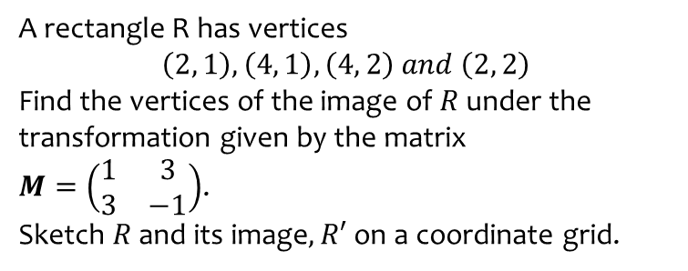
Worked example
Your turn
A rectangle R has vertices
$$\left(2, 1\right), \left(4, 1\right), \left(4, 2\right) and \left(2, 2\right)$$
Find the vertices of the image of $R$ under the transformation given by the matrix
$M=\left(\begin{matrix}1 & 3 \\ 3 & −1\end{matrix}\right)$.
Sketch $R$ and its image$, R′$ on a coordinate grid.
A square has vertices
$\left(1,1\right),\left(3,1\right),(3,3)$ and $\left(1,3\right)$
Find the vertices of the image of $S$ under the transformation given by the matrix
$M=\left(\begin{matrix}−1 & 2 \\ 2 & 1\end{matrix}\right)$.
Sketch $S$ and the image of $S$ on a coordinate grid.
$$\left(1,3\right),\left(−1,7\right),\left(3,9\right),\left(5,5\right)$$

Slide 4
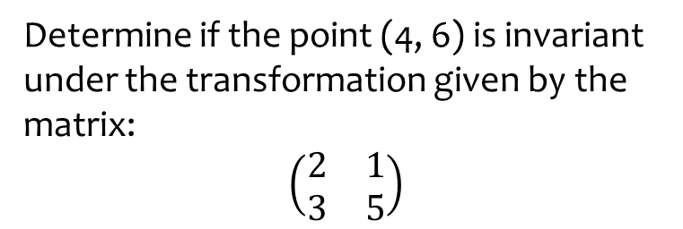
Worked example
Your turn
Determine if the point (2, 5) is invariant under the transformation given by the matrix:
$$\left(\begin{matrix}1 & 6 \\ 4 & 3\end{matrix}\right)$$
$$\left(\begin{matrix}1 & 0 \\ 0 & 1\end{matrix}\right)$$
Determine if the point (4, 6) is invariant under the transformation given by the matrix:
$$\left(\begin{matrix}2 & 1 \\ 3 & 5\end{matrix}\right)$$
No

Slide 5
Worked example
Your turn
Determine whether $\left(\begin{matrix}1 & 2 \\ 3 & 4\end{matrix}\right)$ has any lines of invariant points
Determine whether $\left(\begin{matrix}5 & −2 \\ 3 & −0.5\end{matrix}\right)$ has any lines of invariant points
$$y=2x$$

Slide 6
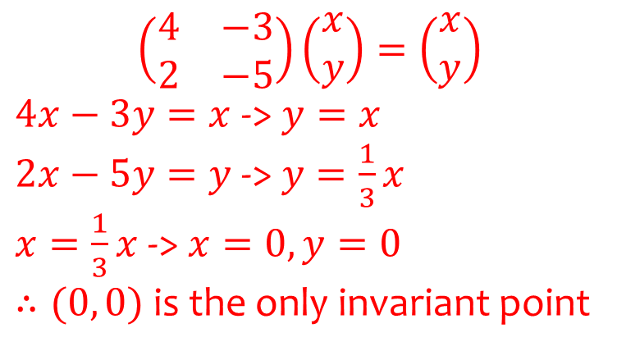
Worked example
Your turn
Show that the matrix $\left(\begin{matrix}2 & −5 \\ 4 & −3\end{matrix}\right)$ has no invariant points other than the origin
Show that the matrix $\left(\begin{matrix}4 & −3 \\ 2 & −5\end{matrix}\right)$ has no invariant points other than the origin
$$\left(\begin{matrix}4 & −3 \\ 2 & −5\end{matrix}\right)\left(\begin{matrix}x \\ y\end{matrix}\right)=\left(\begin{matrix}x \\ y\end{matrix}\right)$$
$4x−3y=x$ -> $y=x$
$2x−5y=y$ -> $y=\frac{1}{3}x$
$x=\frac{1}{3}x$ -> $x=0, y=0$
$∴(0, 0)$ is the only invariant point

Slide 7
Worked example
Your turn
Find the invariant lines of the transformation given by $\left(\begin{matrix}6 & 5 \\ 2 & 3\end{matrix}\right)$
Find the invariant lines of the transformation given by $\left(\begin{matrix}3 & 2 \\ 5 & 6\end{matrix}\right)$
$$y=\frac{5}{2}x+c$$
$$y=−x$$

