Slide 1
7) Methods in differential equations
7.1) First-order differential equations
7.2) Second-order homogenous differential equations
7.3) Second-order non-homogenous differential equations
7.4) Using boundary conditions

Slide 2
7.1) First-order differential equations
Chapter CONTENTS

Slide 3


Worked example
Your turn
Find general solutions to:
$$\frac{dy}{dx}=2$$
$$\frac{dy}{dx}=−\frac{1}{2}$$
Find the general solution to:
$$\frac{dy}{dx}=−3$$
$$y=−3x+c$$

Slide 4


Worked example
Your turn
Find general solutions to:
$$\frac{dy}{dx}=3x^{2}$$
$$\frac{dy}{dx}=4x^{3}$$
Find the general solution to:
$$\frac{dy}{dx}=2x$$
$$y=x^{2}+c$$

Slide 5


Worked example
Your turn
Find general solutions to:
$$\frac{dy}{dx}=\frac{4y}{x}$$
$$\frac{dy}{dx}=\frac{3y}{x}$$
Find the general solution to:
$$\frac{dy}{dx}=\frac{2y}{x}$$
$$y=Ax^{2}$$

Slide 6


Worked example
Your turn
Find general solutions to:
$$\frac{dy}{dx}=\sin{x}$$
$$\frac{dy}{dx}=\sec^{2}{x}$$
Find the general solution to:
$$\frac{dy}{dx}=\cos{x}$$
$$y=\sin{x}+c$$

Slide 7
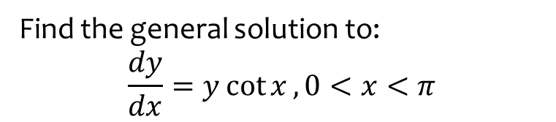

Worked example
Your turn
Find general solutions to:
$$\frac{dy}{dx}=y\tan{x}$$
Find the general solution to:
$$\frac{dy}{dx}=y\cot{x}, 0<x<π$$
$$y=A\sin{x}$$

Slide 8



Worked example
Your turn
Find general solutions to:
$$\frac{dy}{dx}=−\frac{x}{y}$$
$$\frac{dy}{dx}=\frac{x}{y}$$
Find the general solution to:
$$\frac{dy}{dx}=−\frac{y}{x}$$
$y=±\frac{A}{x}$, where $A=e^{c}$

Slide 9



Worked example
Your turn
Find general solutions to:
$$\frac{dy}{dx}=xy+y$$
$$\frac{dy}{dx}=xy−x$$
Find the general solution to:
$$\frac{dy}{dx}=xy+x$$
$$y=Ae^{\frac{1}{2}x^{2}}−1$$

Slide 10



Worked example
Your turn
Express as the derivative of one product:
$$x^{2}\frac{dy}{dx}+2xy$$
$$\left(\ln{x}\right)\frac{dy}{dx}+\frac{y}{x}$$
$$\cos\left(x\right)\frac{dy}{dx}−y\sin\left(x\right)$$
Express as the derivative of one product:
$$x^{3}\frac{dy}{dx}+3x^{2}y$$
$$e^{x}\frac{dy}{dx}+e^{x}y$$
$$\sin\left(x\right)\frac{dy}{dx}+y\cos\left(x\right)$$
$$\frac{d}{dx}\left(x^{3}y\right)$$
$$\frac{d}{dx}\left(e^{x}y\right)$$
$$\frac{d}{dx}(y\sin{x})$$

Slide 11



Worked example
Your turn
Find general solutions to:
$$x^{4}\frac{dy}{dx}+4x^{3}y=\cos{x}$$
Find the general solution to:
$$x^{3}\frac{dy}{dx}+3x^{2}y=\sin{x}$$
$$y=−\frac{1}{x^{3}}\cos{x}+\frac{c}{x^{3}}$$

Slide 12



Worked example
Your turn
Find general solutions to:
$$\frac{1}{x^{2}}\frac{dy}{dx}−\frac{2}{x^{3}}y=e^{x}$$
Find the general solution to:
$$\frac{1}{x}\frac{dy}{dx}−\frac{1}{x^{2}}y=e^{x}$$
$$y=x(e^{x}+c)$$

Slide 13

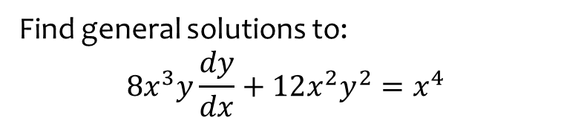

Worked example
Your turn
Find general solutions to:
$$8x^{3}y\frac{dy}{dx}+12x^{2}y^{2}=x^{4}$$
Find the general solution to:
$$4xy\frac{dy}{dx}+2y^{2}=x^{2}$$
$$y^{2}=\frac{1}{6}x^{2}+\frac{c}{2x}$$

Slide 14



Worked example
Your turn
Find general solutions to:
$$\frac{dy}{dx}+2y=e^{x}$$
$$\frac{dy}{dx}−y=e^{2x}$$
Find the general solution to:
$$\frac{dy}{dx}−4y=e^{x}$$
$$y=−\frac{1}{3}e^{x}+ce^{4x}$$

Slide 15
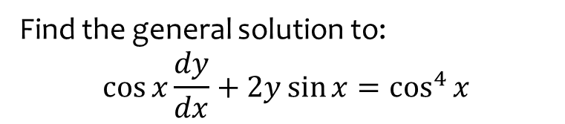

Worked example
Your turn
Find general solutions to:
$$\cos{x}\frac{dy}{dx}+y\sin{x}=1$$
Find the general solution to:
$$\cos{x}\frac{dy}{dx}+2y\sin{x}=\cos^{4}{x}$$
$$y=\cos^{2}{x}\left(\sin{x}+c\right)$$

Slide 16
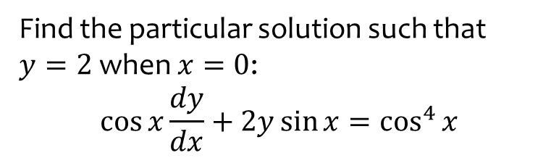
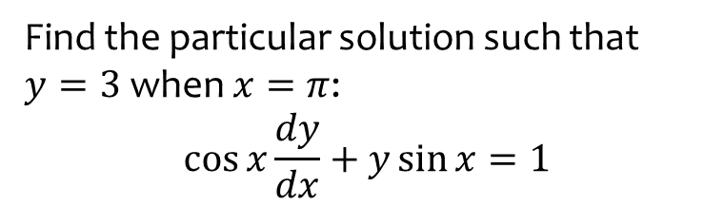

Worked example
Your turn
Find the particular solution such that $y=3$ when $x=π$:
$$\cos{x}\frac{dy}{dx}+y\sin{x}=1$$
Find the particular solution such that $y=2$ when $x=0$:
$$\cos{x}\frac{dy}{dx}+2y\sin{x}=\cos^{4}{x}$$
$$y=\cos^{2}{x}(\sin{x}+2)$$

Slide 17
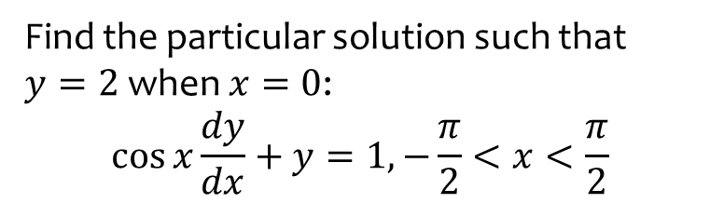
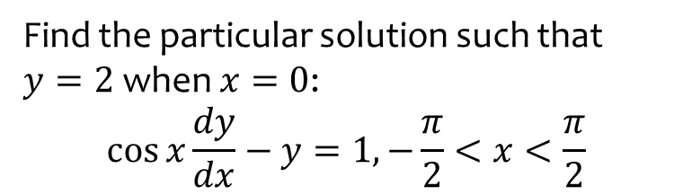

Worked example
Your turn
Find the particular solution such that $y=2$ when $x=0$:
$$\cos{x}\frac{dy}{dx}−y=1, −\frac{π}{2}<x<\frac{π}{2}$$
Find the particular solution such that $y=2$ when $x=0$:
$$\cos{x}\frac{dy}{dx}+y=1, −\frac{π}{2}<x<\frac{π}{2}$$
$$y=1+\frac{\cos{x}}{1+\sin{x}}$$

Slide 18
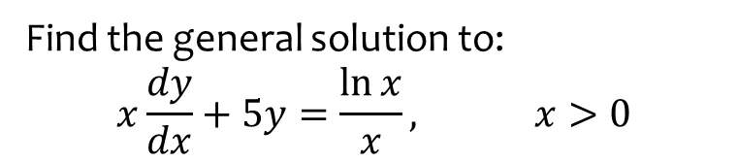
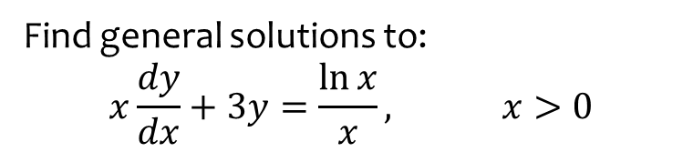

Worked example
Your turn
Find general solutions to:
$$x\frac{dy}{dx}+3y=\frac{\ln{x}}{x}, x>0$$
Find the general solution to:
$$x\frac{dy}{dx}+5y=\frac{\ln{x}}{x}, x>0$$
$$y=\frac{\ln{x}}{4x}−\frac{1}{16x}+\frac{c}{x^{5}}$$

Slide 19
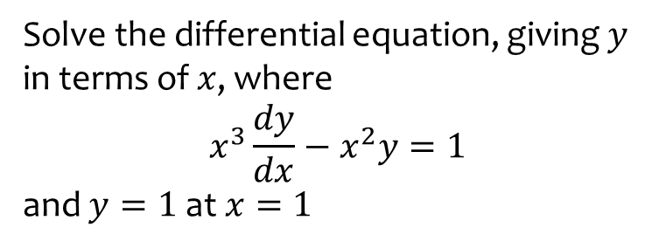
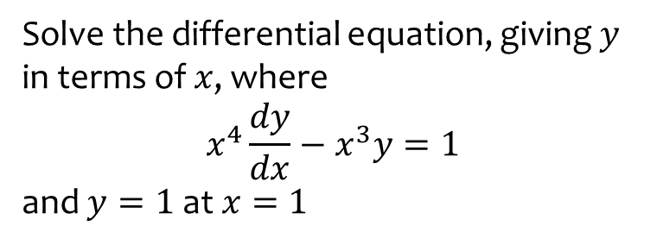

Worked example
Your turn
Solve the differential equation, giving $y$ in terms of $x$, where
$$x^{4}\frac{dy}{dx}−x^{3}y=1$$
and $y=1$at $x=1$
Solve the differential equation, giving $y$ in terms of $x$, where
$$x^{3}\frac{dy}{dx}−x^{2}y=1$$
and $y=1$at $x=1$
$$y=−\frac{1}{3x^{2}}+\frac{4x}{3}$$

Slide 20
7.2) Second-order homogenous differential equations
Chapter CONTENTS

Slide 21


Worked example
Your turn
Find general solutions to:
$$\frac{d^{2}y}{dx^{2}}=6x$$
$$\frac{d^{2}y}{dx^{2}}=24x^{2}$$
Find the general solution to:
$$\frac{d^{2}y}{dx^{2}}=12x$$
$$y=2x^{3}+Ax+B$$

Slide 22



Worked example
Your turn
Find general solutions to:
$$2\frac{d^{2}y}{dx^{2}}−5\frac{dy}{dx}+3y=0$$
$$3\frac{d^{2}y}{dx^{2}}+\frac{dy}{dx}−2y=0$$
Find the general solution to:
$$2\frac{d^{2}y}{dx^{2}}+5\frac{dy}{dx}+3y=0$$
$$y=Ae^{−\frac{3}{2}x}+Be^{−x}$$

Slide 23


Worked example
Your turn
Find general solutions to:
$$\frac{d^{2}y}{dx^{2}}−8\frac{dy}{dx}+16y=0$$
$$\frac{d^{2}y}{dx^{2}}+10\frac{dy}{dx}+25y=0$$
Find the general solution to:
$$\frac{d^{2}y}{dx^{2}}−6\frac{dy}{dx}+9y=0$$
$$y=\left(A+Bx\right)e^{3x}$$

Slide 24


Worked example
Your turn
Find general solutions to:
$$\frac{d^{2}y}{dx^{2}}+9y=0$$
$$\frac{d^{2}y}{dx^{2}}+25y=0$$
Find the general solution to:
$$\frac{d^{2}y}{dx^{2}}+16y=0$$
$$y=A cos 4x+B\sin{4x}$$

Slide 25



Worked example
Your turn
Find general solutions to:
$$\frac{d^{2}y}{dx^{2}}+2\frac{dy}{dx}−15y=0$$
$$\frac{d^{2}y}{dx^{2}}−10\frac{dy}{dx}+25y=0$$
$$\frac{d^{2}y}{dx^{2}}+25y=0$$
$$\frac{d^{2}y}{dx^{2}}−10\frac{dy}{dx}+34y=0$$
Find general solutions to:
$$\frac{d^{2}y}{dx^{2}}+6\frac{dy}{dx}+8y=0$$
$$\frac{d^{2}y}{dx^{2}}+6\frac{dy}{dx}+9y=0$$
$$\frac{d^{2}y}{dx^{2}}+9y=0$$
$$\frac{d^{2}y}{dx^{2}}+6\frac{dy}{dx}+10y=0$$
$$y=Ae^{−4x}+Be^{−2x}$$
$$y=\left(A+Bx\right)e^{−3x}$$
$$y=A\cos{3x}+B\sin{3x}$$
$$y=e^{−3x}(A\cos{x}+B\sin{x})$$

Slide 26
7.3) Second-order non-homogenous differential equations
Chapter CONTENTS

Slide 27



Worked example
Your turn
Find the general solution to:
$$\frac{d^{2}y}{dx^{2}}+5\frac{dy}{dx}+6y=4$$
Find the general solution to:
$$\frac{d^{2}y}{dx^{2}}−5\frac{dy}{dx}+6y=3$$
$$y=Ae^{3x}+Be^{2x}+\frac{1}{2}$$

Slide 28



Worked example
Your turn
Find the general solution to:
$$\frac{d^{2}y}{dx^{2}}+5\frac{dy}{dx}+6y=4x$$
Find the general solution to:
$$\frac{d^{2}y}{dx^{2}}−5\frac{dy}{dx}+6y=3x$$
$$y=Ae^{3x}+Be^{2x}+\frac{1}{2}x+\frac{5}{12}$$

Slide 29


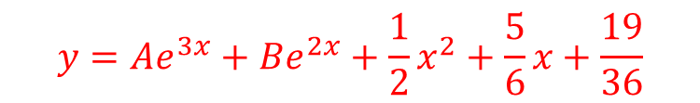
Worked example
Your turn
Find the general solution to:
$$\frac{d^{2}y}{dx^{2}}+5\frac{dy}{dx}+6y=4x^{2}$$
Find the general solution to:
$$\frac{d^{2}y}{dx^{2}}−5\frac{dy}{dx}+6y=3x^{2}$$
$$y=Ae^{3x}+Be^{2x}+\frac{1}{2}x^{2}+\frac{5}{6}x+\frac{19}{36}$$

Slide 30



Worked example
Your turn
Find the general solution to:
$$\frac{d^{2}y}{dx^{2}}+5\frac{dy}{dx}+6y=e^{−x}$$
Find the general solution to:
$$\frac{d^{2}y}{dx^{2}}−5\frac{dy}{dx}+6y=e^{x}$$
$$y=Ae^{3x}+Be^{2x}+\frac{1}{2}e^{x}$$

Slide 31


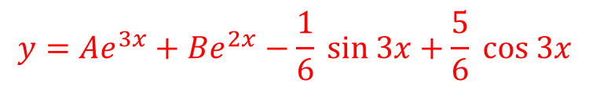
Worked example
Your turn
Find the general solution to:
$$\frac{d^{2}y}{dx^{2}}+5\frac{dy}{dx}+6y=7\sin{4x}$$
Find the general solution to:
$$\frac{d^{2}y}{dx^{2}}−5\frac{dy}{dx}+6y=13\sin{3x}$$
$$y=Ae^{3x}+Be^{2x}−\frac{1}{6} sin 3x+\frac{5}{6} cos 3x$$

Slide 32


Worked example
Your turn
Find the general solution to:
$$\frac{d^{2}y}{dx^{2}}+5\frac{dy}{dx}+6y=e^{−3x}$$
Find the general solution to:
$$\frac{d^{2}y}{dx^{2}}−5\frac{dy}{dx}+6y=e^{2x}$$
$$y=Ae^{3x}+Be^{2x}−xe^{2x}$$

Slide 33



Worked example
Your turn
Find the general solution to:
$$\frac{d^{2}y}{dx^{2}}−3\frac{dy}{dx}=2$$
Find the general solution to:
$$\frac{d^{2}y}{dx^{2}}−2\frac{dy}{dx}=3$$
$$y=A+Be^{2x}−\frac{3}{2}x$$

Slide 34


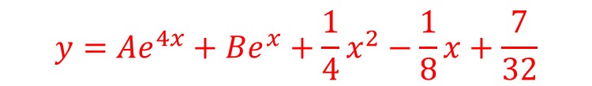
Worked example
Your turn
Find the general solution to:
$$\frac{d^{2}y}{dx^{2}}+5\frac{dy}{dx}+4y=x^{2}−2x+3$$
Find the general solution to:
$$\frac{d^{2}y}{dx^{2}}−5\frac{dy}{dx}+4y=x^{2}−3x+2$$
$$y=Ae^{4x}+Be^{x}+\frac{1}{4}x^{2}−\frac{1}{8}x+\frac{7}{32}$$

Slide 35


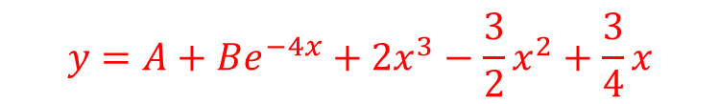
Worked example
Your turn
Find the general solution to:
$$\frac{d^{2}y}{dx^{2}}−6\frac{dy}{dx}={2x}^{2}−x+1$$
Find the general solution to:
$$\frac{d^{2}y}{dx^{2}}+4\frac{dy}{dx}={24x}^{2}$$
$$y=A+Be^{−4x}+2x^{3}−\frac{3}{2}x^{2}+\frac{3}{4}x$$

Slide 36



Worked example
Your turn
Find the general solution to:
$$\frac{d^{2}y}{dx^{2}}+2\frac{dy}{dx}+1=e^{x}$$
Find the general solution to:
$$\frac{d^{2}y}{dx^{2}}−2\frac{dy}{dx}+1=e^{x}$$
$$y=\left(A+Bx+\frac{1}{2}x^{2}\right)e^{x}$$

Slide 37


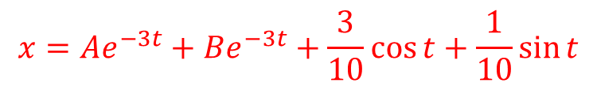
Worked example
Your turn
Find the general solution to:
$$\frac{d^{2}x}{dt^{2}}−5\frac{dx}{dt}+6x=2\sin{t}−\cos{t}$$
Find the general solution to:
$$\frac{d^{2}x}{dt^{2}}+5\frac{dx}{dt}+6x=2\cos{t}−\sin{t}$$
$$x=Ae^{−3t}+Be^{−3t}+\frac{3}{10}\cos{t}+\frac{1}{10}\sin{t}$$

Slide 38
7.4) Using boundary conditions
Chapter CONTENTS

Slide 39
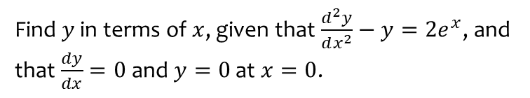
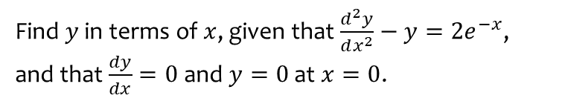

Worked example
Your turn
Find $y$ in terms of $x$, given that $\frac{d^{2}y}{dx^{2}}−y=2e^{−x}$, and that $\frac{dy}{dx}=0$ and $y=0$ at $x=0$.
Find $y$ in terms of $x$, given that $\frac{d^{2}y}{dx^{2}}−y=2e^{x}$, and that $\frac{dy}{dx}=0$ and $y=0$ at $x=0$.
$$y=−\frac{1}{2}e^{x}+\frac{1}{2}e^{−x}+xe^{x}$$

Slide 40
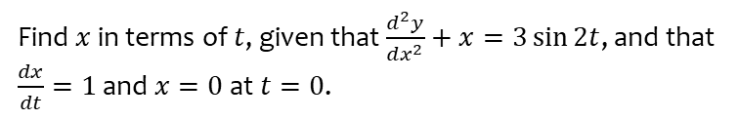
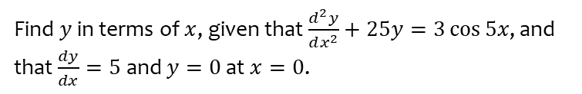
Worked example
Your turn
Find $y$ in terms of $x$, given that $\frac{d^{2}y}{dx^{2}}+25y=3\cos{5x}$, and that $\frac{dy}{dx}=5$ and $y=0$ at $x=0$.
Find $x$ in terms of $t$, given that $\frac{d^{2}y}{dx^{2}}+x=3\sin{2t}$, and that $\frac{dx}{dt}=1$ and $x=0$ at $t=0$.
$$x=3\sin{t}−\sin{2t}$$

Slide 41
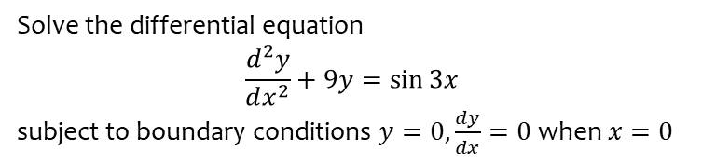
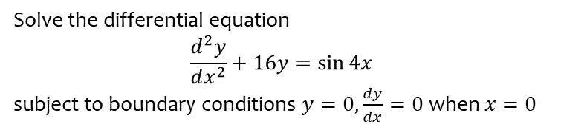

Worked example
Your turn
Solve the differential equation
$$\frac{d^{2}y}{dx^{2}}+16y=\sin{4x}$$
subject to boundary conditions $y=0,\frac{dy}{dx}=0$ when $x=0$
Solve the differential equation
$$\frac{d^{2}y}{dx^{2}}+9y=\sin{3x}$$
subject to boundary conditions $y=0,\frac{dy}{dx}=0$ when $x=0$
$$y=\frac{1}{18}\sin{3x}−\frac{1}{6}x\cos{3x}$$

