Slide 1
7) Linear transformations
7.1) Linear transformations in two dimensions
7.2) Reflections and rotations
7.3) Enlargements and stretches
7.4) Successive transformations
7.5) Linear transformations in three dimensions
7.6) The inverse of a linear transformation

Slide 2
7.1) Linear transformations in two dimensions
Chapter CONTENTS

Slide 3

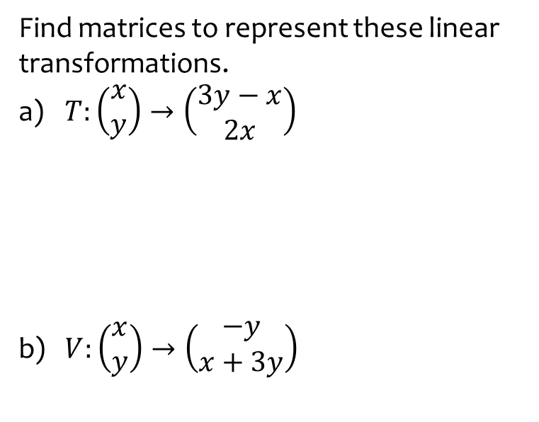

Worked example
Your turn
Find matrices to represent these linear transformations.
$T:\left(\begin{matrix}x \\ y\end{matrix}\right)→\left(\begin{matrix}3y−x \\ 2x\end{matrix}\right)$
$V:\left(\begin{matrix}x \\ y\end{matrix}\right)→\left(\begin{matrix}−y \\ x+3y\end{matrix}\right)$
Find matrices to represent these linear transformations.
$T:\left(\begin{matrix}x \\ y\end{matrix}\right)→\left(\begin{matrix}2y+x \\ 3x\end{matrix}\right)$
$V:\left(\begin{matrix}x \\ y\end{matrix}\right)→\left(\begin{matrix}−2y \\ 3x+y\end{matrix}\right)$
$$\left(\begin{matrix}1 & 2 \\ 3 & 0\end{matrix}\right)$$
$$\left(\begin{matrix}0 & −2 \\ 3 & 1\end{matrix}\right)$$

Slide 4
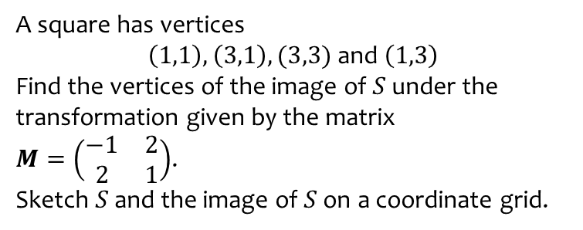
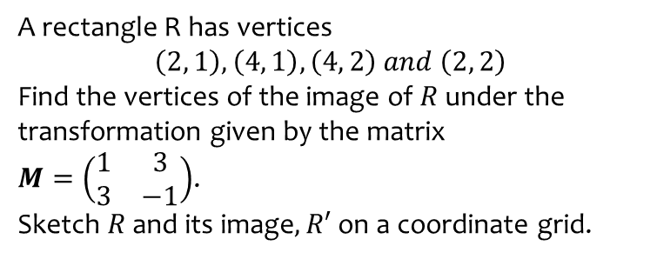
Worked example
Your turn
A rectangle R has vertices
$$\left(2, 1\right), \left(4, 1\right), \left(4, 2\right) and \left(2, 2\right)$$
Find the vertices of the image of $R$ under the transformation given by the matrix
$M=\left(\begin{matrix}1 & 3 \\ 3 & −1\end{matrix}\right)$.
Sketch $R$ and its image$, R′$ on a coordinate grid.
A square has vertices
$\left(1,1\right),\left(3,1\right),(3,3)$ and $\left(1,3\right)$
Find the vertices of the image of $S$ under the transformation given by the matrix
$M=\left(\begin{matrix}−1 & 2 \\ 2 & 1\end{matrix}\right)$.
Sketch $S$ and the image of $S$ on a coordinate grid.
$$\left(1,3\right),\left(−1,7\right),\left(3,9\right),\left(5,5\right)$$

Slide 5
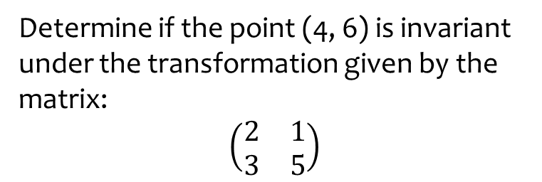
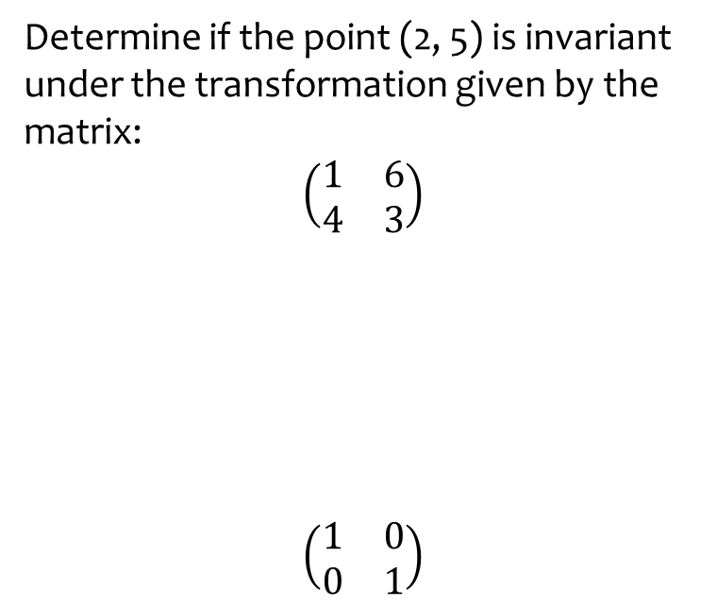
Worked example
Your turn
Determine if the point (2, 5) is invariant under the transformation given by the matrix:
$$\left(\begin{matrix}1 & 6 \\ 4 & 3\end{matrix}\right)$$
$$\left(\begin{matrix}1 & 0 \\ 0 & 1\end{matrix}\right)$$
Determine if the point (4, 6) is invariant under the transformation given by the matrix:
$$\left(\begin{matrix}2 & 1 \\ 3 & 5\end{matrix}\right)$$
No

Slide 6
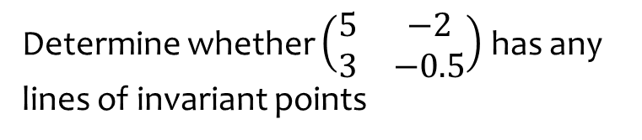
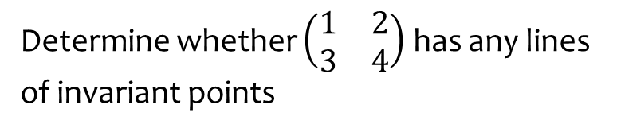

Worked example
Your turn
Determine whether $\left(\begin{matrix}1 & 2 \\ 3 & 4\end{matrix}\right)$ has any lines of invariant points
Determine whether $\left(\begin{matrix}5 & −2 \\ 3 & −0.5\end{matrix}\right)$ has any lines of invariant points
$$y=2x$$

Slide 7
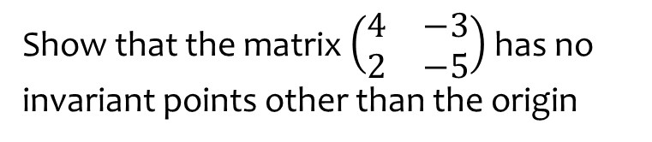
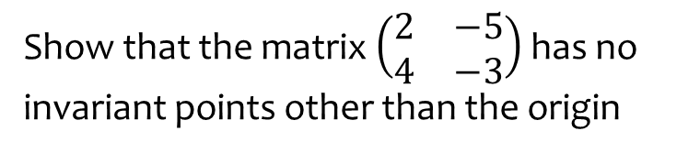
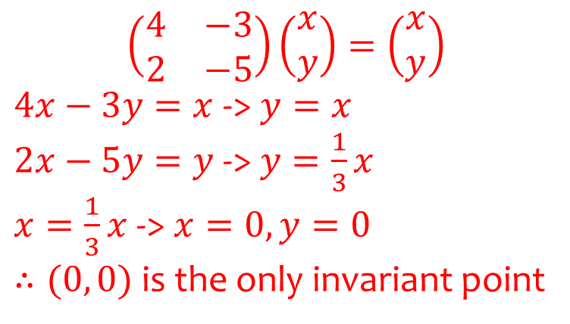
Worked example
Your turn
Show that the matrix $\left(\begin{matrix}2 & −5 \\ 4 & −3\end{matrix}\right)$ has no invariant points other than the origin
Show that the matrix $\left(\begin{matrix}4 & −3 \\ 2 & −5\end{matrix}\right)$ has no invariant points other than the origin
$$\left(\begin{matrix}4 & −3 \\ 2 & −5\end{matrix}\right)\left(\begin{matrix}x \\ y\end{matrix}\right)=\left(\begin{matrix}x \\ y\end{matrix}\right)$$
$4x−3y=x$ -> $y=x$
$2x−5y=y$ -> $y=\frac{1}{3}x$
$x=\frac{1}{3}x$ -> $x=0, y=0$
$∴(0, 0)$ is the only invariant point

Slide 8



Worked example
Your turn
Find the invariant lines of the transformation given by $\left(\begin{matrix}6 & 5 \\ 2 & 3\end{matrix}\right)$
Find the invariant lines of the transformation given by $\left(\begin{matrix}3 & 2 \\ 5 & 6\end{matrix}\right)$
$$y=\frac{5}{2}x+c$$
$$y=−x$$

Slide 9
7.2) Reflections and rotations
Chapter CONTENTS

Slide 10



Worked example
Your turn
Find a $2×2$ matrix that represents:
A reflection in the $y$-axis.
A reflection in the line $y=x$
Find a $2×2$ matrix that represents:
A reflection in the $x$-axis.
A reflection in the line $y=−x$
$$\left(\begin{matrix}1 & 0 \\ 0 & −1\end{matrix}\right)$$
$$\left(\begin{matrix}0 & −1 \\ −1 & 0\end{matrix}\right)$$

Slide 11
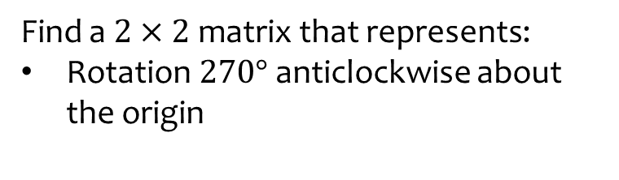


Worked example
Your turn
Find a $2×2$ matrix that represents:
Rotation $90°$ anticlockwise about the origin
Rotation $180°$ about the origin
Find a $2×2$ matrix that represents:
Rotation $270°$ anticlockwise about the origin
$$\left(\begin{matrix}0 & 1 \\ −1 & 0\end{matrix}\right)$$

Slide 12
Worked example
Your turn
Find a $2×2$ matrix that represents:
Rotation $90°$ anticlockwise about the origin
Rotation $180°$ about the origin
Find a $2×2$ matrix that represents:
Rotation $270°$ anticlockwise about the origin
$$\left(\begin{matrix}0 & 1 \\ −1 & 0\end{matrix}\right)$$

Slide 13
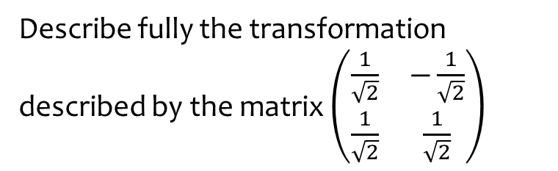
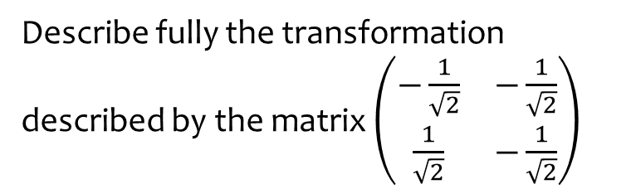

Worked example
Your turn
Describe fully the transformation described by the matrix $\left(\begin{matrix}−\frac{1}{\sqrt{2}} & −\frac{1}{\sqrt{2}} \\ \frac{1}{\sqrt{2}} & −\frac{1}{\sqrt{2}}\end{matrix}\right)$
Describe fully the transformation described by the matrix $\left(\begin{matrix}\frac{1}{\sqrt{2}} & −\frac{1}{\sqrt{2}} \\ \frac{1}{\sqrt{2}} & \frac{1}{\sqrt{2}}\end{matrix}\right)$
Rotation $45°$ anticlockwise about the origin

Slide 14



Worked example
Your turn
For these transformations, state any invariant lines/points:
reflection in the line $y=−x$
Rotation $90°$ anticlockwise about the origin
For these transformations, state any invariant lines/points:
reflection in the line $y=x$
Rotation $180°$ about the origin
Invariant lines:
$y=x$
Any straight line with gradient $−1 (y=−x+k)$
Invariant points:
All points on those lines
Invariant lines:
Any straight line through origin $(y=mx)$
Invariant points:
$$(0, 0)$$

Slide 15
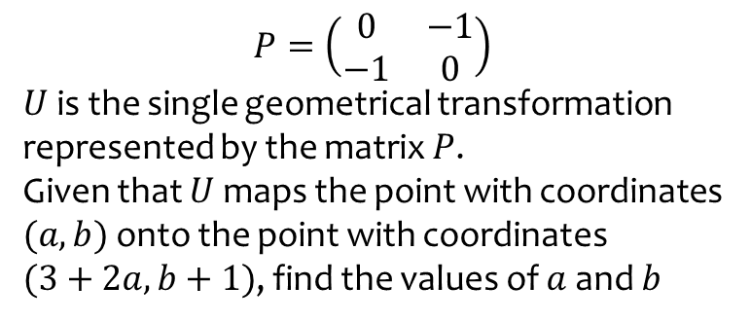
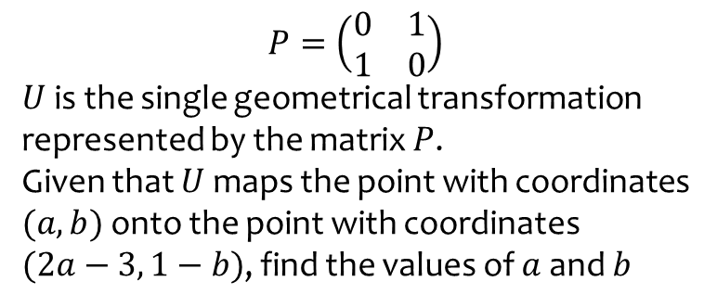
Worked example
Your turn
$$P=\left(\begin{matrix}0 & 1 \\ 1 & 0\end{matrix}\right)$$
$U$ is the single geometrical transformation represented by the matrix $P$.
Given that $U$ maps the point with coordinates $(a, b)$ onto the point with coordinates
$(2a−3, 1−b)$, find the values of $a$ and $b$
$$P=\left(\begin{matrix}0 & −1 \\ −1 & 0\end{matrix}\right)$$
$U$ is the single geometrical transformation represented by the matrix $P$.
Given that $U$ maps the point with coordinates $(a, b)$ onto the point with coordinates
$(3+2a, b+1)$, find the values of $a$ and $b$
$$a=−2, b=1$$

Slide 16
7.3) Enlargements and stretches
Chapter CONTENTS

Slide 17
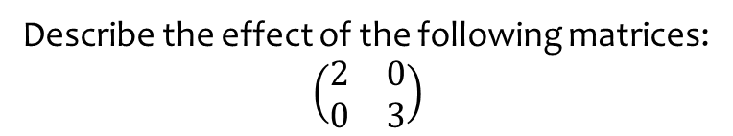

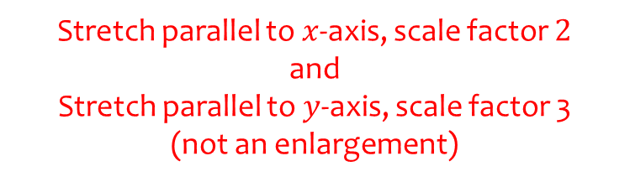
Worked example
Your turn
Describe the effect of the following matrices:
$\left(\begin{matrix}2 & 0 \\ 0 & 2\end{matrix}\right)$
$$\left(\begin{matrix}3 & 0 \\ 0 & 3\end{matrix}\right)$$
$$\left(\begin{matrix}3 & 0 \\ 0 & 2\end{matrix}\right)$$
Describe the effect of the following matrices:
$\left(\begin{matrix}2 & 0 \\ 0 & 3\end{matrix}\right)$
Stretch parallel to $x$-axis, scale factor $2$
and
Stretch parallel to $y$-axis, scale factor 3
(not an enlargement)

Slide 18
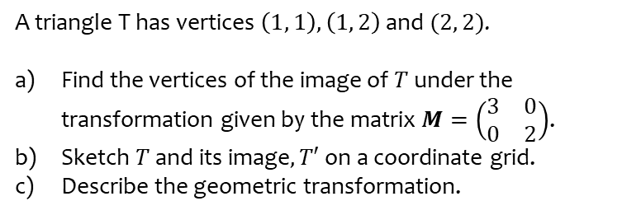
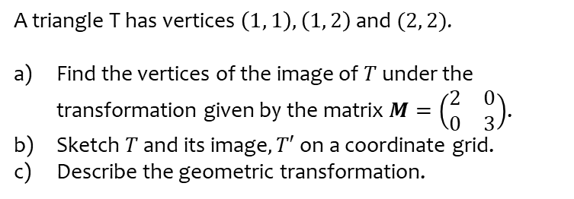
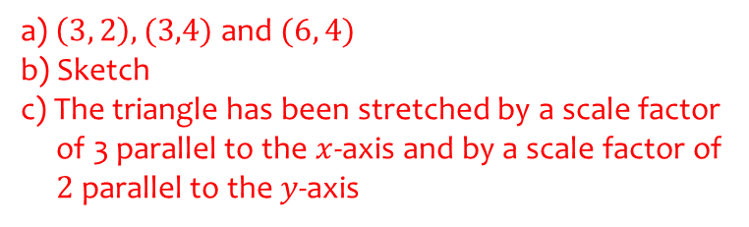
Worked example
Your turn
A triangle T has vertices $\left(1, 1\right), \left(1, 2\right)$ and $(2, 2)$.
Find the vertices of the image of $T$ under the transformation given by the matrix $M=\left(\begin{matrix}2 & 0 \\ 0 & 3\end{matrix}\right)$.
Sketch $T$ and its image$, T′$ on a coordinate grid.
Describe the geometric transformation.
A triangle T has vertices $\left(1, 1\right), \left(1, 2\right)$ and $(2, 2)$.
Find the vertices of the image of $T$ under the transformation given by the matrix $M=\left(\begin{matrix}3 & 0 \\ 0 & 2\end{matrix}\right)$.
Sketch $T$ and its image$, T′$ on a coordinate grid.
Describe the geometric transformation.
a) $\left(3, 2\right), (3,4)$ and $(6, 4)$
b) Sketch
c) The triangle has been stretched by a scale factor
of 3 parallel to the $x$-axis and by a scale factor of
$2$ parallel to the $y$-axis

Slide 19
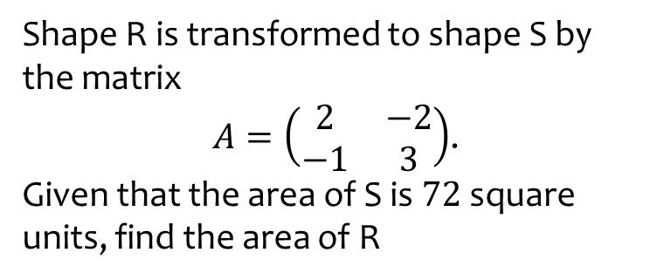
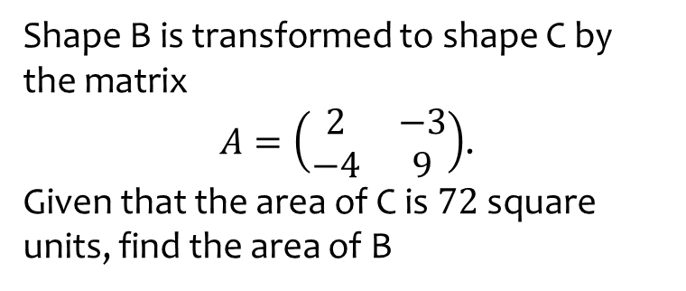
Worked example
Your turn
Shape B is transformed to shape C by the matrix
$A=\left(\begin{matrix}2 & −3 \\ −4 & 9\end{matrix}\right)$.
Given that the area of C is $72$ square units, find the area of B
Shape R is transformed to shape S by the matrix
$A=\left(\begin{matrix}2 & −2 \\ −1 & 3\end{matrix}\right)$.
Given that the area of S is $72$ square units, find the area of R
$$18$$

Slide 20
7.4) Successive transformations
Chapter CONTENTS

Slide 21



Worked example
Your turn
Represent as a single matrix the transformation representing a reflection in the line $y=x$ followed by a stretch parallel to the $x$-axis by a factor of 4.
Represent as a single matrix the transformation representing a rotation $90°$ anticlockwise about the point $\left(0,0\right)$ followed by a reflection in the line $x$-axis.
What single transformation is this?
Represent as a single matrix the transformation representing a reflection in the line $y=−x$ followed by a stretch parallel to the $y$-axis by a factor of 3.
Represent as a single matrix the transformation representing a rotation $270°$ anticlockwise about the point $\left(0,0\right)$ followed by a reflection in the line $y$-axis.
What single transformation is this?
$$\left(\begin{matrix}0 & −3 \\ −1 & 0\end{matrix}\right)$$
$$\left(\begin{matrix}0 & −1 \\ −1 & 0\end{matrix}\right)$$
Reflection in the line $y=−x$

Slide 22
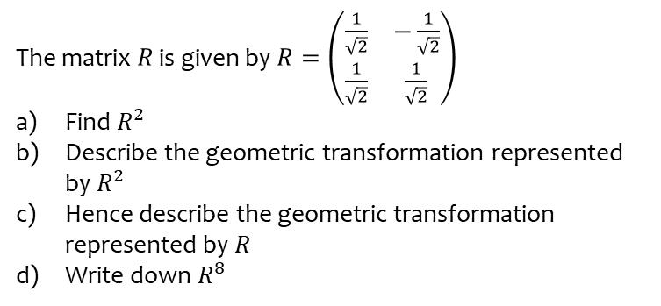
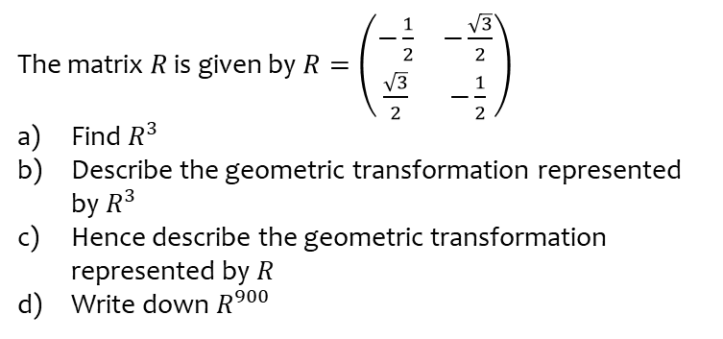
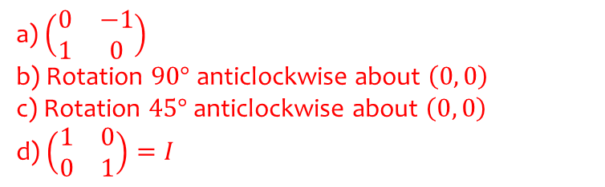
Worked example
Your turn
The matrix $R$ is given by $R=\left(\begin{matrix}−\frac{1}{2} & −\frac{\sqrt{3}}{2} \\ \frac{\sqrt{3}}{2} & −\frac{1}{2}\end{matrix}\right)$
Find $R^{3}$
Describe the geometric transformation represented by $R^{3}$
Hence describe the geometric transformation represented by $R$
Write down $R^{900}$
The matrix $R$ is given by $R=\left(\begin{matrix}\frac{1}{\sqrt{2}} & −\frac{1}{\sqrt{2}} \\ \frac{1}{\sqrt{2}} & \frac{1}{\sqrt{2}}\end{matrix}\right)$
Find $R^{2}$
Describe the geometric transformation represented by $R^{2}$
Hence describe the geometric transformation represented by $R$
Write down $R^{8}$
a) $\left(\begin{matrix}0 & −1 \\ 1 & 0\end{matrix}\right)$
b) Rotation $90°$ anticlockwise about $\left(0, 0\right)$
c) Rotation $45°$ anticlockwise about $\left(0, 0\right)$
d) $\left(\begin{matrix}1 & 0 \\ 0 & 1\end{matrix}\right)=I$

Slide 23
7.5) Linear transformations in three dimensions
Chapter CONTENTS

Slide 24
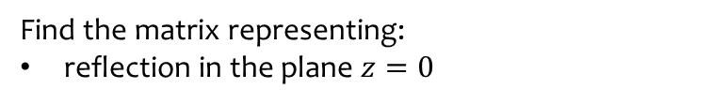


Worked example
Your turn
Find the matrix representing:
reflection in the plane $x=0$
reflection in the plane $y=0$
Find the matrix representing:
reflection in the plane $z=0$
$$\left(\begin{matrix}1 & 0 & 0 \\ 0 & 1 & 0 \\ 0 & 0 & −1\end{matrix}\right)$$

Slide 25
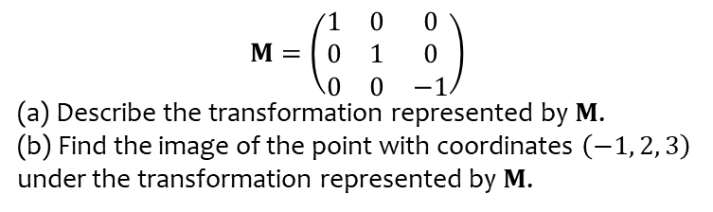
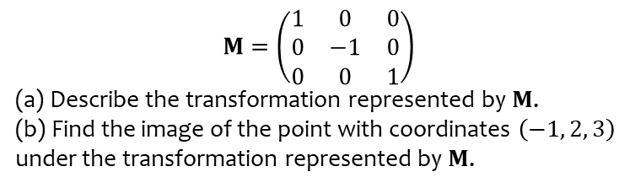
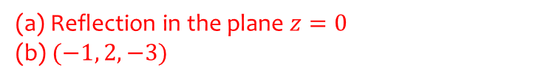
Worked example
Your turn
$$M=\left(\begin{matrix}1 & 0 & 0 \\ 0 & −1 & 0 \\ 0 & 0 & 1\end{matrix}\right)$$
(a) Describe the transformation represented by $M$.
(b) Find the image of the point with coordinates $\left(−1, 2, 3\right)$ under the transformation represented by $M$.
$$M=\left(\begin{matrix}1 & 0 & 0 \\ 0 & 1 & 0 \\ 0 & 0 & −1\end{matrix}\right)$$
(a) Describe the transformation represented by $M$.
(b) Find the image of the point with coordinates $\left(−1, 2, 3\right)$ under the transformation represented by $M$.
(a) Reflection in the plane $z=0$
(b) $(−1, 2, −3)$

Slide 26



Worked example
Your turn
Find the matrix representing:
Rotation, angle $θ$, anticlockwise about the $x$-axis
Rotation, angle $θ$, anticlockwise about the $y$-axis
Find the matrix representing:
Rotation, angle $θ$, anticlockwise about the $z$-axis
$$\left(\begin{matrix}\cos{θ} & −\sin{θ} & 0 \\ \sin{θ} & \cos{θ} & 0 \\ 0 & 0 & 1\end{matrix}\right)$$

Slide 27



Worked example
Your turn
Find the matrix representing:
Rotation, angle $90°$, anticlockwise about the $x$-axis
Rotation, angle $180°$, anticlockwise about the $z$-axis
Find the matrix representing:
Rotation, angle $270°$, anticlockwise about the $y$-axis
$$\left(\begin{matrix}0 & 0 & −1 \\ 0 & 1 & 0 \\ 1 & 0 & 0\end{matrix}\right)$$

Slide 28
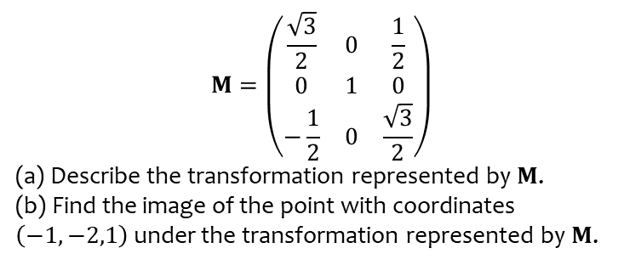
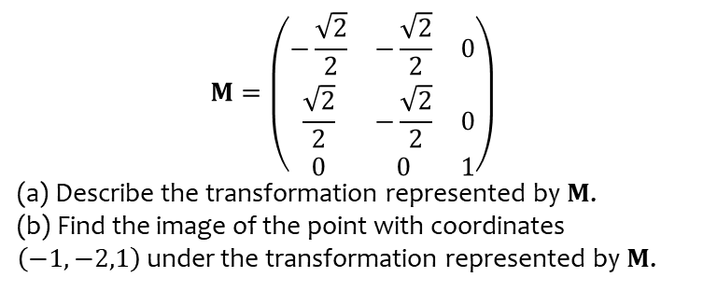
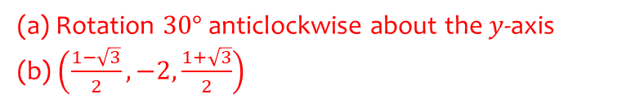
Worked example
Your turn
$$M=\left(\begin{matrix}−\frac{\sqrt{2}}{2} & −\frac{\sqrt{2}}{2} & 0 \\ \frac{\sqrt{2}}{2} & −\frac{\sqrt{2}}{2} & 0 \\ 0 & 0 & 1\end{matrix}\right)$$
(a) Describe the transformation represented by $M$.
(b) Find the image of the point with coordinates $\left(−1,−2,1\right)$ under the transformation represented by $M$.
$$M=\left(\begin{matrix}\frac{\sqrt{3}}{2} & 0 & \frac{1}{2} \\ 0 & 1 & 0 \\ −\frac{1}{2} & 0 & \frac{\sqrt{3}}{2}\end{matrix}\right)$$
(a) Describe the transformation represented by $M$.
(b) Find the image of the point with coordinates $\left(−1,−2,1\right)$ under the transformation represented by $M$.
(a) Rotation $30°$ anticlockwise about the $y$-axis
(b) $\left(\frac{1−\sqrt{3}}{2}, −2,\frac{1+\sqrt{3}}{2}\right)$

Slide 29
7.6) The inverse of a linear transformation
Chapter CONTENTS

Slide 30
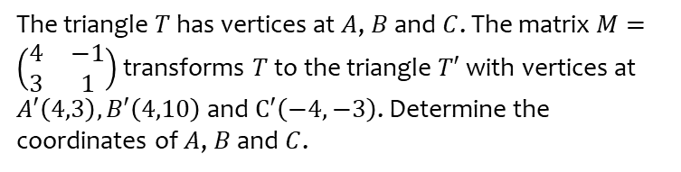
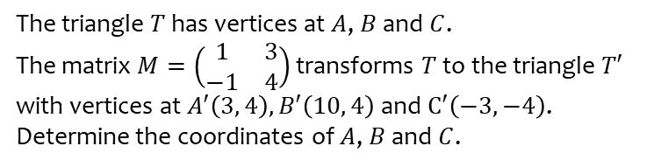
Worked example
Your turn
The triangle $T$ has vertices at $A$, $B$ and $C$.
The matrix $M=\left(\begin{matrix}1 & 3 \\ −1 & 4\end{matrix}\right)$ transforms $T$ to the triangle $T′$ with vertices at $A′\left(3, 4\right), B′\left(10, 4\right)$ and $C′\left(−3, −4\right)$. Determine the coordinates of $A$, $B$ and $C$.
The triangle $T$ has vertices at $A$, $B$ and $C$. The matrix $M=\left(\begin{matrix}4 & −1 \\ 3 & 1\end{matrix}\right)$ transforms $T$ to the triangle $T′$ with vertices at $A′\left(4,3\right), B′\left(4,10\right)$ and $C′\left(−4,−3\right)$. Determine the coordinates of $A$, $B$ and $C$.
$$A \left(1, 0\right) B\left(2, 4\right) C(−1, 0)$$

Slide 31



Worked example
Your turn
$$M=\left(\begin{matrix}5 & −2 \\ 4 & −3\end{matrix}\right)$$
$$A=\left(\begin{matrix}0 & 1 \\ −1 & 0\end{matrix}\right)$$
Find det M
Describe fully the single geometrical transformation represented by A
The transformation represented by A followed by the transformation represented by B is equivalent to the transformation represented by M. Find B
$$M=\left(\begin{matrix}3 & 4 \\ 2 & −5\end{matrix}\right)$$
$$A=\left(\begin{matrix}0 & −1 \\ 1 & 0\end{matrix}\right)$$
Find det M
Describe fully the single geometrical transformation represented by A
The transformation represented by A followed by the transformation represented by B is equivalent to the transformation represented by M. Find B
a) $−23$
b) Rotation $90°$ anticlockwise about $(0, 0)$
c) $\left(\begin{matrix}−4 & 3 \\ 5 & 2\end{matrix}\right)$

Slide 32


Worked example
Your turn
$$M=\left(\begin{matrix}1 & 0 & 1 \\ 1 & 3 & −1 \\ 0 & 2 & −2\end{matrix}\right)$$
The point $(a, b, c)$ is mapped onto $(−3, −2, 1)$ under $M$. Find the values of $a, b$ and $c$
$$M=\left(\begin{matrix}1 & 0 & 1 \\ 0 & 2 & −2 \\ 1 & 3 & −1\end{matrix}\right)$$
The point $(a, b, c)$ is mapped onto $(3, 2, −1)$ under $M$. Find the values of $a, b$ and $c$
$$a=10, b=−6, c=−7$$

Slide 33



Worked example
Your turn
$R=$ $\left(\begin{matrix}0 & 1 \\ 1 & 0\end{matrix}\right)$
Find $R^{−1}$
Explain this geometrically
Find $R^{7999}$
Find $R^{8000}$
$R=$ $\left(\begin{matrix}0 & −1 \\ −1 & 0\end{matrix}\right)$
Find $R^{−1}$
Explain this geometrically
Find $R^{8001}$
Find $R^{8002}$
a) $\left(\begin{matrix}0 & −1 \\ −1 & 0\end{matrix}\right)$
b) Reflection is self-inverse. The inverse of reflection in the line $y=−x$ is reflection in the line $y=−x$ again
c) $\left(\begin{matrix}0 & −1 \\ −1 & 0\end{matrix}\right)$
d) $\left(\begin{matrix}1 & 0 \\ 0 & 1\end{matrix}\right)$

