Slide 1
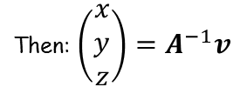
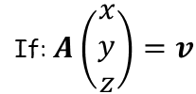
Matrices
If: $A\left(\begin{matrix}x \\ y \\ z\end{matrix}\right)=v$
Then: $\left(\begin{matrix}x \\ y \\ z\end{matrix}\right)=A^{−1}v$
$$y$$
$$4$$
You need to be able to solve simultaneous equations using matrices
When you have 2 simultaneous equations, you will have seen that the solutions can be modelled as the location on a set of axes where the graphs of each equation intersect.
With 3 equations and 3 unknowns, the situation can be more complicated, and will be modelled in 3D.
When an equation in 3 unknowns is plotted, it forms a plane, rather than just a line.
For example…
$$2$$
$$2x+4y=10$$
$$−5$$
$$5$$
$$x$$
$$−2$$
$$−4$$
$$y$$
$$x$$
$$z$$
LINK to Autograph file
$$2x+4y+6z=10$$
6F

Slide 2
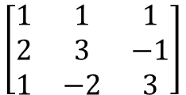
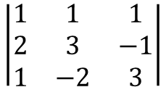
Matrices
If: $A\left(\begin{matrix}x \\ y \\ z\end{matrix}\right)=v$
Then: $\left(\begin{matrix}x \\ y \\ z\end{matrix}\right)=A^{−1}v$
$$x+y+z=2$$
You need to be able to determine whether a system of three linear equations is consistent or inconsistent
A system of linear equations is consistent if there is at least one set of values for $x$, $y$ and $z$ that solve all 3 simultaneously
If the matrix formed by the coefficients is non-singular, then the system of equations has one unique solution and is consistent
If it is singular, then the system of equations will either be consistent and have infinitely many solutions, or be inconsistent and have no solutions…
$$2x+3y−z=13$$
$$x−2y+3z=−11$$
Write as a matrix
$$\left[\begin{matrix}1 & 1 & 1 \\ 2 & 3 & −1 \\ 1 & −2 & 3\end{matrix}\right]$$
We need to find the determinant of this (use your calculator)
$$\left|\begin{matrix}1 & 1 & 1 \\ 2 & 3 & −1 \\ 1 & −2 & 3\end{matrix}\right|$$
Calculate
$$=−7$$
So this matrix is non-singular
→ This means that there will be one unique solution
6F

Slide 3
Matrices
If: $A\left(\begin{matrix}x \\ y \\ z\end{matrix}\right)=v$
Then: $\left(\begin{matrix}x \\ y \\ z\end{matrix}\right)=A^{−1}v$
Non-singular - One solution for x, y and z
$$x+y+z=2$$
You need to be able to determine whether a system of three linear equations is consistent or inconsistent
A system of linear equations is consistent if there is at least one set of values for $x$, $y$ and $z$ that solve all 3 simultaneously
If the matrix formed by the coefficients is non-singular, then the system of equations has one unique solution and is consistent
If it is singular, then the system of equations will either be consistent and have infinitely many solutions, or be inconsistent and have no solutions…
LINK to Autograph file
$$2x+3y−z=13$$
$$x−2y+3z=−11$$
6F

Slide 4
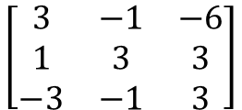
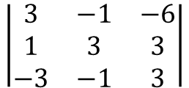
Matrices
If: $A\left(\begin{matrix}x \\ y \\ z\end{matrix}\right)=v$
Then: $\left(\begin{matrix}x \\ y \\ z\end{matrix}\right)=A^{−1}v$
You need to be able to determine whether a system of three linear equations is consistent or inconsistent
A system of linear equations is consistent if there is at least one set of values for $x$, $y$ and $z$ that solve all 3 simultaneously
If the matrix formed by the coefficients is non-singular, then the system of equations has one unique solution and is consistent
If it is singular, then the system of equations will either be consistent and have infinitely many solutions, or be inconsistent and have no solutions…
$$3x−y−6z=1$$
$$x+3y+3z=2$$
$$−3x−y+3z=−2$$
Write as a matrix
$$\left[\begin{matrix}3 & −1 & −6 \\ 1 & 3 & 3 \\ −3 & −1 & 3\end{matrix}\right]$$
We need to find the determinant of this (use your calculator)
$$\left|\begin{matrix}3 & −1 & −6 \\ 1 & 3 & 3 \\ −3 & −1 & 3\end{matrix}\right|$$
Calculate
$$=0$$
So this matrix is singular
→ This means that there will either be an infinite number of solutions, or no solutions
6F

Slide 5
Matrices
If: $A\left(\begin{matrix}x \\ y \\ z\end{matrix}\right)=v$
Then: $\left(\begin{matrix}x \\ y \\ z\end{matrix}\right)=A^{−1}v$
(1)
$$3x−y−6z=1$$
You need to be able to determine whether a system of three linear equations is consistent or inconsistent
A system of linear equations is consistent if there is at least one set of values for $x$, $y$ and $z$ that solve all 3 simultaneously
If the matrix formed by the coefficients is non-singular, then the system of equations has one unique solution and is consistent
If it is singular, then the system of equations will either be consistent and have infinitely many solutions, or be inconsistent and have no solutions…
(2)
$$x+3y+3z=2$$
(3)
$$−3x−y+3z=−2$$
Determining whether there are an infinite number of solutions, or no solutions…
→ Eliminate one of the variables. If the resulting equations are consistent, then the overall system is consistent
(1) + 2(2)
$$5x+5y=5$$
(2) - (3)
$$4x+4y=4$$
As one of these is a multiple of the other, the overall system will be consistent and have an infinite number of solutions
This is because in the 2 equations above, they will always work if $x+y=1$
As long as $x+y=1$, there will also be a value of $z$ to go with this (which will vary depending on $x$ and $y$)
6F

Slide 6
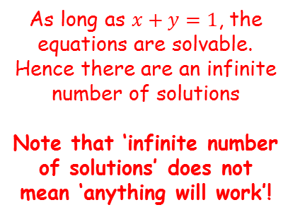
Matrices
If: $A\left(\begin{matrix}x \\ y \\ z\end{matrix}\right)=v$
Then: $\left(\begin{matrix}x \\ y \\ z\end{matrix}\right)=A^{−1}v$
(1)
$$3x−y−6z=1$$
You need to be able to determine whether a system of three linear equations is consistent or inconsistent
A system of linear equations is consistent if there is at least one set of values for $x$, $y$ and $z$ that solve all 3 simultaneously
If the matrix formed by the coefficients is non-singular, then the system of equations has one unique solution and is consistent
If it is singular, then the system of equations will either be consistent and have infinitely many solutions, or be inconsistent and have no solutions…
(1) + 2(2)
$$5x+5y=5$$
(2)
$$x+3y+3z=2$$
(2) - (3)
$$4x+4y=4$$
(3)
$$−3x−y+3z=−2$$
For example, let $x=2$ and $y=−1$ (as this means they add up to 1)
→ Let us see what $z$ will be if this is the case…
$$3x−y−6z=1$$
$$x+3y+3z=2$$
$$3(2)−(−1)−6z=1$$
$$(2)+3(−1)+3z=2$$
$$z=1$$
$$z=1$$
As long as $x+y=1$, the equations are solvable. Hence there are an infinite number of solutions
Note that ‘infinite number of solutions’ does not mean ‘anything will work’!
$$−3x−y+3z=−2$$
$$−3(2)−(−1)+3z=−2$$
$$z=1$$
6F

Slide 7
Matrices
If: $A\left(\begin{matrix}x \\ y \\ z\end{matrix}\right)=v$
Then: $\left(\begin{matrix}x \\ y \\ z\end{matrix}\right)=A^{−1}v$
Singular – infinitely many solutions
You need to be able to determine whether a system of three linear equations is consistent or inconsistent
A system of linear equations is consistent if there is at least one set of values for $x$, $y$ and $z$ that solve all 3 simultaneously
If the matrix formed by the coefficients is non-singular, then the system of equations has one unique solution and is consistent
If it is singular, then the system of equations will either be consistent and have infinitely many solutions, or be inconsistent and have no solutions…
$$3x−y−6z=1$$
LINK to Autograph file
$$x+3y+3z=2$$
$$−3x−y+3z=−2$$
This pattern is called a ‘sheaf’
6F

Slide 8
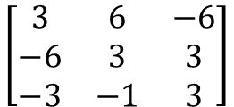
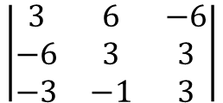
Matrices
If: $A\left(\begin{matrix}x \\ y \\ z\end{matrix}\right)=v$
Then: $\left(\begin{matrix}x \\ y \\ z\end{matrix}\right)=A^{−1}v$
You need to be able to determine whether a system of three linear equations is consistent or inconsistent
A system of linear equations is consistent if there is at least one set of values for $x$, $y$ and $z$ that solve all 3 simultaneously
If the matrix formed by the coefficients is non-singular, then the system of equations has one unique solution and is consistent
If it is singular, then the system of equations will either be consistent and have infinitely many solutions, or be inconsistent and have no solutions…
$$3x+6y−6z=−6$$
$$−6x+3y+3z=2$$
$$−3x−y+3z=−2$$
Write as a matrix
$$\left[\begin{matrix}3 & 6 & −6 \\ −6 & 3 & 3 \\ −3 & −1 & 3\end{matrix}\right]$$
We need to find the determinant of this (use your calculator)
$$\left|\begin{matrix}3 & 6 & −6 \\ −6 & 3 & 3 \\ −3 & −1 & 3\end{matrix}\right|$$
Calculate
$$=0$$
So this matrix is singular
→ This means that there will either be an infinite number of solutions, or no solutions
6F

Slide 9
Matrices
If: $A\left(\begin{matrix}x \\ y \\ z\end{matrix}\right)=v$
Then: $\left(\begin{matrix}x \\ y \\ z\end{matrix}\right)=A^{−1}v$
(1)
$$3x+6y−6z=−6$$
You need to be able to determine whether a system of three linear equations is consistent or inconsistent
A system of linear equations is consistent if there is at least one set of values for $x$, $y$ and $z$ that solve all 3 simultaneously
If the matrix formed by the coefficients is non-singular, then the system of equations has one unique solution and is consistent
If it is singular, then the system of equations will either be consistent and have infinitely many solutions, or be inconsistent and have no solutions…
(2)
$$−6x+3y+3z=2$$
(3)
$$−3x−y+3z=−2$$
Determining whether there are an infinite number of solutions, or no solutions…
→ Eliminate one of the variables. If the resulting equations are consistent, then the overall system is consistent
(1) + (3)
$$5y−3z=−8$$
2(1) + (2)
$$15y−9z=−10$$
As this pair of equations cannot be solved, this means that the overall system cannot be solved
Hence there are no solutions
6F

Slide 10
Matrices
If: $A\left(\begin{matrix}x \\ y \\ z\end{matrix}\right)=v$
Then: $\left(\begin{matrix}x \\ y \\ z\end{matrix}\right)=A^{−1}v$
Singular – no solutions
You need to be able to determine whether a system of three linear equations is consistent or inconsistent
A system of linear equations is consistent if there is at least one set of values for $x$, $y$ and $z$ that solve all 3 simultaneously
If the matrix formed by the coefficients is non-singular, then the system of equations has one unique solution and is consistent
If it is singular, then the system of equations will either be consistent and have infinitely many solutions, or be inconsistent and have no solutions…
$$3x+6y−6z=−6$$
LINK to Autograph file
$$−6x+3y+3z=2$$
$$−3x−y+3z=−2$$
In this case the planes form a prism!
6F

Slide 11
Matrices
If: $A\left(\begin{matrix}x \\ y \\ z\end{matrix}\right)=v$
Then: $\left(\begin{matrix}x \\ y \\ z\end{matrix}\right)=A^{−1}v$
If one is a linear multiple of the other (with a different answer), the planes will be parallel, and hence there will be no solutions
$$x+y+z=8$$
You need to be able to determine whether a system of three linear equations is consistent or inconsistent
A system of linear equations is consistent if there is at least one set of values for $x$, $y$ and $z$ that solve all 3 simultaneously
If the matrix formed by the coefficients is non-singular, then the system of equations has one unique solution and is consistent
If it is singular, then the system of equations will either be consistent and have infinitely many solutions, or be inconsistent and have no solutions…
LINK to Autograph file
$$2x+2y+2z=14$$
$$3x−y−z=10$$
6F

