Slide 1
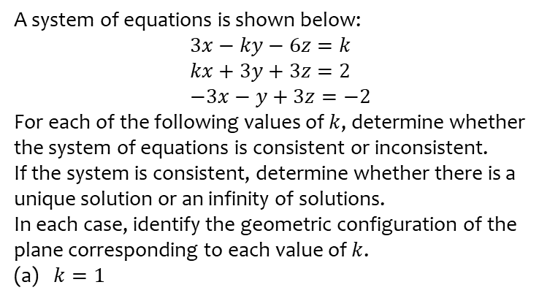
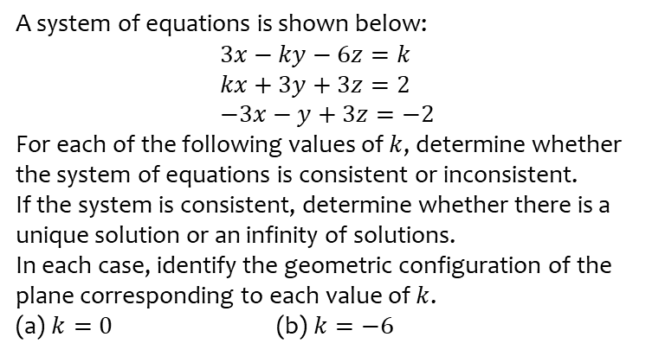
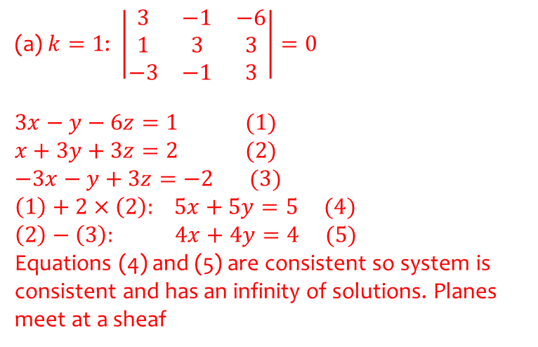
Worked example
Your turn
A system of equations is shown below:
$$3x−ky−6z=k \\ kx+3y+3z=2 \\ −3x−y+3z=−2$$
For each of the following values of $k$, determine whether the system of equations is consistent or inconsistent.
If the system is consistent, determine whether there is a unique solution or an infinity of solutions.
In each case, identify the geometric configuration of the plane corresponding to each value of $k$.
(a) $k=0$ (b) $k=−6$
A system of equations is shown below:
$$3x−ky−6z=k \\ kx+3y+3z=2 \\ −3x−y+3z=−2$$
For each of the following values of $k$, determine whether the system of equations is consistent or inconsistent.
If the system is consistent, determine whether there is a unique solution or an infinity of solutions.
In each case, identify the geometric configuration of the plane corresponding to each value of $k$.
(a) $k=1$
(a) $k=1$: $\left|\begin{matrix}3 & −1 & −6 \\ 1 & 3 & 3 \\ −3 & −1 & 3\end{matrix}\right|=0$
$$3x−y−6z=1 (1) \\ x+3y+3z=2 (2) \\ −3x−y+3z=−2 (3)$$
$\left(1\right)+2×\left(2\right):$ $5x+5y=5 (4)$
$\left(2\right)−\left(3\right):$ $4x+4y=4$ $(5)$
Equations (4) and (5) are consistent so system is consistent and has an infinity of solutions. Planes meet at a sheaf

Slide 2
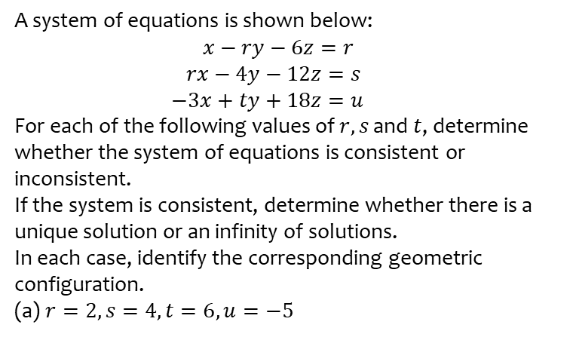
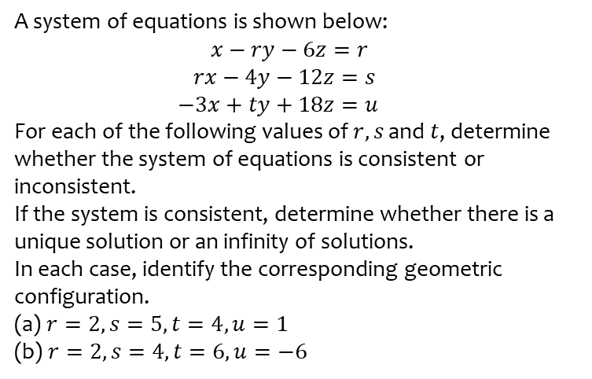
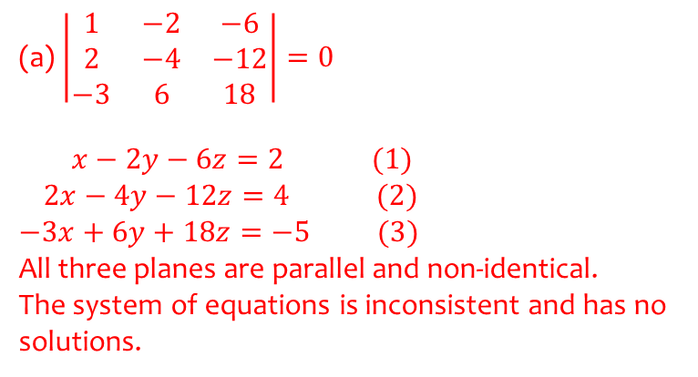
Worked example
Your turn
A system of equations is shown below:
$x−ry−6z=r$
$rx−4y−12z=s$
$−3x+ty+18z=u$
For each of the following values of $r, s$ and $t$, determine whether the system of equations is consistent or inconsistent.
If the system is consistent, determine whether there is a unique solution or an infinity of solutions.
In each case, identify the corresponding geometric configuration.
(a) $r=2, s=5, t=4, u=1$
(b) $r=2, s=4, t=6, u=−6$
A system of equations is shown below:
$x−ry−6z=r$
$rx−4y−12z=s$
$−3x+ty+18z=u$
For each of the following values of $r, s$ and $t$, determine whether the system of equations is consistent or inconsistent.
If the system is consistent, determine whether there is a unique solution or an infinity of solutions.
In each case, identify the corresponding geometric configuration.
(a) $r=2, s=4, t=6, u=−5$
(a) $\left|\begin{matrix}1 & −2 & −6 \\ 2 & −4 & −12 \\ −3 & 6 & 18\end{matrix}\right|=0$
$x−2y−6z=2 (1)$
$2x−4y−12z=4 (2)$
$$−3x+6y+18z=−5 (3)$$
All three planes are parallel and non-identical.
The system of equations is inconsistent and has no solutions.

