Slide 1
Teachings for
Exercise 6F

Slide 2
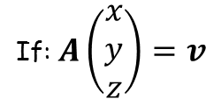
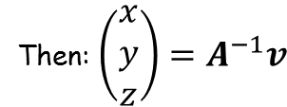
Matrices
You need to be able to solve simultaneous equations using matrices
You can use the inverse of a 3 x 3 matrix to solve a system of three simultaneous equations in three unknowns…
If A is non singular, then a unique solution can be found for any vector $v$
If: $A\left(\begin{matrix}x \\ y \\ z\end{matrix}\right)=v$
Then: $\left(\begin{matrix}x \\ y \\ z\end{matrix}\right)=A^{−1}v$
6F

Slide 3
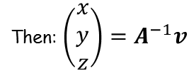

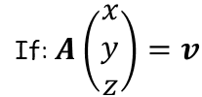

Matrices
If: $A\left(\begin{matrix}x \\ y \\ z\end{matrix}\right)=v$
Then: $\left(\begin{matrix}x \\ y \\ z\end{matrix}\right)=A^{−1}v$
Note that multiplying the first row by the column will give the first equation…
You need to be able to solve simultaneous equations using matrices
Use an inverse matrix to solve the simultaneous equations:
You need to start by writing this information as a matrix calculation…
$$\left[\begin{matrix}−1 & 6 & −2 \\ 6 & −2 & −1 \\ −2 & 3 & 5\end{matrix}\right]$$
$$\left[\begin{matrix}x \\ y \\ z\end{matrix}\right]$$
$$=\left[\begin{matrix}21 \\ −16 \\ 24\end{matrix}\right]$$
Write the coefficients as a grid (ensure the unknowns are in the same order on each equation first!)
Write the 3 unknowns as a column matrix (following the same order they are in the equations)
Write the 3 answers as a column matrix as well
$$−x+6y−2z=21$$
$$6x−2y−z=−16$$
$$−2x+3y+5z=24$$
6F

Slide 4
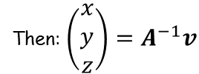
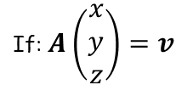
Matrices
If: $A\left(\begin{matrix}x \\ y \\ z\end{matrix}\right)=v$
Then: $\left(\begin{matrix}x \\ y \\ z\end{matrix}\right)=A^{−1}v$
You need to be able to solve simultaneous equations using matrices
Use an inverse matrix to solve the simultaneous equations:
$$\left[\begin{matrix}−1 & 6 & −2 \\ 6 & −2 & −1 \\ −2 & 3 & 5\end{matrix}\right]$$
$$\left[\begin{matrix}x \\ y \\ z\end{matrix}\right]$$
$$=\left[\begin{matrix}21 \\ −16 \\ 24\end{matrix}\right]$$
If: $A\left(\begin{matrix}x \\ y \\ z\end{matrix}\right)=v$
$$−x+6y−2z=21$$
$$6x−2y−z=−16$$
Then: $\left(\begin{matrix}x \\ y \\ z\end{matrix}\right)=A^{−1}v$
$$−2x+3y+5z=24$$
So we need to find the inverse of $A$, and then multiply that by the answer matrix $v$
6F

Slide 5
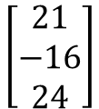
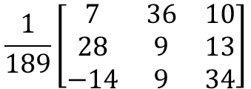
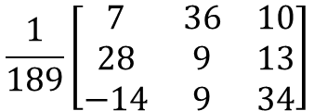
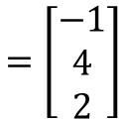
Matrices
If: $A\left(\begin{matrix}x \\ y \\ z\end{matrix}\right)=v$
Then: $\left(\begin{matrix}x \\ y \\ z\end{matrix}\right)=A^{−1}v$
You need to be able to solve simultaneous equations using matrices
Use an inverse matrix to solve the simultaneous equations:
Finding the inverse of $A$
$$\left[\begin{matrix}−1 & 6 & −2 \\ 6 & −2 & −1 \\ −2 & 3 & 5\end{matrix}\right]$$
$$\left[\begin{matrix}x \\ y \\ z\end{matrix}\right]$$
$$=\left[\begin{matrix}21 \\ −16 \\ 24\end{matrix}\right]$$
Using your calculator will give…
$$\frac{1}{189}\left[\begin{matrix}7 & 36 & 10 \\ 28 & 9 & 13 \\ −14 & 9 & 34\end{matrix}\right]$$
$$−x+6y−2z=21$$
We need to multiply this by the answer matrix
$$6x−2y−z=−16$$
$$\frac{1}{189}\left[\begin{matrix}7 & 36 & 10 \\ 28 & 9 & 13 \\ −14 & 9 & 34\end{matrix}\right]$$
$$\left[\begin{matrix}21 \\ −16 \\ 24\end{matrix}\right]$$
$$−2x+3y+5z=24$$
You can use your calculator again (just make it clear what steps you are taking…)
$$=\left[\begin{matrix}−1 \\ 4 \\ 2\end{matrix}\right]$$
So $x=−1$, $y=4$ and $z=2$
6F

Slide 6
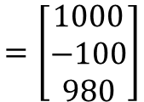
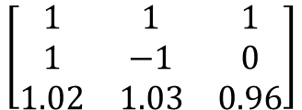
Matrices
If: $A\left(\begin{matrix}x \\ y \\ z\end{matrix}\right)=v$
Then: $\left(\begin{matrix}x \\ y \\ z\end{matrix}\right)=A^{−1}v$
You need to be able to solve simultaneous equations using matrices
A colony of 1000 mole rats is made up of adult males, adult females, and youngsters. Originally there were 100 more adult females than adult males.
After one year, the number of adult males had increased by 2%, the number of adult females had increased by 3%, the number of youngsters had decreased by 4%, and the total number of mole rats had decreased by 20.
Find out how many of each type of mole rat were originally in the colony.
Start by setting up simultaneous equations…
$x=$ original adult males
$y=$ original adult females
$z=$ original youngsters
$$x+y+z=1000$$
$$x−y=−100$$
$$1.02x+1.03y+0.96z=980$$
Now convert these to matrices…
$$\left[\begin{matrix}1 & 1 & 1 \\ 1 & −1 & 0 \\ 1.02 & 1.03 & 0.96\end{matrix}\right]$$
$$\left[\begin{matrix}x \\ y \\ z\end{matrix}\right]$$
$$=\left[\begin{matrix}1000 \\ −100 \\ 980\end{matrix}\right]$$
As before, we now need to find the inverse of the original matrix, and multiply it by the answers…
6F

Slide 7
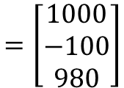
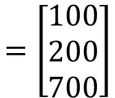
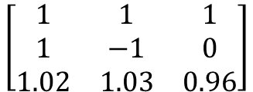
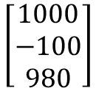
Matrices
If: $A\left(\begin{matrix}x \\ y \\ z\end{matrix}\right)=v$
Then: $\left(\begin{matrix}x \\ y \\ z\end{matrix}\right)=A^{−1}v$
You need to be able to solve simultaneous equations using matrices
A colony of 1000 mole rats is made up of adult males, adult females, and youngsters. Originally there were 100 more adult females than adult males.
After one year, the number of adult males had increased by 2%, the number of adult females had increased by 3%, the number of youngsters had decreased by 4%, and the total number of mole rats had decreased by 20.
Find out how many of each type of mole rat were originally in the colony.
$$\left[\begin{matrix}1 & 1 & 1 \\ 1 & −1 & 0 \\ 1.02 & 1.03 & 0.96\end{matrix}\right]$$
$$\left[\begin{matrix}x \\ y \\ z\end{matrix}\right]$$
$$=\left[\begin{matrix}1000 \\ −100 \\ 980\end{matrix}\right]$$
The inverse of the original matrix can be found using your calculator
$$\frac{1}{13}\left[\begin{matrix}−96 & 7 & 100 \\ −96 & −6 & 100 \\ 205 & −1 & −200\end{matrix}\right]$$
We need to multiply this by the answer matrix
$$\frac{1}{13}\left[\begin{matrix}−96 & 7 & 100 \\ −96 & −6 & 100 \\ 205 & −1 & −200\end{matrix}\right]$$
$$\left[\begin{matrix}1000 \\ −100 \\ 980\end{matrix}\right]$$
You can use your calculator again (just make it clear what steps you are taking…)
$$=\left[\begin{matrix}100 \\ 200 \\ 700\end{matrix}\right]$$
So originally there were 100 adult males, 200 adult females, and 700 youngsters
6F

