Slide 1
6.5) Inverting a 3 x 3 matrix

Slide 2
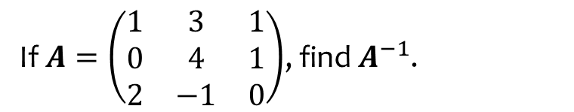
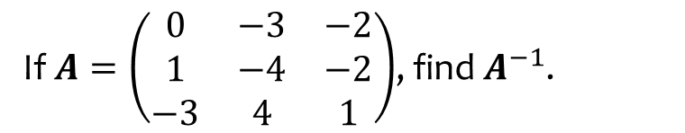

Worked example
Your turn
If $A=\left(\begin{matrix}0 & −3 & −2 \\ 1 & −4 & −2 \\ −3 & 4 & 1\end{matrix}\right)$, find $A^{−1}$.
If $A=\left(\begin{matrix}1 & 3 & 1 \\ 0 & 4 & 1 \\ 2 & −1 & 0\end{matrix}\right)$, find $A^{−1}$.
$$\left(\begin{matrix}−1 & 1 & 1 \\ −2 & 2 & 1 \\ 8 & −7 & −4\end{matrix}\right)$$

Slide 3
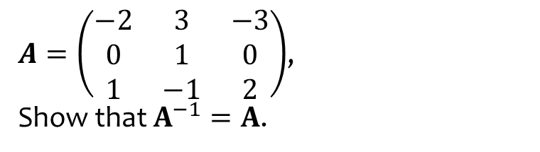
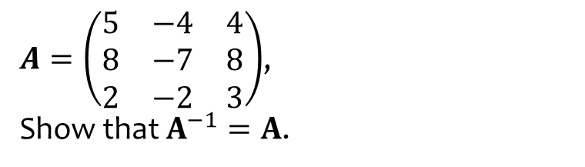
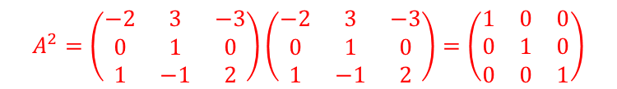
Worked example
Your turn
$A=\left(\begin{matrix}5 & −4 & 4 \\ 8 & −7 & 8 \\ 2 & −2 & 3\end{matrix}\right)$,
Show that $A^{−1}=A$.
$A=\left(\begin{matrix}−2 & 3 & −3 \\ 0 & 1 & 0 \\ 1 & −1 & 2\end{matrix}\right)$,
Show that $A^{−1}=A$.
$$A^{2}=\left(\begin{matrix}−2 & 3 & −3 \\ 0 & 1 & 0 \\ 1 & −1 & 2\end{matrix}\right)\left(\begin{matrix}−2 & 3 & −3 \\ 0 & 1 & 0 \\ 1 & −1 & 2\end{matrix}\right)=\left(\begin{matrix}1 & 0 & 0 \\ 0 & 1 & 0 \\ 0 & 0 & 1\end{matrix}\right)$$

Slide 4
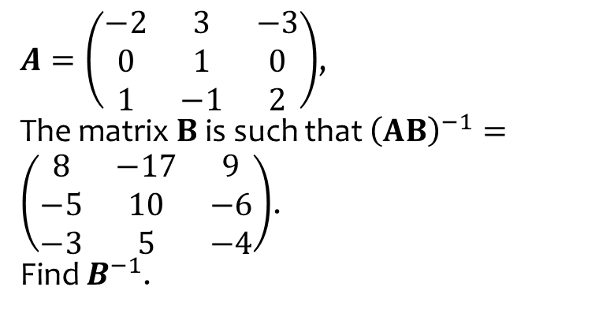
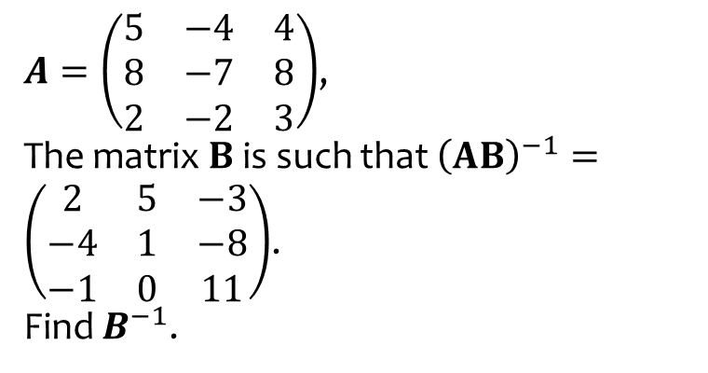
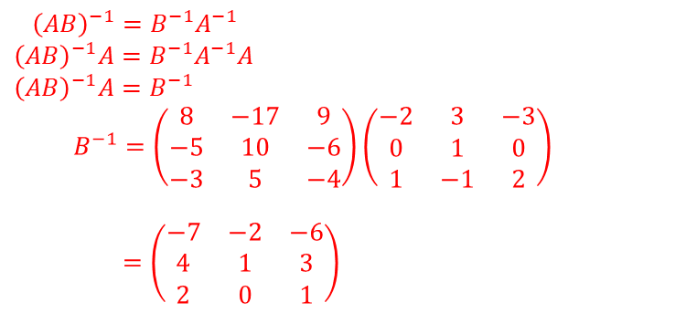
Worked example
Your turn
$A=\left(\begin{matrix}5 & −4 & 4 \\ 8 & −7 & 8 \\ 2 & −2 & 3\end{matrix}\right)$,
The matrix $B$ is such that ${\left(AB\right)}^{−1}=\left(\begin{matrix}2 & 5 & −3 \\ −4 & 1 & −8 \\ −1 & 0 & 11\end{matrix}\right)$.
Find $B^{−1}$.
$A=\left(\begin{matrix}−2 & 3 & −3 \\ 0 & 1 & 0 \\ 1 & −1 & 2\end{matrix}\right)$,
The matrix $B$ is such that ${\left(AB\right)}^{−1}=\left(\begin{matrix}8 & −17 & 9 \\ −5 & 10 & −6 \\ −3 & 5 & −4\end{matrix}\right)$.
Find $B^{−1}$.
$${\left(AB\right)}^{−1}=B^{−1}A^{−1} \\ {\left(AB\right)}^{−1}A=B^{−1}A^{−1}A \\ {\left(AB\right)}^{−1}A=B^{−1}$$
$B^{−1}=\left(\begin{matrix}8 & −17 & 9 \\ −5 & 10 & −6 \\ −3 & 5 & −4\end{matrix}\right)\left(\begin{matrix}−2 & 3 & −3 \\ 0 & 1 & 0 \\ 1 & −1 & 2\end{matrix}\right)$
$=\left(\begin{matrix}−7 & −2 & −6 \\ 4 & 1 & 3 \\ 2 & 0 & 1\end{matrix}\right)$

Slide 5
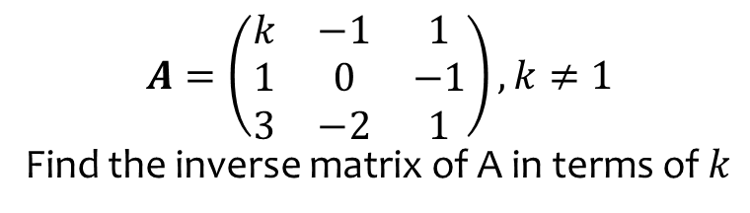
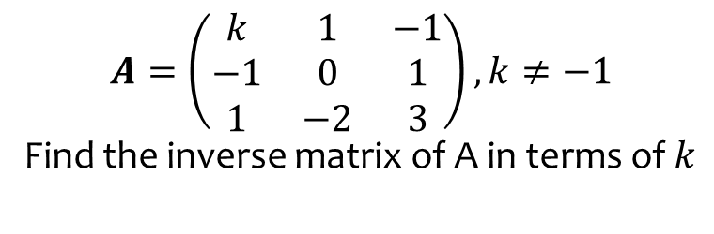
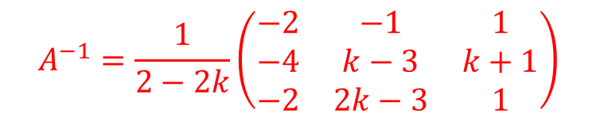
Worked example
Your turn
$$A=\left(\begin{matrix}k & 1 & −1 \\ −1 & 0 & 1 \\ 1 & −2 & 3\end{matrix}\right), k≠−1$$
Find the inverse matrix of A in terms of $k$
$$A=\left(\begin{matrix}k & −1 & 1 \\ 1 & 0 & −1 \\ 3 & −2 & 1\end{matrix}\right), k≠1$$
Find the inverse matrix of A in terms of $k$
$$A^{−1}=\frac{1}{2−2k}\left(\begin{matrix}−2 & −1 & 1 \\ −4 & k−3 & k+1 \\ −2 & 2k−3 & 1\end{matrix}\right)$$

Slide 6
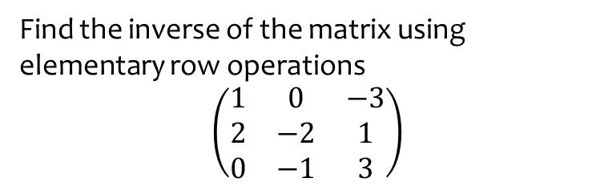
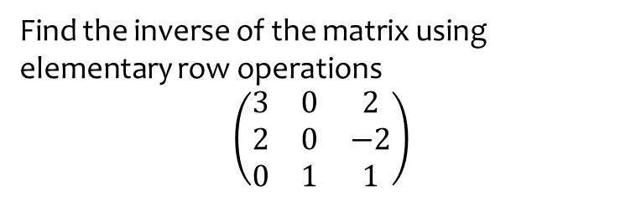

Worked example
Your turn
Find the inverse of the matrix using elementary row operations
$$\left(\begin{matrix}3 & 0 & 2 \\ 2 & 0 & −2 \\ 0 & 1 & 1\end{matrix}\right)$$
Find the inverse of the matrix using elementary row operations
$$\left(\begin{matrix}1 & 0 & −3 \\ 2 & −2 & 1 \\ 0 & −1 & 3\end{matrix}\right)$$
$$\left(\begin{matrix}−5 & 3 & −6 \\ −6 & 3 & −7 \\ −2 & 1 & −2\end{matrix}\right)$$

