Slide 1
Teachings for
Exercise 6E

Slide 2






Hyperbolic Functions
$$\frac{d}{dx}\left(\operatorname{arsinh}{x}\right)=\frac{1}{\sqrt{x^{2}+1}}$$
$$\frac{d}{dx}\left(\operatorname{arcosh}{x}\right)=\frac{1}{\sqrt{x^{2} −1}}, x>1$$
$$\frac{d}{dx}\left(artanh x\right)=\frac{1}{1−x^{2}}, \left|x\right|<1$$
$$\frac{d}{dx}\left(\sinh{x}\right)=\cosh{x}$$
$$\frac{d}{dx}\left(\cosh{x}\right)=\sinh{x}$$
$$\frac{d}{dx}\left(\tanh{x}\right)={sech}^{2}x$$
You need to be able to integrate hyperbolic functions
You will need to use the patterns above, that you learned in the previous section
You may also have to apply various combinations of integration techniques learnt in Further Maths
6E

Slide 3

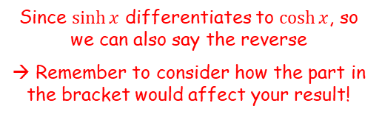


Hyperbolic Functions
$$\frac{d}{dx}\left(\operatorname{arsinh}{x}\right)=\frac{1}{\sqrt{x^{2}+1}}$$
$$\frac{d}{dx}\left(\operatorname{arcosh}{x}\right)=\frac{1}{\sqrt{x^{2} −1}}, x>1$$
$$\frac{d}{dx}\left(artanh x\right)=\frac{1}{1−x^{2}}, \left|x\right|<1$$
$$\frac{d}{dx}\left(\sinh{x}\right)=\cosh{x}$$
$$\frac{d}{dx}\left(\cosh{x}\right)=\sinh{x}$$
$$\frac{d}{dx}\left(\tanh{x}\right)={sech}^{2}x$$
You need to be able to integrate hyperbolic functions
Find:
$$\int{\cosh\left(4x−1\right) dx}$$
Since $\sinh{x}$ differentiates to $\cosh{x}$, so we can also say the reverse
→ Remember to consider how the part in the bracket would affect your result!
$$=\frac{1}{4}\sinh\left(4x−1\right)+c$$
$$\int{\cosh\left(4x−1\right) dx}$$
6E

Slide 4


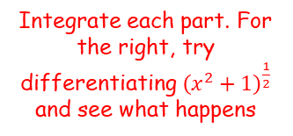








Hyperbolic Functions
$$\frac{d}{dx}\left(\operatorname{arsinh}{x}\right)=\frac{1}{\sqrt{x^{2}+1}}$$
$$\frac{d}{dx}\left(\operatorname{arcosh}{x}\right)=\frac{1}{\sqrt{x^{2} −1}}, x>1$$
$$\frac{d}{dx}\left(artanh x\right)=\frac{1}{1−x^{2}}, \left|x\right|<1$$
$$\frac{d}{dx}\left(\sinh{x}\right)=\cosh{x}$$
$$\frac{d}{dx}\left(\cosh{x}\right)=\sinh{x}$$
$$\frac{d}{dx}\left(\tanh{x}\right)={sech}^{2}x$$
You need to be able to integrate hyperbolic functions
Find:
A good starting point with this type is to check the denominator – can we use any of the rules above somehow?
$$\int{\left(\frac{2+5x}{\sqrt{x^{2}+1}}\right) dx}$$
Write as two separate fractions
$$=\int{\left(\frac{2}{\sqrt{x^{2}+1}}\right) dx}+\int{\left(\frac{5x}{\sqrt{x^{2}+1}}\right) dx}$$
Take the constants out of each integral
$$\int{\left(\frac{2+5x}{\sqrt{x^{2}+1}}\right) dx}$$
$$=2\int{\left(\frac{1}{\sqrt{x^{2}+1}}\right) dx}+5\int{\left(\frac{x}{\sqrt{x^{2}+1}}\right) dx}$$
Rewrite the right hand one using a bracket and a power
$$=2\int{\left(\frac{1}{\sqrt{x^{2}+1}}\right) dx}+5\int{{x\left(x^{2}+1\right)}^{−\frac{1}{2}} dx}$$
Integrate each part. For the right, try differentiating ${\left(x^{2}+1\right)}^{\frac{1}{2}}$ and see what happens
$$=2arsinhx+5{\left(x^{2}+1\right)}^{\frac{1}{2}}+c$$
$${\left(x^{2}+1\right)}^{\frac{1}{2}}$$
Differentiate with respect to $x$
$${\frac{1}{2}\left(x^{2}+1\right)}^{−\frac{1}{2}}(2x)$$
Simplify
$${x\left(x^{2}+1\right)}^{−\frac{1}{2}}$$
6E

Slide 5








Hyperbolic Functions
$$\frac{d}{dx}\left(\operatorname{arsinh}{x}\right)=\frac{1}{\sqrt{x^{2}+1}}$$
$$\frac{d}{dx}\left(\operatorname{arcosh}{x}\right)=\frac{1}{\sqrt{x^{2} −1}}, x>1$$
$$\frac{d}{dx}\left(artanh x\right)=\frac{1}{1−x^{2}}, \left|x\right|<1$$
$$\frac{d}{dx}\left(\sinh{x}\right)=\cosh{x}$$
$$\frac{d}{dx}\left(\cosh{x}\right)=\sinh{x}$$
$$\frac{d}{dx}\left(\tanh{x}\right)={sech}^{2}x$$
You need to be able to integrate hyperbolic functions
Find:
Start by differentiating $\cosh^{6}2x$ and then adjust…
$$\cosh^{6}2x$$
Rewrite
$${=\left(\cosh{2x}\right)}^{6}$$
Differentiate using the chain rule
$${=6\left(\cosh{2x}\right)}^{5}(2\sinh{2x})$$
$$\int{\cosh^{5}2x sinh2x dx}$$
Simplify
$$=12\cosh^{5}2x sinh2x$$
This is 12 times what we want, do we need to divide the original guess by 12
$$\int{\cosh^{5}2x sinh2x dx}$$
Integrate
$$=\frac{1}{12}\cosh^{6}2x+c$$
6E

Slide 6


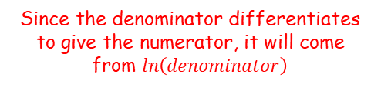



Hyperbolic Functions
$$\frac{d}{dx}\left(\operatorname{arsinh}{x}\right)=\frac{1}{\sqrt{x^{2}+1}}$$
$$\frac{d}{dx}\left(\operatorname{arcosh}{x}\right)=\frac{1}{\sqrt{x^{2} −1}}, x>1$$
$$\frac{d}{dx}\left(artanh x\right)=\frac{1}{1−x^{2}}, \left|x\right|<1$$
$$\frac{d}{dx}\left(\sinh{x}\right)=\cosh{x}$$
$$\frac{d}{dx}\left(\cosh{x}\right)=\sinh{x}$$
$$\frac{d}{dx}\left(\tanh{x}\right)={sech}^{2}x$$
You need to be able to integrate hyperbolic functions
Find:
$$\int{tanhx dx}$$
Rewrite
$$=\int{\frac{\sinh{x}}{\cosh{x}} dx}$$
Since the denominator differentiates to give the numerator, it will come from $ln\left(denominator\right)$
$$\int{tanhx dx}$$
$$=ln\left(\cosh{x}\right)+c$$
Since $\cosh{x}>0$ for all $x$, the modulus sign is not necessary here
6E

Slide 7












Hyperbolic Functions
$$\frac{d}{dx}\left(\operatorname{arsinh}{x}\right)=\frac{1}{\sqrt{x^{2}+1}}$$
$$\frac{d}{dx}\left(\operatorname{arcosh}{x}\right)=\frac{1}{\sqrt{x^{2} −1}}, x>1$$
$$\frac{d}{dx}\left(artanh x\right)=\frac{1}{1−x^{2}}, \left|x\right|<1$$
$$\frac{d}{dx}\left(\sinh{x}\right)=\cosh{x}$$
$$\frac{d}{dx}\left(\cosh{x}\right)=\sinh{x}$$
$$\frac{d}{dx}\left(\tanh{x}\right)={sech}^{2}x$$
You need to be able to integrate hyperbolic functions
Find:
You can also use the hyperbolic identities to help…
$$\int{\cosh^{2}3x dx}$$
Replace using a hyperbolic identity
$$=\int{\frac{cosh6x+1}{2} dx}$$
Take the $\frac{1}{2}$ out as a factor
$$\int{\cosh^{2}3x dx}$$
$$=\frac{1}{2}\int{\left(cosh6x+1\right)dx}$$
Integrate
$$=\frac{1}{2}\left(\frac{1}{6}\sinh{6x}+x\right)+c$$
Simplify
$$cos2A=2\cos^{2}A−1$$
Change using Osborn’s rule
$$=\frac{1}{12}\sinh{6x}+\frac{1}{2}x+c$$
$$cosh2A=2\cosh^{2}A−1$$
Let $A=3x$
$$cosh6x=2\cosh^{2}3x−1$$
Rearrange
$$\frac{cosh6x+1}{2}=\cosh^{2}3x$$
6E

Slide 8







Hyperbolic Functions
$$\frac{d}{dx}\left(\operatorname{arsinh}{x}\right)=\frac{1}{\sqrt{x^{2}+1}}$$
$$\frac{d}{dx}\left(\operatorname{arcosh}{x}\right)=\frac{1}{\sqrt{x^{2} −1}}, x>1$$
$$\frac{d}{dx}\left(artanh x\right)=\frac{1}{1−x^{2}}, \left|x\right|<1$$
$$\frac{d}{dx}\left(\sinh{x}\right)=\cosh{x}$$
$$\frac{d}{dx}\left(\cosh{x}\right)=\sinh{x}$$
$$\frac{d}{dx}\left(\tanh{x}\right)={sech}^{2}x$$
You need to be able to integrate hyperbolic functions
Find:
You can also use the hyperbolic identities to help…
$$\int{\sinh^{3}x dx}$$
Rewrite
$$=\int{\sinh^{2}x\sinh{x}dx}$$
Replace using a hyperbolic identity (derive them if you can’t remember them!)
$$\int{\sinh^{3}x dx}$$
$$=\int{\left(\cosh^{2}x−1\right)\sinh{x} dx}$$
Separate into 2 integrals
$$=\int{\cosh^{2}x sinhx dx−\int{\sinh{x dx}}}$$
The first one would come from differentiating $\cosh^{3}x$
$$=\frac{1}{3}cosh^{3}x−\cosh{x}+c$$
6E

Slide 9


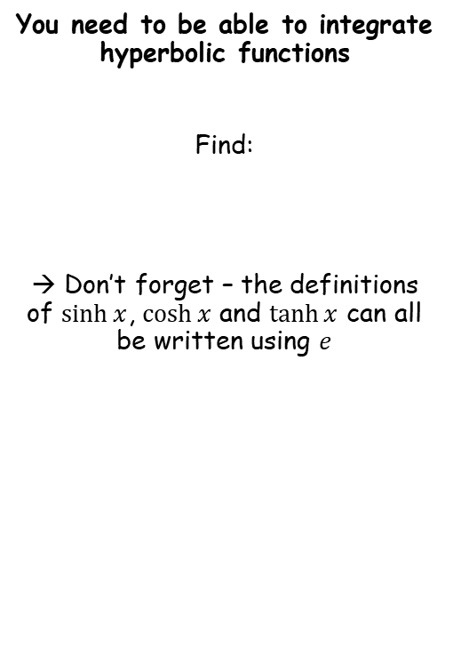






Hyperbolic Functions
$$\frac{d}{dx}\left(\operatorname{arsinh}{x}\right)=\frac{1}{\sqrt{x^{2}+1}}$$
$$\frac{d}{dx}\left(\operatorname{arcosh}{x}\right)=\frac{1}{\sqrt{x^{2} −1}}, x>1$$
$$\frac{d}{dx}\left(artanh x\right)=\frac{1}{1−x^{2}}, \left|x\right|<1$$
$$\frac{d}{dx}\left(\sinh{x}\right)=\cosh{x}$$
$$\frac{d}{dx}\left(\cosh{x}\right)=\sinh{x}$$
$$\frac{d}{dx}\left(\tanh{x}\right)={sech}^{2}x$$
You need to be able to integrate hyperbolic functions
Find:
→ Don’t forget – the definitions of $\sinh{x}$, $\cosh{x}$ and $\tanh{x}$ can all be written using $e$
$$\int{e^{2x}\sinh{x} dx}$$
Write $\sinh{x}$ using $e$ from earlier in the chapter
$$=\int{e^{2x}\left(\frac{e^{x}−e^{−x}}{2}\right)dx}$$
Simplify and factorise the $\frac{1}{2}$ out
$$\int{e^{2x}\sinh{x} dx}$$
$$=\frac{1}{2}\int{\left(e^{3x}−e^{x}\right)dx}$$
Integrate
$$=\frac{1}{2}\left(\frac{1}{3}e^{x}−e^{x}\right)+c$$
Simplify
$$=\frac{1}{6}e^{3x}−\frac{1}{2}e^{x}+c$$
6E

Slide 10


















Hyperbolic Functions
$$\frac{d}{dx}\left(\operatorname{arsinh}{x}\right)=\frac{1}{\sqrt{x^{2}+1}}$$
$$\frac{d}{dx}\left(\operatorname{arcosh}{x}\right)=\frac{1}{\sqrt{x^{2} −1}}, x>1$$
$$\frac{d}{dx}\left(artanh x\right)=\frac{1}{1−x^{2}}, \left|x\right|<1$$
$$\frac{d}{dx}\left(\sinh{x}\right)=\cosh{x}$$
$$\frac{d}{dx}\left(\cosh{x}\right)=\sinh{x}$$
$$\frac{d}{dx}\left(\tanh{x}\right)={sech}^{2}x$$
You need to be able to integrate hyperbolic functions
By using an appropriate substitution, find:
You can use the following idea…
$$\int{\frac{1}{\sqrt{x^{2}−a^{2}}} dx}$$
Let $x=\operatorname{acosh}{u}$
→ $\frac{dx}{du}=\operatorname{asinh}{u}$
$$=\int{\frac{1}{\sqrt{{\left(\operatorname{acosh}{u}\right)}^{2}−a^{2}}}\operatorname{asinh}{u} du}$$
→ $dx=\operatorname{asinh}{u du}$
Square the bracket
$$\int{\frac{1}{\sqrt{x^{2}−a^{2}}} dx}, x>a$$
$$=\int{\frac{1}{\sqrt{a^{2}\cosh^{2}u−a^{2}}}\operatorname{asinh}{u} du}$$
Replace using the expression we worked out before
$$=\int{\frac{1}{\operatorname{asinh}{u}}\operatorname{asinh}{u} du}$$
$$\cosh^{2}x−1≡sinh^{2}x$$
Multiply all by $a^{2}$
Simplify
$$=\int{1 du}$$
$${a^{2}cosh}^{2}x−a^{2}≡a^{2}sinh^{2}x$$
Square root
Integrate
$$\sqrt{a^{2}cosh^{2}x−a^{2}}≡\operatorname{asinh}{x}$$
$$x=\operatorname{acosh}{u}$$
$$=u+c$$
$\frac{x}{a}=\cosh{u}$
$$=arcosh\left(\frac{x}{a}\right)+c$$
$arcosh\left(\frac{x}{a}\right)=u$
6E

Slide 11
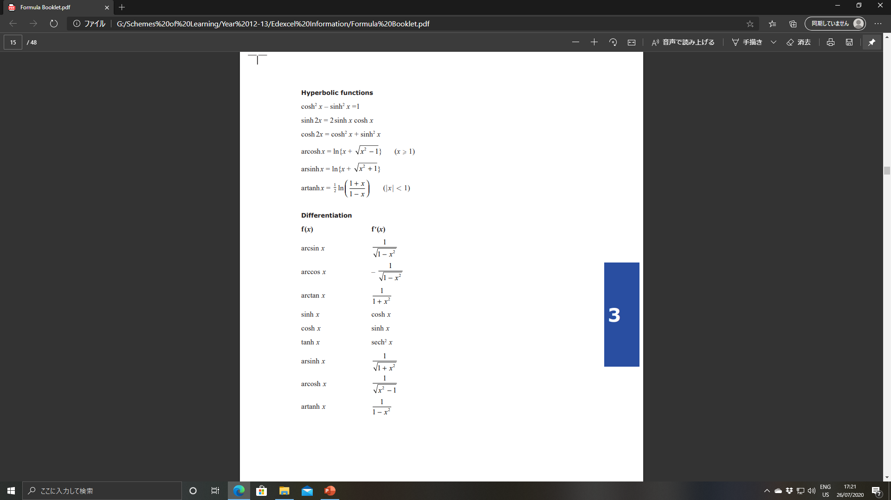
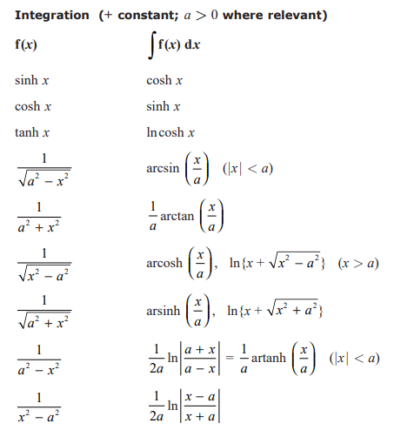
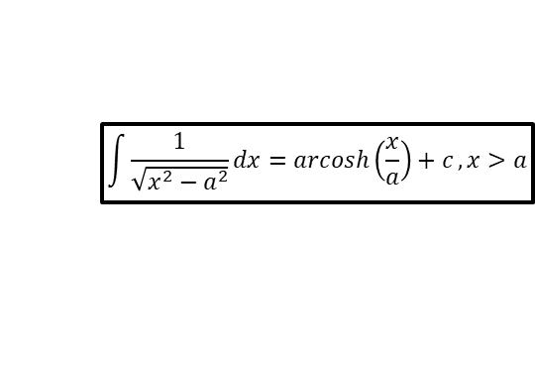
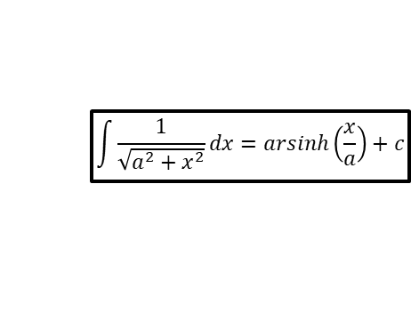
Hyperbolic Functions
$$\int{\frac{1}{\sqrt{a^{2}+x^{2}}}dx=arsinh\left(\frac{x}{a}\right)+c}$$
$$\int{\frac{1}{\sqrt{x^{2}−a^{2}}}dx=arcosh\left(\frac{x}{a}\right)+c}, x>a$$
$$\frac{d}{dx}\left(\sinh{x}\right)=\cosh{x}$$
$$\frac{d}{dx}\left(\cosh{x}\right)=\sinh{x}$$
$$\frac{d}{dx}\left(\tanh{x}\right)={sech}^{2}x$$
You need to be able to integrate hyperbolic functions
By the way, you get all this in the formula booklet so just look it up if you need to!
6E

Slide 12








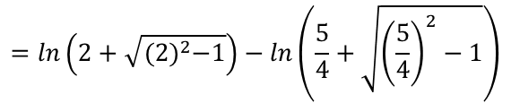
Hyperbolic Functions
$$\int{\frac{1}{\sqrt{a^{2}+x^{2}}}dx=arsinh\left(\frac{x}{a}\right)+c}$$
$$\int{\frac{1}{\sqrt{x^{2}−a^{2}}}dx=arcosh\left(\frac{x}{a}\right)+c}, x>a$$
$$\frac{d}{dx}\left(\sinh{x}\right)=\cosh{x}$$
$$\frac{d}{dx}\left(\cosh{x}\right)=\sinh{x}$$
$$\frac{d}{dx}\left(\tanh{x}\right)={sech}^{2}x$$
You need to be able to integrate hyperbolic functions
Show that:
$$\int_{5}^{8}{\frac{1}{\sqrt{x^{2}−16}} dx}$$
Integrate using the pattern above, with $a=4$
$$={\left[arcosh\left(\frac{x}{4}\right)\right]}_{5}^{8}$$
$$\int_{5}^{8}{\frac{1}{\sqrt{x^{2}−16}} dx=ln\left(\frac{2+\sqrt{3}}{2}\right)}$$
Sub in limits and subtract
$$=arcosh2−arcosh\frac{5}{4}$$
From 6B,
$$=ln\left(2+\sqrt{{(2)}^{2}−1}\right)−ln\left(\frac{5}{4}+\sqrt{{\left(\frac{5}{4}\right)}^{2}−1}\right)$$
$arcosh x=ln\left(x+\sqrt{x^{2}−1}\right)$
Simplify
$$=ln\left(2+\sqrt{3}\right)−ln\left(2\right)$$
Combine using the division rule
$$=ln\left(\frac{2+\sqrt{3}}{2}\right)$$
6E

Slide 13
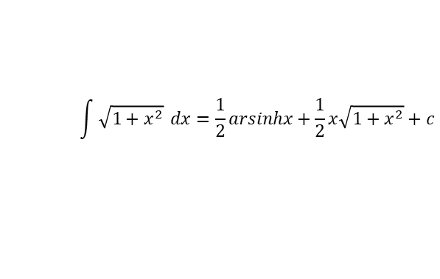














Hyperbolic Functions
$$\frac{d}{dx}\left(\operatorname{arsinh}{x}\right)=\frac{1}{\sqrt{x^{2}+1}}$$
$$\frac{d}{dx}\left(\operatorname{arcosh}{x}\right)=\frac{1}{\sqrt{x^{2} −1}}, x>1$$
$$\frac{d}{dx}\left(artanh x\right)=\frac{1}{1−x^{2}}, \left|x\right|<1$$
$$\frac{d}{dx}\left(\sinh{x}\right)=\cosh{x}$$
$$\frac{d}{dx}\left(\cosh{x}\right)=\sinh{x}$$
$$\frac{d}{dx}\left(\tanh{x}\right)={sech}^{2}x$$
You need to be able to integrate hyperbolic functions
Show that:
Try to use trigonometric identities which have a similar ‘form’ to the expression you are integrating
For example…
$$\int{\sqrt{1+x^{2}}} dx$$
Let $x=\sinh{u}$
→ $arsinhx=u$
→ $\frac{dx}{du}=\cosh{u}$
$$=\int{\sqrt{1+\sinh^{2}u}}\cosh{u du}$$
→ $dx=\cosh{u} du$
Simplify using the relationship we have to the left
$$\int{\sqrt{1+x^{2}}} dx=\frac{1}{2}arsinhx+\frac{1}{2}x\sqrt{1+x^{2}}+c$$
$$=\int{\cosh^{2}x}du$$
Since $\cosh{2x}=2\cosh^{2}x+1$
$$=\int{\frac{\cosh{2u}+1}{2}}du$$
Factorise the half out
$$=\frac{1}{2}\int{\left(\cosh{2u}+1\right)}du$$
Integrate
$$\cosh^{2}x=1+\sinh^{2}x$$
$$=\frac{1}{2}\left(\frac{1}{2}\sinh{2u}+u\right)$$
$$\cosh{x}=\sqrt{1+\sinh^{2}x}$$
Expand the bracket
$$=\frac{1}{4}\sinh{2u}+\frac{1}{2}u+c$$
6E

Slide 14









Hyperbolic Functions
$$\frac{d}{dx}\left(\operatorname{arsinh}{x}\right)=\frac{1}{\sqrt{x^{2}+1}}$$
$$\frac{d}{dx}\left(\operatorname{arcosh}{x}\right)=\frac{1}{\sqrt{x^{2} −1}}, x>1$$
$$\frac{d}{dx}\left(artanh x\right)=\frac{1}{1−x^{2}}, \left|x\right|<1$$
$$\frac{d}{dx}\left(\sinh{x}\right)=\cosh{x}$$
$$\frac{d}{dx}\left(\cosh{x}\right)=\sinh{x}$$
$$\frac{d}{dx}\left(\tanh{x}\right)={sech}^{2}x$$
Let $x=\sinh{u}$
→ $\frac{dx}{du}=\cosh{u}$
You need to be able to integrate hyperbolic functions
Show that:
Try to use trigonometric identities which have a similar ‘form’ to the expression you are integrating
For example…
→ $arsinhx=u$
→ $dx=\cosh{u} du$
$$=\frac{1}{4}\sinh{2u}+\frac{1}{2}u+c$$
$$\int{\sqrt{1+x^{2}}} dx=\frac{1}{2}arsinhx+\frac{1}{2}x\sqrt{1+x^{2}}+c$$
Since $\sinh{2u}=2\sinh{u}\cosh{u}$
$$=\frac{1}{2}\sinh{u}\cosh{u}+\frac{1}{2}u+c$$
$$\cosh^{2}u=1+\sinh^{2}u$$
$$\cosh{u}=\sqrt{1+\sinh^{2}u}$$
From above…
$$=\frac{1}{2}x\sqrt{1+x^{2}}+\frac{1}{2}arsinhx+c$$
$$\cosh{u}=\sqrt{1+x^{2}}$$
$$\cosh^{2}x=1+\sinh^{2}x$$
$$\cosh{x}=\sqrt{1+\sinh^{2}x}$$
6E

Slide 15


















Hyperbolic Functions
$$\frac{d}{dx}\left(\operatorname{arsinh}{x}\right)=\frac{1}{\sqrt{x^{2}+1}}$$
$$\frac{d}{dx}\left(\operatorname{arcosh}{x}\right)=\frac{1}{\sqrt{x^{2} −1}}, x>1$$
$$\frac{d}{dx}\left(artanh x\right)=\frac{1}{1−x^{2}}, \left|x\right|<1$$
$$\frac{d}{dx}\left(\sinh{x}\right)=\cosh{x}$$
$$\frac{d}{dx}\left(\cosh{x}\right)=\sinh{x}$$
$$\frac{d}{dx}\left(\tanh{x}\right)={sech}^{2}x$$
You need to be able to integrate hyperbolic functions
By using a hyperbolic substitution, evaluate:
We can use the same idea as from the previous question.
However, we will need to factorise a 9 out to leave 1 as the constant term, which means we need to ‘create’ a 9 in the squared term via substitution…
$$\int_{0}^{6}{\frac{x^{3}}{\sqrt{x^{2}+9}} dx}$$
Let $x=3\sinh{u}$
→ $\frac{dx}{du}=3\cosh{u}$
→ $dx=3\cosh{u} du$
When $x=0$
When $x=6$
$$\int_{0}^{6}{\frac{x^{3}}{\sqrt{x^{2}+9}} dx}$$
$$0=3\sinh{u}$$
$$6=3\sinh{u}$$
$$0=\sinh{u}$$
$$2=\sinh{u}$$
$$arsinh0=u$$
$$arsinh2=u$$
$$=\int_{arsinh0}^{arsinh2}{\frac{{\left(3\sinh{u}\right)}^{3}}{\sqrt{{\left(3\sinh{u}\right)}^{2}+9}}3cosh u{du}}$$
Simplify terms
$$\cosh{x}=\sqrt{\sinh^{2}x+1}$$
$$=\int_{arsinh0}^{arsinh2}{\frac{27\sinh^{3}u}{\sqrt{{9sinh}^{2}u+9}}3cosh u{du}}$$
Write the denominator as two square roots
$$=\int_{arsinh0}^{arsinh2}{\frac{27\sinh^{3}u}{\sqrt{9}\sqrt{\left(\sinh^{2}u+1\right)}}3cosh u{du}}$$
Now we can use the rule to the left, since the 9 has been factored away!
$$=\int_{arsinh0}^{arsinh2}{\frac{27\sinh^{3}u}{3\cosh{u}}3cosh u{du}}$$
6E

Slide 16
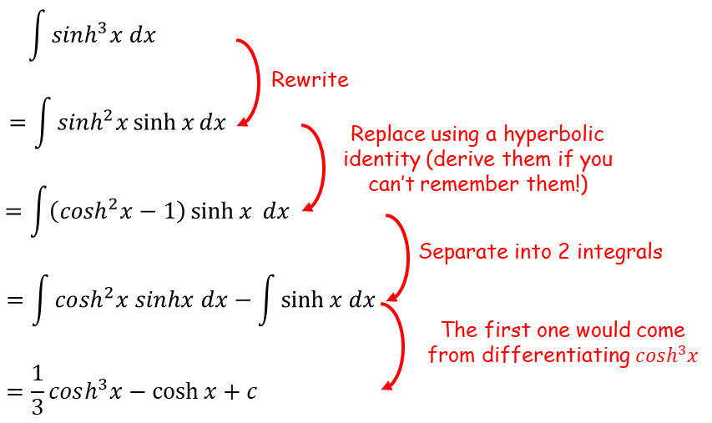













Hyperbolic Functions
$$\frac{d}{dx}\left(\operatorname{arsinh}{x}\right)=\frac{1}{\sqrt{x^{2}+1}}$$
$$\frac{d}{dx}\left(\operatorname{arcosh}{x}\right)=\frac{1}{\sqrt{x^{2} −1}}, x>1$$
$$\frac{d}{dx}\left(artanh x\right)=\frac{1}{1−x^{2}}, \left|x\right|<1$$
$$\frac{d}{dx}\left(\sinh{x}\right)=\cosh{x}$$
$$\frac{d}{dx}\left(\cosh{x}\right)=\sinh{x}$$
$$\frac{d}{dx}\left(\tanh{x}\right)={sech}^{2}x$$
You need to be able to integrate hyperbolic functions
By using a hyperbolic substitution, evaluate:
We can use the same idea as from the previous question.
However, we will need to factorise a 9 out to leave 1 as the constant term, which means we need to ‘create’ a 9 in the squared term via substitution…
$$=\int_{arsinh0}^{arsinh2}{\frac{27\sinh^{3}u}{3\cosh{u}}3cosh u{du}}$$
Simplify and factor the 27 out
$$=27\int_{arsinh0}^{arsinh2}{\sinh^{3}u} du$$
Integrate!
We did the integration of this earlier!
$$\int_{0}^{6}{\frac{x^{3}}{\sqrt{x^{2}+9}} dx}$$
$$=27{\left[\frac{1}{3}cosh^{3}u−\cosh{u}\right]}_{arsinh0}^{arsinh2}$$
Replace cos terms
$$=27\left(\left(\frac{1}{3}{\left(\sqrt{5}\right)}^{3}−\sqrt{5}\right)−\left(\frac{1}{3}{\left(\sqrt{1}\right)}^{3}−\sqrt{1}\right)\right)$$
Simplify
$$=18\sqrt{5}+18$$
If $u=arsinh2$
$$\cosh{x}=\sqrt{\sinh^{2}x+1}$$
→ $sinh u=2$
$$\cosh{u}=\sqrt{\sinh^{2}u+1}$$
$$\cosh{u}=\sqrt{5}$$
If $u=arsinh0$
→ $sinh u=0$
$$\cosh{u}=\sqrt{\sinh^{2}u+1}$$
$$\cosh{u}=\sqrt{1}$$
6E

Slide 17
















Hyperbolic Functions
$$\int{\frac{1}{\sqrt{a^{2}+x^{2}}}dx=arsinh\left(\frac{x}{a}\right)+c}$$
$$\int{\frac{1}{\sqrt{x^{2}−a^{2}}}dx=arcosh\left(\frac{x}{a}\right)+c}, x>a$$
$$\frac{d}{dx}\left(\sinh{x}\right)=\cosh{x}$$
$$\frac{d}{dx}\left(\cosh{x}\right)=\sinh{x}$$
$$\frac{d}{dx}\left(\tanh{x}\right)={sech}^{2}x$$
$$\int{\frac{1}{\sqrt{12x+{2x}^{2}}} dx}$$
You need to be able to integrate hyperbolic functions
Find:
Sometimes completing the square can enable you to use one of the rules above…
Rewrite the part in the root
$$=\int{\frac{1}{\sqrt{2\left[{\left(x+3\right)}^{2}−9\right]}} dx}$$
Let $u=x+3$
→ $\frac{du}{dx}=1$
$$\int{\frac{1}{\sqrt{12x+{2x}^{2}}} dx}$$
$$=\int{\frac{1}{\sqrt{2\left(u^{2}−9\right)}} du}$$
→ $du=dx$
Factor out the $\frac{1}{\sqrt{2}}$ term
$$=\frac{1}{\sqrt{2}}\int{\frac{1}{\sqrt{u^{2}−9}} du}$$
Integrate using the rule above and $a=3$
$$12x+{2x}^{2}$$
$$=\frac{1}{\sqrt{2}}arcosh\left(\frac{u}{3}\right)+c$$
Factor the 2 out
Replace $u$ with the original substitution
$$=2\left(x^{2}+6x\right)$$
Complete the square for the inner part
$$=\frac{1}{\sqrt{2}}arcosh\left(\frac{x+3}{3}\right)+c$$
$$=2\left[{\left(x+3\right)}^{2}−9\right]$$
6E

Slide 18
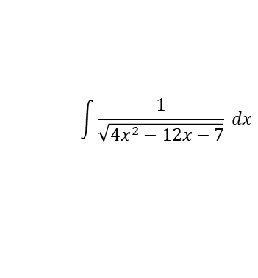
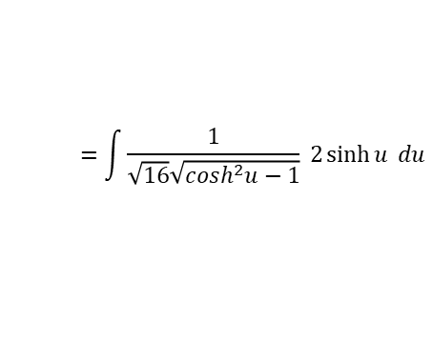

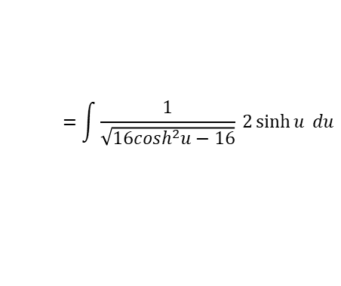

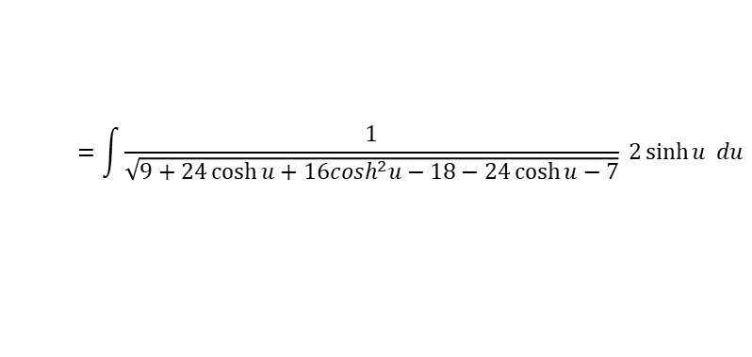


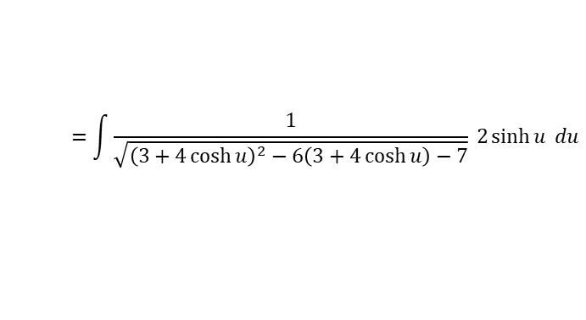

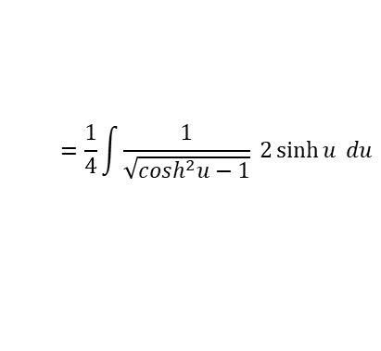

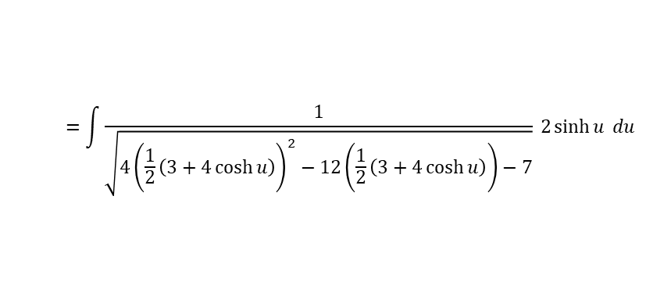
Hyperbolic Functions
$$\frac{d}{dx}\left(\operatorname{arsinh}{x}\right)=\frac{1}{\sqrt{x^{2}+1}}$$
$$\frac{d}{dx}\left(\operatorname{arcosh}{x}\right)=\frac{1}{\sqrt{x^{2} −1}}, x>1$$
$$\frac{d}{dx}\left(artanh x\right)=\frac{1}{1−x^{2}}, \left|x\right|<1$$
$$\frac{d}{dx}\left(\sinh{x}\right)=\cosh{x}$$
$$\frac{d}{dx}\left(\cosh{x}\right)=\sinh{x}$$
$$\frac{d}{dx}\left(\tanh{x}\right)={sech}^{2}x$$
$$\int{\frac{1}{\sqrt{{4x}^{2}−12x−7}} dx}$$
You need to be able to integrate hyperbolic functions
Use the substitution
$x=\frac{1}{2}\left(3+4\cosh{u}\right)$ to find:
Replace using the substitution
$$=\int{\frac{1}{\sqrt{{4\left(\frac{1}{2}\left(3+4\cosh{u}\right)\right)}^{2}−12\left(\frac{1}{2}\left(3+4\cosh{u}\right)\right)−7}} 2\sinh{u} du}$$
Simplify denominator
$$=\int{\frac{1}{\sqrt{{\left(3+4\cosh{u}\right)}^{2}−6\left(3+4\cosh{u}\right)−7}} 2\sinh{u} du}$$
$$\int{\frac{1}{\sqrt{{4x}^{2}−12x−7}} dx}$$
Multiply out brackets
$$=\int{\frac{1}{\sqrt{9+24\cosh{u}+16\cosh^{2}u−18−24\cosh{u}−7}} 2\sinh{u} du}$$
Simplify the root
$$x=\frac{1}{2}\left(3+4\cosh{u}\right)$$
$$=\int{\frac{1}{\sqrt{16\cosh^{2}u−16}} 2\sinh{u} du}$$
Differentiate
$$\frac{dx}{du}=2\sinh{u}$$
Rewrite denominator
Rearrange
$$=\int{\frac{1}{\sqrt{16}\sqrt{\cosh^{2}u−1}} 2\sinh{u} du}$$
$$dx=2\sinh{u} du$$
You can factor the $\frac{1}{\sqrt{16}}$ out as $\frac{1}{4}$
$$=\frac{1}{4}\int{\frac{1}{\sqrt{\cosh^{2}u−1}} 2\sinh{u} du}$$
6E

Slide 19


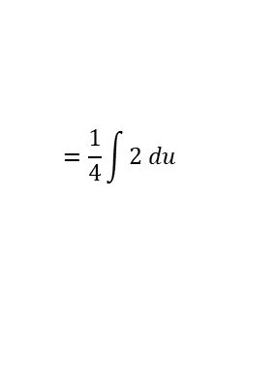



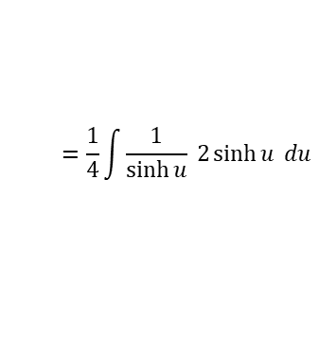

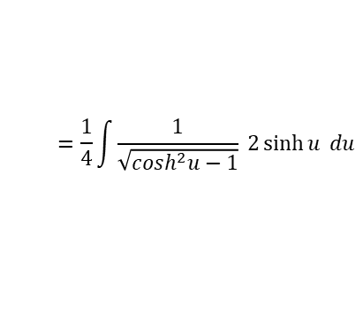


Hyperbolic Functions
$$\frac{d}{dx}\left(\operatorname{arsinh}{x}\right)=\frac{1}{\sqrt{x^{2}+1}}$$
$$\frac{d}{dx}\left(\operatorname{arcosh}{x}\right)=\frac{1}{\sqrt{x^{2} −1}}, x>1$$
$$\frac{d}{dx}\left(artanh x\right)=\frac{1}{1−x^{2}}, \left|x\right|<1$$
$$\frac{d}{dx}\left(\sinh{x}\right)=\cosh{x}$$
$$\frac{d}{dx}\left(\cosh{x}\right)=\sinh{x}$$
$$\frac{d}{dx}\left(\tanh{x}\right)={sech}^{2}x$$
You need to be able to integrate hyperbolic functions
Use the substitution
$x=\frac{1}{2}\left(3+4\cosh{u}\right)$ to find:
$$=\frac{1}{4}\int{\frac{1}{\sqrt{\cosh^{2}u−1}} 2\sinh{u} du}$$
Simplify the denominator using an identity
$$=\frac{1}{4}\int{\frac{1}{\sinh{u}} 2\sinh{u} du}$$
Simplify the integral
$$=\frac{1}{4}\int{2 du}$$
$$\int{\frac{1}{\sqrt{{4x}^{2}−12x−7}} dx}$$
Integrate
$$=\frac{1}{4}\left(2u\right)+c$$
$x=\frac{1}{2}\left(3+4\cosh{u}\right)$
Simplify
Rearrange
$$=\frac{1}{2}u+c$$
$$\frac{2x−3}{4}=\cosh{u}$$
Inverse $cosh⁡$
Replace $u$
$$arcosh\left(\frac{2x−3}{4}\right)=u$$
$$=\frac{1}{2}arcosh\left(\frac{2x−3}{4}\right)+c$$
6E

