Slide 1
6.5) Integrating hyperbolic functions

Slide 2
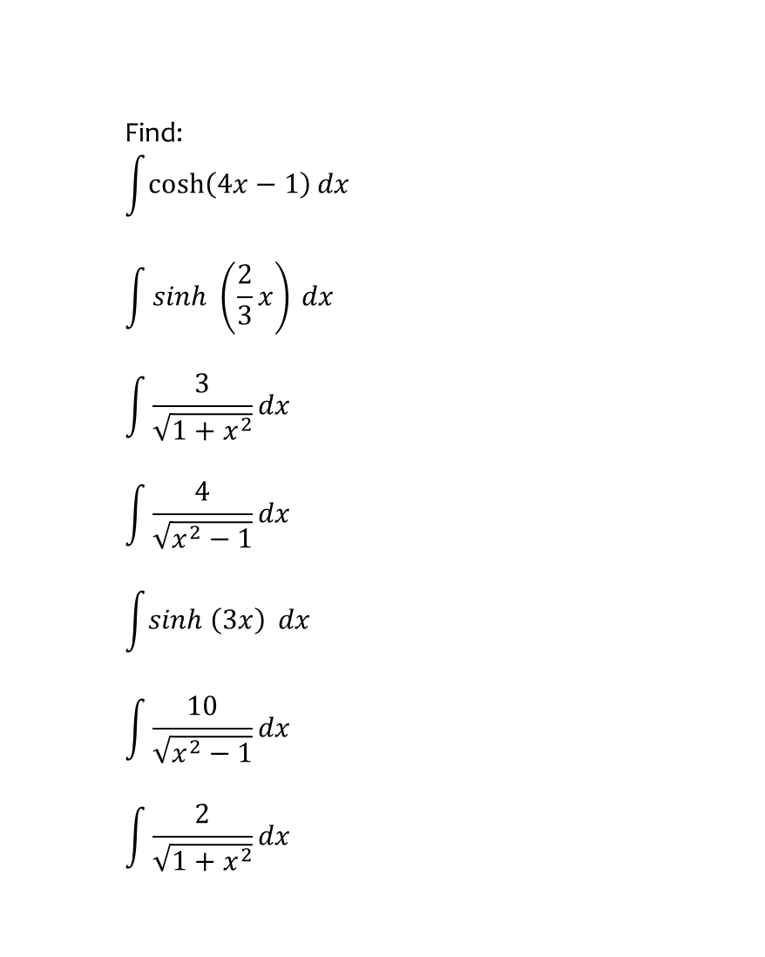
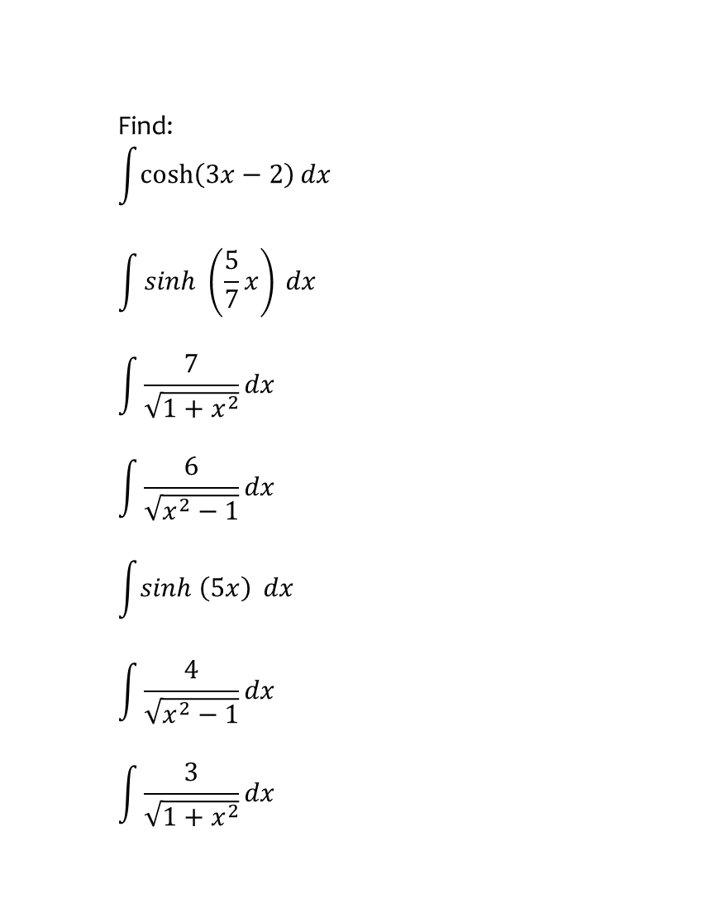

Worked example
Your turn
Find:
$$\int{\cosh\left(3x−2\right)dx}$$
$$\int{sinh \left(\frac{5}{7}x\right)} dx$$
$$\int{\frac{7}{\sqrt{1+x^{2}}}dx}$$
$$\int{\frac{6}{\sqrt{x^{2}−1}}dx}$$
$$\int{sinh \left(5x\right)} dx$$
$$\int{\frac{4}{\sqrt{x^{2}−1}}dx}$$
$$\int{\frac{3}{\sqrt{1+x^{2}}}dx}$$
Find:
$$\int{\cosh\left(4x−1\right)dx}$$
$$\int{sinh \left(\frac{2}{3}x\right)} dx$$
$$\int{\frac{3}{\sqrt{1+x^{2}}}dx}$$
$$\int{\frac{4}{\sqrt{x^{2}−1}}dx}$$
$$\int{sinh \left(3x\right)} dx$$
$$\int{\frac{10}{\sqrt{x^{2}−1}}dx}$$
$$\int{\frac{2}{\sqrt{1+x^{2}}}dx}$$
$$\frac{1}{4}\sinh\left(4x−1\right)+c$$
$$\frac{3}{2}\cosh\left(\frac{2}{3}x\right)+c$$
$$3 arsinh x+c$$
$$4 arcosh x+c$$
$$\frac{1}{3}\cosh\left(3x\right)+c$$
$$10 arcosh x+c$$
$$2 arsinh x+c$$

Slide 3
Worked example
Your turn
Find:
$$\int{\frac{3−7x}{\sqrt{x^{2}+1}} dx}$$
Find:
$$\int{\frac{2+5x}{\sqrt{x^{2}+1}} dx}$$
$$2 arsinh x+5\sqrt{1+x^{2}}+c$$

Slide 4
Worked example
Your turn
Find:
$$\int{\sinh^{7}{3x}\cosh{3x} dx}$$
Find:
$$\int{\cosh^{5}{2x}\sinh{2x} dx}$$
$$\frac{1}{12}\cosh^{6}{2x}+c$$

Slide 5
Worked example
Your turn
Find:
$$\int{\coth{x} dx}$$
Find:
$$\int{\tanh{x} dx}$$
$$\ln\left|\cosh{x}\right|+C$$

Slide 6
Worked example
Your turn
Find:
$$\int{\sinh^{2}{5x} dx}$$
Find:
$$\int{\cosh^{2}{3x} dx}$$
$$\frac{1}{2}x+\frac{1}{12}\sinh{6x}+c$$

Slide 7
Worked example
Your turn
Find:
$$\int{\cosh^{3}{x} dx}$$
Find:
$$\int{\sinh^{3}{x} dx}$$
$$\frac{1}{3}\cosh^{3}{x}−\cosh{x}+c$$

Slide 8
Worked example
Your turn
Find:
$$\int{e^{3x}\cosh{x} dx}$$
Find:
$$\int{e^{2x}\sinh{x} dx}$$
$$\frac{1}{6}\left(e^{3x}−3e^{x}\right)+c$$

Slide 9
Worked example
Your turn
Find:
$$\int{cosech x dx}$$
(requires partial fractions)
Find:
$$\int{\operatorname{sech}{x} dx}$$
$$2\arctan\left(e^{x}\right)+c$$

Slide 10
Worked example
Your turn
Show that $\int{\frac{1}{\sqrt{a^{2}+x^{2}}}dx}=arsinh \left(\frac{x}{a}\right)+c$
Show that $\int{\frac{1}{\sqrt{x^{2}−a^{2}}}dx}=arcosh \left(\frac{x}{a}\right)+c$
Shown

Slide 11
Worked example
Your turn
Evaluate $\int_{5}^{8}{\frac{1}{\sqrt{x^{2}+16}}dx}$
Evaluate $\int_{5}^{8}{\frac{1}{\sqrt{x^{2}−16}}dx}$
$$\ln\left(\frac{2+\sqrt{3}}{2}\right)$$

Slide 12
Worked example
Your turn
By using a hyperbolic substitution, show that
$$\int{\sqrt{x^{2}−1} dx}=\frac{1}{2}x\sqrt{x^{2}−1}−\frac{1}{2}arcosh x+c$$
By using a hyperbolic substitution, show that
$$\int{\sqrt{1+x^{2}} dx}=\frac{1}{2}arsinh x+\frac{1}{2}x\sqrt{1+x^{2}}+c$$
Shown using $x=\sinh{u}$
NB: Can also use $x=\tan{u }$but longer

Slide 13
Worked example
Your turn
Using a hyperbolic substitution, evaluate
$$\int_{4}^{8}{\frac{x^{3}}{\sqrt{x^{2}−16}} dx}$$
Using a hyperbolic substitution, evaluate
$$\int_{0}^{6}{\frac{x^{3}}{\sqrt{x^{2}+9}} dx}$$
$$18\sqrt{5}+18$$

Slide 14
Worked example
Your turn
Find:
$$\int{\frac{1}{\sqrt{12x+3x^{2}}}dx}$$
Find:
$$\int{\frac{1}{\sqrt{12x+2x^{2}}}dx}$$
$$\frac{1}{\sqrt{2}}arcosh \left(\frac{x+3}{3}\right)+C$$

Slide 15
Worked example
Your turn
Find:
$$\int{\frac{1}{x^{2}−6x−3}dx}$$
Find:
$$\int{\frac{1}{x^{2}−8x+8}dx}$$
$$\frac{\sqrt{2}}{8}\ln\left|\frac{x−4−2\sqrt{2}}{x−4+2\sqrt{2}}\right|+C$$

Slide 16
Worked example
Your turn
Evaluate:
$$\int_{0}^{1}{\frac{1}{\sqrt{x^{2}+8x+17}}dx}$$
Evaluate:
$$\int_{0}^{1}{\frac{1}{\sqrt{x^{2}+2x+5}}dx}$$
$0.400$ (3 sf)

Slide 17
Worked example
Your turn
Find:
$$\int{\frac{1}{\sqrt{9x^{2}+4}}dx}$$
Find:
$$\int{\frac{1}{\sqrt{4x^{2}+9}}dx}$$
$$\frac{1}{2}arsinh \left(\frac{2x}{3}\right)+c$$

Slide 18
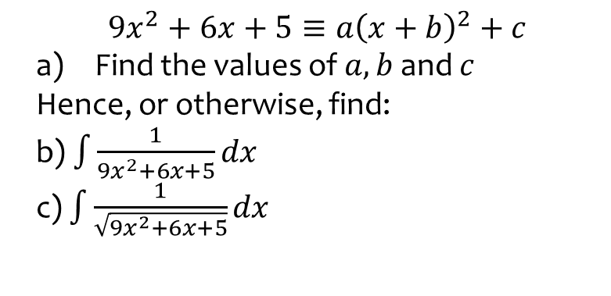
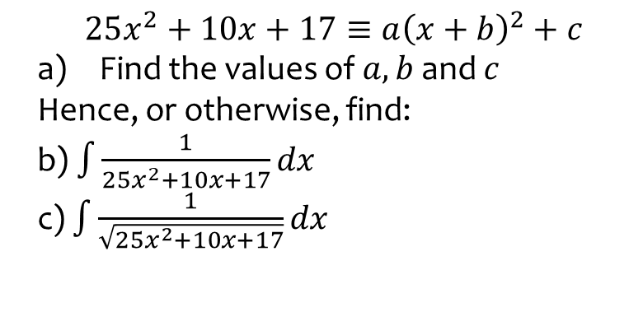
Worked example
Your turn
$$25x^{2}+10x+17≡a{\left(x+b\right)}^{2}+c$$
Find the values of $a, b$and $c$
Hence, or otherwise, find:
b) $\int{\frac{1}{25x^{2}+10x+17}dx}$
c) $\int{\frac{1}{\sqrt{25x^{2}+10x+17}}dx}$
$$9x^{2}+6x+5≡a{\left(x+b\right)}^{2}+c$$
Find the values of $a, b$and $c$
Hence, or otherwise, find:
b) $\int{\frac{1}{9x^{2}+6x+5}dx}$
c) $\int{\frac{1}{\sqrt{9x^{2}+6x+5}}dx}$
a) $a=9, b=\frac{1}{3}, c=4$
b) $\frac{1}{6}\arctan{\frac{3x+1}{2}}+c$
c) $\frac{1}{3}arsinh\frac{3x+1}{2}+c$

