Slide 1
6.4) Inverting a 2 x 2 matrix

Slide 2



Worked example
Your turn
Find the inverse matrix for:
$$\left(\begin{matrix}2 & 0 \\ 0 & 2\end{matrix}\right)$$
$$\left(\begin{matrix}1 & 2 \\ 3 & 4\end{matrix}\right)$$
$$\left(\begin{matrix}4 & 3 \\ −2 & −1\end{matrix}\right)$$
Find the inverse matrix for
$$\left(\begin{matrix}1 & −2 \\ 3 & −4\end{matrix}\right)$$
$\frac{1}{2}\left(\begin{matrix}−4 & 2 \\ −3 & 1\end{matrix}\right)$ or $\left(\begin{matrix}−2 & 1 \\ −\frac{3}{2} & \frac{1}{2}\end{matrix}\right)$

Slide 3



Worked example
Your turn
For what value of $p$ is $\left(\begin{matrix}1 & 2−p \\ −4 & p+3\end{matrix}\right)$ singular?
Given $p$ is not this value, find the inverse.
For what value of $p$ is $\left(\begin{matrix}4 & p+2 \\ −1 & 3−p\end{matrix}\right)$ singular?
Given $p$ is not this value, find the inverse.
$$p=\frac{14}{3}$$
$$\frac{1}{14−3p} \left(\begin{matrix}3−p & −\left(p+2\right) \\ 1 & 4\end{matrix}\right)$$

Slide 4


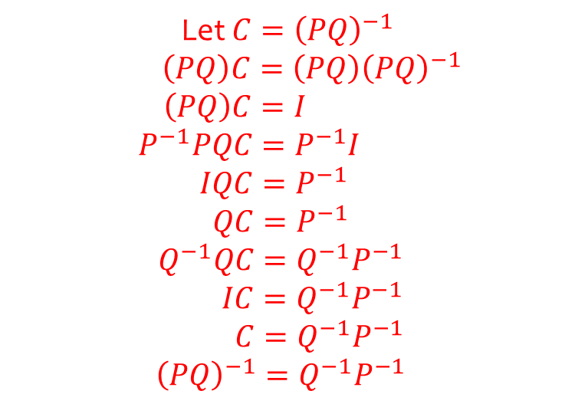
Worked example
Your turn
If $A$ and $B$ are non-singular matrices, prove that ${\left(AB\right)}^{−1}=B^{−1}A^{−1}$
If $P$ and $Q$ are non-singular matrices, prove that ${\left(PQ\right)}^{−1}=Q^{−1}P^{−1}$
Let $C={\left(PQ\right)}^{−1}$
$\left(PQ\right)C=\left(PQ\right){\left(PQ\right)}^{−1}$
$$\left(PQ\right)C=I$$
$$P^{−1}PQC=P^{−1}I$$
$$IQC=P^{−1}$$
$$QC=P^{−1}$$
$$Q^{−1}QC=Q^{−1}P^{−1}$$
$IC=Q^{−1}P^{−1}$
$C=Q^{−1}P^{−1}$
$${\left(PQ\right)}^{−1}=Q^{−1}P^{−1}$$

Slide 5
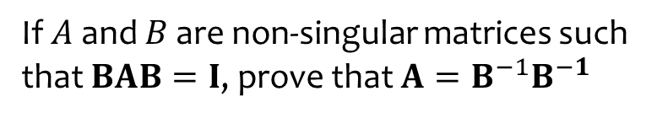
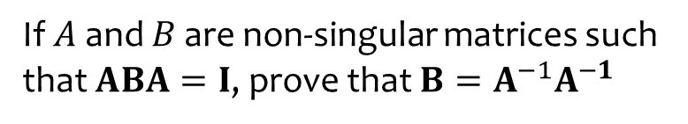
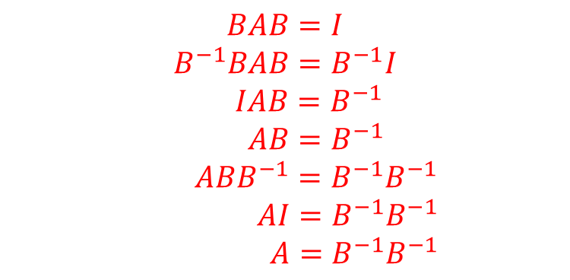
Worked example
Your turn
If $A$ and $B$ are non-singular matrices such that $ABA=I$, prove that $B=A^{−1}A^{−1}$
If $A$ and $B$ are non-singular matrices such that $BAB=I$, prove that $A=B^{−1}B^{−1}$
$$BAB=I$$
$$B^{−1}BAB=B^{−1}I$$
$IAB=B^{−1}$
$AB=B^{−1}$
$ABB^{−1}=B^{−1}B^{−1}$
$AI=B^{−1}B^{−1}$
$A=B^{−1}B^{−1}$

