Slide 1
Teachings for
Exercise 6D

Slide 2











Hyperbolic Functions
$$sinhx=\frac{e^{x}−e^{−x}}{2}$$
$$\frac{d}{dx}\left(\sinh{x}\right)=\cosh{x}$$
$$coshx=\frac{e^{x}+e^{−x}}{2}$$
$$tanhx=\frac{e^{2x}−1}{e^{2x}+1}$$
You need to be able to differentiate hyperbolic functions
Show that $\frac{d}{dx}\left(\sinh{x}\right)=\cosh{x}$
$$\sinh{x}=\frac{e^{x}−e^{−x}}{2}$$
Differentiate both sides
$$\frac{d}{dx}\left(\sinh{x}\right)=\frac{d}{dx}\left(\frac{e^{x}−e^{−x}}{2}\right)$$
Work out the right side
$$\frac{d}{dx}\left(\sinh{x}\right)=\frac{e^{x}+e^{−x}}{2}$$
The right side is the definition of $\cosh{x}$
This means the differential of $\sinh{x}$
$$\frac{d}{dx}\left(\sinh{x}\right)=\cosh{x}$$
6D

Slide 3







Hyperbolic Functions
$$sinhx=\frac{e^{x}−e^{−x}}{2}$$
$$\frac{d}{dx}\left(\sinh{x}\right)=\cosh{x}$$
$$coshx=\frac{e^{x}+e^{−x}}{2}$$
$$\frac{d}{dx}\left(\cosh{x}\right)=\sinh{x}$$
$$tanhx=\frac{e^{2x}−1}{e^{2x}+1}$$
You need to be able to differentiate hyperbolic functions
Show that $\frac{d}{dx}\left(\cosh{x}\right)=\sinh{x}$
$$\cosh{x}=\frac{e^{x}+e^{−x}}{2}$$
Differentiate both sides
$$\frac{d}{dx}\left(\cosh{x}\right)=\frac{d}{dx}\left(\frac{e^{x}+e^{−x}}{2}\right)$$
Work out the right side
$$\frac{d}{dx}\left(\cosh{x}\right)=\frac{e^{x}−e^{−x}}{2}$$
The right side is the definition of $\sinh{x}$
$$\frac{d}{dx}\left(\cosh{x}\right)=\sinh{x}$$
Notice that, unlike for regular trigonometry, cosine → sine does not become negative
6D

Slide 4

















Hyperbolic Functions
$$sinhx=\frac{e^{x}−e^{−x}}{2}$$
$$\frac{d}{dx}\left(\sinh{x}\right)=\cosh{x}$$
$$coshx=\frac{e^{x}+e^{−x}}{2}$$
$$\frac{d}{dx}\left(\cosh{x}\right)=\sinh{x}$$
$$tanhx=\frac{e^{2x}−1}{e^{2x}+1}$$
$$\frac{d}{dx}\left(\tanh{x}\right)={sech}^{2}x$$
You need to be able to differentiate hyperbolic functions
Show that $\frac{d}{dx}\left(\tanh{x}\right)=sech^{2} x$
$$\tanh{x}=\frac{\sinh{x}}{\cosh{x}}$$
Differentiate both sides
$$\frac{d}{dx}\left(\tanh{x}\right)=\frac{d}{dx}\left(\frac{\sinh{x}}{\cosh{x}}\right)$$
Work out right side using the quotient rule
Using the quotient rule
$$\frac{d}{dx}\left(\tanh{x}\right)=$$
$$\frac{\left(\cosh{x}\right)\left(\cosh{x}\right)−\left(\sinh{x}\right)\left(\sinh{x}\right)}{{\left(\cosh{x}\right)}^{2}}$$
Simplify numerator
$$\frac{d}{dx}\left(\frac{u}{v}\right)=\frac{v\frac{du}{dx}−u\frac{dv}{dx}}{v^{2}}$$
$$\frac{d}{dx}\left(\tanh{x}\right)=\frac{{\left(\cosh{x}\right)}^{2}−{\left(\sinh{x}\right)}^{2}}{{\left(\cosh{x}\right)}^{2}}$$
$$\cosh^{2}x−sinh^{2}x≡1$$
Divide all by $\cosh^{2}x$
Simplify
$$u=\sinh{x}$$
$$v=\cosh{x}$$
$$\frac{d}{dx}\left(\tanh{x}\right)=1−\tanh^{2} x$$
$$1−\tanh^{2}x≡{sech}^{2}x$$
$$\frac{du}{dx}=\cosh{x}$$
$$\frac{dv}{dx}=\sinh{x}$$
Rewrite
$$\frac{d}{dx}\left(\tanh{x}\right)={sech}^{2} x$$
6D

Slide 5



Hyperbolic Functions
$$sinhx=\frac{e^{x}−e^{−x}}{2}$$
$$\frac{d}{dx}\left(\sinh{x}\right)=\cosh{x}$$
$$coshx=\frac{e^{x}+e^{−x}}{2}$$
$$\frac{d}{dx}\left(\cosh{x}\right)=\sinh{x}$$
$$tanhx=\frac{e^{2x}−1}{e^{2x}+1}$$
$$\frac{d}{dx}\left(\tanh{x}\right)={sech}^{2}x$$
You need to be able to differentiate hyperbolic functions
Differentiate $\cosh{3x}$ with respect to $x$
$$\frac{d}{dx}\left(\cosh{3x}\right)$$
Using the chain rule, it will follow the same patterns as regular trigonometry
$$=3\sinh{3x}$$
6D

Slide 6





Hyperbolic Functions
$$sinhx=\frac{e^{x}−e^{−x}}{2}$$
$$\frac{d}{dx}\left(\sinh{x}\right)=\cosh{x}$$
$$coshx=\frac{e^{x}+e^{−x}}{2}$$
$$\frac{d}{dx}\left(\cosh{x}\right)=\sinh{x}$$
$$tanhx=\frac{e^{2x}−1}{e^{2x}+1}$$
$$\frac{d}{dx}\left(\tanh{x}\right)={sech}^{2}x$$
You need to be able to differentiate hyperbolic functions
Differentiate $x^{2}\cosh{4x}$ with respect to $x$
$$\frac{d}{dx}\left(x^{2}\cosh{4x}\right)$$
Using the product rule – you might find it quick to write it this way!
$$=\left(x^{2}\right)\frac{d}{dx}\left(\cosh{4x}\right)+\left(\cosh{4x}\right)\frac{d}{dx}\left(x^{2}\right)$$
Calculate the differentials and simplify
$$=4x^{2}\sinh{4x}+2xcosh 4x$$
Product rule
$$\frac{d}{dx}\left(uv\right)=u\frac{dv}{dx}+v\frac{du}{dx}$$
6D

Slide 7


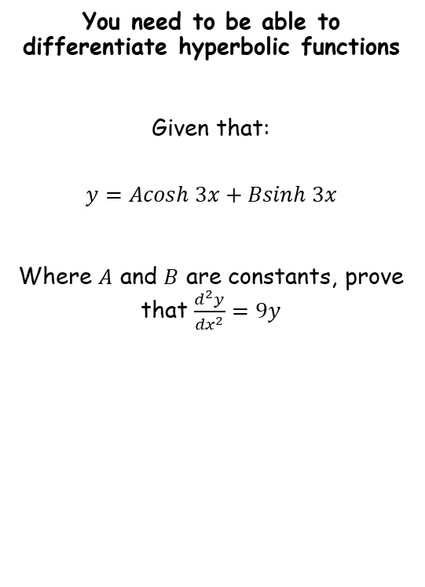



Hyperbolic Functions
$$sinhx=\frac{e^{x}−e^{−x}}{2}$$
$$\frac{d}{dx}\left(\sinh{x}\right)=\cosh{x}$$
$$coshx=\frac{e^{x}+e^{−x}}{2}$$
$$\frac{d}{dx}\left(\cosh{x}\right)=\sinh{x}$$
$$tanhx=\frac{e^{2x}−1}{e^{2x}+1}$$
$$\frac{d}{dx}\left(\tanh{x}\right)={sech}^{2}x$$
You need to be able to differentiate hyperbolic functions
Given that:
$$y=Acosh 3x+Bsinh 3x$$
Where $A$ and $B$ are constants, prove that $\frac{d^{2}y}{{dx}^{2}}=9y$
$$y=Acosh 3x+Bsinh 3x$$
Differentiate
$$\frac{dy}{dx}=3Asinh 3x+3Bcosh 3x$$
Differentiate again
$$\frac{d^{2}y}{{dx}^{2}}=9Acosh 3x+9Bsinh 3x$$
Factorise
$$=9\left(Acosh 3x+Bsinh 3x\right)$$
Rewrite using the original statement
$$=9y$$
6D

Slide 8


















Hyperbolic Functions
$$sinhx=\frac{e^{x}−e^{−x}}{2}$$
$$\frac{d}{dx}\left(\operatorname{arsinh}{x}\right)=\frac{1}{\sqrt{x^{2}+1}}$$
$$\frac{d}{dx}\left(\operatorname{arcosh}{x}\right)=\frac{1}{\sqrt{x^{2} −1}}, x>1$$
$$\frac{d}{dx}\left(artanh x\right)=\frac{1}{1−x^{2}}, \left|x\right|<1$$
$$\frac{d}{dx}\left(\sinh{x}\right)=\cosh{x}$$
$$coshx=\frac{e^{x}+e^{−x}}{2}$$
$$\frac{d}{dx}\left(\cosh{x}\right)=\sinh{x}$$
$$tanhx=\frac{e^{2x}−1}{e^{2x}+1}$$
$$\frac{d}{dx}\left(\tanh{x}\right)={sech}^{2}x$$
You need to be able to differentiate hyperbolic functions
Show that $\frac{d}{dx}\left(arcosh x\right)=\frac{1}{\sqrt{x^{2}−1}}, x>1$
Let $y=arcosh x$
$y=arcosh x$
Rewrite
$\cosh{y}=x$
Differentiate
$sinhy=\frac{dx}{dy}$
Invert
$\frac{1}{sinhy}=\frac{dy}{dx}$
Replace $\sinh{y}$ with an equivalent expression
$\frac{1}{\sqrt{\cosh^{2}y −1}}=\frac{dy}{dx}$
Earlier, we said that $coshy=x$
$$\cos^{2}y+\sin^{2}y≡1$$
Osborn’s rule
$\frac{1}{\sqrt{x^{2} −1}}=\frac{dy}{dx}$
$$\cosh^{2}y−\sinh^{2}y≡1$$
Rearrange
$$\cosh^{2}y−1≡\sinh^{2}y$$
The part $x>1$ is for the square root!
Square root
$$\sqrt{\cosh^{2}y−1}≡\sinh{y}$$
You can follow similar processes for differentiating $arsinh x$ and $artanh x$
6D

Slide 9




Hyperbolic Functions
$$\frac{d}{dx}\left(\operatorname{arsinh}{x}\right)=\frac{1}{\sqrt{x^{2}+1}}$$
$$\frac{d}{dx}\left(\operatorname{arcosh}{x}\right)=\frac{1}{\sqrt{x^{2} −1}}, x>1$$
$$\frac{d}{dx}\left(artanh x\right)=\frac{1}{1−x^{2}}, \left|x\right|<1$$
$$\frac{d}{dx}\left(\sinh{x}\right)=\cosh{x}$$
$$\frac{d}{dx}\left(\cosh{x}\right)=\sinh{x}$$
$$\frac{d}{dx}\left(\tanh{x}\right)={sech}^{2}x$$
You need to be able to differentiate hyperbolic functions
Given $y=xarcosh x$, find $\frac{dy}{dx}$
$$y=xarcosh x$$
Use the product rule and the quicker notation we used before…
$$\frac{dy}{dx}=\left(x\right)\frac{d}{dx}\left(arcosh x\right)+(arcosh x)\frac{d}{dx}\left(x\right)$$
$$\frac{dy}{dx}=\frac{x}{\sqrt{x^{2} −1}}+arcosh x$$
Work out each term
6D

Slide 10




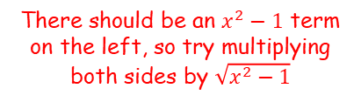
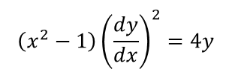
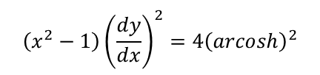
Hyperbolic Functions
$$\frac{d}{dx}\left(\operatorname{arsinh}{x}\right)=\frac{1}{\sqrt{x^{2}+1}}$$
$$\frac{d}{dx}\left(\operatorname{arcosh}{x}\right)=\frac{1}{\sqrt{x^{2} −1}}, x>1$$
$$\frac{d}{dx}\left(artanh x\right)=\frac{1}{1−x^{2}}, \left|x\right|<1$$
$$\frac{d}{dx}\left(\sinh{x}\right)=\cosh{x}$$
$$\frac{d}{dx}\left(\cosh{x}\right)=\sinh{x}$$
$$\frac{d}{dx}\left(\tanh{x}\right)={sech}^{2}x$$
You need to be able to differentiate hyperbolic functions
Given $y={\left(arcosh x\right)}^{2}$, prove that:
$$\left(x^{2}−1\right){\left(\frac{dy}{dx}\right)}^{2}=4y$$
$$y={\left(arcosh x\right)}^{2}$$
Differentiate using the chain rule
$$\frac{dy}{dx}=2{(arcoshx)}^{1}\left(\frac{1}{\sqrt{x^{2} −1}}\right)$$
→ Look at the ‘target’
There should be an $x^{2}−1$ term on the left, so try multiplying both sides by $\sqrt{x^{2}−1}$
$$\sqrt{x^{2}−1}\frac{dy}{dx}=2arcoshx$$
$$\left(x^{2}−1\right){\left(\frac{dy}{dx}\right)}^{2}={4\left(arcosh\right)}^{2}$$
Square both sides
Replace using the original relationship
$$\left(x^{2}−1\right){\left(\frac{dy}{dx}\right)}^{2}=4y$$
With this type of question, do keep checking what you are aiming for as it can help you decide how to proceed!
6D

Slide 11









Hyperbolic Functions
$$\frac{d}{dx}\left(\operatorname{arsinh}{x}\right)=\frac{1}{\sqrt{x^{2}+1}}$$
$$\frac{d}{dx}\left(\operatorname{arcosh}{x}\right)=\frac{1}{\sqrt{x^{2} −1}}, x>1$$
$$\frac{d}{dx}\left(artanh x\right)=\frac{1}{1−x^{2}}, \left|x\right|<1$$
$$\frac{d}{dx}\left(\sinh{x}\right)=\cosh{x}$$
$$\frac{d}{dx}\left(\cosh{x}\right)=\sinh{x}$$
$$\frac{d}{dx}\left(\tanh{x}\right)={sech}^{2}x$$
You need to be able to differentiate hyperbolic functions
Show that $\frac{d}{dx}\left(arsinh x\right)=\frac{1}{\sqrt{1+x^{2}}}$
$y=arsinh x$
Rewrite
$\sinh{y}=x$
Differentiate
$coshy=\frac{dx}{dy}$
Invert
$\frac{1}{coshy}=\frac{dy}{dx}$
Replace $\cosh{y}$ with an equivalent expression
$\frac{1}{\sqrt{{1+sinh}^{2}y }}=\frac{dy}{dx}$
Earlier, we said that $sinhy=x$
$\frac{1}{\sqrt{1+x^{2}}}=\frac{dy}{dx}$
6D

Slide 12




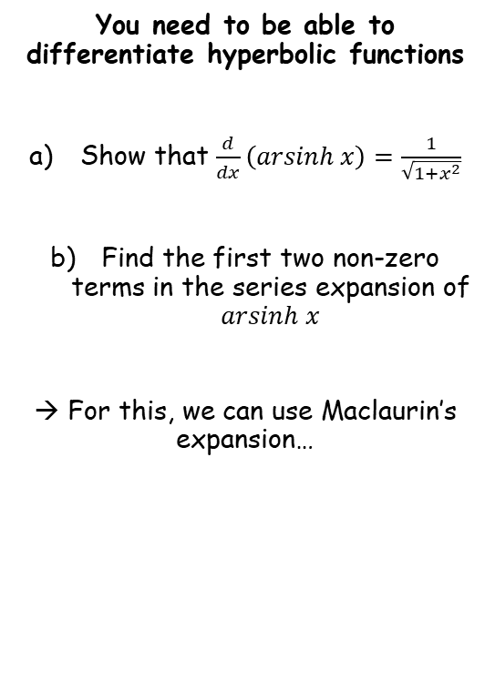





Hyperbolic Functions
$$\frac{d}{dx}\left(\operatorname{arsinh}{x}\right)=\frac{1}{\sqrt{x^{2}+1}}$$
$$\frac{d}{dx}\left(\operatorname{arcosh}{x}\right)=\frac{1}{\sqrt{x^{2} −1}}, x>1$$
$$\frac{d}{dx}\left(artanh x\right)=\frac{1}{1−x^{2}}, \left|x\right|<1$$
$$f\left(x\right)=f\left(0\right)+f^{′}\left(0\right)x+\frac{f′′(0)}{2!}x^{2}+\frac{f′′′(0)}{3!}x^{3}…$$
You need to be able to differentiate hyperbolic functions
Show that $\frac{d}{dx}\left(arsinh x\right)=\frac{1}{\sqrt{1+x^{2}}}$
Find the first two non-zero terms in the series expansion of $arsinh x$
→ For this, we can use Maclaurin’s expansion…
We need to work out the first few differentials ($f′(x)$, $f′′(x)$ etc…)
$$f\left(x\right)=arsinh x$$
Differentiate ( as we just showed)
$$f′\left(x\right)=\frac{1}{\sqrt{1+x^{2}}}$$
Rewrite
$$={\left(1+x^{2}\right)}^{−\frac{1}{2}}$$
Differentiate using the chain rule
$$f′′(x)=−\frac{1}{2}{\left(1+x^{2}\right)}^{−\frac{3}{2}}(2x)$$
Simplify
$$=−x{\left(1+x^{2}\right)}^{−\frac{3}{2}}$$
Differentiate using the product rule and the chain rule
$$f^{′′′}\left(x\right)={3x}^{2}{\left(1+x^{2}\right)}^{−\frac{5}{2}}−{\left(1+x^{2}\right)}^{−\frac{3}{2}}$$
Simplify
$$=\left({2x}^{2}−1\right){\left(1+x^{2}\right)}^{−\frac{3}{2}}$$
6D

Slide 13











Hyperbolic Functions
$$\frac{d}{dx}\left(\operatorname{arsinh}{x}\right)=\frac{1}{\sqrt{x^{2}+1}}$$
$$\frac{d}{dx}\left(\operatorname{arcosh}{x}\right)=\frac{1}{\sqrt{x^{2} −1}}, x>1$$
$$\frac{d}{dx}\left(artanh x\right)=\frac{1}{1−x^{2}}, \left|x\right|<1$$
$$f\left(x\right)=f\left(0\right)+f^{′}\left(0\right)x+\frac{f′′(0)}{2!}x^{2}+\frac{f′′′(0)}{3!}x^{3}…$$
You need to be able to differentiate hyperbolic functions
Show that $\frac{d}{dx}\left(arsinh x\right)=\frac{1}{\sqrt{1+x^{2}}}$
Find the first two non-zero terms in the series expansion of $arsinh x$
→ For this, we can use Maclaurin’s expansion…
We then need to substitute 0 into these…
$$f\left(x\right)=arsinh x$$
$$f\left(0\right)=0$$
$$f′\left(x\right)={\left(1+x^{2}\right)}^{−\frac{1}{2}}$$
$$f′\left(0\right)=1$$
$$f′′(x)=−x{\left(1+x^{2}\right)}^{−\frac{3}{2}}$$
$$f′′(0)=0$$
$$f^{′′′}\left(x\right)=\left({2x}^{2}−1\right){\left(1+x^{2}\right)}^{−\frac{3}{2}}$$
$$f^{′′′}\left(0\right)=−1$$
$$f\left(x\right)=f\left(0\right)+f^{′}\left(0\right)x+\frac{f′′(0)}{2!}x^{2}+\frac{f′′′(0)}{3!}x^{3}…$$
Replace terms using what we have
$$\operatorname{arsinh}{x}=(0)+(1)x+\frac{0}{2}x^{2}+\frac{(−1)}{6}x^{3}…$$
Simplify
$$\operatorname{arsinh}{x}≈x−\frac{1}{6}x^{3}$$
6D

Slide 14



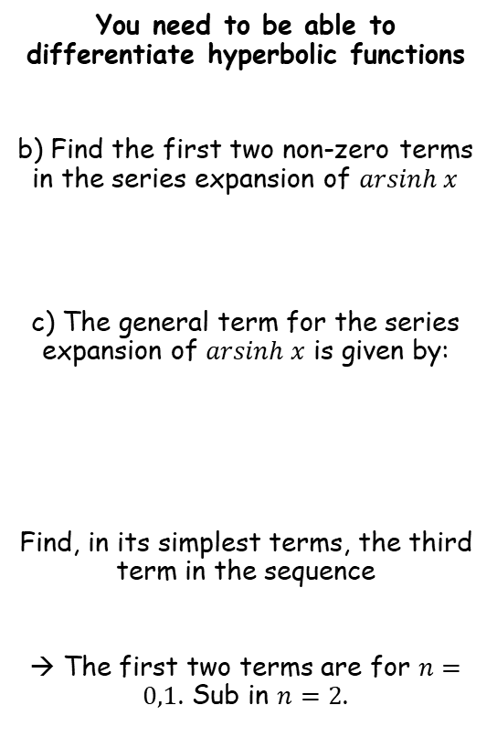




Hyperbolic Functions
$$\frac{d}{dx}\left(\operatorname{arsinh}{x}\right)=\frac{1}{\sqrt{x^{2}+1}}$$
$$\frac{d}{dx}\left(\operatorname{arcosh}{x}\right)=\frac{1}{\sqrt{x^{2} −1}}, x>1$$
$$\frac{d}{dx}\left(artanh x\right)=\frac{1}{1−x^{2}}, \left|x\right|<1$$
$$\left(\frac{{(−1)}^{n}\left(2n\right)!}{2^{2n}{\left(n!\right)}^{2}}\right)\frac{x^{2n+1}}{2n+1}$$
You need to be able to differentiate hyperbolic functions
b) Find the first two non-zero terms in the series expansion of $arsinh x$
c) The general term for the series expansion of $arsinh x$ is given by:
Find, in its simplest terms, the third term in the sequence
→ The first two terms are for $n=0,1$. Sub in $n=2$.
Let $n=2$
$$=\left(\frac{{(−1)}^{4}\left(4\right)!}{2^{4}{\left(2!\right)}^{2}}\right)\frac{x^{5}}{5}$$
Simplify the bracket
$$\operatorname{arsinh}{x}≈x−\frac{1}{6}x^{3}$$
$$=\left(\frac{24}{64}\right)\frac{x^{5}}{5}$$
Simplify
$$=\frac{3}{40}x^{5}$$
$$arsinh x=\sum_{r=0}^{∞}{\left(\frac{{(−1)}^{n}\left(2n\right)!}{2^{2n}{\left(n!\right)}^{2}}\right)\frac{x^{2n+1}}{2n+1}}$$
6D

Slide 15






Hyperbolic Functions
$$\frac{d}{dx}\left(\operatorname{arsinh}{x}\right)=\frac{1}{\sqrt{x^{2}+1}}$$
$$\frac{d}{dx}\left(\operatorname{arcosh}{x}\right)=\frac{1}{\sqrt{x^{2} −1}}, x>1$$
$$\frac{d}{dx}\left(artanh x\right)=\frac{1}{1−x^{2}}, \left|x\right|<1$$
You need to be able to differentiate hyperbolic functions
d) Use your approximation, up to and including the term in $x^{5}$, to find an approximation for $arsinh 0.5$
$$\operatorname{arsinh}{x}≈x−\frac{1}{6}x^{3}+\frac{3}{40}x^{5}$$
$$≈(0.5)−\frac{1}{6}{\left(0.5\right)}^{3}+\frac{3}{40}{\left(0.5\right)}^{5}$$
$x=0.5$
$$\operatorname{arsinh}{x}≈x−\frac{1}{6}x^{3}+\frac{3}{40}x^{5}$$
Calculate
$$≈0.48151…$$
6D

Slide 16




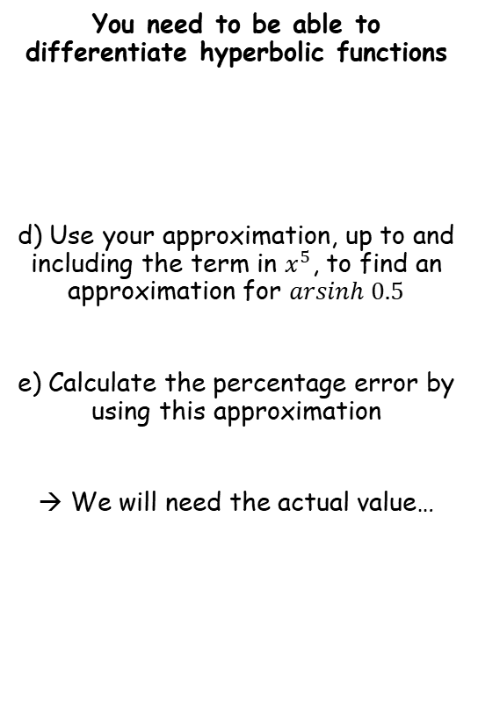




Hyperbolic Functions
$$\frac{d}{dx}\left(\operatorname{arsinh}{x}\right)=\frac{1}{\sqrt{x^{2}+1}}$$
$$\frac{d}{dx}\left(\operatorname{arcosh}{x}\right)=\frac{1}{\sqrt{x^{2} −1}}, x>1$$
$$\frac{d}{dx}\left(artanh x\right)=\frac{1}{1−x^{2}}, \left|x\right|<1$$
You need to be able to differentiate hyperbolic functions
d) Use your approximation, up to and including the term in $x^{5}$, to find an approximation for $arsinh 0.5$
e) Calculate the percentage error by using this approximation
→ We will need the actual value…
$$\% error=\frac{approximation−actual value}{actual value}$$
Sub in values
$$\operatorname{arsinh}{x}≈x−\frac{1}{6}x^{3}+\frac{3}{40}x^{5}$$
$$=\frac{0.48151…−0.48121…}{0.48121…}$$
Calculate
$$=0.062\%$$
$$≈0.48151…$$
$$arsinh x=ln\left(x+\sqrt{x^{2}+1}\right)$$
$x=0.5$
$$arsinh 0.5=ln\left(0.5+\sqrt{{(0.5)}^{2}+1}\right)$$
Calculate
$$=0.48121…$$
6D

