Slide 1
6.4) Differentiating hyperbolic functions

Slide 2
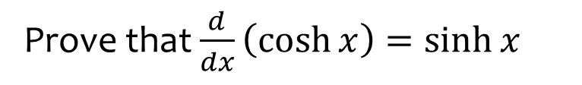
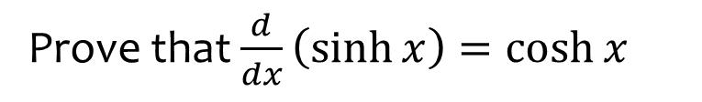
Worked example
Your turn
Prove that $\frac{d}{dx}\left(\sinh{x}\right)=\cosh{x}$
Prove that $\frac{d}{dx}\left(\cosh{x}\right)=\sinh{x}$
Proof

Slide 3



Worked example
Your turn
Differentiate with respect to $x$:
$$\sinh{7x}$$
$$\cosh{6x}$$
$$\tanh{5x}$$
Differentiate with respect to $x$:
$$\sinh{2x}$$
$$\cosh{3x}$$
$$\tanh{4x}$$
$$2\cosh{2x}$$
$$3\sinh{3x}$$
$$4{sech}^{2}{4x}$$

Slide 4
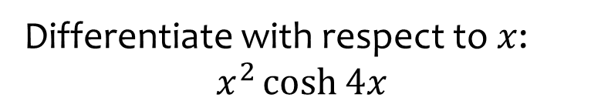
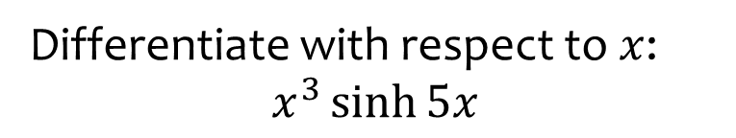

Worked example
Your turn
Differentiate with respect to $x$:
$$x^{3}\sinh{5x}$$
Differentiate with respect to $x$:
$$x^{2}\cosh{4x}$$
$$2x\cosh{4x}+4x^{2}\sinh{4x}$$

Slide 5
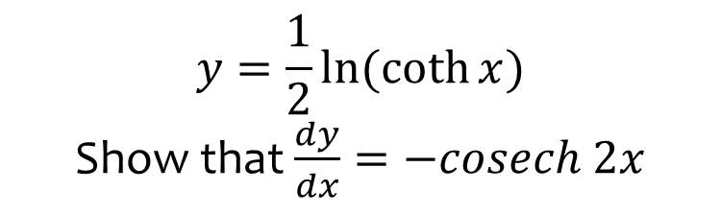
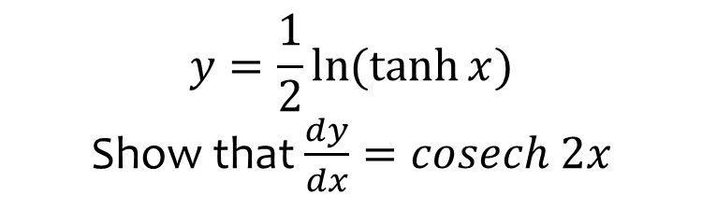
Worked example
Your turn
$$y=\frac{1}{2}\ln{(\tanh{x})}$$
Show that $\frac{dy}{dx}=cosech 2x$
$$y=\frac{1}{2}\ln{(\coth{x})}$$
Show that $\frac{dy}{dx}=−cosech 2x$
Shown

Slide 6
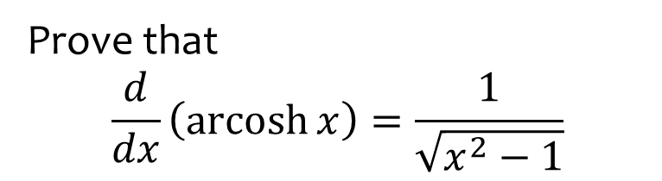
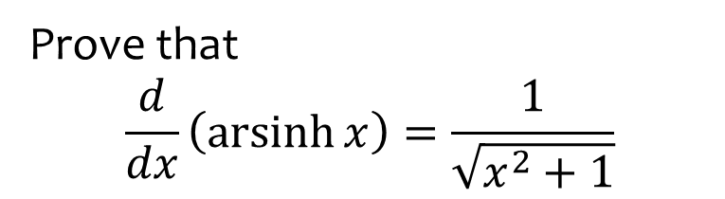
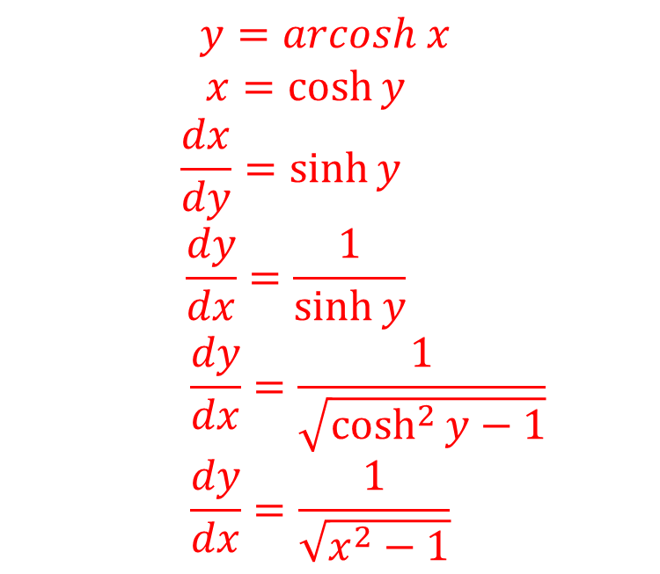
Worked example
Your turn
Prove that
$$\frac{d}{dx}\left(\operatorname{arsinh}{x}\right)=\frac{1}{\sqrt{x^{2}+1}}$$
Prove that
$$\frac{d}{dx}\left(\operatorname{arcosh}{x}\right)=\frac{1}{\sqrt{x^{2}−1}}$$
$$y=arcosh x$$
$$x=\cosh{y}$$
$$\frac{dx}{dy}=\sinh{y}$$
$$\frac{dy}{dx}=\frac{1}{\sinh{y}}$$
$$\frac{dy}{dx}=\frac{1}{\sqrt{\cosh^{2}{y}−1}}$$
$$\frac{dy}{dx}=\frac{1}{\sqrt{x^{2}−1}}$$

Slide 7



Worked example
Your turn
Differentiate with respect to $x$:
$$arsinh 7x$$
$$arcosh 6x$$
$$artanh 5x$$
Differentiate with respect to $x$:
$$arsinh 2x$$
$$arcosh 3x$$
$$artanh 4x$$
$$\frac{2}{\sqrt{4x^{2}+1}}$$
$$\frac{3}{\sqrt{9x^{2}−1}}$$
$$\frac{4}{1−16x^{2}}$$

Slide 8
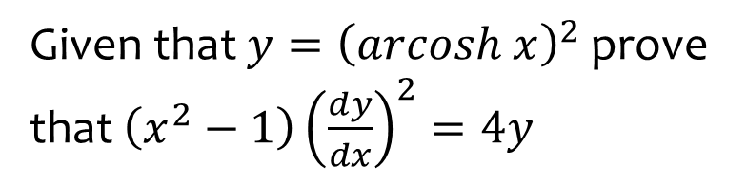
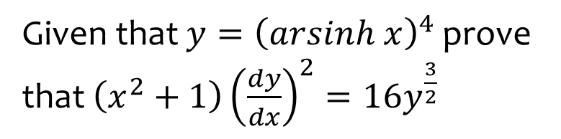
Worked example
Your turn
Given that $y={\left(arsinh x\right)}^{4}$ prove that $\left(x^{2}+1\right){\left(\frac{dy}{dx}\right)}^{2}=16y^{\frac{3}{2}}$
Given that $y={\left(arcosh x\right)}^{2}$ prove that $\left(x^{2}−1\right){\left(\frac{dy}{dx}\right)}^{2}=4y$
Proof

Slide 9
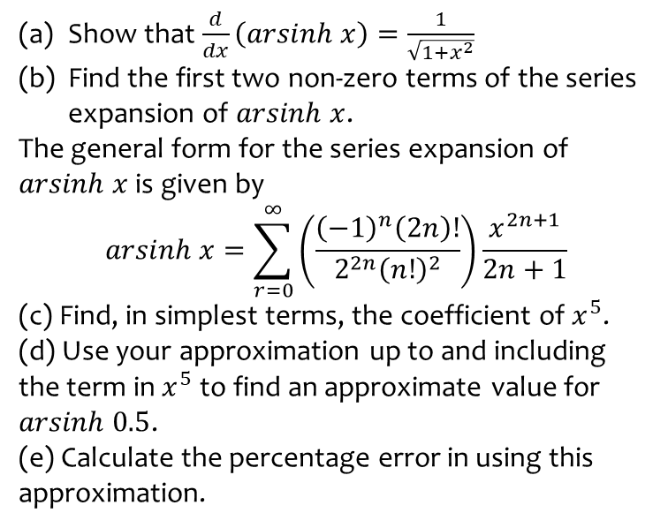
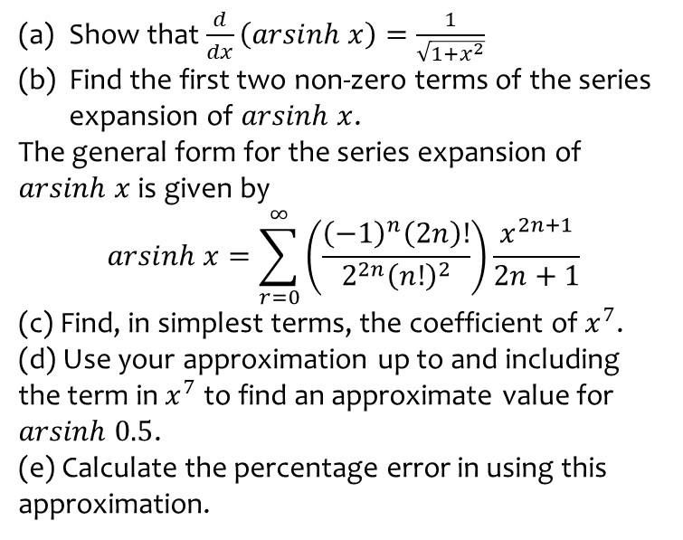
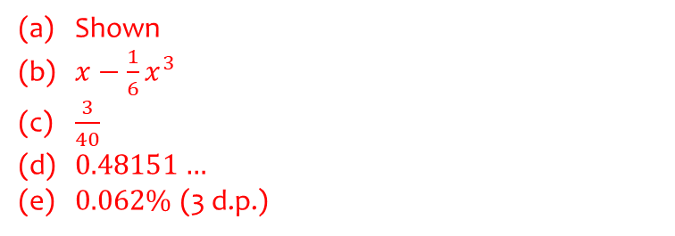
Worked example
Your turn
Show that $\frac{d}{dx}\left(arsinh x\right)=\frac{1}{\sqrt{1+x^{2}}}$
Find the first two non-zero terms of the series expansion of $arsinh x$.
The general form for the series expansion of $arsinh x$ is given by
$$arsinh x=\sum_{r=0}^{∞}{\left(\frac{{\left(−1\right)}^{n}\left(2n\right)!}{2^{2n}{\left(n!\right)}^{2}}\right)\frac{x^{2n+1}}{2n+1}}$$
(c) Find, in simplest terms, the coefficient of $x^{7}$.
(d) Use your approximation up to and including the term in $x^{7}$ to find an approximate value for $arsinh 0.5$.
(e) Calculate the percentage error in using this approximation.
Show that $\frac{d}{dx}\left(arsinh x\right)=\frac{1}{\sqrt{1+x^{2}}}$
Find the first two non-zero terms of the series expansion of $arsinh x$.
The general form for the series expansion of $arsinh x$ is given by
$$arsinh x=\sum_{r=0}^{∞}{\left(\frac{{\left(−1\right)}^{n}\left(2n\right)!}{2^{2n}{\left(n!\right)}^{2}}\right)\frac{x^{2n+1}}{2n+1}}$$
(c) Find, in simplest terms, the coefficient of $x^{5}$.
(d) Use your approximation up to and including the term in $x^{5}$ to find an approximate value for $arsinh 0.5$.
(e) Calculate the percentage error in using this approximation.
Shown
$x−\frac{1}{6}x^{3}$
$\frac{3}{40}$
$0.48151…$
$0.062\%$(3 d.p.)

Slide 10
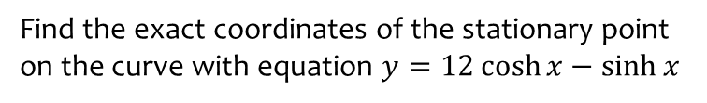
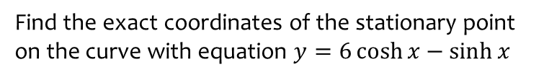

Worked example
Your turn
Find the exact coordinates of the stationary point on the curve with equation $y=6\cosh{x}−\sinh{x}$
Find the exact coordinates of the stationary point on the curve with equation $y=12\cosh{x}−\sinh{x}$
$$\left(\frac{1}{2}\ln{\frac{13}{11},\sqrt{143}}\right)$$

Slide 11
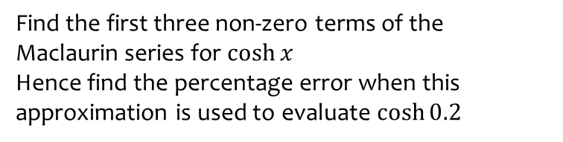
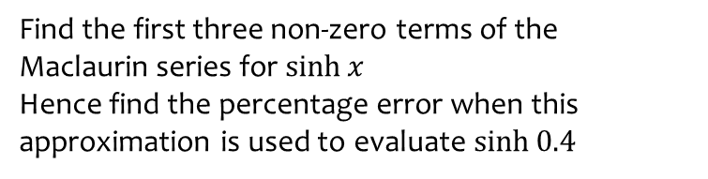

Worked example
Your turn
Find the first three non-zero terms of the Maclaurin series for $\sinh{x}$
Hence find the percentage error when this approximation is used to evaluate $\sinh{0.4}$
Find the first three non-zero terms of the Maclaurin series for $\cosh{x}$
Hence find the percentage error when this approximation is used to evaluate $\cosh{0.2}$
$$1+\frac{1}{2}x^{2}+\frac{1}{24}x^{4}$$
$$0.0000087\%$$

