Slide 1
6.3) Identities and equations

Slide 2
Worked example
Your turn
Use definitions of $\sinh{x}$ and $\cosh{x}$ to prove that $sech^{2}x=1−tanh^{2}x$
Use definitions of $\sinh{x}$ and $\cosh{x}$ to prove that$\cosh^{2}{x}−\sinh^{2}{x}=1$
Proof

Slide 3
Worked example
Your turn
Use definitions of $\sinh{x}$ and $\cosh{x}$ to prove that:
$$sinh \left(A+B\right)=sinh A cosh B+cosh A sinh B$$
$$cosh \left(A−B\right)=cosh A cosh B−sinh A sinh B$$
Use definitions of $\sinh{x}$ and $\cosh{x}$ to prove that:
$$sinh \left(A−B\right)=sinh A cosh B−cosh A sinh B$$
$$cosh \left(A+B\right)=cosh A cosh B+sinh A sinh B$$
Proof
Proof

Slide 4
Worked example
Your turn
Use definitions of $\sinh{x}$ and $\cosh{x}$ to prove that $\cosh{2x}=1+2\sinh^{2}{x}$
Use definitions of $\sinh{x}$ and $\cosh{x}$ to prove that $\cosh{2x}=2\cosh^{2}{x}−1$
Proof

Slide 5
Worked example
Your turn
Use Osborn’s rule to write down the hyperbolic identities corresponding to the trigonometric identities:
$$\cos{2x}=\cos^{4}{x}−\sin^{4}{x}$$
Use Osborn’s rule to write down the hyperbolic identities corresponding to the trigonometric identities:
$$\cos{2x}=\cos^{2}{x}−\sin^{2}{x}$$
$$\cosh{2x}=\cosh^{2}{x}+\sinh^{2}{x}$$

Slide 6

Worked example
Your turn
Given that $\sinh{x}=\frac{3}{5}$, find the exact value of:
$$\cosh{x}$$
$$\tanh{x}$$
$$\sinh{2x}$$
Given that $\sinh{x}=\frac{3}{4}$, find the exact value of:
$$\cosh{x}$$
$$\tanh{x}$$
$$\sinh{2x}$$
$\frac{5}{4}$
$\frac{3}{5}$
$\frac{15}{8}$

Slide 7
Worked example
Your turn
Solve for all real values of $x$:
$$6\sinh{x}+2\cosh{x}=7$$
Solve for all real values of $x$:
$$6\sinh{x}−2\cosh{x}=7$$
$$x=\ln{4}$$

Slide 8
Worked example
Your turn
Solve for all real values of $x$:
$$2\sinh^{2}{x}−5cosh{x}=5$$
Solve for all real values of $x$:
$$2\cosh^{2}{x}−5sinh{x}=5$$
$x=\ln\left(−\frac{1}{2}+\frac{\sqrt{5}}{2}\right)$
$x=\ln\left(3+\sqrt{10}\right)$

Slide 9
Worked example
Your turn
Solve for all real values of $x$:
$$\cosh{2x}−5\sinh{x}+2=0$$
Solve for all real values of $x$:
$$\cosh{2x}−5\cosh{x}+4=0$$
$x=\ln\left(\frac{3±\sqrt{5}}{2}\right), x=0$

Slide 10
Worked example
Your turn
Solve the equation
$$4\sinh{3x}=15−6e^{3x}$$
Give your answer in the form $\frac{1}{3}\ln{k}$, where $k$ is an integer
Solve the equation
$$3\sinh{2x}=13−3e^{2x}$$
Give your answer in the form $\frac{1}{2}\ln{k}$, where $k$ is an integer
$$x=\frac{1}{2}\ln{3}$$

Slide 11
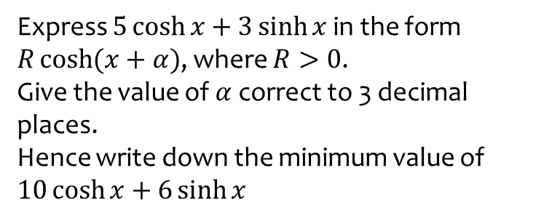
Worked example
Your turn
Express $5\cosh{x}+3\sinh{x}$ in the form $R\cosh{(x+α})$, where $R>0$.
Give the value of $α$ correct to 3 decimal places.
Hence write down the minimum value of $10\cosh{x}+6\sinh{x}$
Express $10\cosh{x}+6\sinh{x}$ in the form $R\cosh{(x+α})$, where $R>0$.
Give the value of $α$ correct to 3 decimal places.
Hence write down the minimum value of $10\cosh{x}+6\sinh{x}$
$$8\cosh{(x+0.693)}$$
Minimum $=8$

