Slide 1
6.3) Determinants

Slide 2


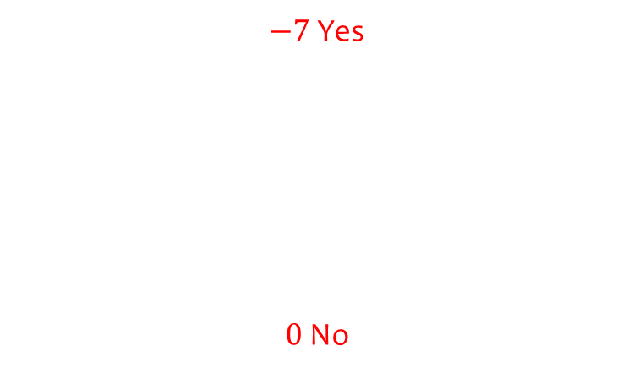
Worked example
Your turn
Calculate the determinant then decide if the matrix has an inverse.
$$\left(\begin{matrix}1 & 0 \\ 0 & 1\end{matrix}\right)$$
$$\left(\begin{matrix}1 & −2 \\ −3 & −4\end{matrix}\right)$$
$$\left(\begin{matrix}1 & −2 \\ −3 & 6\end{matrix}\right)$$
$$\text{Calculate} \text{the} \text{determinant} \text{then} \text{decide} \text{if} \text{the} \text{matrix} \text{has} \text{an} \text{inverse}\text{.}$$
$$\left(\begin{matrix}0 & −3 \\ −1 & −4\end{matrix}\right)$$
$$\left(\begin{matrix}10 & −2 \\ 5 & −1\end{matrix}\right)$$
$−7$ Yes
$0$ No

Slide 3
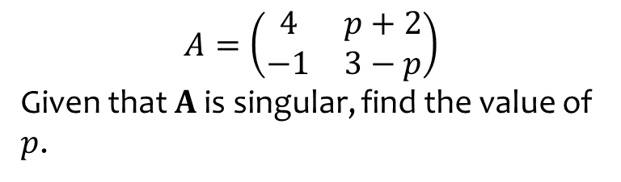
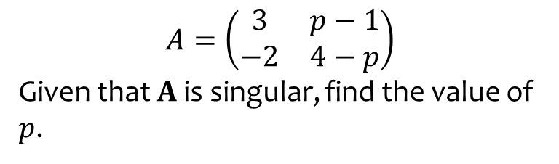

Worked example
Your turn
$$A=\left(\begin{matrix}3 & p−1 \\ −2 & 4−p\end{matrix}\right)$$
Given that $A$ is singular, find the value of $p$.
$$A=\left(\begin{matrix}4 & p+2 \\ −1 & 3−p\end{matrix}\right)$$
Given that $A$ is singular, find the value of $p$.
$$p=\frac{14}{3}$$

Slide 4



Worked example
Your turn
$$\left|\begin{matrix}3 & 1 & 4 \\ 7 & 2 & 5 \\ −3 & 4 & 3\end{matrix}\right|$$
Find the minor of:
2
-3
7
$$\left(\begin{matrix}1 & 2 & 0 \\ 4 & 5 & −6 \\ −1 & 8 & 2\end{matrix}\right)$$
Find the minor of:
5
0
-6
$$\left|\begin{matrix}1 & 0 \\ −1 & 2\end{matrix}\right|=2$$
$$\left|\begin{matrix}4 & 5 \\ −1 & 8\end{matrix}\right|=37$$
$$\left|\begin{matrix}1 & 2 \\ −1 & 8\end{matrix}\right|=10$$

Slide 5


Worked example
Your turn
Calculate the determinant:
$$\left|\begin{matrix}2 & 1 & 0 \\ 5 & 4 & −6 \\ 8 & −1 & 2\end{matrix}\right|$$
Calculate the determinant:
$$\left|\begin{matrix}1 & 2 & 0 \\ 4 & 5 & −6 \\ −1 & 8 & 2\end{matrix}\right|$$
$$54$$

Slide 6
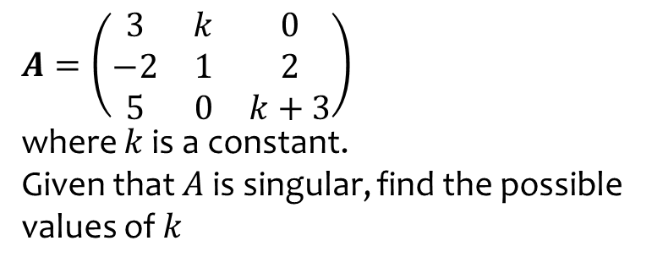
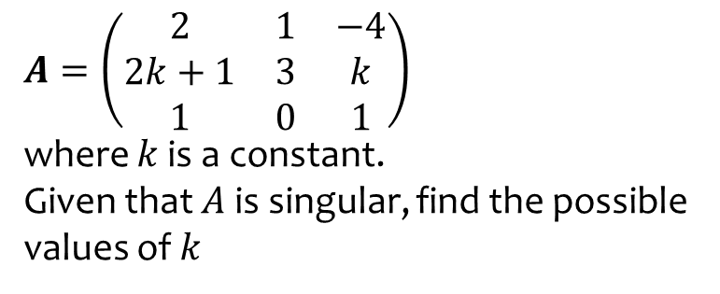

Worked example
Your turn
$A=\left(\begin{matrix}2 & 1 & −4 \\ 2k+1 & 3 & k \\ 1 & 0 & 1\end{matrix}\right)$
where $k$ is a constant.
Given that $A$ is singular, find the possible values of $k$
$A=\left(\begin{matrix}3 & k & 0 \\ −2 & 1 & 2 \\ 5 & 0 & k+3\end{matrix}\right)$
where $k$ is a constant.
Given that $A$ is singular, find the possible values of $k$
$$k=−\frac{1}{2},−9$$

