Slide 1
6.2) Matrix multiplication

Slide 2
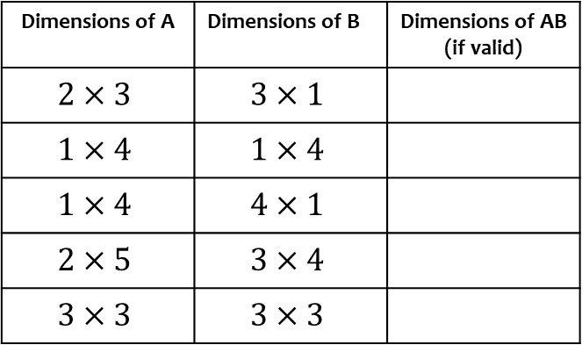
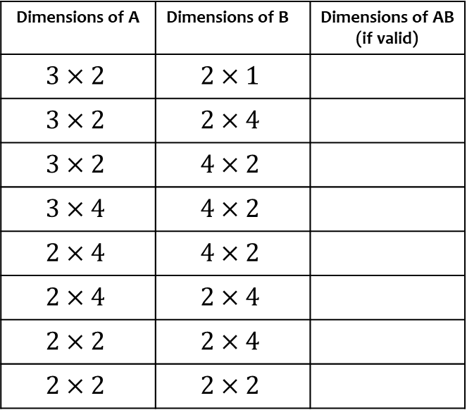
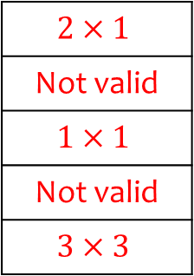
Worked example
Your turn
Determine the size of the matrix AB given the dimensions of A and B
Determine the size of the matrix AB given the dimensions of A and B
Dimensions of A | Dimensions of B | Dimensions of AB (if valid)
$$3×2$$ | $$2×1$$
$$3×2$$ | $$2×4$$
$$3×2$$ | $$4×2$$
$$3×4$$ | $$4×2$$
$$2×4$$ | $$4×2$$
$$2×4$$ | $$2×4$$
$$2×2$$ | $$2×4$$
$$2×2$$ | $$2×2$$
Dimensions of A | Dimensions of B | Dimensions of AB (if valid)
$$2×3$$ | $$3×1$$
$$1×4$$ | $$1×4$$
$$1×4$$ | $$4×1$$
$$2×5$$ | $$3×4$$
$$3×3$$ | $$3×3$$
$$2×1$$
Not valid
$$1×1$$
Not valid
$$3×3$$

Slide 3

Worked example
Your turn
Find the product of these matrices where possible:
$$\left(\begin{matrix}1 & 2 \\ 3 & 4\end{matrix}\right)\left(\begin{matrix}5 & 6 \\ 7 & 8\end{matrix}\right)$$
$$\left(\begin{matrix}1 & 2 \\ 3 & 4 \\ 5 & 6\end{matrix}\right)\left(\begin{matrix}7 & 8 \\ 9 & 10\end{matrix}\right)$$
$$\left(\begin{matrix}1 & 2 & 3 \\ 4 & 5 & 6\end{matrix}\right)\left(\begin{matrix}7 & 8 \\ 9 & 10\end{matrix}\right)$$
$$\left(\begin{matrix}7 & 8 \\ 9 & 10\end{matrix}\right)\left(\begin{matrix}1 & 2 & 3 \\ 4 & 5 & 6\end{matrix}\right)$$
Find the product of these matrices where possible:
$$\left(\begin{matrix}1 & 2 \\ 3 & 4 \\ 5 & 6\end{matrix}\right)\left(\begin{matrix}7 & 8 & 9 \\ 10 & 11 & 12\end{matrix}\right)$$
$$\left(\begin{matrix}27 & 30 & 33 \\ 61 & 68 & 75 \\ 95 & 106 & 117\end{matrix}\right)$$

Slide 4



Worked example
Your turn
Find:
$$\left(\begin{matrix}4 & 5 & 6\end{matrix}\right)\left(\begin{matrix}7 \\ 8 \\ 9\end{matrix}\right)$$
$$\left(\begin{matrix}4 \\ 5 \\ 6\end{matrix}\right)\left(\begin{matrix}7 & 8 & 9\end{matrix}\right)$$
Find:
$$\left(\begin{matrix}1 & 2 & 3\end{matrix}\right)\left(\begin{matrix}1 \\ 2 \\ 3\end{matrix}\right)$$
$$\left(\begin{matrix}1 \\ 2 \\ 3\end{matrix}\right)\left(\begin{matrix}1 & 2 & 3\end{matrix}\right)$$
$$\left(\begin{matrix}14\end{matrix}\right)$$
$$\left(\begin{matrix}1 & 2 & 3 \\ 2 & 4 & 6 \\ 3 & 6 & 9\end{matrix}\right)$$

Slide 5

Worked example
Your turn
Find:
$${\left(\begin{matrix}1 & 2 \\ 3 & 4\end{matrix}\right)}^{2}$$
$${\left(\begin{matrix}1 & 2 \\ 3 & 4\end{matrix}\right)}^{3}$$
Find:
$${\left(\begin{matrix}1 & 2 \\ 3 & 4\end{matrix}\right)}^{4}$$
$$\left(\begin{matrix}199 & 290 \\ 435 & 634\end{matrix}\right)$$

Slide 6

Worked example
Your turn
Find:
$${\left(\begin{matrix}1 & a \\ 0 & 1\end{matrix}\right)}^{2}$$
$${\left(\begin{matrix}1 & 0 \\ b & 1\end{matrix}\right)}^{3}$$
Find:
$${\left(\begin{matrix}1 & 0 \\ c & 1\end{matrix}\right)}^{k}$$
$$\left(\begin{matrix}1 & 0 \\ ck & 1\end{matrix}\right)$$

Slide 7
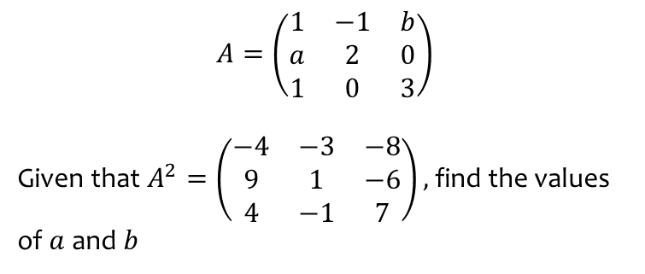
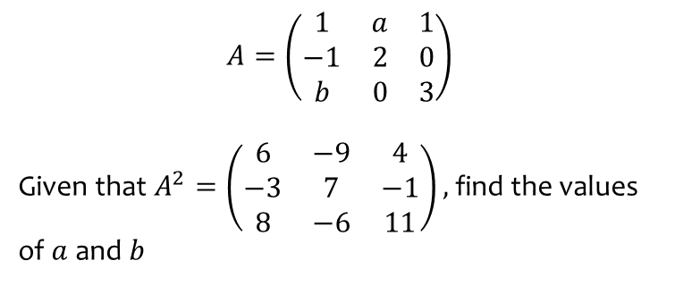
Worked example
Your turn
$$A=\left(\begin{matrix}1 & a & 1 \\ −1 & 2 & 0 \\ b & 0 & 3\end{matrix}\right)$$
Given that $A^{2}=\left(\begin{matrix}6 & −9 & 4 \\ −3 & 7 & −1 \\ 8 & −6 & 11\end{matrix}\right),$find the values of $a$and $b$
$$A=\left(\begin{matrix}1 & −1 & b \\ a & 2 & 0 \\ 1 & 0 & 3\end{matrix}\right)$$
Given that $A^{2}=\left(\begin{matrix}−4 & −3 & −8 \\ 9 & 1 & −6 \\ 4 & −1 & 7\end{matrix}\right),$find the values of $a$and $b$
$$a=3, b=−2$$

Slide 8
Worked example
Your turn
$A=\left(\begin{matrix}−2 \\ a\end{matrix}\right)$ and $B=(\begin{matrix}1 & b\end{matrix})$. Given that $BA=(0)$ find $AB$ in terms of $a$
$A=\left(\begin{matrix}−1 \\ a\end{matrix}\right)$ and $B=(\begin{matrix}b & 2\end{matrix})$. Given that $BA=(0)$ find $AB$ in terms of $a$
$$AB=\left(\begin{matrix}−2a & −2 \\ 2a^{2} & 2a\end{matrix}\right)$$

Slide 9

Worked example
Your turn
Find:
$$\left(\begin{matrix}1 & 2 \\ 3 & 4\end{matrix}\right)\left(\begin{matrix}1 & 0 \\ 0 & 1\end{matrix}\right)$$
$$\left(\begin{matrix}1 & 2 \\ 3 & 4 \\ 5 & 6\end{matrix}\right)\left(\begin{matrix}1 & 0 \\ 0 & 1\end{matrix}\right)$$
$$\left(\begin{matrix}1 & 2 & 3 \\ 4 & 5 & 6\end{matrix}\right)\left(\begin{matrix}1 & 0 \\ 0 & 1\end{matrix}\right)$$
$$\left(\begin{matrix}1 & 0 \\ 0 & 1\end{matrix}\right)\left(\begin{matrix}1 & 2 & 3 \\ 4 & 5 & 6\end{matrix}\right)$$
Find:
$$\left(\begin{matrix}1 & 2 & 3 \\ 4 & 5 & 6 \\ 7 & 8 & 9\end{matrix}\right)\left(\begin{matrix}1 & 0 & 0 \\ 0 & 1 & 0 \\ 0 & 0 & 1\end{matrix}\right)$$
$$\left(\begin{matrix}1 & 2 & 3 \\ 4 & 5 & 6 \\ 7 & 8 & 9\end{matrix}\right)$$

