Slide 1
6.2) Inverse hyperbolic functions

Slide 2
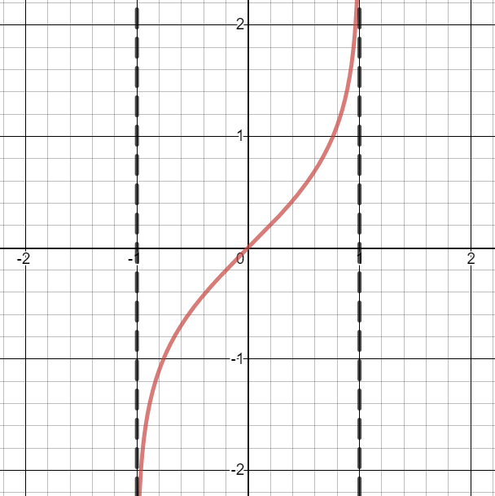

Worked example
Your turn
Sketch the graphs of:
$$y=arsinh x$$
$$y=arcosh x$$
Sketch the graphs of:
$$y=artanh x$$
Graphs used with permission from DESMOS: https://www.desmos.com/

Slide 3



Worked example
Your turn
Express as natural logarithms:
$$arsinh 2$$
$$arcosh 1$$
$$artanh 3$$
Express as natural logarithms:
$$arsinh 1$$
$$arcosh 2$$
$$artanh\frac{1}{3}$$
$$\ln\left(1+\sqrt{2}\right)$$
$$\ln{(2+\sqrt{3}})$$
$$\ln{\sqrt{2}}$$

Slide 4
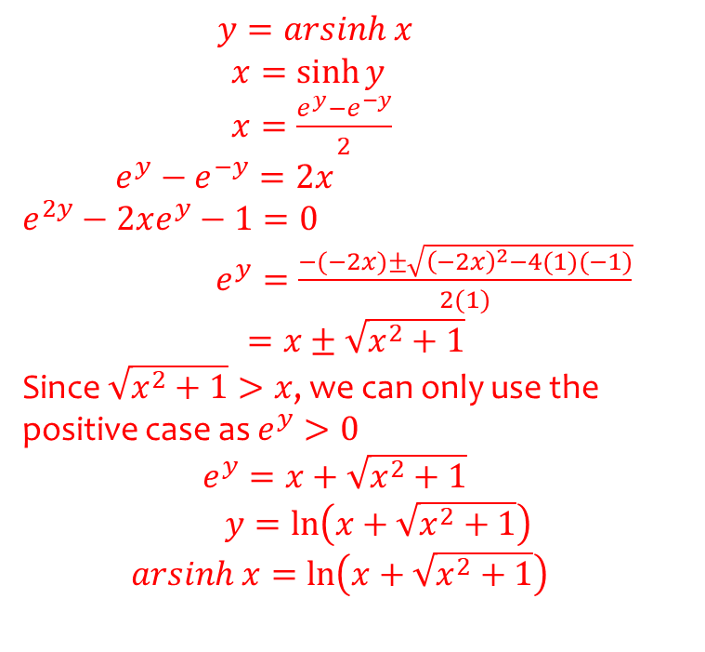
Worked example
Your turn
Prove that $arcosh x=\ln\left(x+\sqrt{x^{2}−1}\right), x≥1$
Prove that $arsinh x=\ln\left(x+\sqrt{x^{2}+1}\right)$
$y=arsinh x$ $x=\sinh{y}$ $x=\frac{e^{y}−e^{−y}}{2}$ $e^{y}−e^{−y}=2x$ $$e^{2y}−2xe^{y}−1=0$$ $e^{y}=\frac{−(−2x)±\sqrt{{\left(−2x\right)}^{2}−4(1)(−1)}}{2(1)}$
$=x±\sqrt{x^{2}+1}$
Since $\sqrt{x^{2}+1}>x$, we can only use the positive case as $e^{y}>0$
$e^{y}=x+\sqrt{x^{2}+1}$
$y=\ln\left(x+\sqrt{x^{2}+1}\right)$ $arsinh x=\ln\left(x+\sqrt{x^{2}+1}\right)$

Slide 5
Worked example
Your turn
Given that $artanh x+artanh y=ln\sqrt{5}$, find an expression for $y$ in terms of $x$
Given that $artanh x+artanh y=ln\sqrt{3}$, prove that $y=\frac{2x−1}{x−2}$
Proof

