Slide 1
6.1) Introduction to hyperbolic functions

Slide 2


Worked example
Your turn
$$\sinh{x}=\frac{e^{x}−e^{−x}}{2}$$
$$cosech x=$$
$$\cosh{x}=\frac{e^{x}+e^{−x}}{2}$$
$$sech x=$$
$\frac{2}{e^{x}+e^{−x}}$

Slide 3

Worked example
Your turn
Find to 2 decimal places, the values of:
$$\sinh{2}$$
$$\cosh{0}$$
$$\tanh{1.8}$$
Find to 2 decimal places, the values of:
$$\sinh{3}$$
$$\cosh{1}$$
$$\tanh{0.8}$$
$$10.02$$
$$1.54$$
$$0.66$$

Slide 4

Worked example
Your turn
Find the exact values of:
$$\sinh{(ln{3})}$$
$$\cosh{(ln{2)}}$$
$$\tanh{(\ln{5)}}$$
Find the exact values of:
$$\sinh{(ln{2})}$$
$$\cosh{(ln{3)}}$$
$$\tanh{(\ln{4)}}$$
$$\frac{3}{4}$$
$$\frac{5}{3}$$
$$\frac{15}{17}$$

Slide 5
Worked example
Your turn
Find, to two decimal places, the value of $x$ for which
$\cosh{x}=3$
Find, to two decimal places, the value of $x$ for which
$\sinh{x}=5$
$$x=2.31$$

Slide 6
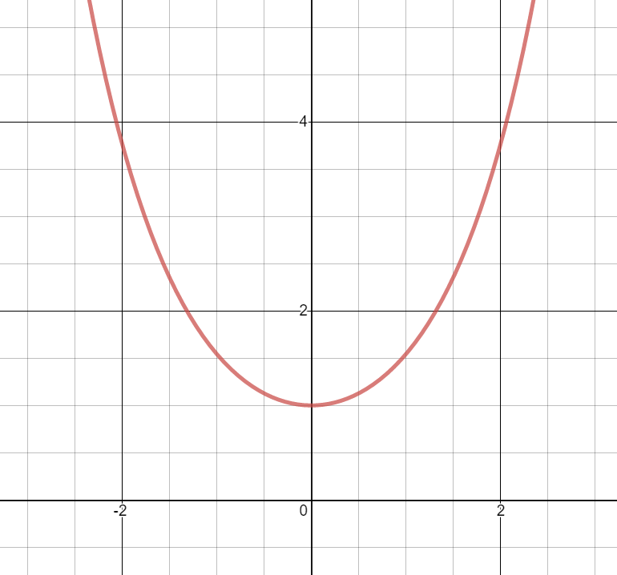
Worked example
Your turn
Sketch the graph of $y=\sinh{x}$ by using the exponential definition and state the range
Sketch the graph of $y=\cosh{x}, x∈ℝ$
by using the exponential definition and state the range
$$\cosh{x}≥1$$
Graphs used with permission from DESMOS: https://www.desmos.com/

Slide 7
Worked example
Your turn
By using the graph of $y=\sinh{x}$, sketch the graph of $y=cosech x$
By using the graph of $y=\cosh{x}$, Sketch the graph of $y=sech x$
Graphs used with permission from DESMOS: https://www.desmos.com/

Slide 8
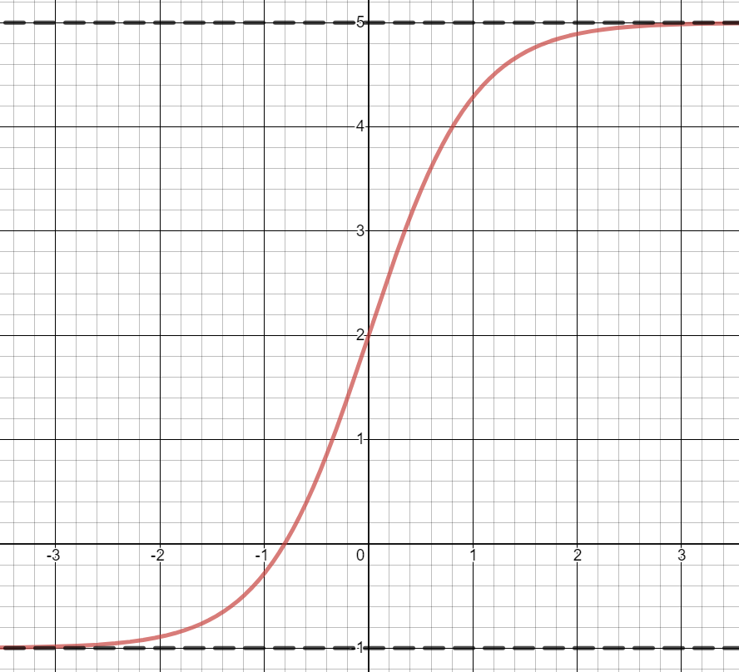
Worked example
Your turn
Sketch the graph of $y=2\tanh{x}+3$, stating the asymptote equations of the curve
Sketch the graph of $y=3\tanh{x}+2$, stating the asymptote equations of the curve
Asymptotes $y=5$ and $y=−1$
Graphs used with permission from DESMOS: https://www.desmos.com/

Slide 9
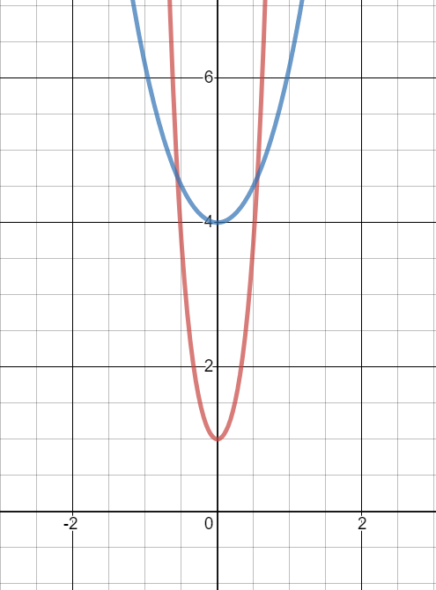
Worked example
Your turn
On the same diagram sketch the graphs of $y=\sinh{2x}$ and $y=2\sinh{x}$
On the same diagram sketch the graphs of $y=\cosh{4x}$ and $y=4\cosh{x}$
Graphs used with permission from DESMOS: https://www.desmos.com/

