Slide 1
6) Matrices
6.1) Introduction to matrices
6.2) Matrix multiplication
6.3) Determinants
6.4) Inverting a 2 x 2 matrix
6.5) Inverting a 3 x 3 matrix
6.6) Solving systems of equations using matrices

Slide 2
6.1) Introduction to matrices
Chapter CONTENTS

Slide 3


Worked example
Your turn
Write down the size of the matrix:
$$\left(\begin{matrix}1 & 2 \\ 3 & 4\end{matrix}\right)$$
$$\left(\begin{matrix}1 & 2 & 3 \\ 4 & 5 & 6\end{matrix}\right)$$
$$\left(\begin{matrix}1 & 2 & 3 \\ 4 & 5 & 6 \\ 7 & 8 & 9\end{matrix}\right)$$
$$\left(\begin{matrix}1 \\ 2\end{matrix}\right)$$
Write down the size of the matrix:
$$\left(\begin{matrix}1 & 2 \\ 3 & 4 \\ 5 & 6\end{matrix}\right)$$
$$\left(\begin{matrix}1 & 2\end{matrix}\right)$$
$$2×3$$
$$1×2$$

Slide 4



Worked example
Your turn
Find (where possible):
$$\left(\begin{matrix}1 & 2 \\ 3 & 4\end{matrix}\right)+\left(\begin{matrix}0 & −2 \\ −3 & −3\end{matrix}\right)$$
$$\left(\begin{matrix}1 & 2 \\ 3 & 4\end{matrix}\right)+\left(\begin{matrix}1 & 2 & 3 \\ 4 & 5 & 6\end{matrix}\right)$$
$$\left(\begin{matrix}1 \\ 2\end{matrix}\right)−\left(\begin{matrix}−3 \\ 4\end{matrix}\right)$$
Find (where possible):
$$\left(\begin{matrix}1 & 2 & 3 \\ 4 & 5 & 6 \\ 7 & 8 & 9\end{matrix}\right)+\left(\begin{matrix}0 & −2 & −3 \\ −4 & −4 & −6 \\ −7 & −8 & −8\end{matrix}\right)$$
$$\left(\begin{matrix}1 & 2 \\ 3 & 4 \\ 5 & 6\end{matrix}\right)−\left(\begin{matrix}7 \\ 8 \\ 9\end{matrix}\right)$$
$$\left(\begin{matrix}1 & 0 & 0 \\ 0 & 1 & 0 \\ 0 & 0 & 1\end{matrix}\right)$$
Not additively conformable

Slide 5

Worked example
Your turn
Find:
$$5\left(\begin{matrix}1 & 2 \\ 3 & 4\end{matrix}\right)$$
$$−7\left(\begin{matrix}1 & 2 & 3 \\ 4 & 5 & 6\end{matrix}\right)$$
Find:
$$7\left(\begin{matrix}1 & 2 \\ 3 & 4 \\ 5 & 6\end{matrix}\right)$$
$$\left(\begin{matrix}7 & 14 \\ 21 & 28 \\ 25 & 42\end{matrix}\right)$$

Slide 6
Worked example
Your turn
Find the value of $k$:
$$\left(\begin{matrix}−5 \\ 3k\end{matrix}\right)+k\left(\begin{matrix}2k \\ 2k\end{matrix}\right)=\left(\begin{matrix}3k \\ 20\end{matrix}\right)$$
Find the value of $k$:
$$\left(\begin{matrix}−3 \\ k\end{matrix}\right)+k\left(\begin{matrix}2k \\ 2k\end{matrix}\right)=\left(\begin{matrix}k \\ 6\end{matrix}\right)$$
$$k=\frac{3}{2}$$

Slide 7
Worked example
Your turn
Write down the $2×2$ identity matrix
Write down the $3×3$ identity matrix
Write down the $4×4$ identity matrix
$$\left({1 \atop \begin{aligned}0 \\ 0 \\ 0\end{aligned}}{0 \atop \begin{aligned}1 \\ 0 \\ 0\end{aligned}}{0 \atop \begin{aligned}0 \\ 1 \\ 0\end{aligned}}{0 \atop \begin{aligned}0 \\ 0 \\ 1\end{aligned}}\right)$$

Slide 8
6.2) Matrix multiplication
Chapter CONTENTS

Slide 9
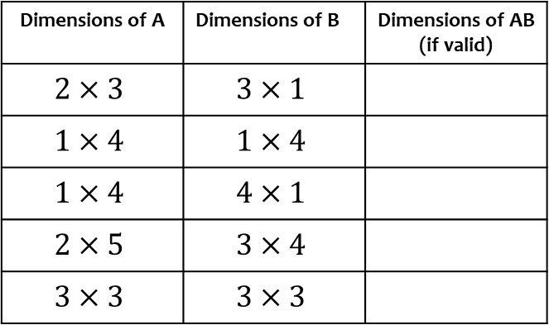
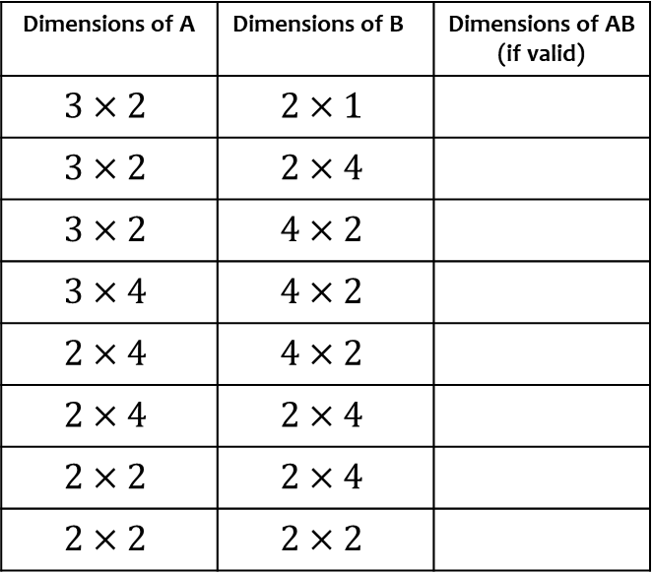
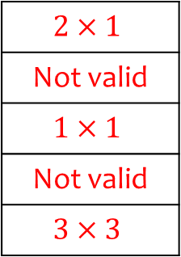
Worked example
Your turn
Determine the size of the matrix AB given the dimensions of A and B
Determine the size of the matrix AB given the dimensions of A and B
Dimensions of A | Dimensions of B | Dimensions of AB (if valid)
$$3×2$$ | $$2×1$$
$$3×2$$ | $$2×4$$
$$3×2$$ | $$4×2$$
$$3×4$$ | $$4×2$$
$$2×4$$ | $$4×2$$
$$2×4$$ | $$2×4$$
$$2×2$$ | $$2×4$$
$$2×2$$ | $$2×2$$
Dimensions of A | Dimensions of B | Dimensions of AB (if valid)
$$2×3$$ | $$3×1$$
$$1×4$$ | $$1×4$$
$$1×4$$ | $$4×1$$
$$2×5$$ | $$3×4$$
$$3×3$$ | $$3×3$$
$$2×1$$
Not valid
$$1×1$$
Not valid
$$3×3$$

Slide 10

Worked example
Your turn
Find the product of these matrices where possible:
$$\left(\begin{matrix}1 & 2 \\ 3 & 4\end{matrix}\right)\left(\begin{matrix}5 & 6 \\ 7 & 8\end{matrix}\right)$$
$$\left(\begin{matrix}1 & 2 \\ 3 & 4 \\ 5 & 6\end{matrix}\right)\left(\begin{matrix}7 & 8 \\ 9 & 10\end{matrix}\right)$$
$$\left(\begin{matrix}1 & 2 & 3 \\ 4 & 5 & 6\end{matrix}\right)\left(\begin{matrix}7 & 8 \\ 9 & 10\end{matrix}\right)$$
$$\left(\begin{matrix}7 & 8 \\ 9 & 10\end{matrix}\right)\left(\begin{matrix}1 & 2 & 3 \\ 4 & 5 & 6\end{matrix}\right)$$
Find the product of these matrices where possible:
$$\left(\begin{matrix}1 & 2 \\ 3 & 4 \\ 5 & 6\end{matrix}\right)\left(\begin{matrix}7 & 8 & 9 \\ 10 & 11 & 12\end{matrix}\right)$$
$$\left(\begin{matrix}27 & 30 & 33 \\ 61 & 68 & 75 \\ 95 & 106 & 117\end{matrix}\right)$$

Slide 11



Worked example
Your turn
Find:
$$\left(\begin{matrix}4 & 5 & 6\end{matrix}\right)\left(\begin{matrix}7 \\ 8 \\ 9\end{matrix}\right)$$
$$\left(\begin{matrix}4 \\ 5 \\ 6\end{matrix}\right)\left(\begin{matrix}7 & 8 & 9\end{matrix}\right)$$
Find:
$$\left(\begin{matrix}1 & 2 & 3\end{matrix}\right)\left(\begin{matrix}1 \\ 2 \\ 3\end{matrix}\right)$$
$$\left(\begin{matrix}1 \\ 2 \\ 3\end{matrix}\right)\left(\begin{matrix}1 & 2 & 3\end{matrix}\right)$$
$$\left(\begin{matrix}14\end{matrix}\right)$$
$$\left(\begin{matrix}1 & 2 & 3 \\ 2 & 4 & 6 \\ 3 & 6 & 9\end{matrix}\right)$$

Slide 12

Worked example
Your turn
Find:
$${\left(\begin{matrix}1 & 2 \\ 3 & 4\end{matrix}\right)}^{2}$$
$${\left(\begin{matrix}1 & 2 \\ 3 & 4\end{matrix}\right)}^{3}$$
Find:
$${\left(\begin{matrix}1 & 2 \\ 3 & 4\end{matrix}\right)}^{4}$$
$$\left(\begin{matrix}199 & 290 \\ 435 & 634\end{matrix}\right)$$

Slide 13

Worked example
Your turn
Find:
$${\left(\begin{matrix}1 & a \\ 0 & 1\end{matrix}\right)}^{2}$$
$${\left(\begin{matrix}1 & 0 \\ b & 1\end{matrix}\right)}^{3}$$
Find:
$${\left(\begin{matrix}1 & 0 \\ c & 1\end{matrix}\right)}^{k}$$
$$\left(\begin{matrix}1 & 0 \\ ck & 1\end{matrix}\right)$$

Slide 14
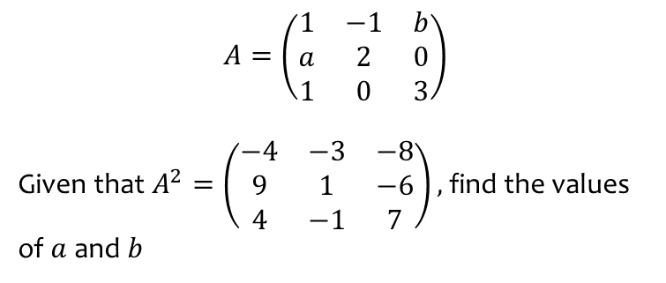
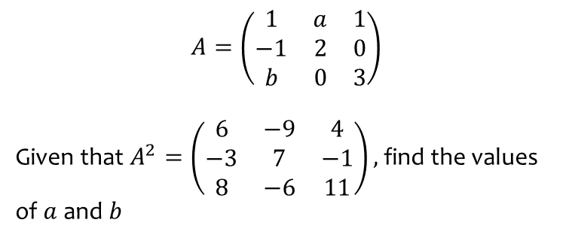
Worked example
Your turn
$$A=\left(\begin{matrix}1 & a & 1 \\ −1 & 2 & 0 \\ b & 0 & 3\end{matrix}\right)$$
Given that $A^{2}=\left(\begin{matrix}6 & −9 & 4 \\ −3 & 7 & −1 \\ 8 & −6 & 11\end{matrix}\right),$find the values of $a$and $b$
$$A=\left(\begin{matrix}1 & −1 & b \\ a & 2 & 0 \\ 1 & 0 & 3\end{matrix}\right)$$
Given that $A^{2}=\left(\begin{matrix}−4 & −3 & −8 \\ 9 & 1 & −6 \\ 4 & −1 & 7\end{matrix}\right),$find the values of $a$and $b$
$$a=3, b=−2$$

Slide 15
Worked example
Your turn
$A=\left(\begin{matrix}−2 \\ a\end{matrix}\right)$ and $B=(\begin{matrix}1 & b\end{matrix})$. Given that $BA=(0)$ find $AB$ in terms of $a$
$A=\left(\begin{matrix}−1 \\ a\end{matrix}\right)$ and $B=(\begin{matrix}b & 2\end{matrix})$. Given that $BA=(0)$ find $AB$ in terms of $a$
$$AB=\left(\begin{matrix}−2a & −2 \\ 2a^{2} & 2a\end{matrix}\right)$$

Slide 16

Worked example
Your turn
Find:
$$\left(\begin{matrix}1 & 2 \\ 3 & 4\end{matrix}\right)\left(\begin{matrix}1 & 0 \\ 0 & 1\end{matrix}\right)$$
$$\left(\begin{matrix}1 & 2 \\ 3 & 4 \\ 5 & 6\end{matrix}\right)\left(\begin{matrix}1 & 0 \\ 0 & 1\end{matrix}\right)$$
$$\left(\begin{matrix}1 & 2 & 3 \\ 4 & 5 & 6\end{matrix}\right)\left(\begin{matrix}1 & 0 \\ 0 & 1\end{matrix}\right)$$
$$\left(\begin{matrix}1 & 0 \\ 0 & 1\end{matrix}\right)\left(\begin{matrix}1 & 2 & 3 \\ 4 & 5 & 6\end{matrix}\right)$$
Find:
$$\left(\begin{matrix}1 & 2 & 3 \\ 4 & 5 & 6 \\ 7 & 8 & 9\end{matrix}\right)\left(\begin{matrix}1 & 0 & 0 \\ 0 & 1 & 0 \\ 0 & 0 & 1\end{matrix}\right)$$
$$\left(\begin{matrix}1 & 2 & 3 \\ 4 & 5 & 6 \\ 7 & 8 & 9\end{matrix}\right)$$

Slide 17
6.3) Determinants
Chapter CONTENTS

Slide 18
Worked example
Your turn
Calculate the determinant then decide if the matrix has an inverse.
$$\left(\begin{matrix}1 & 0 \\ 0 & 1\end{matrix}\right)$$
$$\left(\begin{matrix}1 & −2 \\ −3 & −4\end{matrix}\right)$$
$$\left(\begin{matrix}1 & −2 \\ −3 & 6\end{matrix}\right)$$
$$\text{Calculate} \text{the} \text{determinant} \text{then} \text{decide} \text{if} \text{the} \text{matrix} \text{has} \text{an} \text{inverse}\text{.}$$
$$\left(\begin{matrix}0 & −3 \\ −1 & −4\end{matrix}\right)$$
$$\left(\begin{matrix}10 & −2 \\ 5 & −1\end{matrix}\right)$$
$−7$ Yes
$0$ No

Slide 19
Worked example
Your turn
$$A=\left(\begin{matrix}3 & p−1 \\ −2 & 4−p\end{matrix}\right)$$
Given that $A$ is singular, find the value of $p$.
$$A=\left(\begin{matrix}4 & p+2 \\ −1 & 3−p\end{matrix}\right)$$
Given that $A$ is singular, find the value of $p$.
$$p=\frac{14}{3}$$

Slide 20



Worked example
Your turn
$$\left|\begin{matrix}3 & 1 & 4 \\ 7 & 2 & 5 \\ −3 & 4 & 3\end{matrix}\right|$$
Find the minor of:
2
-3
7
$$\left(\begin{matrix}1 & 2 & 0 \\ 4 & 5 & −6 \\ −1 & 8 & 2\end{matrix}\right)$$
Find the minor of:
5
0
-6
$$\left|\begin{matrix}1 & 0 \\ −1 & 2\end{matrix}\right|=2$$
$$\left|\begin{matrix}4 & 5 \\ −1 & 8\end{matrix}\right|=37$$
$$\left|\begin{matrix}1 & 2 \\ −1 & 8\end{matrix}\right|=10$$

Slide 21
Worked example
Your turn
Calculate the determinant:
$$\left|\begin{matrix}2 & 1 & 0 \\ 5 & 4 & −6 \\ 8 & −1 & 2\end{matrix}\right|$$
Calculate the determinant:
$$\left|\begin{matrix}1 & 2 & 0 \\ 4 & 5 & −6 \\ −1 & 8 & 2\end{matrix}\right|$$
$$54$$

Slide 22
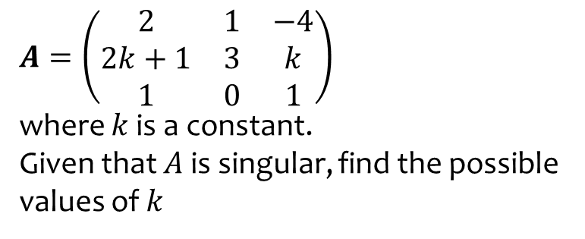
Worked example
Your turn
$A=\left(\begin{matrix}2 & 1 & −4 \\ 2k+1 & 3 & k \\ 1 & 0 & 1\end{matrix}\right)$
where $k$ is a constant.
Given that $A$ is singular, find the possible values of $k$
$A=\left(\begin{matrix}3 & k & 0 \\ −2 & 1 & 2 \\ 5 & 0 & k+3\end{matrix}\right)$
where $k$ is a constant.
Given that $A$ is singular, find the possible values of $k$
$$k=−\frac{1}{2},−9$$

Slide 23
6.4) Inverting a 2 x 2 matrix
Chapter CONTENTS

Slide 24

Worked example
Your turn
Find the inverse matrix for:
$$\left(\begin{matrix}2 & 0 \\ 0 & 2\end{matrix}\right)$$
$$\left(\begin{matrix}1 & 2 \\ 3 & 4\end{matrix}\right)$$
$$\left(\begin{matrix}4 & 3 \\ −2 & −1\end{matrix}\right)$$
Find the inverse matrix for
$$\left(\begin{matrix}1 & −2 \\ 3 & −4\end{matrix}\right)$$
$\frac{1}{2}\left(\begin{matrix}−4 & 2 \\ −3 & 1\end{matrix}\right)$ or $\left(\begin{matrix}−2 & 1 \\ −\frac{3}{2} & \frac{1}{2}\end{matrix}\right)$

Slide 25

Worked example
Your turn
For what value of $p$ is $\left(\begin{matrix}1 & 2−p \\ −4 & p+3\end{matrix}\right)$ singular?
Given $p$ is not this value, find the inverse.
For what value of $p$ is $\left(\begin{matrix}4 & p+2 \\ −1 & 3−p\end{matrix}\right)$ singular?
Given $p$ is not this value, find the inverse.
$$p=\frac{14}{3}$$
$$\frac{1}{14−3p} \left(\begin{matrix}3−p & −\left(p+2\right) \\ 1 & 4\end{matrix}\right)$$

Slide 26
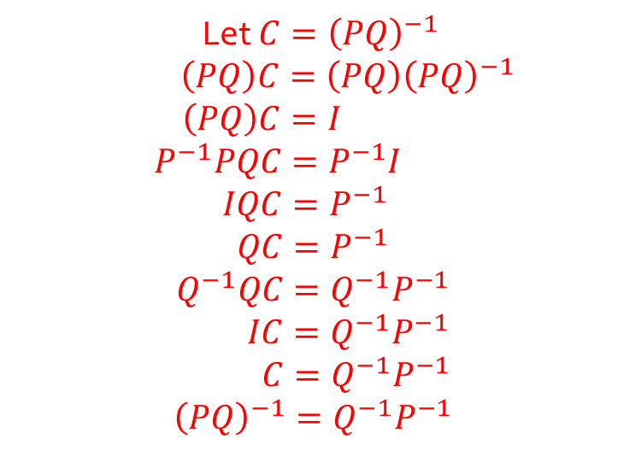
Worked example
Your turn
If $A$ and $B$ are non-singular matrices, prove that ${\left(AB\right)}^{−1}=B^{−1}A^{−1}$
If $P$ and $Q$ are non-singular matrices, prove that ${\left(PQ\right)}^{−1}=Q^{−1}P^{−1}$
Let $C={\left(PQ\right)}^{−1}$
$\left(PQ\right)C=\left(PQ\right){\left(PQ\right)}^{−1}$
$$\left(PQ\right)C=I$$
$$P^{−1}PQC=P^{−1}I$$
$$IQC=P^{−1}$$
$$QC=P^{−1}$$
$$Q^{−1}QC=Q^{−1}P^{−1}$$
$IC=Q^{−1}P^{−1}$
$C=Q^{−1}P^{−1}$
$${\left(PQ\right)}^{−1}=Q^{−1}P^{−1}$$

Slide 27
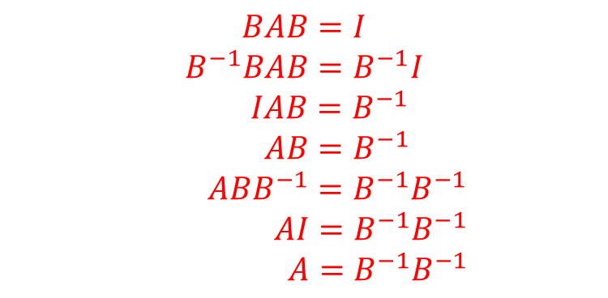
Worked example
Your turn
If $A$ and $B$ are non-singular matrices such that $ABA=I$, prove that $B=A^{−1}A^{−1}$
If $A$ and $B$ are non-singular matrices such that $BAB=I$, prove that $A=B^{−1}B^{−1}$
$$BAB=I$$
$$B^{−1}BAB=B^{−1}I$$
$IAB=B^{−1}$
$AB=B^{−1}$
$ABB^{−1}=B^{−1}B^{−1}$
$AI=B^{−1}B^{−1}$
$A=B^{−1}B^{−1}$

Slide 28
6.5) Inverting a 3 x 3 matrix
Chapter CONTENTS

Slide 29
Worked example
Your turn
If $A=\left(\begin{matrix}0 & −3 & −2 \\ 1 & −4 & −2 \\ −3 & 4 & 1\end{matrix}\right)$, find $A^{−1}$.
If $A=\left(\begin{matrix}1 & 3 & 1 \\ 0 & 4 & 1 \\ 2 & −1 & 0\end{matrix}\right)$, find $A^{−1}$.
$$\left(\begin{matrix}−1 & 1 & 1 \\ −2 & 2 & 1 \\ 8 & −7 & −4\end{matrix}\right)$$

Slide 30
Worked example
Your turn
$A=\left(\begin{matrix}5 & −4 & 4 \\ 8 & −7 & 8 \\ 2 & −2 & 3\end{matrix}\right)$,
Show that $A^{−1}=A$.
$A=\left(\begin{matrix}−2 & 3 & −3 \\ 0 & 1 & 0 \\ 1 & −1 & 2\end{matrix}\right)$,
Show that $A^{−1}=A$.
$$A^{2}=\left(\begin{matrix}−2 & 3 & −3 \\ 0 & 1 & 0 \\ 1 & −1 & 2\end{matrix}\right)\left(\begin{matrix}−2 & 3 & −3 \\ 0 & 1 & 0 \\ 1 & −1 & 2\end{matrix}\right)=\left(\begin{matrix}1 & 0 & 0 \\ 0 & 1 & 0 \\ 0 & 0 & 1\end{matrix}\right)$$

Slide 31
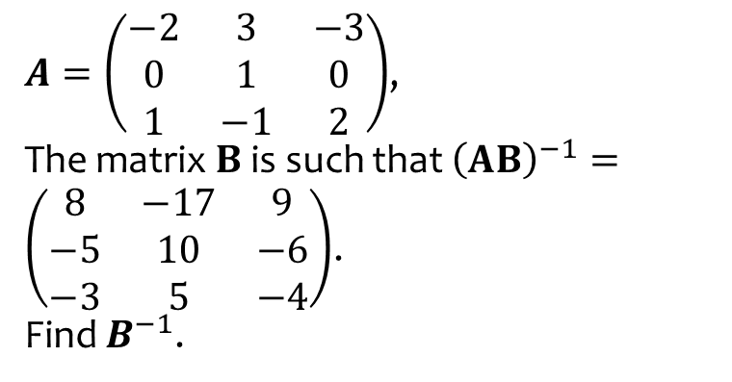
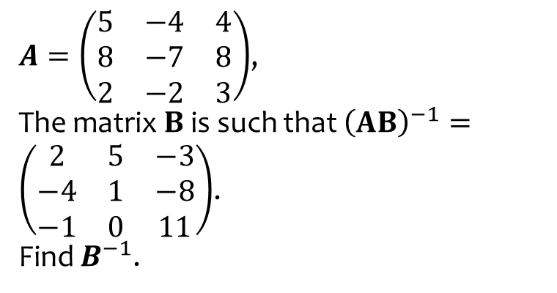
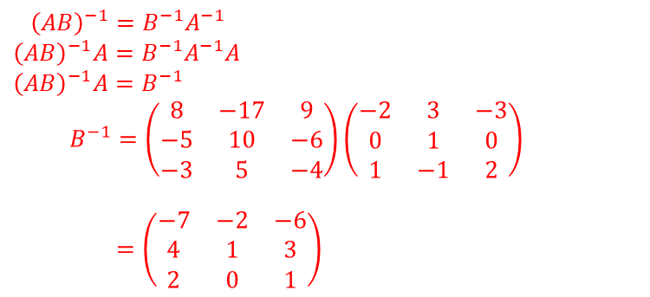
Worked example
Your turn
$A=\left(\begin{matrix}5 & −4 & 4 \\ 8 & −7 & 8 \\ 2 & −2 & 3\end{matrix}\right)$,
The matrix $B$ is such that ${\left(AB\right)}^{−1}=\left(\begin{matrix}2 & 5 & −3 \\ −4 & 1 & −8 \\ −1 & 0 & 11\end{matrix}\right)$.
Find $B^{−1}$.
$A=\left(\begin{matrix}−2 & 3 & −3 \\ 0 & 1 & 0 \\ 1 & −1 & 2\end{matrix}\right)$,
The matrix $B$ is such that ${\left(AB\right)}^{−1}=\left(\begin{matrix}8 & −17 & 9 \\ −5 & 10 & −6 \\ −3 & 5 & −4\end{matrix}\right)$.
Find $B^{−1}$.
$${\left(AB\right)}^{−1}=B^{−1}A^{−1} \\ {\left(AB\right)}^{−1}A=B^{−1}A^{−1}A \\ {\left(AB\right)}^{−1}A=B^{−1}$$ $B^{−1}=\left(\begin{matrix}8 & −17 & 9 \\ −5 & 10 & −6 \\ −3 & 5 & −4\end{matrix}\right)\left(\begin{matrix}−2 & 3 & −3 \\ 0 & 1 & 0 \\ 1 & −1 & 2\end{matrix}\right)$
$=\left(\begin{matrix}−7 & −2 & −6 \\ 4 & 1 & 3 \\ 2 & 0 & 1\end{matrix}\right)$

Slide 32
Worked example
Your turn
$$A=\left(\begin{matrix}k & 1 & −1 \\ −1 & 0 & 1 \\ 1 & −2 & 3\end{matrix}\right), k≠−1$$
Find the inverse matrix of A in terms of $k$
$$A=\left(\begin{matrix}k & −1 & 1 \\ 1 & 0 & −1 \\ 3 & −2 & 1\end{matrix}\right), k≠1$$
Find the inverse matrix of A in terms of $k$
$$A^{−1}=\frac{1}{2−2k}\left(\begin{matrix}−2 & −1 & 1 \\ −4 & k−3 & k+1 \\ −2 & 2k−3 & 1\end{matrix}\right)$$

Slide 33
Worked example
Your turn
Find the inverse of the matrix using elementary row operations
$$\left(\begin{matrix}3 & 0 & 2 \\ 2 & 0 & −2 \\ 0 & 1 & 1\end{matrix}\right)$$
Find the inverse of the matrix using elementary row operations
$$\left(\begin{matrix}1 & 0 & −3 \\ 2 & −2 & 1 \\ 0 & −1 & 3\end{matrix}\right)$$
$$\left(\begin{matrix}−5 & 3 & −6 \\ −6 & 3 & −7 \\ −2 & 1 & −2\end{matrix}\right)$$

Slide 34
6.6) Solving systems of equations using matrices
Chapter CONTENTS

Slide 35
Worked example
Your turn
Solve the simultaneous equations:
$$6x−y+2z=6$$
$$−x+2y−6z=3$$
$$2x−3y−5z=24$$
Solve the simultaneous equations:
$$−x+6y−2z=21 \\ 6x−2y−z=−16 \\ −2x+3y+5z=24$$
$$x=−1, y=4, z=2$$

Slide 36
Worked example
Your turn
A llama farmer has three types of llama: woolly, classic and Suri. Initially his flock had 2810 llamas in it. There were 160 more woolly llamas than classic.
After one year:
The number of woolly llamas had increased by 5%
The number of classic llamas had increased by 3%
The number of Suri llamas had decreased by 4%
Overall the flock size had increased by 46
Form and solve a matrix equation to find out how many of each type of llama there were in the initial flock.
A colony of 1000 mole-rats is made up of adult males, adult females and youngsters. Originally there were 100 more adult females than adult males.
After one year:
The number of adult males had increased by 2%
The number of adult females had increased by 3%
The number of youngsters had decreased by 4%
The total number of mole-rats had decreased by 20
Form and solve a matrix equation to find out how many of each type of mole-rat were in the original colony.
$100$adult males, 200 adult females, 700 youngsters in the original colony

Slide 37
Worked example
Your turn
The system of equations is consistent and has a single solution. Determine the possible values of $k$.
$$x−3y−2z=7 \\ kx−y+3z=11 \\ x−y+z=13$$
The system of equations is consistent and has a single solution. Determine the possible values of $k$.
$$2x+3y−z=13 \\ 3x−y+kz=11 \\ x+y+z=7$$
$$k≠15$$

Slide 38
Worked example
Your turn
A system of equations is shown below:
$$3x−ky−6z=k \\ kx+3y+3z=2 \\ −3x−y+3z=−2$$
For each of the following values of $k$, determine whether the system of equations is consistent or inconsistent.
If the system is consistent, determine whether there is a unique solution or an infinity of solutions.
In each case, identify the geometric configuration of the plane corresponding to each value of $k$.
(a) $k=0$ (b) $k=−6$
A system of equations is shown below:
$$3x−ky−6z=k \\ kx+3y+3z=2 \\ −3x−y+3z=−2$$
For each of the following values of $k$, determine whether the system of equations is consistent or inconsistent.
If the system is consistent, determine whether there is a unique solution or an infinity of solutions.
In each case, identify the geometric configuration of the plane corresponding to each value of $k$.
(a) $k=1$
(a) $k=1$: $\left|\begin{matrix}3 & −1 & −6 \\ 1 & 3 & 3 \\ −3 & −1 & 3\end{matrix}\right|=0$
$$3x−y−6z=1 (1) \\ x+3y+3z=2 (2) \\ −3x−y+3z=−2 (3)$$
$\left(1\right)+2×\left(2\right):$ $5x+5y=5 (4)$
$\left(2\right)−\left(3\right):$ $4x+4y=4$ $(5)$
Equations (4) and (5) are consistent so system is consistent and has an infinity of solutions. Planes meet at a sheaf

Slide 39
Worked example
Your turn
A system of equations is shown below:
$x−ry−6z=r$ $rx−4y−12z=s$ $−3x+ty+18z=u$
For each of the following values of $r, s$ and $t$, determine whether the system of equations is consistent or inconsistent.
If the system is consistent, determine whether there is a unique solution or an infinity of solutions.
In each case, identify the corresponding geometric configuration.
(a) $r=2, s=5, t=4, u=1$
(b) $r=2, s=4, t=6, u=−6$
A system of equations is shown below:
$x−ry−6z=r$ $rx−4y−12z=s$ $−3x+ty+18z=u$
For each of the following values of $r, s$ and $t$, determine whether the system of equations is consistent or inconsistent.
If the system is consistent, determine whether there is a unique solution or an infinity of solutions.
In each case, identify the corresponding geometric configuration.
(a) $r=2, s=4, t=6, u=−5$
(a) $\left|\begin{matrix}1 & −2 & −6 \\ 2 & −4 & −12 \\ −3 & 6 & 18\end{matrix}\right|=0$
$x−2y−6z=2 (1)$ $2x−4y−12z=4 (2)$ $$−3x+6y+18z=−5 (3)$$
All three planes are parallel and non-identical.
The system of equations is inconsistent and has no solutions.

