Slide 1
6) Hyperbolic functions
6.1) Introduction to hyperbolic functions
6.2) Inverse hyperbolic functions
6.3) Identities and equations
6.4) Differentiating hyperbolic functions
6.5) Integrating hyperbolic functions

Slide 2
6.1) Introduction to hyperbolic functions
Chapter CONTENTS

Slide 3



Worked example
Your turn
$$\sinh{x}=\frac{e^{x}−e^{−x}}{2}$$
$$cosech x=$$
$$\cosh{x}=\frac{e^{x}+e^{−x}}{2}$$
$$sech x=$$
$\frac{2}{e^{x}+e^{−x}}$

Slide 4



Worked example
Your turn
Find to 2 decimal places, the values of:
$$\sinh{2}$$
$$\cosh{0}$$
$$\tanh{1.8}$$
Find to 2 decimal places, the values of:
$$\sinh{3}$$
$$\cosh{1}$$
$$\tanh{0.8}$$
$$10.02$$
$$1.54$$
$$0.66$$

Slide 5



Worked example
Your turn
Find the exact values of:
$$\sinh{(ln{3})}$$
$$\cosh{(ln{2)}}$$
$$\tanh{(\ln{5)}}$$
Find the exact values of:
$$\sinh{(ln{2})}$$
$$\cosh{(ln{3)}}$$
$$\tanh{(\ln{4)}}$$
$$\frac{3}{4}$$
$$\frac{5}{3}$$
$$\frac{15}{17}$$

Slide 6
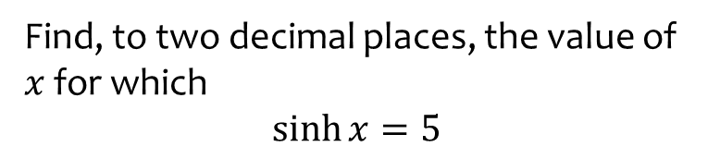
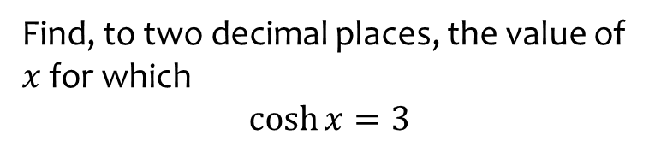
Worked example
Your turn
Find, to two decimal places, the value of $x$ for which
$\cosh{x}=3$
Find, to two decimal places, the value of $x$ for which
$\sinh{x}=5$
$$x=2.31$$

Slide 7
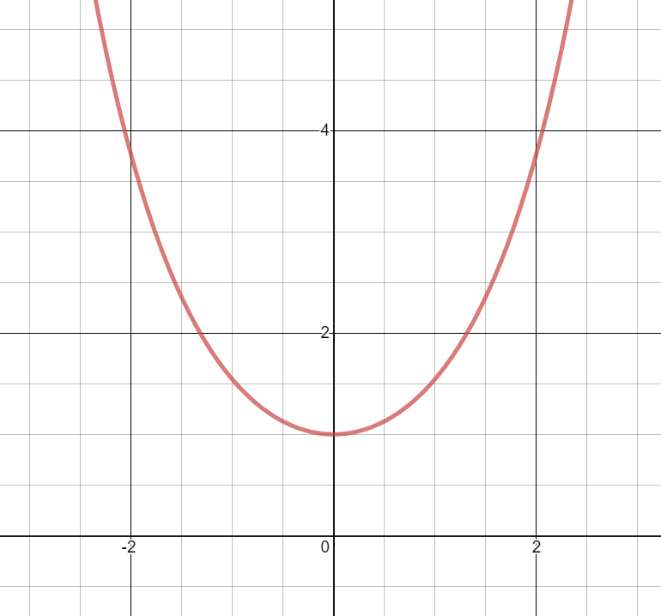
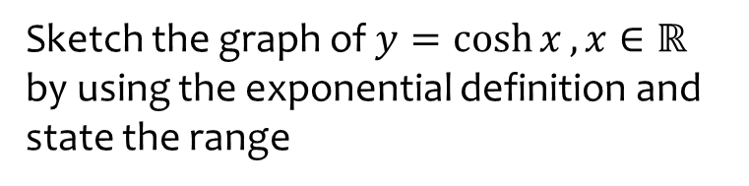


Worked example
Your turn
Sketch the graph of $y=\sinh{x}$ by using the exponential definition and state the range
Sketch the graph of $y=\cosh{x}, x∈ℝ$
by using the exponential definition and state the range
$$\cosh{x}≥1$$
Graphs used with permission from DESMOS: https://www.desmos.com/

Slide 8
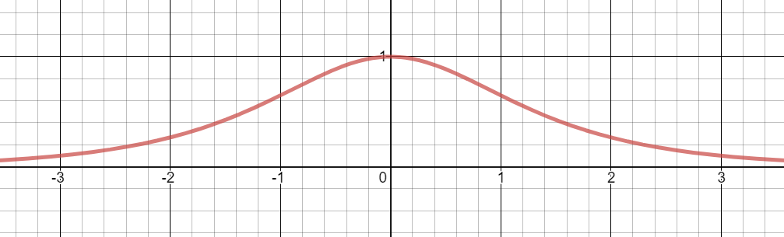
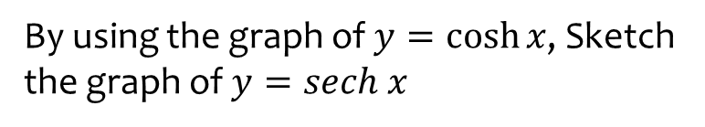

Worked example
Your turn
By using the graph of $y=\sinh{x}$, sketch the graph of $y=cosech x$
By using the graph of $y=\cosh{x}$, Sketch the graph of $y=sech x$
Graphs used with permission from DESMOS: https://www.desmos.com/

Slide 9
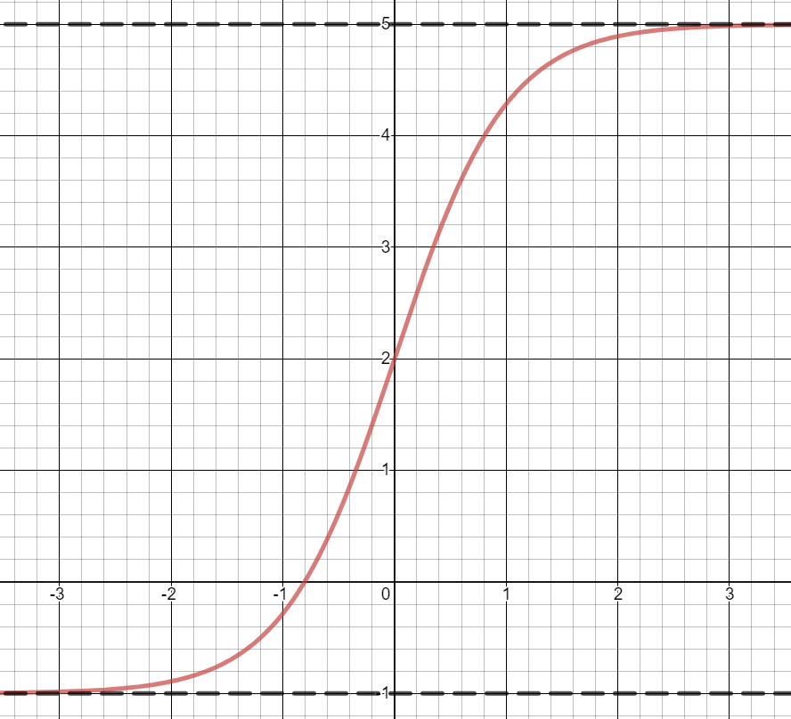
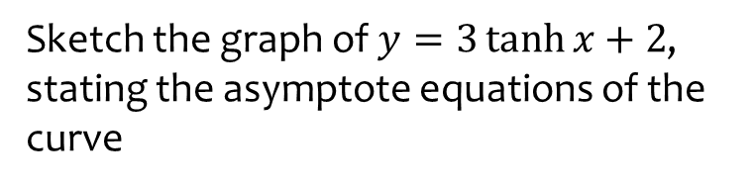
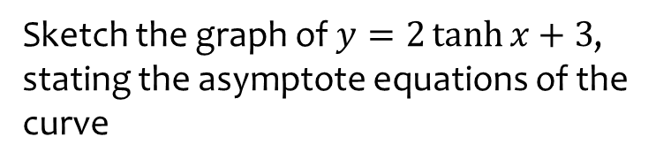
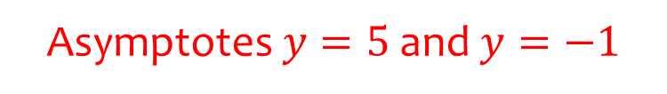
Worked example
Your turn
Sketch the graph of $y=2\tanh{x}+3$, stating the asymptote equations of the curve
Sketch the graph of $y=3\tanh{x}+2$, stating the asymptote equations of the curve
Asymptotes $y=5$ and $y=−1$
Graphs used with permission from DESMOS: https://www.desmos.com/

Slide 10
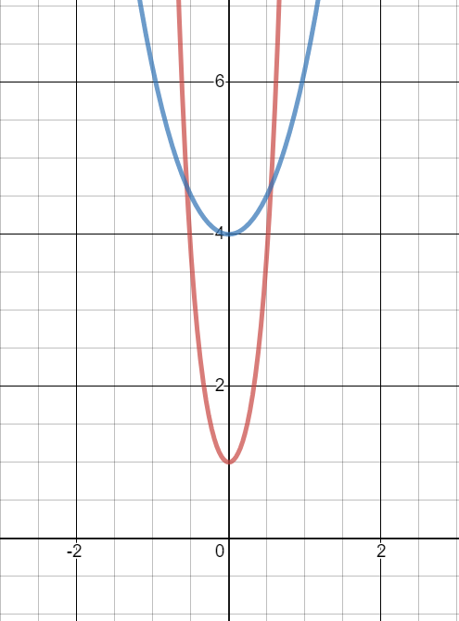
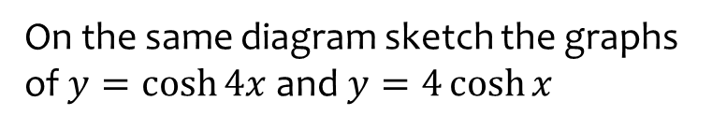
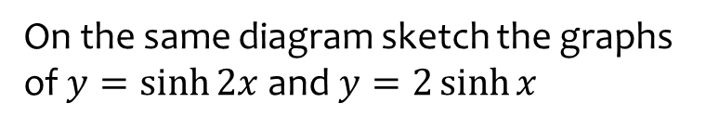
Worked example
Your turn
On the same diagram sketch the graphs of $y=\sinh{2x}$ and $y=2\sinh{x}$
On the same diagram sketch the graphs of $y=\cosh{4x}$ and $y=4\cosh{x}$
Graphs used with permission from DESMOS: https://www.desmos.com/

Slide 11
6.2) Inverse hyperbolic functions
Chapter CONTENTS

Slide 12
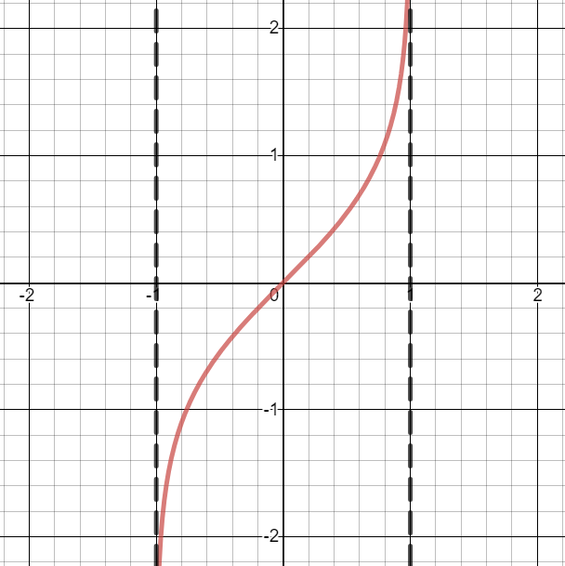


Worked example
Your turn
Sketch the graphs of:
$$y=arsinh x$$
$$y=arcosh x$$
Sketch the graphs of:
$$y=artanh x$$
Graphs used with permission from DESMOS: https://www.desmos.com/

Slide 13



Worked example
Your turn
Express as natural logarithms:
$$arsinh 2$$
$$arcosh 1$$
$$artanh 3$$
Express as natural logarithms:
$$arsinh 1$$
$$arcosh 2$$
$$artanh\frac{1}{3}$$
$$\ln\left(1+\sqrt{2}\right)$$
$$\ln{(2+\sqrt{3}})$$
$$\ln{\sqrt{2}}$$

Slide 14
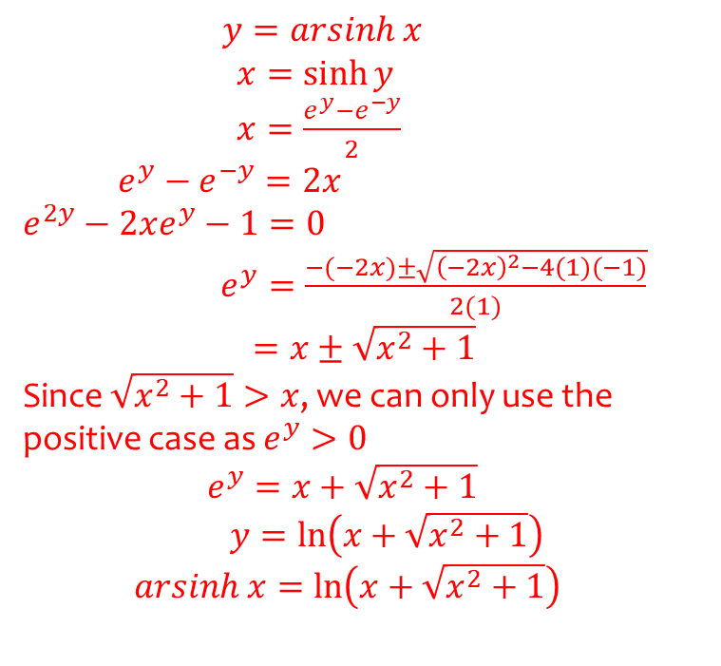
Worked example
Your turn
Prove that $arcosh x=\ln\left(x+\sqrt{x^{2}−1}\right), x≥1$
Prove that $arsinh x=\ln\left(x+\sqrt{x^{2}+1}\right)$
$y=arsinh x$
$x=\sinh{y}$
$x=\frac{e^{y}−e^{−y}}{2}$
$e^{y}−e^{−y}=2x$
$$e^{2y}−2xe^{y}−1=0$$
$e^{y}=\frac{−(−2x)±\sqrt{{\left(−2x\right)}^{2}−4(1)(−1)}}{2(1)}$
$=x±\sqrt{x^{2}+1}$
Since $\sqrt{x^{2}+1}>x$, we can only use the positive case as $e^{y}>0$
$e^{y}=x+\sqrt{x^{2}+1}$
$y=\ln\left(x+\sqrt{x^{2}+1}\right)$
$arsinh x=\ln\left(x+\sqrt{x^{2}+1}\right)$

Slide 15
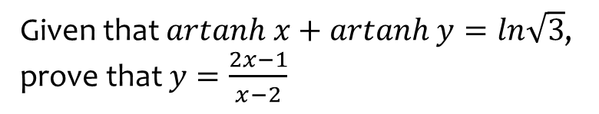
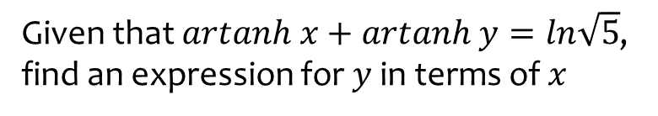
Worked example
Your turn
Given that $artanh x+artanh y=ln\sqrt{5}$, find an expression for $y$ in terms of $x$
Given that $artanh x+artanh y=ln\sqrt{3}$, prove that $y=\frac{2x−1}{x−2}$
Proof

Slide 16
6.3) Identities and equations
Chapter CONTENTS

Slide 17
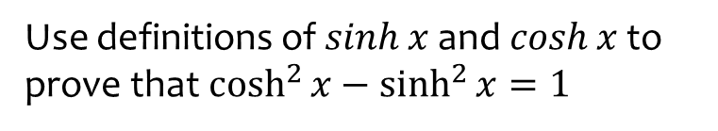
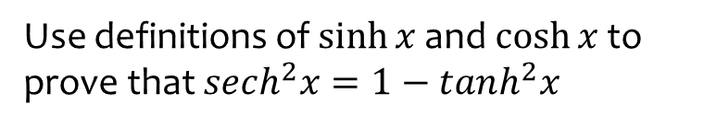
Worked example
Your turn
Use definitions of $\sinh{x}$ and $\cosh{x}$ to prove that $sech^{2}x=1−tanh^{2}x$
Use definitions of $\sinh{x}$ and $\cosh{x}$ to prove that$\cosh^{2}{x}−\sinh^{2}{x}=1$
Proof

Slide 18


Worked example
Your turn
Use definitions of $\sinh{x}$ and $\cosh{x}$ to prove that:
$$sinh \left(A+B\right)=sinh A cosh B+cosh A sinh B$$
$$cosh \left(A−B\right)=cosh A cosh B−sinh A sinh B$$
Use definitions of $\sinh{x}$ and $\cosh{x}$ to prove that:
$$sinh \left(A−B\right)=sinh A cosh B−cosh A sinh B$$
$$cosh \left(A+B\right)=cosh A cosh B+sinh A sinh B$$
Proof
Proof

Slide 19
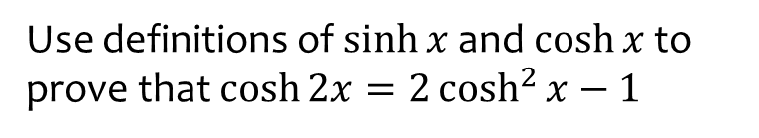
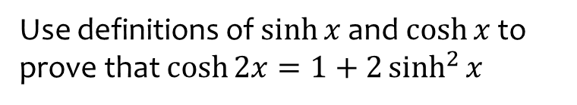
Worked example
Your turn
Use definitions of $\sinh{x}$ and $\cosh{x}$ to prove that $\cosh{2x}=1+2\sinh^{2}{x}$
Use definitions of $\sinh{x}$ and $\cosh{x}$ to prove that $\cosh{2x}=2\cosh^{2}{x}−1$
Proof

Slide 20
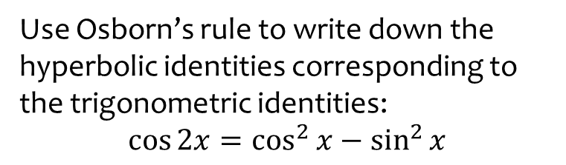
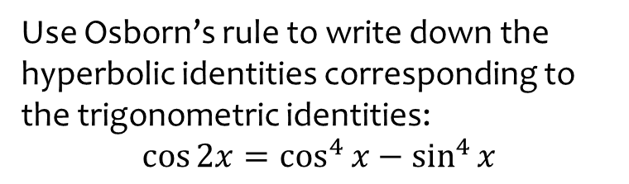
Worked example
Your turn
Use Osborn’s rule to write down the hyperbolic identities corresponding to the trigonometric identities:
$$\cos{2x}=\cos^{4}{x}−\sin^{4}{x}$$
Use Osborn’s rule to write down the hyperbolic identities corresponding to the trigonometric identities:
$$\cos{2x}=\cos^{2}{x}−\sin^{2}{x}$$
$$\cosh{2x}=\cosh^{2}{x}+\sinh^{2}{x}$$

Slide 21



Worked example
Your turn
Given that $\sinh{x}=\frac{3}{5}$, find the exact value of:
$$\cosh{x}$$
$$\tanh{x}$$
$$\sinh{2x}$$
Given that $\sinh{x}=\frac{3}{4}$, find the exact value of:
$$\cosh{x}$$
$$\tanh{x}$$
$$\sinh{2x}$$
$\frac{5}{4}$
$\frac{3}{5}$
$\frac{15}{8}$

Slide 22
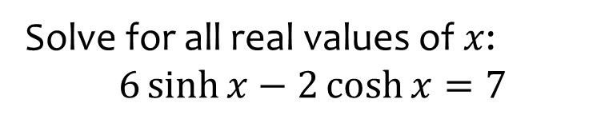
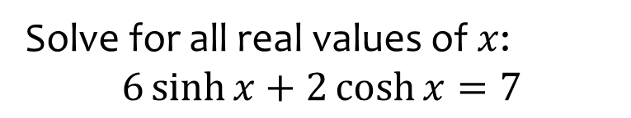

Worked example
Your turn
Solve for all real values of $x$:
$$6\sinh{x}+2\cosh{x}=7$$
Solve for all real values of $x$:
$$6\sinh{x}−2\cosh{x}=7$$
$$x=\ln{4}$$

Slide 23
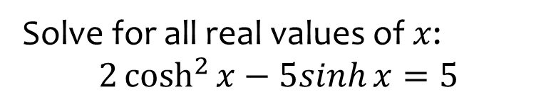
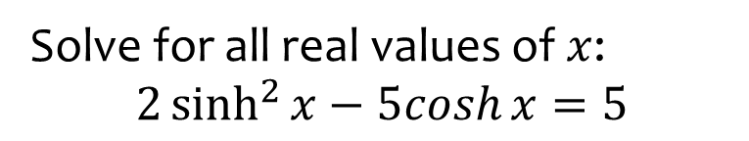

Worked example
Your turn
Solve for all real values of $x$:
$$2\sinh^{2}{x}−5cosh{x}=5$$
Solve for all real values of $x$:
$$2\cosh^{2}{x}−5sinh{x}=5$$
$x=\ln\left(−\frac{1}{2}+\frac{\sqrt{5}}{2}\right)$
$x=\ln\left(3+\sqrt{10}\right)$

Slide 24
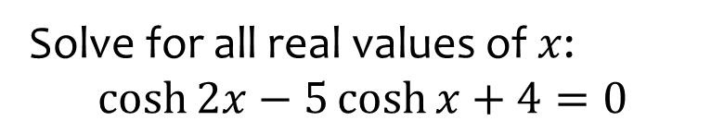
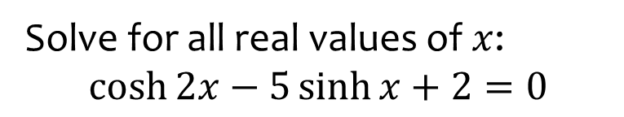

Worked example
Your turn
Solve for all real values of $x$:
$$\cosh{2x}−5\sinh{x}+2=0$$
Solve for all real values of $x$:
$$\cosh{2x}−5\cosh{x}+4=0$$
$x=\ln\left(\frac{3±\sqrt{5}}{2}\right), x=0$

Slide 25
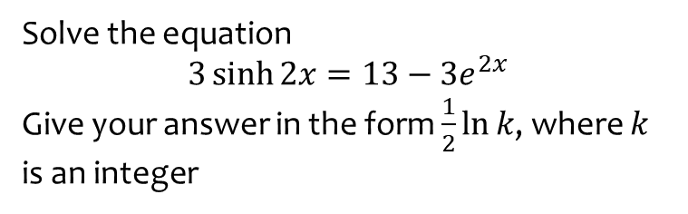
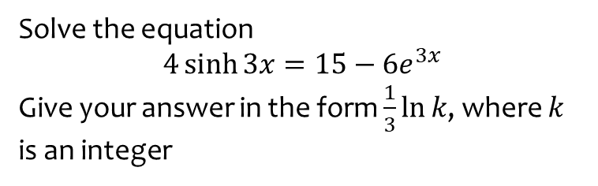

Worked example
Your turn
Solve the equation
$$4\sinh{3x}=15−6e^{3x}$$
Give your answer in the form $\frac{1}{3}\ln{k}$, where $k$ is an integer
Solve the equation
$$3\sinh{2x}=13−3e^{2x}$$
Give your answer in the form $\frac{1}{2}\ln{k}$, where $k$ is an integer
$$x=\frac{1}{2}\ln{3}$$

Slide 26
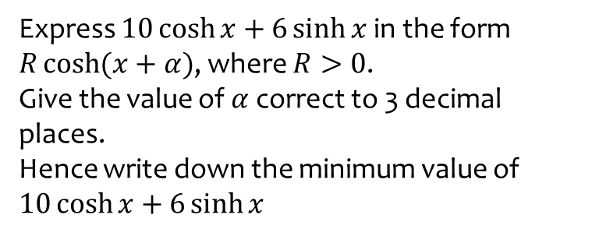
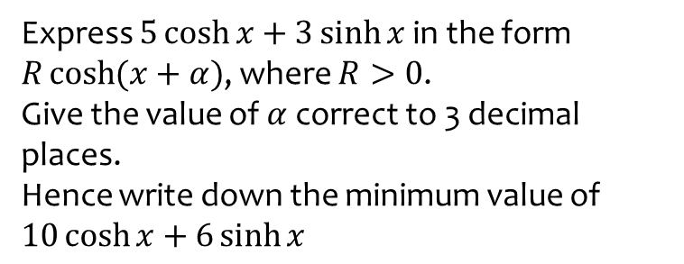

Worked example
Your turn
Express $5\cosh{x}+3\sinh{x}$ in the form $R\cosh{(x+α})$, where $R>0$.
Give the value of $α$ correct to 3 decimal places.
Hence write down the minimum value of $10\cosh{x}+6\sinh{x}$
Express $10\cosh{x}+6\sinh{x}$ in the form $R\cosh{(x+α})$, where $R>0$.
Give the value of $α$ correct to 3 decimal places.
Hence write down the minimum value of $10\cosh{x}+6\sinh{x}$
$$8\cosh{(x+0.693)}$$
Minimum $=8$

Slide 27
6.4) Differentiating hyperbolic functions
Chapter CONTENTS

Slide 28


Worked example
Your turn
Prove that $\frac{d}{dx}\left(\sinh{x}\right)=\cosh{x}$
Prove that $\frac{d}{dx}\left(\cosh{x}\right)=\sinh{x}$
Proof

Slide 29



Worked example
Your turn
Differentiate with respect to $x$:
$$\sinh{7x}$$
$$\cosh{6x}$$
$$\tanh{5x}$$
Differentiate with respect to $x$:
$$\sinh{2x}$$
$$\cosh{3x}$$
$$\tanh{4x}$$
$$2\cosh{2x}$$
$$3\sinh{3x}$$
$$4{sech}^{2}{4x}$$

Slide 30



Worked example
Your turn
Differentiate with respect to $x$:
$$x^{3}\sinh{5x}$$
Differentiate with respect to $x$:
$$x^{2}\cosh{4x}$$
$$2x\cosh{4x}+4x^{2}\sinh{4x}$$

Slide 31


Worked example
Your turn
$$y=\frac{1}{2}\ln{(\tanh{x})}$$
Show that $\frac{dy}{dx}=cosech 2x$
$$y=\frac{1}{2}\ln{(\coth{x})}$$
Show that $\frac{dy}{dx}=−cosech 2x$
Shown

Slide 32



Worked example
Your turn
Prove that
$$\frac{d}{dx}\left(\operatorname{arsinh}{x}\right)=\frac{1}{\sqrt{x^{2}+1}}$$
Prove that
$$\frac{d}{dx}\left(\operatorname{arcosh}{x}\right)=\frac{1}{\sqrt{x^{2}−1}}$$
$$y=arcosh x$$
$$x=\cosh{y}$$
$$\frac{dx}{dy}=\sinh{y}$$
$$\frac{dy}{dx}=\frac{1}{\sinh{y}}$$
$$\frac{dy}{dx}=\frac{1}{\sqrt{\cosh^{2}{y}−1}}$$
$$\frac{dy}{dx}=\frac{1}{\sqrt{x^{2}−1}}$$

Slide 33



Worked example
Your turn
Differentiate with respect to $x$:
$$arsinh 7x$$
$$arcosh 6x$$
$$artanh 5x$$
Differentiate with respect to $x$:
$$arsinh 2x$$
$$arcosh 3x$$
$$artanh 4x$$
$$\frac{2}{\sqrt{4x^{2}+1}}$$
$$\frac{3}{\sqrt{9x^{2}−1}}$$
$$\frac{4}{1−16x^{2}}$$

Slide 34


Worked example
Your turn
Given that $y={\left(arsinh x\right)}^{4}$ prove that $\left(x^{2}+1\right){\left(\frac{dy}{dx}\right)}^{2}=16y^{\frac{3}{2}}$
Given that $y={\left(arcosh x\right)}^{2}$ prove that $\left(x^{2}−1\right){\left(\frac{dy}{dx}\right)}^{2}=4y$
Proof

Slide 35



Worked example
Your turn
Show that $\frac{d}{dx}\left(arsinh x\right)=\frac{1}{\sqrt{1+x^{2}}}$
Find the first two non-zero terms of the series expansion of $arsinh x$.
The general form for the series expansion of $arsinh x$ is given by
$$arsinh x=\sum_{r=0}^{∞}{\left(\frac{{\left(−1\right)}^{n}\left(2n\right)!}{2^{2n}{\left(n!\right)}^{2}}\right)\frac{x^{2n+1}}{2n+1}}$$
(c) Find, in simplest terms, the coefficient of $x^{7}$.
(d) Use your approximation up to and including the term in $x^{7}$ to find an approximate value for $arsinh 0.5$.
(e) Calculate the percentage error in using this approximation.
Show that $\frac{d}{dx}\left(arsinh x\right)=\frac{1}{\sqrt{1+x^{2}}}$
Find the first two non-zero terms of the series expansion of $arsinh x$.
The general form for the series expansion of $arsinh x$ is given by
$$arsinh x=\sum_{r=0}^{∞}{\left(\frac{{\left(−1\right)}^{n}\left(2n\right)!}{2^{2n}{\left(n!\right)}^{2}}\right)\frac{x^{2n+1}}{2n+1}}$$
(c) Find, in simplest terms, the coefficient of $x^{5}$.
(d) Use your approximation up to and including the term in $x^{5}$ to find an approximate value for $arsinh 0.5$.
(e) Calculate the percentage error in using this approximation.
Shown
$x−\frac{1}{6}x^{3}$
$\frac{3}{40}$
$0.48151…$
$0.062\%$(3 d.p.)

Slide 36



Worked example
Your turn
Find the exact coordinates of the stationary point on the curve with equation $y=6\cosh{x}−\sinh{x}$
Find the exact coordinates of the stationary point on the curve with equation $y=12\cosh{x}−\sinh{x}$
$$\left(\frac{1}{2}\ln{\frac{13}{11},\sqrt{143}}\right)$$

Slide 37



Worked example
Your turn
Find the first three non-zero terms of the Maclaurin series for $\sinh{x}$
Hence find the percentage error when this approximation is used to evaluate $\sinh{0.4}$
Find the first three non-zero terms of the Maclaurin series for $\cosh{x}$
Hence find the percentage error when this approximation is used to evaluate $\cosh{0.2}$
$$1+\frac{1}{2}x^{2}+\frac{1}{24}x^{4}$$
$$0.0000087\%$$

Slide 38
6.5) Integrating hyperbolic functions
Chapter CONTENTS

Slide 39



Worked example
Your turn
Find:
$$\int{\cosh\left(3x−2\right)dx}$$
$$\int{sinh \left(\frac{5}{7}x\right)} dx$$
$$\int{\frac{7}{\sqrt{1+x^{2}}}dx}$$
$$\int{\frac{6}{\sqrt{x^{2}−1}}dx}$$
$$\int{sinh \left(5x\right)} dx$$
$$\int{\frac{4}{\sqrt{x^{2}−1}}dx}$$
$$\int{\frac{3}{\sqrt{1+x^{2}}}dx}$$
Find:
$$\int{\cosh\left(4x−1\right)dx}$$
$$\int{sinh \left(\frac{2}{3}x\right)} dx$$
$$\int{\frac{3}{\sqrt{1+x^{2}}}dx}$$
$$\int{\frac{4}{\sqrt{x^{2}−1}}dx}$$
$$\int{sinh \left(3x\right)} dx$$
$$\int{\frac{10}{\sqrt{x^{2}−1}}dx}$$
$$\int{\frac{2}{\sqrt{1+x^{2}}}dx}$$
$$\frac{1}{4}\sinh\left(4x−1\right)+c$$
$$\frac{3}{2}\cosh\left(\frac{2}{3}x\right)+c$$
$$3 arsinh x+c$$
$$4 arcosh x+c$$
$$\frac{1}{3}\cosh\left(3x\right)+c$$
$$10 arcosh x+c$$
$$2 arsinh x+c$$

Slide 40


Worked example
Your turn
Find:
$$\int{\frac{3−7x}{\sqrt{x^{2}+1}} dx}$$
Find:
$$\int{\frac{2+5x}{\sqrt{x^{2}+1}} dx}$$
$$2 arsinh x+5\sqrt{1+x^{2}}+c$$

Slide 41



Worked example
Your turn
Find:
$$\int{\sinh^{7}{3x}\cosh{3x} dx}$$
Find:
$$\int{\cosh^{5}{2x}\sinh{2x} dx}$$
$$\frac{1}{12}\cosh^{6}{2x}+c$$

Slide 42


Worked example
Your turn
Find:
$$\int{\coth{x} dx}$$
Find:
$$\int{\tanh{x} dx}$$
$$\ln\left|\cosh{x}\right|+C$$

Slide 43



Worked example
Your turn
Find:
$$\int{\sinh^{2}{5x} dx}$$
Find:
$$\int{\cosh^{2}{3x} dx}$$
$$\frac{1}{2}x+\frac{1}{12}\sinh{6x}+c$$

Slide 44



Worked example
Your turn
Find:
$$\int{\cosh^{3}{x} dx}$$
Find:
$$\int{\sinh^{3}{x} dx}$$
$$\frac{1}{3}\cosh^{3}{x}−\cosh{x}+c$$

Slide 45



Worked example
Your turn
Find:
$$\int{e^{3x}\cosh{x} dx}$$
Find:
$$\int{e^{2x}\sinh{x} dx}$$
$$\frac{1}{6}\left(e^{3x}−3e^{x}\right)+c$$

Slide 46


Worked example
Your turn
Find:
$$\int{cosech x dx}$$
(requires partial fractions)
Find:
$$\int{\operatorname{sech}{x} dx}$$
$$2\arctan\left(e^{x}\right)+c$$

Slide 47


Worked example
Your turn
Show that $\int{\frac{1}{\sqrt{a^{2}+x^{2}}}dx}=arsinh \left(\frac{x}{a}\right)+c$
Show that $\int{\frac{1}{\sqrt{x^{2}−a^{2}}}dx}=arcosh \left(\frac{x}{a}\right)+c$
Shown

Slide 48



Worked example
Your turn
Evaluate $\int_{5}^{8}{\frac{1}{\sqrt{x^{2}+16}}dx}$
Evaluate $\int_{5}^{8}{\frac{1}{\sqrt{x^{2}−16}}dx}$
$$\ln\left(\frac{2+\sqrt{3}}{2}\right)$$

Slide 49



Worked example
Your turn
By using a hyperbolic substitution, show that
$$\int{\sqrt{x^{2}−1} dx}=\frac{1}{2}x\sqrt{x^{2}−1}−\frac{1}{2}arcosh x+c$$
By using a hyperbolic substitution, show that
$$\int{\sqrt{1+x^{2}} dx}=\frac{1}{2}arsinh x+\frac{1}{2}x\sqrt{1+x^{2}}+c$$
Shown using $x=\sinh{u}$
NB: Can also use $x=\tan{u }$but longer

Slide 50


Worked example
Your turn
Using a hyperbolic substitution, evaluate
$$\int_{4}^{8}{\frac{x^{3}}{\sqrt{x^{2}−16}} dx}$$
Using a hyperbolic substitution, evaluate
$$\int_{0}^{6}{\frac{x^{3}}{\sqrt{x^{2}+9}} dx}$$
$$18\sqrt{5}+18$$

Slide 51



Worked example
Your turn
Find:
$$\int{\frac{1}{\sqrt{12x+3x^{2}}}dx}$$
Find:
$$\int{\frac{1}{\sqrt{12x+2x^{2}}}dx}$$
$$\frac{1}{\sqrt{2}}arcosh \left(\frac{x+3}{3}\right)+C$$

Slide 52



Worked example
Your turn
Find:
$$\int{\frac{1}{x^{2}−6x−3}dx}$$
Find:
$$\int{\frac{1}{x^{2}−8x+8}dx}$$
$$\frac{\sqrt{2}}{8}\ln\left|\frac{x−4−2\sqrt{2}}{x−4+2\sqrt{2}}\right|+C$$

Slide 53



Worked example
Your turn
Evaluate:
$$\int_{0}^{1}{\frac{1}{\sqrt{x^{2}+8x+17}}dx}$$
Evaluate:
$$\int_{0}^{1}{\frac{1}{\sqrt{x^{2}+2x+5}}dx}$$
$0.400$ (3 sf)

Slide 54



Worked example
Your turn
Find:
$$\int{\frac{1}{\sqrt{9x^{2}+4}}dx}$$
Find:
$$\int{\frac{1}{\sqrt{4x^{2}+9}}dx}$$
$$\frac{1}{2}arsinh \left(\frac{2x}{3}\right)+c$$

Slide 55



Worked example
Your turn
$$25x^{2}+10x+17≡a{\left(x+b\right)}^{2}+c$$
Find the values of $a, b$and $c$
Hence, or otherwise, find:
b) $\int{\frac{1}{25x^{2}+10x+17}dx}$
c) $\int{\frac{1}{\sqrt{25x^{2}+10x+17}}dx}$
$$9x^{2}+6x+5≡a{\left(x+b\right)}^{2}+c$$
Find the values of $a, b$and $c$
Hence, or otherwise, find:
b) $\int{\frac{1}{9x^{2}+6x+5}dx}$
c) $\int{\frac{1}{\sqrt{9x^{2}+6x+5}}dx}$
a) $a=9, b=\frac{1}{3}, c=4$
b) $\frac{1}{6}\arctan{\frac{3x+1}{2}}+c$
c) $\frac{1}{3}arsinh\frac{3x+1}{2}+c$

