Slide 1
5.4) Tangents to polar curves

Slide 2
Worked example
Your turn
Find the coordinates of the points on
$r=a\left(1+\sin{θ}\right)$ where the tangents are parallel to the initial line $θ=0$.
Find the coordinates of the points on
$r=a\left(1+\cos{θ}\right)$ where the tangents are parallel to the initial line $θ=0$.
$\left(\frac{3a}{2}, ±\frac{π}{3}\right)$ and $(0, π$)

Slide 3
Worked example
Your turn
Find the coordinates of the points on
$r=a\left(1+\sin{θ}\right)$ where the tangents are perpendicular to the initial line $θ=0$.
Find the coordinates of the points on
$r=a\left(1+\cos{θ}\right)$ where the tangents are perpendicular to the initial line $θ=0$.
$\left(2a, 0\right), (0, π$) and $\left(\frac{\left(2−\sqrt{2}\right)}{2}a, ±\frac{3π}{4}\right)$

Slide 4
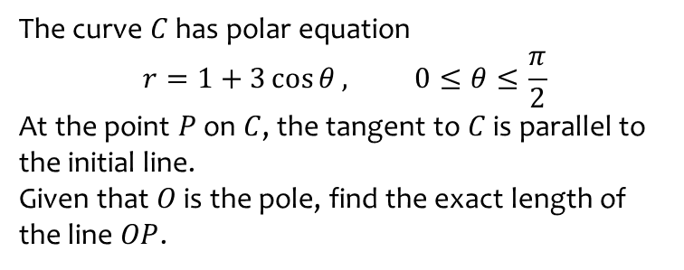
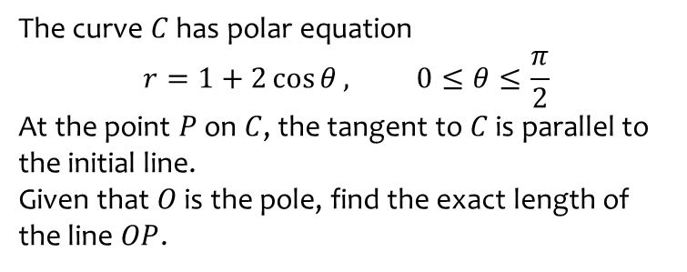
Worked example
Your turn
The curve $C$ has polar equation
$$r=1+3\cos{θ}, 0≤θ≤\frac{π}{2}$$
At the point $P$ on $C$, the tangent to $C$ is parallel to the initial line.
Given that $O$ is the pole, find the exact length of the line $OP$.
The curve $C$ has polar equation
$$r=1+2\cos{θ}, 0≤θ≤\frac{π}{2}$$
At the point $P$ on $C$, the tangent to $C$ is parallel to the initial line.
Given that $O$ is the pole, find the exact length of the line $OP$.
$$\frac{3+\sqrt{33}}{4}$$

Slide 5

Worked example
Your turn
Find the points on the spiral $r=e^{3θ}, 0≤θ≤π$, where the tangents are:
Perpendicular to the initial line
Perpendicular to the initial line
Find the points on the spiral $r=e^{2θ}, 0≤θ≤π$, where the tangents are:
Perpendicular to the initial line
Perpendicular to the initial line
$$(9.15, 1.11)$$
$$(212, 2.68)$$

Slide 6
Worked example
Your turn
Find the equation and the points of contact of the tangents to the curve $$r=a\cos{2θ, 0≤θ≤\frac{π}{2}}$$
that are parallel to the initial line
Find the equation and the points of contact of the tangents to the curve $$r=a\sin{2θ, 0≤θ≤\frac{π}{2}}$$
that are parallel to the initial line
$(0, 0)$ ; Tangent $θ=0$
$\left(\frac{2a\sqrt{2}}{3}, 0.955\right)$ ; Tangent $r=\frac{4a}{3\sqrt{3}} cosec θ$

Slide 7
Worked example
Your turn
Find the equation and the points of contact of the tangents to the curve $$r=a\cos{2θ, 0≤θ≤\frac{π}{2}}$$
that are perpendicular to the initial line.
Find the equation and the points of contact of the tangents to the curve $$r=a\sin{2θ, 0≤θ≤\frac{π}{2}}$$
that are perpendicular to the initial line.
$(0, 0)$ ; Tangent $θ=\frac{π}{2}$
$\left(\frac{2a\sqrt{2}}{3}, 0.615\right)$ ; Tangent $r=\frac{4a}{3\sqrt{3}} sec θ$

Slide 8
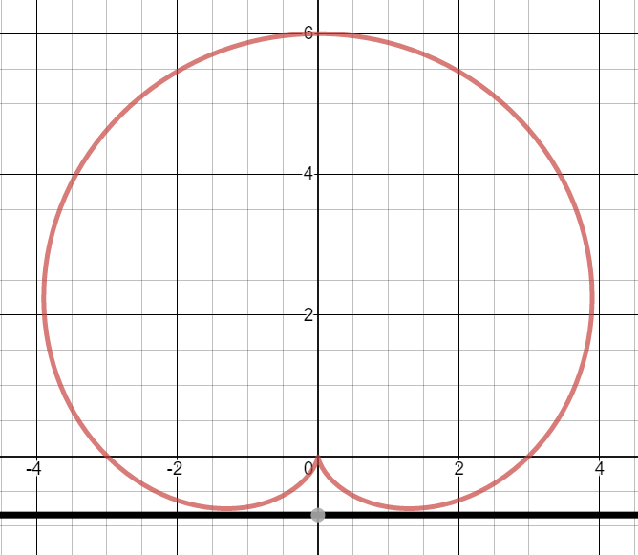
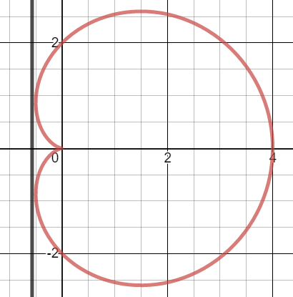
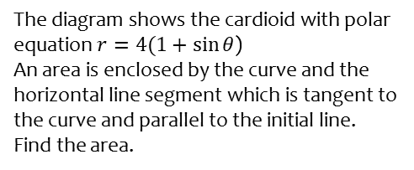
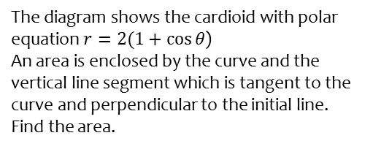
Worked example
Your turn
The diagram shows the cardioid with polar equation $r=4(1+\sin{θ}$)
An area is enclosed by the curve and the horizontal line segment which is tangent to the curve and parallel to the initial line.
Find the area.
The diagram shows the cardioid with polar equation $r=2(1+\cos{θ}$)
An area is enclosed by the curve and the vertical line segment which is tangent to the curve and perpendicular to the initial line.
Find the area.
$$\frac{15\sqrt{3}}{4}−2π$$
Graphs used with permission from DESMOS: https://www.desmos.com/

