Slide 1
5.4) Modelling with volumes of revolution

Slide 2
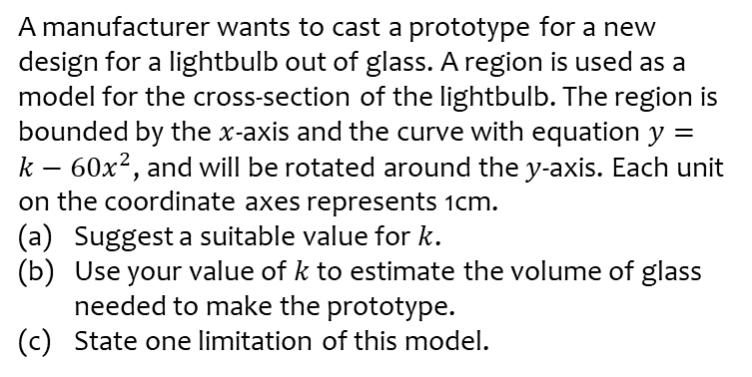
Worked example
Your turn
A manufacturer wants to cast a prototype for a new design for a lightbulb out of glass. A region is used as a model for the cross-section of the lightbulb. The region is bounded by the $x$-axis and the curve with equation $y=k−60x^{2}$, and will be rotated around the $y$-axis. Each unit on the coordinate axes represents 1cm.
Suggest a suitable value for $k$.
Use your value of $k$ to estimate the volume of glass needed to make the prototype.
State one limitation of this model.
A manufacturer wants to cast a prototype for a new design for a pen barrel out of solid resin. A region is used as a model for the cross-section of the pen barrel. The region is bounded by the $x$-axis and the curve with equation $y=k−100x^{2}$, and will be rotated around the $y$-axis. Each unit on the coordinate axes represents 1cm.
Suggest a suitable value for $k$.
Use your value of $k$ to estimate the volume of resin needed to make the prototype.
State one limitation of this model.
(a) $k=10 (10≤k≤15$ sensible)
(b) $1.57cm^{3}$ (3 sf)
(c) The cross-section of the pen unlikely to match the curve exactly

Slide 3
Worked example
Your turn
Use integration to show that the volume of a cylinder is $V=πr^{2}h$
Use integration to show that the volume of a sphere is $V=\frac{4}{3}πr^{3}$
Use integration to show that the volume of a cone is $V=\frac{1}{3}πr^{2}h$
Shown

