Slide 1
5.3) Area enclosed by a polar curve

Slide 2
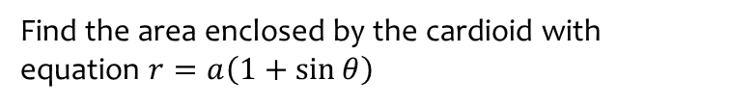

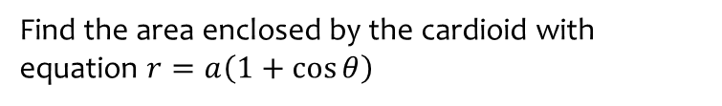
Worked example
Your turn
Find the area enclosed by the cardioid with equation $r=a\left(1+\sin{θ}\right)$
Find the area enclosed by the cardioid with equation $r=a\left(1+\cos{θ}\right)$
$$\frac{3a^{2}π}{2}$$

Slide 3
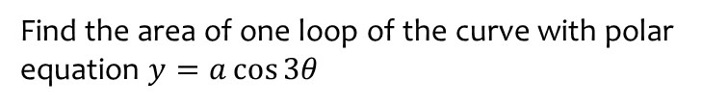

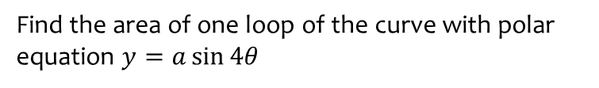
Worked example
Your turn
Find the area of one loop of the curve with polar equation $y=a\cos{3θ}$
Find the area of one loop of the curve with polar equation $y=a\sin{4θ}$
$$\frac{a^{2}π}{16}$$

Slide 4
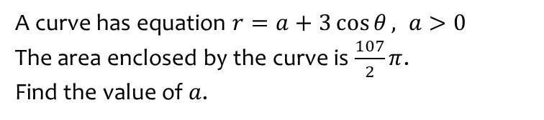
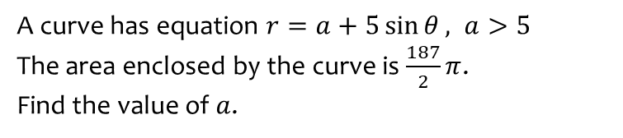
Worked example
Your turn
A curve has equation $r=a+3\cos{θ}, a>0$
The area enclosed by the curve is $\frac{107}{2}π$.
Find the value of $a$.
A curve has equation $r=a+5\sin{θ}, a>5$
The area enclosed by the curve is $\frac{187}{2}π$.
Find the value of $a$.
$$a=9$$

Slide 5
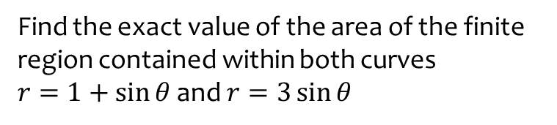

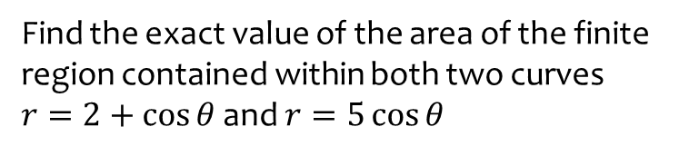
Worked example
Your turn
Find the exact value of the area of the finite region contained within both curves
$r=1+\sin{θ}$ and $r=3\sin{θ}$
Find the exact value of the area of the finite region contained within both two curves
$r=2+\cos{θ}$ and $r=5\cos{θ}$
$$\frac{43π}{12}−\sqrt{3}$$

Slide 6
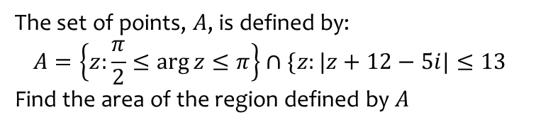
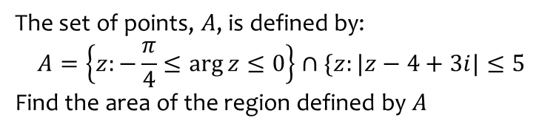
Worked example
Your turn
The set of points, $A$, is defined by:
$$A=\left\{z:\frac{π}{2}≤\arg{z}≤π\right\}∩\{z:|z+12−5i|≤13$$
Find the area of the region defined by $A$
The set of points, $A$, is defined by:
$$A=\left\{z:−\frac{π}{4}≤\arg{z}≤0\right\}∩\{z:|z−4+3i|≤5$$
Find the area of the region defined by $A$
$35.1$ (3 sf)

Slide 7
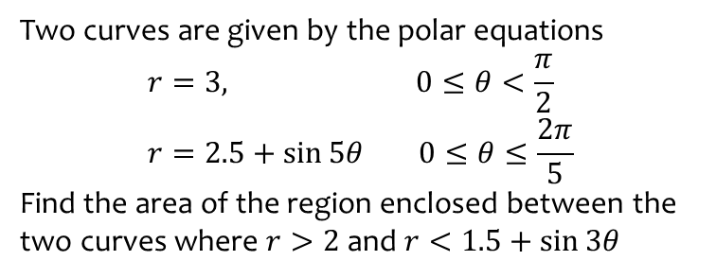

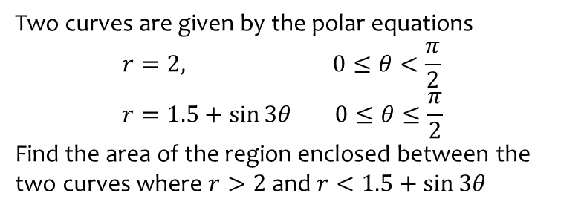
Worked example
Your turn
Two curves are given by the polar equations
$$r=3, 0≤θ<\frac{π}{2} \\ r=2.5+\sin{5θ} 0≤θ≤\frac{2π}{5}$$
Find the area of the region enclosed between the two curves where $r>2$ and $r<1.5+\sin{3θ}$
Two curves are given by the polar equations
$$r=2, 0≤θ<\frac{π}{2} \\ r=1.5+\sin{3θ} 0≤θ≤\frac{π}{2}$$
Find the area of the region enclosed between the two curves where $r>2$ and $r<1.5+\sin{3θ}$
$$\frac{13\sqrt{3}}{24}−\frac{5π}{36}$$

