Slide 1
TEACHINGS FOR EXERCISE 5B

Slide 2





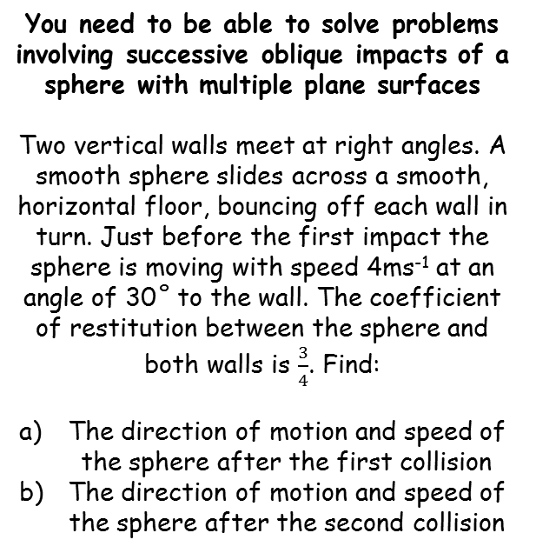








Elastic Collisions in two dimensions
$$vcosβ=ucosα$$
$$vsinβ=eusinα$$
$$tanβ=etanα$$
$$cosθ=\frac{u.v}{\left|u\right|\left|v\right|}$$
$$β=23.4^{°}$$
You need to be able to solve problems involving successive oblique impacts of a sphere with multiple plane surfaces
Two vertical walls meet at right angles. A smooth sphere slides across a smooth, horizontal floor, bouncing off each wall in turn. Just before the first impact the sphere is moving with speed 4ms⁻¹ at an angle of 30˚ to the wall. The coefficient of restitution between the sphere and both walls is $\frac{3}{4}$. Find:
The direction of motion and speed of the sphere after the first collision
The direction of motion and speed of the sphere after the second collision
$$4 ms^{−1}$$
$$v$$
$${30}^{°}$$
$$β$$
$$tanβ=etanα$$
Sub in values
$$tanβ=\frac{3}{4}tan30$$
Calculate
$$tanβ=\frac{\sqrt{3}}{4}$$
Inverse Tan
$$β=23.4^{°}$$
5B

Slide 3





Elastic Collisions in two dimensions
$$vcosβ=ucosα$$
$$vsinβ=eusinα$$
$$tanβ=etanα$$
$$cosθ=\frac{u.v}{\left|u\right|\left|v\right|}$$
$$β=23.4^{°}$$
You need to be able to solve problems involving successive oblique impacts of a sphere with multiple plane surfaces
Two vertical walls meet at right angles. A smooth sphere slides across a smooth, horizontal floor, bouncing off each wall in turn. Just before the first impact the sphere is moving with speed 4ms⁻¹ at an angle of 30˚ to the wall. The coefficient of restitution between the sphere and both walls is $\frac{3}{4}$. Find:
The direction of motion and speed of the sphere after the first collision
The direction of motion and speed of the sphere after the second collision
$$v=3.77 ms^{−1}$$
$$4 ms^{−1}$$
$$v$$
$${30}^{°}$$
$$β$$
$$vcosβ=ucosα$$
Sub in values (remember to use exact prior answers)
$$vcos(23.4)=4cos30$$
Divide by $cos⁡(23.4)$
$$v=3.77 ms^{−1}$$
5B

Slide 4







Elastic Collisions in two dimensions
$$vcosβ=ucosα$$
$$vsinβ=eusinα$$
$$tanβ=etanα$$
$$cosθ=\frac{u.v}{\left|u\right|\left|v\right|}$$
$$β=23.4^{°}$$
$$β={60}^{°}$$
You need to be able to solve problems involving successive oblique impacts of a sphere with multiple plane surfaces
Two vertical walls meet at right angles. A smooth sphere slides across a smooth, horizontal floor, bouncing off each wall in turn. Just before the first impact the sphere is moving with speed 4ms⁻¹ at an angle of 30˚ to the wall. The coefficient of restitution between the sphere and both walls is $\frac{3}{4}$. Find:
The direction of motion and speed of the sphere after the first collision
The direction of motion and speed of the sphere after the second collision
$$v=3.77 ms^{−1}$$
You can use the triangle formed to calculate the angle of approach
$$v$$
$$β$$
$$4 ms^{−1}$$
$$3.77 ms^{−1}$$
$$v$$
$$66.6^{°}$$
$$β$$
$${30}^{°}$$
$$23.4^{°}$$
$$tanβ=etanα$$
Sub in exact values
$$tanβ=\frac{3}{4}tan66.6$$
Calculate
$$tanβ=1.732…$$
For the second part, you should draw a separate diagram which includes the new information
Inverse Tan
$$β={60}^{°}$$
5B

Slide 5





Elastic Collisions in two dimensions
$$vcosβ=ucosα$$
$$vsinβ=eusinα$$
$$tanβ=etanα$$
$$cosθ=\frac{u.v}{\left|u\right|\left|v\right|}$$
$$β={60}^{°}$$
You need to be able to solve problems involving successive oblique impacts of a sphere with multiple plane surfaces
Two vertical walls meet at right angles. A smooth sphere slides across a smooth, horizontal floor, bouncing off each wall in turn. Just before the first impact the sphere is moving with speed 4ms⁻¹ at an angle of 30˚ to the wall. The coefficient of restitution between the sphere and both walls is $\frac{3}{4}$. Find:
The direction of motion and speed of the sphere after the first collision
The direction of motion and speed of the sphere after the second collision
$$v=3ms^{−1}$$
$$v$$
$$β$$
$$3.77 ms^{−1}$$
$$66.6^{°}$$
$$23.4^{°}$$
$$vcosβ=ucosα$$
Sub in values (remember to use exact prior answers)
$$vcos(60)=3.77cos66.6$$
Divide by $cos⁡(60)$
$$v=3ms^{−1}$$
For the second part, you should draw a separate diagram which includes the new information
5B

Slide 6






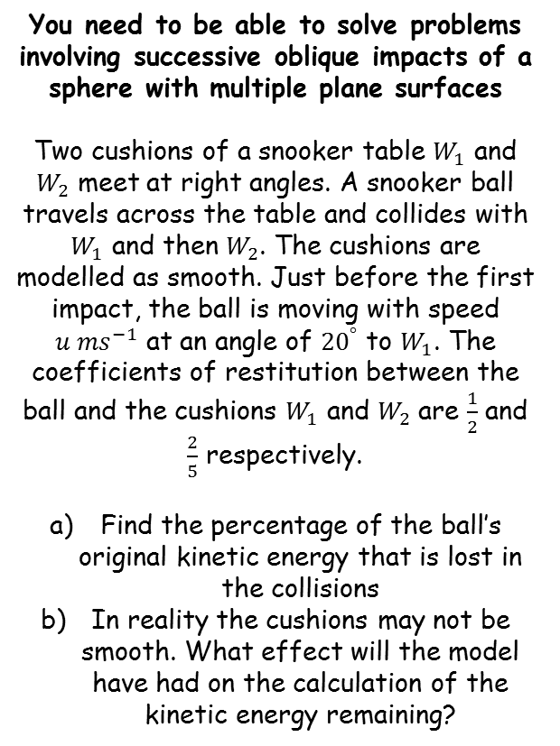






Elastic Collisions in two dimensions
$$vcosβ=ucosα$$
$$vsinβ=eusinα$$
$$tanβ=etanα$$
$$cosθ=\frac{u.v}{\left|u\right|\left|v\right|}$$
$$tanβ_{1}=\frac{1}{2}tan20$$
To find the percentage of kinetic energy lost, we will need to know the final speed of the ball…
You need to be able to solve problems involving successive oblique impacts of a sphere with multiple plane surfaces
Two cushions of a snooker table $W_{1}$ and $W_{2}$ meet at right angles. A snooker ball travels across the table and collides with $W_{1}$ and then $W_{2}$. The cushions are modelled as smooth. Just before the first impact, the ball is moving with speed $u {ms}^{−1}$ at an angle of ${20}^{°}$ to $W_{1}$. The coefficients of restitution between the ball and the cushions $W_{1}$ and $W_{2}$ are $\frac{1}{2}$ and $\frac{2}{5}$ respectively.
Find the percentage of the ball’s original kinetic energy that is lost in the collisions
In reality the cushions may not be smooth. What effect will the model have had on the calculation of the kinetic energy remaining?
$$v_{1}cosβ_{1}=ucos20$$
$$W_{2}$$
$$u$$
$$v_{1}$$
$${20}^{°}$$
$$β_{1}$$
$$W_{1}$$
$$tanβ_{1}=etanα$$
Sub in values
$$tanβ_{1}=\frac{1}{2}tan20$$
We will leave these expressions as they are for now, to avoid potential rounding errors…
$$vcosβ_{1}=ucosα$$
Sub in values
$$v_{1}cosβ_{1}=ucos20$$
5B

Slide 7












Elastic Collisions in two dimensions
$$vcosβ=ucosα$$
$$vsinβ=eusinα$$
$$tanβ=etanα$$
$$cosθ=\frac{u.v}{\left|u\right|\left|v\right|}$$
$$tanβ_{1}=\frac{1}{2}tan20$$
You need to be able to solve problems involving successive oblique impacts of a sphere with multiple plane surfaces
Two cushions of a snooker table $W_{1}$ and $W_{2}$ meet at right angles. A snooker ball travels across the table and collides with $W_{1}$ and then $W_{2}$. The cushions are modelled as smooth. Just before the first impact, the ball is moving with speed $u {ms}^{−1}$ at an angle of ${20}^{°}$ to $W_{1}$. The coefficients of restitution between the ball and the cushions $W_{1}$ and $W_{2}$ are $\frac{1}{2}$ and $\frac{2}{5}$ respectively.
Find the percentage of the ball’s original kinetic energy that is lost in the collisions
In reality the cushions may not be smooth. What effect will the model have had on the calculation of the kinetic energy remaining?
$$v_{1}cosβ_{1}=ucos20$$
$$v_{2}$$
$$β_{2}$$
Update the diagram for the second collision…
$$v_{2}cosβ_{2}=v_{1}sinβ_{1}$$
$$W_{2}$$
$$v_{2}sinβ_{2}=\frac{2}{5}v_{1}cosβ_{1}$$
$$u$$
$$v_{1}$$
$$v_{1}$$
$${90−β}_{1}$$
$${20}^{°}$$
$$β_{1}$$
$$W_{1}$$
$$vcosβ=ucosα$$
Sub in values
$$v_{2}cosβ_{2}=v_{1}cos\left(90−β_{1}\right)$$
The second part can be rewritten using sine
$$v_{2}cosβ_{2}=v_{1}sinβ_{1}$$
$$vsinβ=eusinα$$
Sub in values (remember that $e$ is different for this wall)
$$v_{2}sinβ_{2}=\frac{2}{5}v_{1}sin\left(90−β_{1}\right)$$
The second part can be rewritten using cos
$$v_{2}sinβ_{2}=\frac{2}{5}v_{1}cosβ_{1}$$
5B

Slide 8



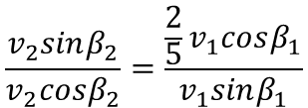



Elastic Collisions in two dimensions
$$vcosβ=ucosα$$
$$vsinβ=eusinα$$
$$tanβ=etanα$$
$$cosθ=\frac{u.v}{\left|u\right|\left|v\right|}$$
$$tanβ_{1}=\frac{1}{2}tan20$$
$$β_{2}=65.5^{°}$$
You need to be able to solve problems involving successive oblique impacts of a sphere with multiple plane surfaces
Two cushions of a snooker table $W_{1}$ and $W_{2}$ meet at right angles. A snooker ball travels across the table and collides with $W_{1}$ and then $W_{2}$. The cushions are modelled as smooth. Just before the first impact, the ball is moving with speed $u {ms}^{−1}$ at an angle of ${20}^{°}$ to $W_{1}$. The coefficients of restitution between the ball and the cushions $W_{1}$ and $W_{2}$ are $\frac{1}{2}$ and $\frac{2}{5}$ respectively.
Find the percentage of the ball’s original kinetic energy that is lost in the collisions
In reality the cushions may not be smooth. What effect will the model have had on the calculation of the kinetic energy remaining?
$$v_{1}cosβ_{1}=ucos20$$
$$v_{2}$$
$$β_{2}$$
$$v_{2}cosβ_{2}=v_{1}sinβ_{1}$$
$$W_{2}$$
$$v_{2}sinβ_{2}=\frac{2}{5}v_{1}cosβ_{1}$$
$$v_{1}$$
$${90−β}_{1}$$
$$β_{1}$$
$$W_{1}$$
We can divide one of the new equations by the other to form an equation for $β_{2}$
$$\frac{v_{2}sinβ_{2}}{v_{2}cosβ_{2}}=\frac{\frac{2}{5}v_{1}cosβ_{1}}{v_{1}sinβ_{1}}$$
We can simplify a lot here!
$$tanβ_{2}=\frac{2}{5}tanβ_{1}$$
We already have an expression for $tanβ_{1}$
$$tanβ_{2}=\frac{2}{5}\left(\frac{1}{2}tan20\right)$$
Calculate
$$β_{2}=65.5^{°}$$
5B

Slide 9




Elastic Collisions in two dimensions
$$vcosβ=ucosα$$
$$vsinβ=eusinα$$
$$tanβ=etanα$$
$$cosθ=\frac{u.v}{\left|u\right|\left|v\right|}$$
$$tanβ_{1}=\frac{1}{2}tan20$$
$$β_{2}=65.5^{°}$$
You need to be able to solve problems involving successive oblique impacts of a sphere with multiple plane surfaces
Two cushions of a snooker table $W_{1}$ and $W_{2}$ meet at right angles. A snooker ball travels across the table and collides with $W_{1}$ and then $W_{2}$. The cushions are modelled as smooth. Just before the first impact, the ball is moving with speed $u {ms}^{−1}$ at an angle of ${20}^{°}$ to $W_{1}$. The coefficients of restitution between the ball and the cushions $W_{1}$ and $W_{2}$ are $\frac{1}{2}$ and $\frac{2}{5}$ respectively.
Find the percentage of the ball’s original kinetic energy that is lost in the collisions
In reality the cushions may not be smooth. What effect will the model have had on the calculation of the kinetic energy remaining?
$$v_{1}cosβ_{1}=ucos20$$
$$v_{2}=0.413…$$
$$v_{2}$$
$$β_{2}$$
$$v_{2}cosβ_{2}=v_{1}sinβ_{1}$$
$$W_{2}$$
$$v_{2}sinβ_{2}=\frac{2}{5}v_{1}cosβ_{1}$$
$$v_{1}$$
$${90−β}_{1}$$
$$β_{1}$$
$$W_{1}$$
$$v_{2}sinβ_{2}=\frac{2}{5}v_{1}cosβ_{1}$$
Sub in values…
$$v_{2}sin\left(65.5\right)=\frac{2}{5}\left(ucos20\right)$$
Calculate (make sure you store the exact value in your calculator…)
$$v_{2}=0.413…$$
5B

Slide 10



Elastic Collisions in two dimensions
$$vcosβ=ucosα$$
$$vsinβ=eusinα$$
$$tanβ=etanα$$
$$cosθ=\frac{u.v}{\left|u\right|\left|v\right|}$$
$$tanβ_{1}=\frac{1}{2}tan20$$
$$β_{2}=65.5^{°}$$
You need to be able to solve problems involving successive oblique impacts of a sphere with multiple plane surfaces
Two cushions of a snooker table $W_{1}$ and $W_{2}$ meet at right angles. A snooker ball travels across the table and collides with $W_{1}$ and then $W_{2}$. The cushions are modelled as smooth. Just before the first impact, the ball is moving with speed $u {ms}^{−1}$ at an angle of ${20}^{°}$ to $W_{1}$. The coefficients of restitution between the ball and the cushions $W_{1}$ and $W_{2}$ are $\frac{1}{2}$ and $\frac{2}{5}$ respectively.
Find the percentage of the ball’s original kinetic energy that is lost in the collisions
In reality the cushions may not be smooth. What effect will the model have had on the calculation of the kinetic energy remaining?
$$v_{1}cosβ_{1}=ucos20$$
$$v_{2}=0.413…$$
$$v_{2}$$
$$β_{2}$$
$$v_{2}cosβ_{2}=v_{1}sinβ_{1}$$
$$W_{2}$$
$$v_{2}sinβ_{2}=\frac{2}{5}v_{1}cosβ_{1}$$
$$v_{1}$$
$${90−β}_{1}$$
$$β_{1}$$
$$W_{1}$$
KE Before
KE After
$$\frac{1}{2}mu^{2}$$
$$\frac{1}{2}m{(0.413u)}^{2}$$
Calculate the squared part
$$=\frac{1}{2}mu^{2}(0.171)$$
So this is the original KE, multiplied by 0.17
--> Therefore 83% of the kinetic energy has been lost!
5B

Slide 11




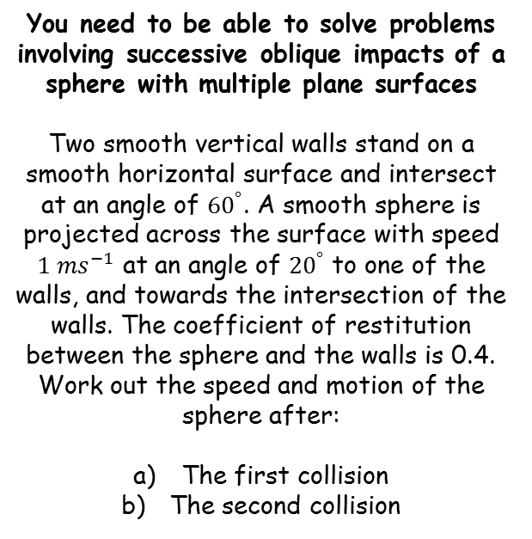





Elastic Collisions in two dimensions
$$vcosβ=ucosα$$
$$vsinβ=eusinα$$
$$tanβ=etanα$$
$$cosθ=\frac{u.v}{\left|u\right|\left|v\right|}$$
$$β={8.28}^{°}$$
You need to be able to solve problems involving successive oblique impacts of a sphere with multiple plane surfaces
Two smooth vertical walls stand on a smooth horizontal surface and intersect at an angle of ${60}^{°}$. A smooth sphere is projected across the surface with speed $1 {ms}^{−1}$ at an angle of ${20}^{°}$ to one of the walls, and towards the intersection of the walls. The coefficient of restitution between the sphere and the walls is 0.4. Work out the speed and motion of the sphere after:
The first collision
The second collision
$$1 {ms}^{−1}$$
$$v$$
$${20}^{°}$$
$$β$$
$${60}^{°}$$
$$tanβ=etanα$$
Sub in values
$$tanβ=0.4tan20$$
Calculate right side
$$tanβ=0.145…$$
Inverse tan
$$β={8.28}^{°}$$
5B

Slide 12





Elastic Collisions in two dimensions
$$vcosβ=ucosα$$
$$vsinβ=eusinα$$
$$tanβ=etanα$$
$$cosθ=\frac{u.v}{\left|u\right|\left|v\right|}$$
$$β={8.28}^{°}$$
You need to be able to solve problems involving successive oblique impacts of a sphere with multiple plane surfaces
Two smooth vertical walls stand on a smooth horizontal surface and intersect at an angle of ${60}^{°}$. A smooth sphere is projected across the surface with speed $1 {ms}^{−1}$ at an angle of ${20}^{°}$ to one of the walls, and towards the intersection of the walls. The coefficient of restitution between the sphere and the walls is 0.4. Work out the speed and motion of the sphere after:
The first collision
The second collision
$$v=0.950$$
$$1 {ms}^{−1}$$
$$v$$
$${20}^{°}$$
$$β$$
$${60}^{°}$$
$$vcosβ=ucosα$$
Sub in values
$$vcos\left(8.28\right)=1cos20$$
Calculate $v$
$$v=0.950 (3sf)$$
5B

Slide 13











Elastic Collisions in two dimensions
$$vcosβ=ucosα$$
$$vsinβ=eusinα$$
$$tanβ=etanα$$
$$cosθ=\frac{u.v}{\left|u\right|\left|v\right|}$$
$$β={45.1}^{°}$$
You need to be careful here – think about which way the sphere will be travelling after the second bounce…
You need to be able to solve problems involving successive oblique impacts of a sphere with multiple plane surfaces
Two smooth vertical walls stand on a smooth horizontal surface and intersect at an angle of ${60}^{°}$. A smooth sphere is projected across the surface with speed $1 {ms}^{−1}$ at an angle of ${20}^{°}$ to one of the walls, and towards the intersection of the walls. The coefficient of restitution between the sphere and the walls is 0.4. Work out the speed and motion of the sphere after:
The first collision
The second collision
→ It will bounce towards the corner – calculate the acute angle between the second wall and the direction of movement (a separate diagram would be very helpful!)
$$1 {ms}^{−1}$$
$${68.28}^{°}$$
$$0.95 {ms}^{−1}$$
$${20}^{°}$$
$${8.28}^{°}$$
$${60}^{°}$$
$$β$$
$$v$$
$$tanβ=etanα$$
Sub in values
$$v=0.950$$
$$β={8.28}^{°}$$
$$tanβ=0.4tan68.28$$
Calculate right side
$$tanβ=1.004…$$
Inverse tan
$$β={45.1}^{°}$$
5B

Slide 14




Elastic Collisions in two dimensions
$$vcosβ=ucosα$$
$$vsinβ=eusinα$$
$$tanβ=etanα$$
$$cosθ=\frac{u.v}{\left|u\right|\left|v\right|}$$
$$β={45.1}^{°}$$
$$v=0.498 ms^{−1}$$
You need to be careful here – think about which way the sphere will be travelling after the second bounce…
You need to be able to solve problems involving successive oblique impacts of a sphere with multiple plane surfaces
Two smooth vertical walls stand on a smooth horizontal surface and intersect at an angle of ${60}^{°}$. A smooth sphere is projected across the surface with speed $1 {ms}^{−1}$ at an angle of ${20}^{°}$ to one of the walls, and towards the intersection of the walls. The coefficient of restitution between the sphere and the walls is 0.4. Work out the speed and motion of the sphere after:
The first collision
The second collision
→ It will bounce towards the corner – calculate the acute angle between the second wall and the direction of movement (a separate diagram would be very helpful!)
$${68.28}^{°}$$
$$0.95 {ms}^{−1}$$
$$β$$
$$v$$
$$vcosβ=ucosα$$
$$v=0.950$$
$$β={8.28}^{°}$$
Sub in exact values
$$vcos(45.1)=0.95cos\left(68.28\right)$$
Calculate
$$v=0.498 ms^{−1}$$
5B

