Slide 1
Teachings for
Exercise 5B

Slide 2
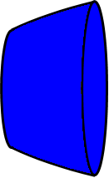
Volumes of Revolution
$$V=π\int_{a}^{b}{y^{2} dx}$$
You need to be able to calculate the volume of a solid created by revolving a shape around the y-axis
y
$$y=x^{2}$$
y
$$y=x^{2}$$
This would be the solid formed
x
x
5B

Slide 3
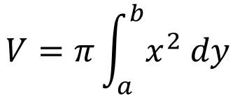
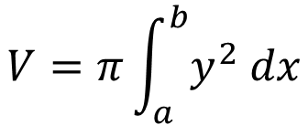
Volumes of Revolution
$$V=π\int_{a}^{b}{y^{2} dx}$$
$$V=π\int_{a}^{b}{x^{2} dy}$$
For rotation about the x axis
For rotation about the y axis
You need to be able to calculate the volume of a solid created by revolving a shape around the y-axis
There is nothing particularly new here though!
The process is the same, just with the x and y reversed!
$$V=π\int_{a}^{b}{y^{2} dx}$$
For rotation about the x axis
$$V=π\int_{a}^{b}{x^{2} dy}$$
For rotation about the y axis
5B

Slide 4
Volumes of Revolution
$$V=π\int_{a}^{b}{y^{2} dx}$$
$$V=π\int_{a}^{b}{x^{2} dy}$$
For rotation about the x axis
For rotation about the y axis
$$y$$
$$y=\sqrt{x−1}$$
You need to be able to calculate the volume of a solid created by revolving a shape around the y-axis
The diagram shows the curve with equation $y=\sqrt{x−1}$. The region R is bounded by the curve, the y axis and the lines $y=1$ and $y=3$. The region is rotated 360˚ about the y axis. Find the volume of the solid generated.
→ We will need x to be the subject here
$$y^{2}+1=x$$
$$3$$
$$R$$
$$1$$
$$V=π\int_{a}^{b}{x^{2} dy}$$
$$x$$
$$y=\sqrt{x−1}$$
Square both sides
$$y^{2}=x−1$$
Add 1
$$y^{2}+1=x$$
5B

Slide 5
Volumes of Revolution
$$V=π\int_{a}^{b}{y^{2} dx}$$
$$V=π\int_{a}^{b}{x^{2} dy}$$
For rotation about the x axis
For rotation about the y axis
$$y$$
$$y=\sqrt{x−1}$$
You need to be able to calculate the volume of a solid created by revolving a shape around the y-axis
The diagram shows the curve with equation $y=\sqrt{x−1}$. The region R is bounded by the curve, the y axis and the lines $y=1$ and $y=3$. The region is rotated 360˚ about the y axis. Find the volume of the solid generated.
$$y^{2}+1=x$$
$$3$$
$$R$$
$$1$$
$$V=π\int_{a}^{b}{x^{2} dy}$$
$$x$$
Sub in the equation for x
$$V=π\int_{1}^{3}{{\left(y^{2}+1\right)}^{2} dy}$$
Square the bracket (do not forget this!)
$$V=π\int_{1}^{3}{y^{4}+{2y}^{2}+1 dy}$$
Integrate and use a square bracket
$$V=π{\left[\frac{y^{5}}{5}+{\frac{2y}{3}}^{3}+y\right]}_{1}^{3}$$
Write as a subtraction
$$V=π\left(\frac{{(3)}^{5}}{5}+{\frac{2(3)}{3}}^{3}+(3)\right)−π\left(\frac{{(1)}^{5}}{5}+{\frac{2(1)}{3}}^{3}+(1)\right)$$
Calculate
$$V=\frac{1016π}{15}$$
5B

