Slide 1
5.2) Volumes of revolution around the $y$-axis

Slide 2
Worked example
Your turn
A curve has equation $y=\sqrt{x−2}$. A finite region is bounded by the curve, the $y$-axis and the lines $y=1$ and $y=4$. The region is rotated through $360°$ about the $y$-axis. Find the volume of the solid generated.
A curve has equation $y=\sqrt{x−1}$. A finite region is bounded by the curve, the $y$-axis and the lines $y=1$ and $y=3$. The region is rotated through $360°$ about the $y$-axis. Find the volume of the solid generated.
$$\frac{1016π}{15}$$

Slide 3
Worked example
Your turn
A curve has equation $y=\sqrt[3]{3x+1}$. A finite region is bounded by the curve, the $y$-axis and the lines $y=2$ and $y=5$. The region is rotated through $360°$ about the $y$-axis. Find the volume of the solid generated.
A curve has equation $y=\sqrt[3]{2x+1}$. A finite region is bounded by the curve, the $y$-axis and the lines $y=2$ and $y=4$. The region is rotated through $360°$ about the $y$-axis. Find the volume of the solid generated.
$$\frac{7715π}{14}$$

Slide 4
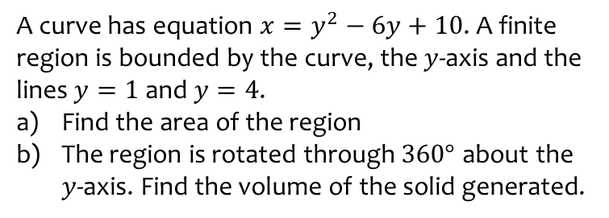
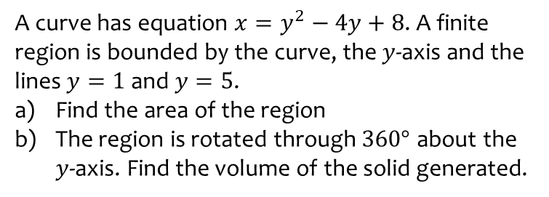
Worked example
Your turn
A curve has equation $x=y^{2}−4y+8$. A finite region is bounded by the curve, the $y$-axis and the lines $y=1$ and $y=5$.
Find the area of the region
The region is rotated through $360°$ about the $y$-axis. Find the volume of the solid generated.
A curve has equation $x=y^{2}−6y+10$. A finite region is bounded by the curve, the $y$-axis and the lines $y=1$ and $y=4$.
Find the area of the region
The region is rotated through $360°$ about the $y$-axis. Find the volume of the solid generated.
a) $6$
b) $\frac{78}{5}π$

Slide 5
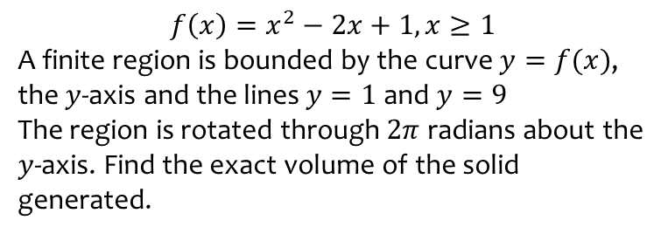
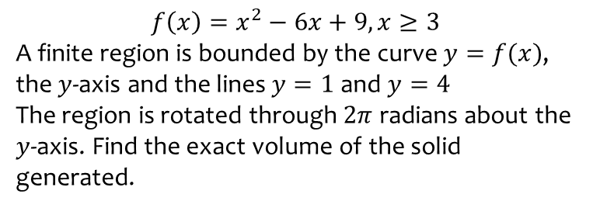
Worked example
Your turn
$$f\left(x\right)=x^{2}−6x+9, x≥3$$
A finite region is bounded by the curve $y=f(x)$, the $y$-axis and the lines $y=1$ and $y=4$
The region is rotated through $2π$ radians about the $y$-axis. Find the exact volume of the solid generated.
$$f\left(x\right)=x^{2}−2x+1, x≥1$$
A finite region is bounded by the curve $y=f(x)$, the $y$-axis and the lines $y=1$ and $y=9$
The region is rotated through $2π$ radians about the $y$-axis. Find the exact volume of the solid generated.
$$\frac{248}{3}π$$

Slide 6
Worked example
Your turn
A curve has equation $y^{2}=\frac{1}{3x+2}$
A finite region is bounded by the curve $y=f(x)$, the $y$-axis and the line $y=5$
The region is rotated through $2π$ radians about the $y$-axis. Find the volume of the solid generated.
A curve has equation $y^{2}=\frac{1}{2x+1}$
A finite region is bounded by the curve $y=f(x)$, the $y$-axis and the line $y=4$
The region is rotated through $2π$ radians about the $y$-axis. Find the volume of the solid generated.
$$\frac{117}{256}π$$

