Slide 1
5.2) Sketching curves

Slide 2
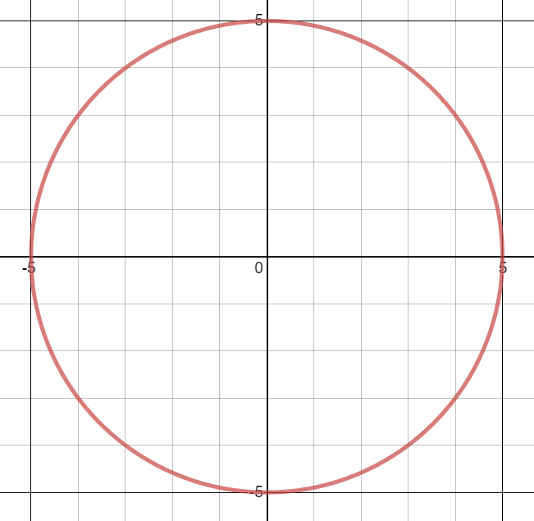


Worked example
Your turn
Sketch the following curves:
$$r=4$$
$$r=6$$
Sketch the following curve:
$$r=5$$
$$r=a$$
Graphs used with permission from DESMOS: https://www.desmos.com/

Slide 3
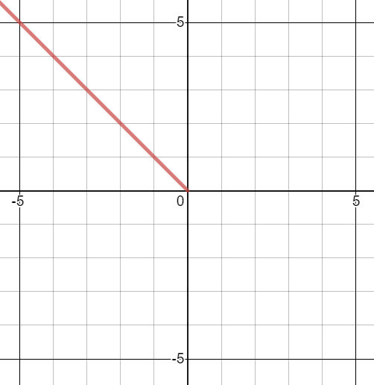


Worked example
Your turn
Sketch the following curves:
$$θ=−\frac{3π}{4}$$
$$θ=\frac{π}{4}$$
Sketch the following curves:
$$θ=\frac{3π}{4}$$
$$θ=a$$
Graphs used with permission from DESMOS: https://www.desmos.com/

Slide 4
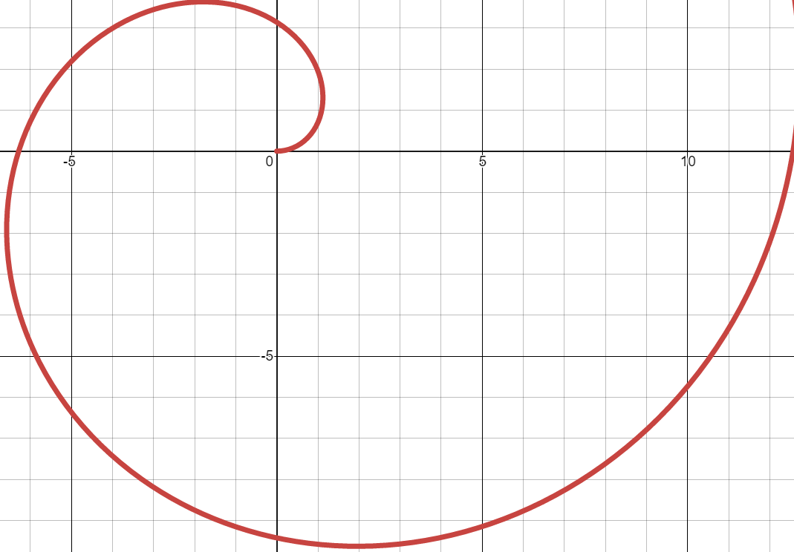


Worked example
Your turn
Sketch the following curves:
$$r=θ$$
$$r=3θ$$
Sketch the following curves:
$$r=2θ$$
$$r=aθ$$
Graphs used with permission from DESMOS: https://www.desmos.com/

Slide 5
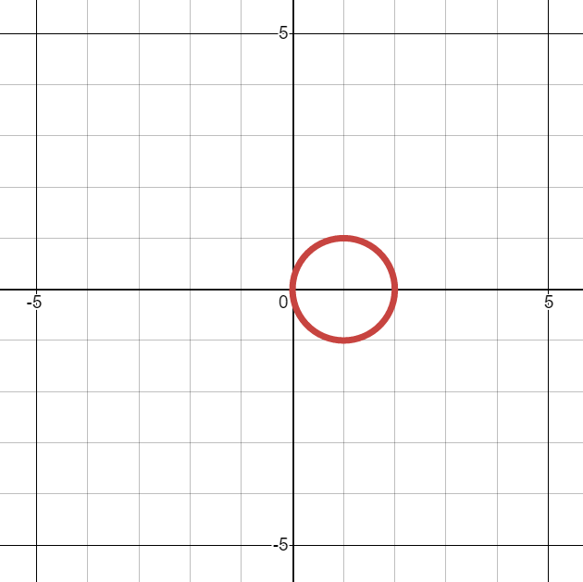


Worked example
Your turn
Sketch the following curves:
$$r=\cos{θ}$$
$$r=3\cos{θ}$$
Sketch the following curves:
$$r=2 cos{θ}$$
$$r=a\cos{θ}$$
Graphs used with permission from DESMOS: https://www.desmos.com/

Slide 6
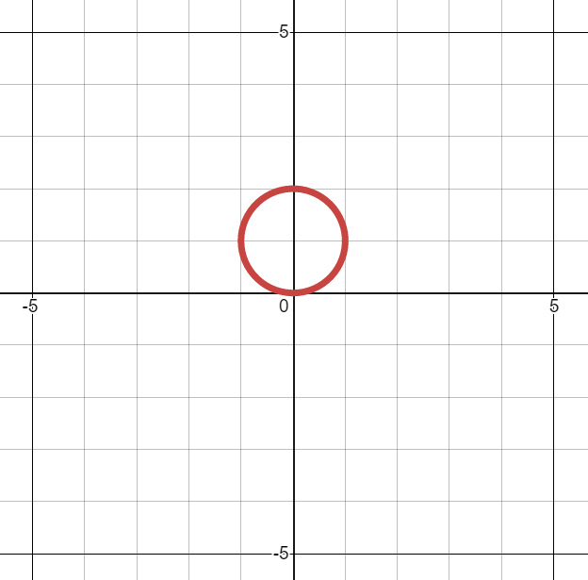


Worked example
Your turn
Sketch the following curves:
$$r=\sin{θ}$$
$$r=3\sin{θ}$$
Sketch the following curves:
$$r=2 sin{θ}$$
$$r=a\sin{θ}$$
Graphs used with permission from DESMOS: https://www.desmos.com/

Slide 7
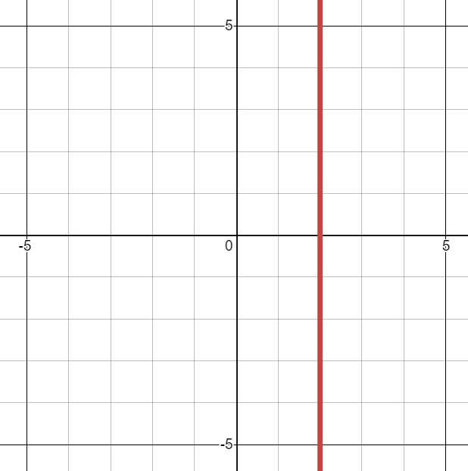


Worked example
Your turn
Sketch the following curves:
$$r=\sec{θ}$$
$$r=3\sec{θ}$$
Sketch the following curves:
$$r=2 sec{θ}$$
$$r=a\sec{θ}$$
Graphs used with permission from DESMOS: https://www.desmos.com/

Slide 8
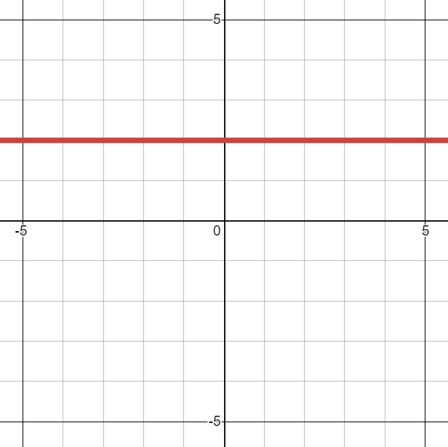


Worked example
Your turn
Sketch the following curves:
$$r=\operatorname{cosec}{θ}$$
$$r=3\operatorname{cosec}{θ}$$
Sketch the following curves:
$$r=2 cosec{θ}$$
$$r=a\operatorname{cosec}{θ}$$
Graphs used with permission from DESMOS: https://www.desmos.com/

Slide 9
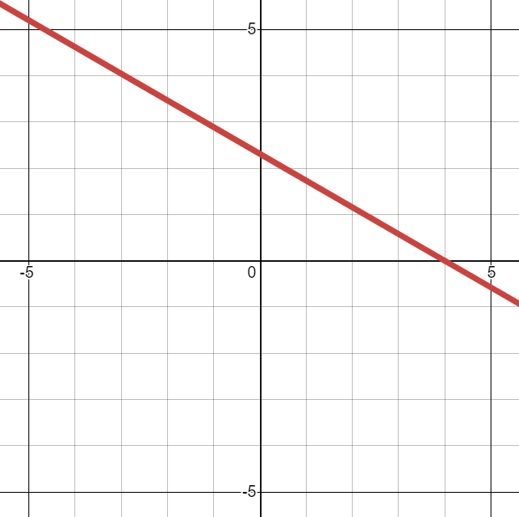


Worked example
Your turn
Sketch the following curves:
$$r=\sec\left(θ−\frac{π}{4}\right)$$
$$r=3sec\left(θ+\frac{π}{6}\right)$$
Sketch the following curves:
$$r=2sec\left(θ−\frac{π}{3}\right)$$
$$r=a\sec{(θ−k)}$$
Graphs used with permission from DESMOS: https://www.desmos.com/

Slide 10
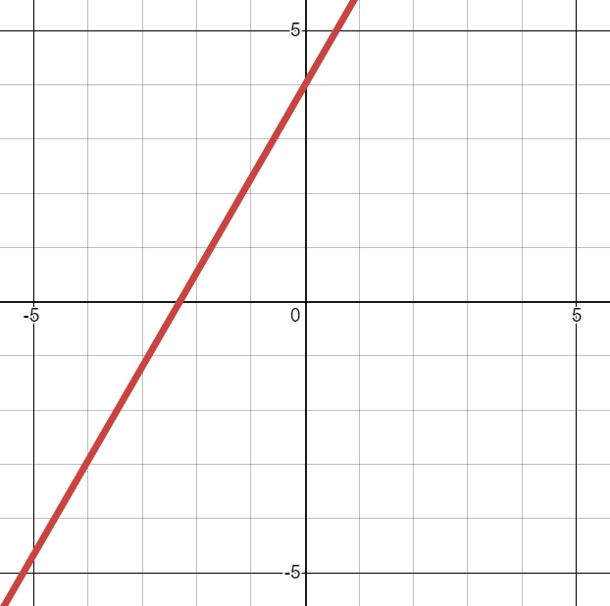


Worked example
Your turn
Sketch the following curves:
$$r=\operatorname{cosec}\left(θ−\frac{π}{4}\right)$$
$$r=3cosec\left(θ+\frac{π}{6}\right)$$
Sketch the following curves:
$$r=2cosec\left(θ−\frac{π}{3}\right)$$
$$r=a\operatorname{cosec}{(θ−k)}$$
Graphs used with permission from DESMOS: https://www.desmos.com/

Slide 11
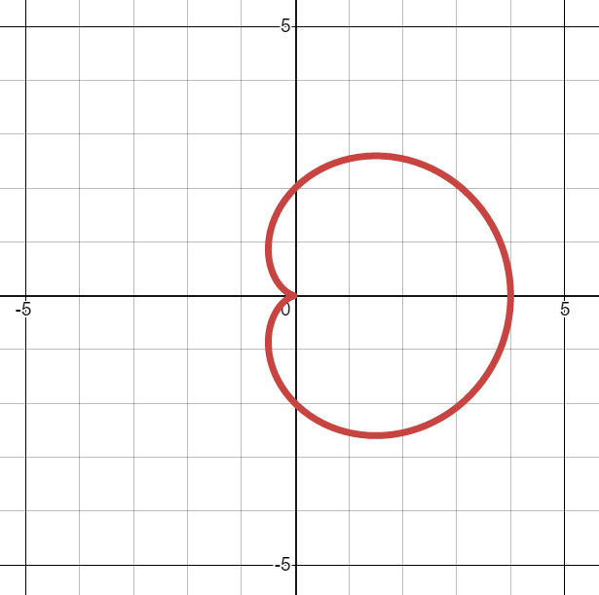


Worked example
Your turn
Sketch the following curves:
$$r=1+\cos{θ}$$
$$r=3(1+\cos{θ})$$
Sketch the following curves:
$$r=2(1+\cos{θ})$$
$$r=a(1+\cos{θ)}$$
Graphs used with permission from DESMOS: https://www.desmos.com/

Slide 12
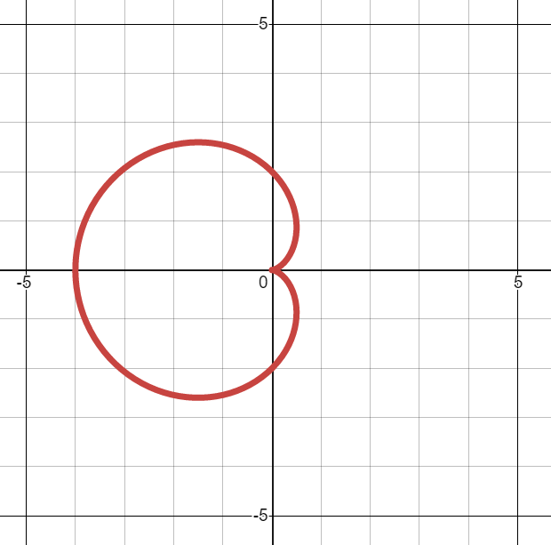


Worked example
Your turn
Sketch the following curves:
$$r=1−\cos{θ}$$
$$r=3(1−\cos{θ})$$
Sketch the following curves:
$$r=2(1−\cos{θ})$$
$$r=a(1−\cos{θ)}$$
Graphs used with permission from DESMOS: https://www.desmos.com/

Slide 13
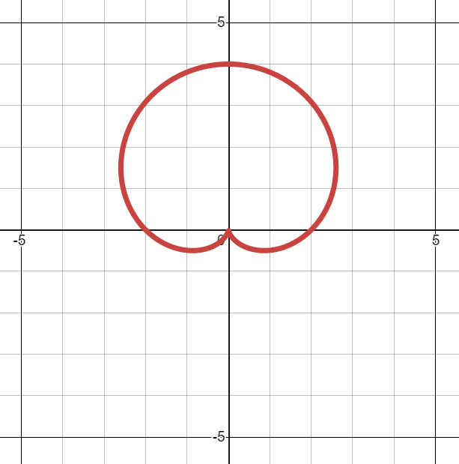


Worked example
Your turn
Sketch the following curves:
$$r=1+\sin{θ}$$
$$r=3(1+\sin{θ})$$
Sketch the following curves:
$$r=2(1+\sin{θ})$$
$$r=a\left(1+\sin{θ}\right)$$
Graphs used with permission from DESMOS: https://www.desmos.com/

Slide 14
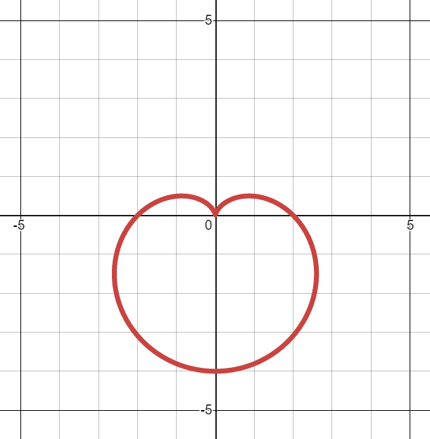


Worked example
Your turn
Sketch the following curves:
$$r=1−\sin{θ}$$
$$r=3(1−\sin{θ})$$
Sketch the following curves:
$$r=2(1−\sin{θ})$$
$$r=a(1−\sin{θ})$$
Graphs used with permission from DESMOS: https://www.desmos.com/

Slide 15
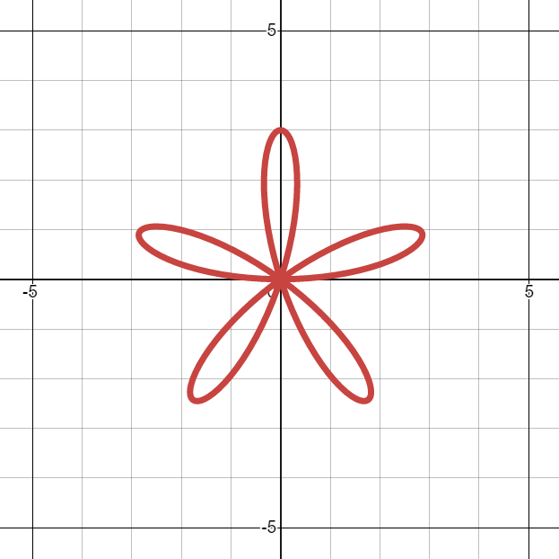


Worked example
Your turn
Sketch the following curves:
$$r=2\sin{3θ}$$
$$r=5\sin{7θ}$$
Sketch the following curves:
$$r=3\sin{5θ}$$
$$r=a\sin{nθ}$$
Graphs used with permission from DESMOS: https://www.desmos.com/

Slide 16
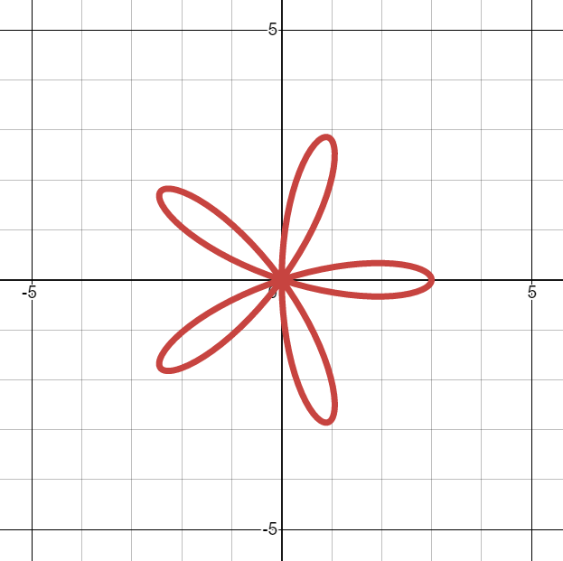


Worked example
Your turn
Sketch the following curves:
$$r=2\cos{3θ}$$
$$r=5\cos{7θ}$$
Sketch the following curves:
$$r=3\cos{5θ}$$
$$r=a\cos{nθ}$$
Graphs used with permission from DESMOS: https://www.desmos.com/

Slide 17
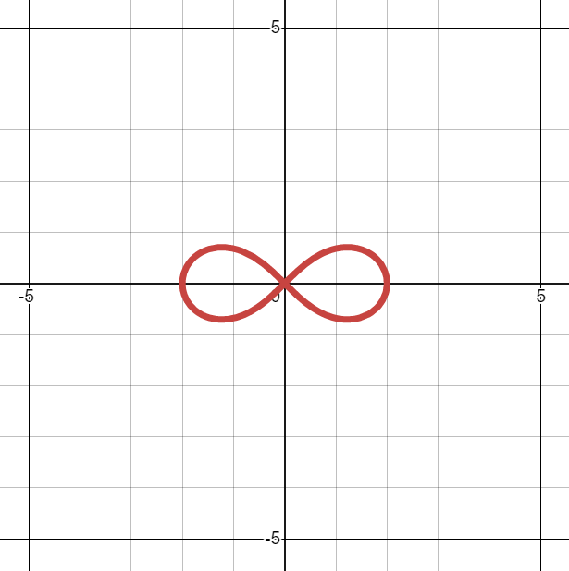


Worked example
Your turn
Sketch the following curves:
$$r^{2}=16\cos{2θ}$$
$$r^{2}=9\cos{2θ}$$
Sketch the following curves:
$$r^{2}=4\cos{2θ}$$
$$r^{2}=a^{2}\cos{2θ}$$
Graphs used with permission from DESMOS: https://www.desmos.com/

Slide 18
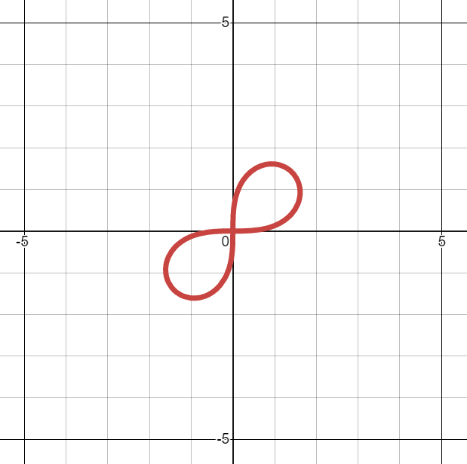


Worked example
Your turn
Sketch the following curves:
$$r^{2}=16\sin{2θ}$$
$$r^{2}=9\sin{2θ}$$
Sketch the following curves:
$$r^{2}=4\sin{2θ}$$
$$r^{2}=a^{2}\sin{2θ}$$
Graphs used with permission from DESMOS: https://www.desmos.com/

Slide 19



Worked example
Your turn
Sketch the following curves:
$$r^{2}=16\cos{θ}$$
$$r^{2}=9\cos{θ}$$
Sketch the following curves:
$$r^{2}=4\cos{θ}$$
$$r^{2}=a^{2}\cos{θ}$$
Graphs used with permission from DESMOS: https://www.desmos.com/

Slide 20



Worked example
Your turn
Sketch the following curves:
$$r^{2}=16\sin{θ}$$
$$r^{2}=9\sin{θ}$$
Sketch the following curves:
$$r^{2}=4\sin{θ}$$
$$r^{2}=a^{2}\sin{2θ}$$
Graphs used with permission from DESMOS: https://www.desmos.com/

Slide 21





Worked example
Your turn
Sketch:
$$r=6\left(3+3\cos{θ}\right)$$
$$r=5\left(3+2\cos{θ}\right)$$
$$r=4\left(3+\cos{θ}\right)$$
Sketch:
$$r=a\left(2+2\cos{θ}\right)$$
$$r=a(5+2\cos{θ})$$
$$r=a(3+2\cos{θ})$$
Sketches with intercepts and axes labelled. General shapes:
Graphs used with permission from DESMOS: https://www.desmos.com/

Slide 22





Worked example
Your turn
Sketch:
$$r=6\left(3+3\sin{θ}\right)$$
$$r=5\left(3+2\sin{θ}\right)$$
$$r=4\left(3+\sin{θ}\right)$$
Sketch:
$$r=a\left(2+2\sin{θ}\right)$$
$$r=a(5+2\sin{θ})$$
$$r=a(3+2\sin{θ})$$
Sketches with intercepts and axes labelled. General shapes:
Graphs used with permission from DESMOS: https://www.desmos.com/

Slide 23


Worked example
Your turn
Show on an Argand diagram the locus of points given by the values of $z$ satisfying $\left|z+4+3i\right|=5$
Show that this locus of points can be represented by the polar curve $r=−8\cos{θ}−6\sin{θ}$
Show on an Argand diagram the locus of points given by the values of $z$ satisfying $\left|z−3−4i\right|=5$
Show that this locus of points can be represented by the polar curve $r=6\cos{θ}+8\sin{θ}$
Shown

