Slide 1
5.1) Volumes of revolution around the $x$-axis

Slide 2
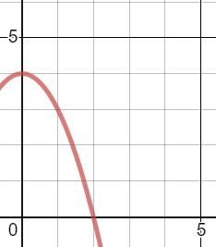
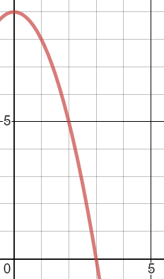
Worked example
Your turn
A sketch of $y=4−x^{2}$ is shown.
The region $R$ is bounded by the $x$-axis, the $y$-axis and the curve with equation $y=4−x^{2}$. The region is rotated through $360°$ about the $x$-axis. Find the exact volume of the solid generated.
A sketch of $y=9−x^{2}$ is shown.
The region $R$ is bounded by the $x$-axis, the $y$-axis and the curve with equation $y=9−x^{2}$. The region is rotated through $360°$ about the $x$-axis. Find the exact volume of the solid generated.
$$\frac{648π}{5}$$
Graphs used with permission from DESMOS: https://www.desmos.com/

Slide 3
Worked example
Your turn
Find the exact volume of the solid generated when the curve is rotated through $360°$ about the $x$-axis between the given limits:
$y=1−\frac{1}{x^{2}}$ between $x=1$ and $x=4$
Find the exact volume of the solid generated when the curve is rotated through $360°$ about the $x$-axis between the given limits:
$y=1+\frac{1}{x^{2}}$ between $x=1$ and $x=2$
$$\frac{55}{24}π$$

Slide 4
Worked example
Your turn
A finite region is bounded by the curve with equation $y={\left(x^{\frac{3}{2}}−8\right)}^{\frac{1}{2}}$, the $x$-axis and the line $x=9$. This region is rotated $360°$ about the $x$-axis to form a solid of revolution. Find the exact value of the volume of the solid of revolution
A finite region is bounded by the curve with equation $y={\left(x^{\frac{2}{3}}−9\right)}^{\frac{1}{2}}$, the $x$-axis and the line $x=125$. This region is rotated $360°$ about the $x$-axis to form a solid of revolution. Find the exact value of the volume of the solid of revolution
$$\frac{4236π}{5}$$

Slide 5
Worked example
Your turn
A curve has equation $7y^{2}−x^{3}=2x−12$. A finite region is bounded by the curve, the $x$-axis and the line $x=5$. The region is rotated about the $x$-axis to generate a solid of revolution. Find the volume of the solid generated.
A curve has equation $5y^{2}−x^{3}=2x−3$. A finite region is bounded by the curve, the $x$-axis and the line $x=4$. The region is rotated about the $x$-axis to generate a solid of revolution. Find the volume of the solid generated.
$$\frac{279}{20}π$$

Slide 6
Worked example
Your turn
A curve has equation $y=x\sqrt{9−x^{2}}$. A finite region is bounded by the curve, the $x$-axis and the line $x=a$ where $0<a<3$. The region is rotated through $2π$ radians to generate a solid of revolution with volume $\frac{1025π}{32}$. Find the value of $a$
A curve has equation $y=x\sqrt{4−x^{2}}$. A finite region is bounded by the curve, the $x$-axis and the line $x=a$ where $0<a<2$. The region is rotated through $2π$ radians to generate a solid of revolution with volume $\frac{657π}{160}$. Find the value of $a$
$$a=\frac{1}{2}$$

