Slide 1
5) Polar coordinates
5.1) Polar coordinates and equations
5.2) Sketching curves
5.3) Area enclosed by a polar curve
5.4) Tangents to polar curves

Slide 2
5.1) Polar coordinates and equations
Chapter CONTENTS

Slide 3



Worked example
Your turn
Convert from Cartesian to polar coordinates:
$$\left(4, −3\right)$$
$$\left(−5, 12\right)$$
$$(\sqrt{3}, 1)$$
Convert from Cartesian to polar coordinates:
$$\left(3, 4\right)$$
$$\left(5, −12\right)$$
$$(−\sqrt{3}, −1)$$
$$(5, 0.927)$$
$$(13, −1.176)$$
$\left(2,\frac{7π}{6}\right)$ or $\left(2, −\frac{5π}{6}\right)$

Slide 4



Worked example
Your turn
Convert from polar to Cartesian coordinates:
$$\left(8,\frac{−5π}{3}\right)$$
$$\left(4,\frac{π}{3}\right)$$
$$(3,\frac{π}{2})$$
Convert from polar to Cartesian coordinates:
$$\left(10,\frac{4π}{3}\right)$$
$$\left(8,\frac{2π}{3}\right)$$
$$(2, π)$$
$$\left(−5, 5\sqrt{3}\right)$$
$$\left(−4, 4\sqrt{3}\right)$$
$$(−2, 0)$$

Slide 5



Worked example
Your turn
Find Cartesian equations for the following curves:
$$r=4$$
$$r=3+\cos{4θ}$$
$r^{4}=\sin{2}θ,$ $0<θ≤\frac{π}{2}$
Find Cartesian equations for the following curves:
$$r=5$$
$$r=2+\cos{2θ}$$
$r^{2}=\sin{2}θ,$ $0<θ≤\frac{π}{2}$
$$x^{2}+y^{2}=25$$
$${\left(x^{2}+y^{2}\right)}^{\frac{3}{2}}=3x^{2}+y^{2}$$
$${\left(x^{2}+y^{2}\right)}^{2}=2xy$$

Slide 6



Worked example
Your turn
Find Cartesian equations for the following curves:
$$r=5\sec{θ}$$
$$r=3cosec θ$$
$$r=4\cos{θ}$$
$$r=2\sin{θ}$$
Find Cartesian equations for the following curves:
$$r=3\sec{θ}$$
$$r=5cosec θ$$
$$r=2\cos{θ}$$
$$r=4\sin{θ}$$
$$x=3$$
$$y=5$$
$x^{2}+y^{2}=2x$ or ${\left(x−1\right)}^{2}+y^{2}=1$
$x^{2}+y^{2}=4y$ or $x^{2}+{\left(y−2\right)}^{2}=4$

Slide 7



Worked example
Your turn
Find Cartesian equations for the following curves:
$$r=8\cot{θ}\operatorname{cosec}{θ}$$
$$r^{2}=1+\cot^{2}{θ}$$
Find Cartesian equations for the following curves:
$$r=4\tan{θ}\sec{θ}$$
$$r^{2}=1+\tan^{2}{θ}$$
$x^{2}=4y$ or $y=\frac{x^{2}}{4}$
$x^{2}=1$ or $x=±1$

Slide 8



Worked example
Your turn
Find polar equations for the following curves:
$$y^{2}=2x$$
$$x^{2}−y^{2}=10$$
$$y\sqrt{2}=x+8$$
Find polar equations for the following curves:
$$y^{2}=4x$$
$$x^{2}−y^{2}=5$$
$$y\sqrt{3}=x+4$$
$$r=4\cot{θ}cosec θ$$
$$r^{2}=5\sec{2θ}$$
$$r=2cosec \left(θ−\frac{π}{6}\right)$$

Slide 9



Worked example
Your turn
Find polar equations for the following curves:
$$y=4x$$
$$xy=8$$
$$y=−\sqrt{2}x+4$$
Find polar equations for the following curves:
$$y=2x$$
$$xy=4$$
$$y=−\sqrt{3}x+4$$
$$\tan{θ}=2$$
$$r^{2}=8 cosec 2θ$$
$$r=2 cosec\left(θ+\frac{π}{3}\right)$$

Slide 10



Worked example
Your turn
Find polar equations for the following curves:
$$x^{2}+y^{2}−4x=0$$
$${\left(x+y\right)}^{2}=8$$
$$x−y=5$$
Find polar equations for the following curves:
$$x^{2}+y^{2}−2x=0$$
$${\left(x+y\right)}^{2}=4$$
$$x−y=3$$
$$r=2\cos{θ}$$
$$r^{2}=\frac{4}{1+\sin{2θ}}$$
$$r=\frac{3}{\sqrt{2}}\sec\left(θ+\frac{π}{4}\right)$$

Slide 11
5.2) Sketching curves
Chapter CONTENTS

Slide 12
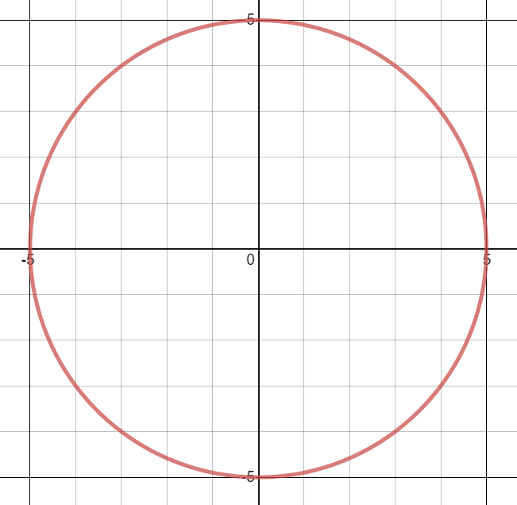


Worked example
Your turn
Sketch the following curves:
$$r=4$$
$$r=6$$
Sketch the following curve:
$$r=5$$
$$r=a$$
Graphs used with permission from DESMOS: https://www.desmos.com/

Slide 13
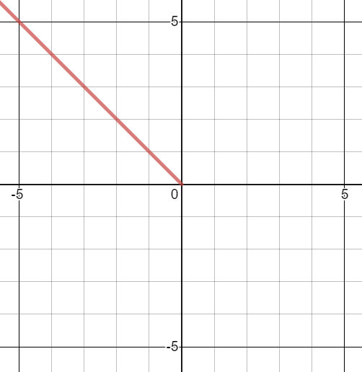


Worked example
Your turn
Sketch the following curves:
$$θ=−\frac{3π}{4}$$
$$θ=\frac{π}{4}$$
Sketch the following curves:
$$θ=\frac{3π}{4}$$
$$θ=a$$
Graphs used with permission from DESMOS: https://www.desmos.com/

Slide 14
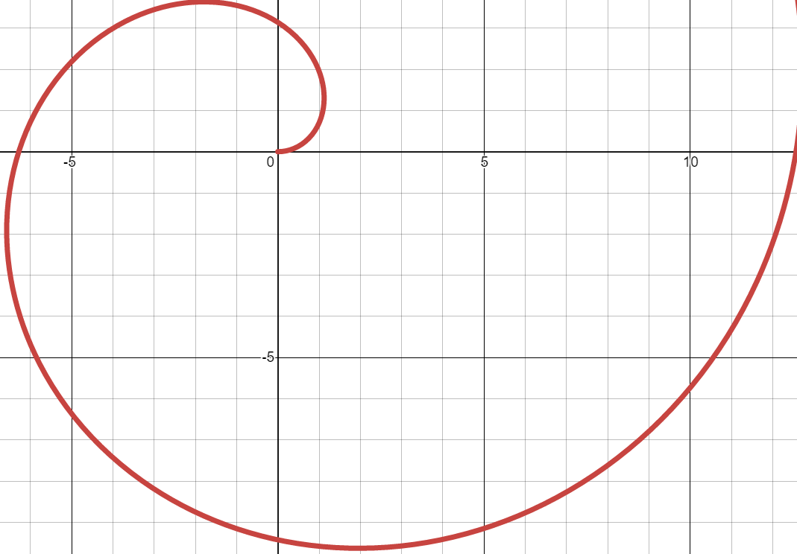


Worked example
Your turn
Sketch the following curves:
$$r=θ$$
$$r=3θ$$
Sketch the following curves:
$$r=2θ$$
$$r=aθ$$
Graphs used with permission from DESMOS: https://www.desmos.com/

Slide 15
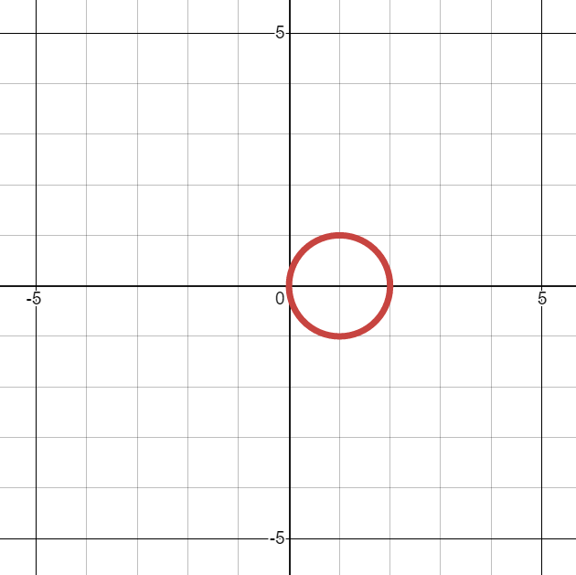


Worked example
Your turn
Sketch the following curves:
$$r=\cos{θ}$$
$$r=3\cos{θ}$$
Sketch the following curves:
$$r=2 cos{θ}$$
$$r=a\cos{θ}$$
Graphs used with permission from DESMOS: https://www.desmos.com/

Slide 16
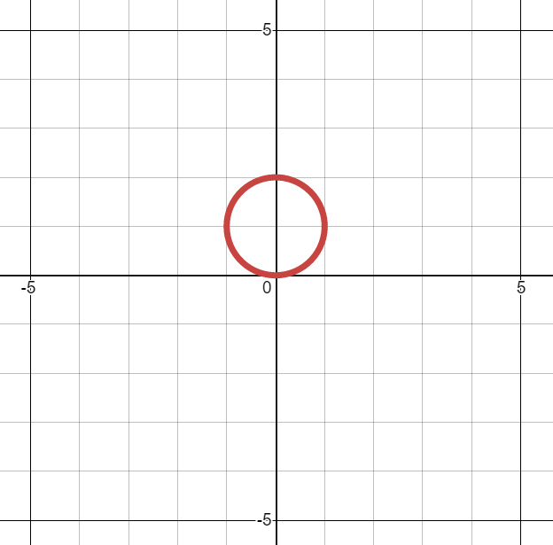


Worked example
Your turn
Sketch the following curves:
$$r=\sin{θ}$$
$$r=3\sin{θ}$$
Sketch the following curves:
$$r=2 sin{θ}$$
$$r=a\sin{θ}$$
Graphs used with permission from DESMOS: https://www.desmos.com/

Slide 17
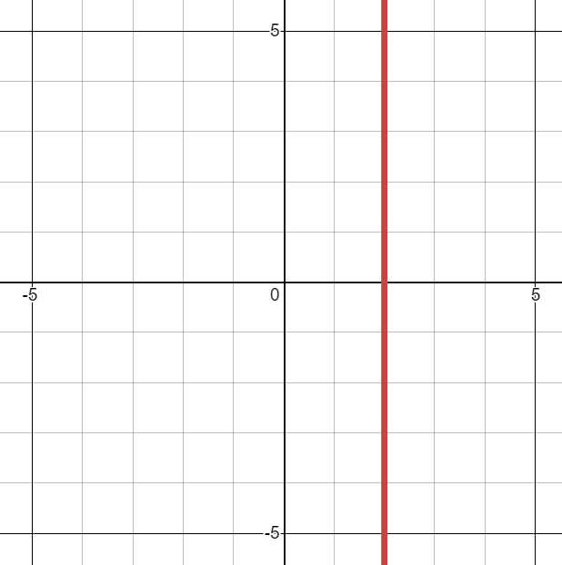


Worked example
Your turn
Sketch the following curves:
$$r=\sec{θ}$$
$$r=3\sec{θ}$$
Sketch the following curves:
$$r=2 sec{θ}$$
$$r=a\sec{θ}$$
Graphs used with permission from DESMOS: https://www.desmos.com/

Slide 18
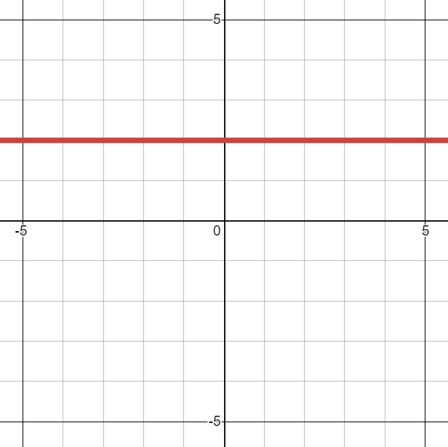


Worked example
Your turn
Sketch the following curves:
$$r=\operatorname{cosec}{θ}$$
$$r=3\operatorname{cosec}{θ}$$
Sketch the following curves:
$$r=2 cosec{θ}$$
$$r=a\operatorname{cosec}{θ}$$
Graphs used with permission from DESMOS: https://www.desmos.com/

Slide 19
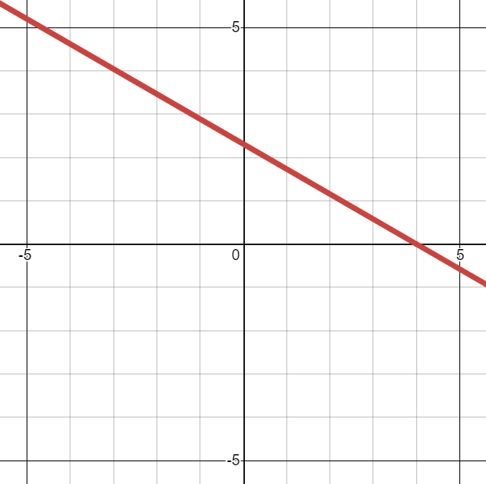


Worked example
Your turn
Sketch the following curves:
$$r=\sec\left(θ−\frac{π}{4}\right)$$
$$r=3sec\left(θ+\frac{π}{6}\right)$$
Sketch the following curves:
$$r=2sec\left(θ−\frac{π}{3}\right)$$
$$r=a\sec{(θ−k)}$$
Graphs used with permission from DESMOS: https://www.desmos.com/

Slide 20
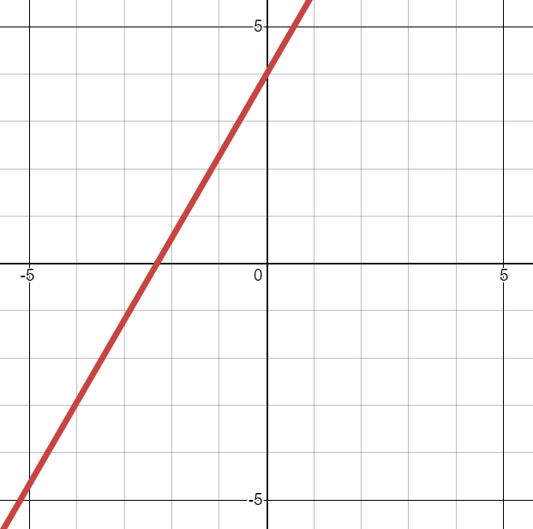


Worked example
Your turn
Sketch the following curves:
$$r=\operatorname{cosec}\left(θ−\frac{π}{4}\right)$$
$$r=3cosec\left(θ+\frac{π}{6}\right)$$
Sketch the following curves:
$$r=2cosec\left(θ−\frac{π}{3}\right)$$
$$r=a\operatorname{cosec}{(θ−k)}$$
Graphs used with permission from DESMOS: https://www.desmos.com/

Slide 21



Worked example
Your turn
Sketch the following curves:
$$r=1+\cos{θ}$$
$$r=3(1+\cos{θ})$$
Sketch the following curves:
$$r=2(1+\cos{θ})$$
$$r=a(1+\cos{θ)}$$
Graphs used with permission from DESMOS: https://www.desmos.com/

Slide 22



Worked example
Your turn
Sketch the following curves:
$$r=1−\cos{θ}$$
$$r=3(1−\cos{θ})$$
Sketch the following curves:
$$r=2(1−\cos{θ})$$
$$r=a(1−\cos{θ)}$$
Graphs used with permission from DESMOS: https://www.desmos.com/

Slide 23



Worked example
Your turn
Sketch the following curves:
$$r=1+\sin{θ}$$
$$r=3(1+\sin{θ})$$
Sketch the following curves:
$$r=2(1+\sin{θ})$$
$$r=a\left(1+\sin{θ}\right)$$
Graphs used with permission from DESMOS: https://www.desmos.com/

Slide 24



Worked example
Your turn
Sketch the following curves:
$$r=1−\sin{θ}$$
$$r=3(1−\sin{θ})$$
Sketch the following curves:
$$r=2(1−\sin{θ})$$
$$r=a(1−\sin{θ})$$
Graphs used with permission from DESMOS: https://www.desmos.com/

Slide 25



Worked example
Your turn
Sketch the following curves:
$$r=2\sin{3θ}$$
$$r=5\sin{7θ}$$
Sketch the following curves:
$$r=3\sin{5θ}$$
$$r=a\sin{nθ}$$
Graphs used with permission from DESMOS: https://www.desmos.com/

Slide 26



Worked example
Your turn
Sketch the following curves:
$$r=2\cos{3θ}$$
$$r=5\cos{7θ}$$
Sketch the following curves:
$$r=3\cos{5θ}$$
$$r=a\cos{nθ}$$
Graphs used with permission from DESMOS: https://www.desmos.com/

Slide 27



Worked example
Your turn
Sketch the following curves:
$$r^{2}=16\cos{2θ}$$
$$r^{2}=9\cos{2θ}$$
Sketch the following curves:
$$r^{2}=4\cos{2θ}$$
$$r^{2}=a^{2}\cos{2θ}$$
Graphs used with permission from DESMOS: https://www.desmos.com/

Slide 28



Worked example
Your turn
Sketch the following curves:
$$r^{2}=16\sin{2θ}$$
$$r^{2}=9\sin{2θ}$$
Sketch the following curves:
$$r^{2}=4\sin{2θ}$$
$$r^{2}=a^{2}\sin{2θ}$$
Graphs used with permission from DESMOS: https://www.desmos.com/

Slide 29



Worked example
Your turn
Sketch the following curves:
$$r^{2}=16\cos{θ}$$
$$r^{2}=9\cos{θ}$$
Sketch the following curves:
$$r^{2}=4\cos{θ}$$
$$r^{2}=a^{2}\cos{θ}$$
Graphs used with permission from DESMOS: https://www.desmos.com/

Slide 30



Worked example
Your turn
Sketch the following curves:
$$r^{2}=16\sin{θ}$$
$$r^{2}=9\sin{θ}$$
Sketch the following curves:
$$r^{2}=4\sin{θ}$$
$$r^{2}=a^{2}\sin{2θ}$$
Graphs used with permission from DESMOS: https://www.desmos.com/

Slide 31





Worked example
Your turn
Sketch:
$$r=6\left(3+3\cos{θ}\right)$$
$$r=5\left(3+2\cos{θ}\right)$$
$$r=4\left(3+\cos{θ}\right)$$
Sketch:
$$r=a\left(2+2\cos{θ}\right)$$
$$r=a(5+2\cos{θ})$$
$$r=a(3+2\cos{θ})$$
Sketches with intercepts and axes labelled. General shapes:
Graphs used with permission from DESMOS: https://www.desmos.com/

Slide 32





Worked example
Your turn
Sketch:
$$r=6\left(3+3\sin{θ}\right)$$
$$r=5\left(3+2\sin{θ}\right)$$
$$r=4\left(3+\sin{θ}\right)$$
Sketch:
$$r=a\left(2+2\sin{θ}\right)$$
$$r=a(5+2\sin{θ})$$
$$r=a(3+2\sin{θ})$$
Sketches with intercepts and axes labelled. General shapes:
Graphs used with permission from DESMOS: https://www.desmos.com/

Slide 33


Worked example
Your turn
Show on an Argand diagram the locus of points given by the values of $z$ satisfying $\left|z+4+3i\right|=5$
Show that this locus of points can be represented by the polar curve $r=−8\cos{θ}−6\sin{θ}$
Show on an Argand diagram the locus of points given by the values of $z$ satisfying $\left|z−3−4i\right|=5$
Show that this locus of points can be represented by the polar curve $r=6\cos{θ}+8\sin{θ}$
Shown

Slide 34
5.3) Area enclosed by a polar curve
Chapter CONTENTS

Slide 35



Worked example
Your turn
Find the area enclosed by the cardioid with equation $r=a\left(1+\sin{θ}\right)$
Find the area enclosed by the cardioid with equation $r=a\left(1+\cos{θ}\right)$
$$\frac{3a^{2}π}{2}$$

Slide 36



Worked example
Your turn
Find the area of one loop of the curve with polar equation $y=a\cos{3θ}$
Find the area of one loop of the curve with polar equation $y=a\sin{4θ}$
$$\frac{a^{2}π}{16}$$

Slide 37


Worked example
Your turn
A curve has equation $r=a+3\cos{θ}, a>0$
The area enclosed by the curve is $\frac{107}{2}π$.
Find the value of $a$.
A curve has equation $r=a+5\sin{θ}, a>5$
The area enclosed by the curve is $\frac{187}{2}π$.
Find the value of $a$.
$$a=9$$

Slide 38



Worked example
Your turn
Find the exact value of the area of the finite region contained within both curves
$r=1+\sin{θ}$ and $r=3\sin{θ}$
Find the exact value of the area of the finite region contained within both two curves
$r=2+\cos{θ}$ and $r=5\cos{θ}$
$$\frac{43π}{12}−\sqrt{3}$$

Slide 39


Worked example
Your turn
The set of points, $A$, is defined by:
$$A=\left\{z:\frac{π}{2}≤\arg{z}≤π\right\}∩\{z:|z+12−5i|≤13$$
Find the area of the region defined by $A$
The set of points, $A$, is defined by:
$$A=\left\{z:−\frac{π}{4}≤\arg{z}≤0\right\}∩\{z:|z−4+3i|≤5$$
Find the area of the region defined by $A$
$35.1$ (3 sf)

Slide 40



Worked example
Your turn
Two curves are given by the polar equations
$$r=3, 0≤θ<\frac{π}{2} \\ r=2.5+\sin{5θ} 0≤θ≤\frac{2π}{5}$$
Find the area of the region enclosed between the two curves where $r>2$ and $r<1.5+\sin{3θ}$
Two curves are given by the polar equations
$$r=2, 0≤θ<\frac{π}{2} \\ r=1.5+\sin{3θ} 0≤θ≤\frac{π}{2}$$
Find the area of the region enclosed between the two curves where $r>2$ and $r<1.5+\sin{3θ}$
$$\frac{13\sqrt{3}}{24}−\frac{5π}{36}$$

Slide 41
5.4) Tangents to polar curves
Chapter CONTENTS

Slide 42



Worked example
Your turn
Find the coordinates of the points on
$r=a\left(1+\sin{θ}\right)$ where the tangents are parallel to the initial line $θ=0$.
Find the coordinates of the points on
$r=a\left(1+\cos{θ}\right)$ where the tangents are parallel to the initial line $θ=0$.
$\left(\frac{3a}{2}, ±\frac{π}{3}\right)$ and $(0, π$)

Slide 43



Worked example
Your turn
Find the coordinates of the points on
$r=a\left(1+\sin{θ}\right)$ where the tangents are perpendicular to the initial line $θ=0$.
Find the coordinates of the points on
$r=a\left(1+\cos{θ}\right)$ where the tangents are perpendicular to the initial line $θ=0$.
$\left(2a, 0\right), (0, π$) and $\left(\frac{\left(2−\sqrt{2}\right)}{2}a, ±\frac{3π}{4}\right)$

Slide 44



Worked example
Your turn
The curve $C$ has polar equation
$$r=1+3\cos{θ}, 0≤θ≤\frac{π}{2}$$
At the point $P$ on $C$, the tangent to $C$ is parallel to the initial line.
Given that $O$ is the pole, find the exact length of the line $OP$.
The curve $C$ has polar equation
$$r=1+2\cos{θ}, 0≤θ≤\frac{π}{2}$$
At the point $P$ on $C$, the tangent to $C$ is parallel to the initial line.
Given that $O$ is the pole, find the exact length of the line $OP$.
$$\frac{3+\sqrt{33}}{4}$$

Slide 45



Worked example
Your turn
Find the points on the spiral $r=e^{3θ}, 0≤θ≤π$, where the tangents are:
Perpendicular to the initial line
Perpendicular to the initial line
Find the points on the spiral $r=e^{2θ}, 0≤θ≤π$, where the tangents are:
Perpendicular to the initial line
Perpendicular to the initial line
$$(9.15, 1.11)$$
$$(212, 2.68)$$

Slide 46



Worked example
Your turn
Find the equation and the points of contact of the tangents to the curve
$$r=a\cos{2θ, 0≤θ≤\frac{π}{2}}$$
that are parallel to the initial line
Find the equation and the points of contact of the tangents to the curve
$$r=a\sin{2θ, 0≤θ≤\frac{π}{2}}$$
that are parallel to the initial line
$(0, 0)$ ; Tangent $θ=0$
$\left(\frac{2a\sqrt{2}}{3}, 0.955\right)$ ; Tangent $r=\frac{4a}{3\sqrt{3}} cosec θ$

Slide 47



Worked example
Your turn
Find the equation and the points of contact of the tangents to the curve
$$r=a\cos{2θ, 0≤θ≤\frac{π}{2}}$$
that are perpendicular to the initial line.
Find the equation and the points of contact of the tangents to the curve
$$r=a\sin{2θ, 0≤θ≤\frac{π}{2}}$$
that are perpendicular to the initial line.
$(0, 0)$ ; Tangent $θ=\frac{π}{2}$
$\left(\frac{2a\sqrt{2}}{3}, 0.615\right)$ ; Tangent $r=\frac{4a}{3\sqrt{3}} sec θ$

Slide 48





Worked example
Your turn
The diagram shows the cardioid with polar equation $r=4(1+\sin{θ}$)
An area is enclosed by the curve and the horizontal line segment which is tangent to the curve and parallel to the initial line.
Find the area.
The diagram shows the cardioid with polar equation $r=2(1+\cos{θ}$)
An area is enclosed by the curve and the vertical line segment which is tangent to the curve and perpendicular to the initial line.
Find the area.
$$\frac{15\sqrt{3}}{4}−2π$$
Graphs used with permission from DESMOS: https://www.desmos.com/

