Slide 1
Teachings for
Exercise 4D

Slide 2


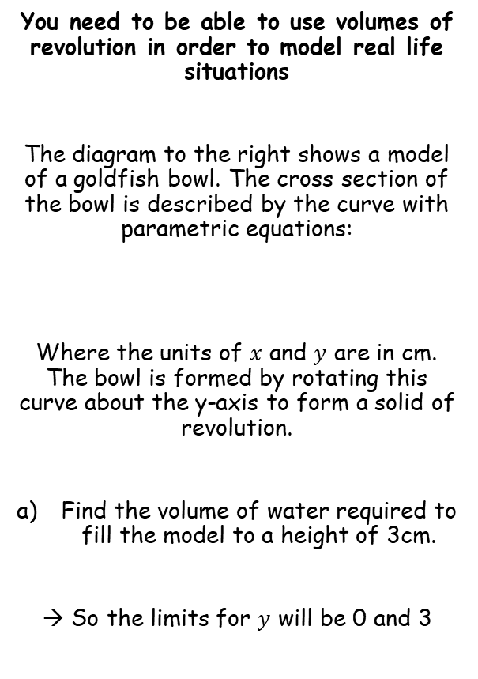



Volumes of Revolution
$$V=π\int_{a}^{b}{y^{2}} dx$$
$$V=π\int_{t=q}^{t=p}{y^{2}} \frac{dx}{dt}dt$$
$$V=π\int_{a}^{b}{x^{2}} dy$$
$$V=π\int_{t=q}^{t=p}{x^{2}} \frac{dy}{dt}dt$$
You need to be able to use volumes of revolution in order to model real life situations
The diagram to the right shows a model of a goldfish bowl. The cross section of the bowl is described by the curve with parametric equations:
Where the units of $x$ and $y$ are in cm. The bowl is formed by rotating this curve about the y-axis to form a solid of revolution.
Find the volume of water required to fill the model to a height of 3cm.
→ So the limits for $y$ will be 0 and 3
$$y$$
$$3$$
3cm
$$O$$
$$x$$
$x=2sint,$ $y=2cost+2$, $\frac{π}{6}≤t≤\frac{11π}{6}$
4cm
4D

Slide 3


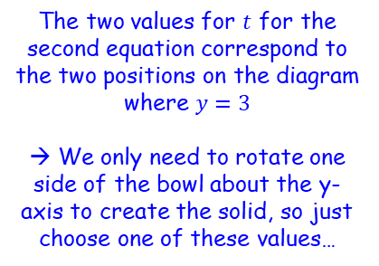




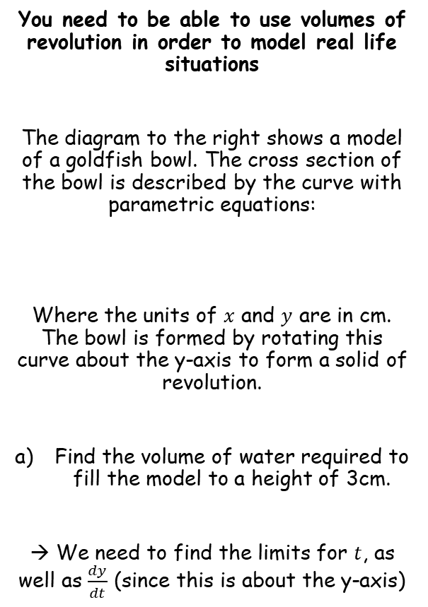






Volumes of Revolution
$$V=π\int_{a}^{b}{y^{2}} dx$$
$$V=π\int_{t=q}^{t=p}{y^{2}} \frac{dx}{dt}dt$$
$$V=π\int_{a}^{b}{x^{2}} dy$$
$$V=π\int_{t=q}^{t=p}{x^{2}} \frac{dy}{dt}dt$$
You need to be able to use volumes of revolution in order to model real life situations
The diagram to the right shows a model of a goldfish bowl. The cross section of the bowl is described by the curve with parametric equations:
Where the units of $x$ and $y$ are in cm. The bowl is formed by rotating this curve about the y-axis to form a solid of revolution.
Find the volume of water required to fill the model to a height of 3cm.
→ We need to find the limits for $t$, as well as $\frac{dy}{dt}$ (since this is about the y-axis)
Finding the limits
When $t=\frac{5π}{3}$
$$y$$
When $t=\frac{π}{3}$
$$y=2cost+2$$
$$y=0$$
$$y=3$$
$$3$$
$$cost=−1$$
$$cost=\frac{1}{2}$$
$$t=π$$
$$,\frac{5π}{3}$$
$$t=\frac{π}{3}$$
$$O$$
$$x$$
$x=2sint,$ $y=2cost+2$, $\frac{π}{6}≤t≤\frac{11π}{6}$
Remember to check for other values for $t$ within the range given…
4cm
The two values for $t$ for the second equation correspond to the two positions on the diagram where $y=3$
→ We only need to rotate one side of the bowl about the y-axis to create the solid, so just choose one of these values…
Limits of $t=\left[\frac{π}{3},π\right]$
4D

Slide 4




Volumes of Revolution
$$V=π\int_{a}^{b}{y^{2}} dx$$
$$V=π\int_{t=q}^{t=p}{y^{2}} \frac{dx}{dt}dt$$
$$V=π\int_{a}^{b}{x^{2}} dy$$
$$V=π\int_{t=q}^{t=p}{x^{2}} \frac{dy}{dt}dt$$
You need to be able to use volumes of revolution in order to model real life situations
The diagram to the right shows a model of a goldfish bowl. The cross section of the bowl is described by the curve with parametric equations:
Where the units of $x$ and $y$ are in cm. The bowl is formed by rotating this curve about the y-axis to form a solid of revolution.
Find the volume of water required to fill the model to a height of 3cm.
→ We need to find the limits for $t$, as well as $\frac{dy}{dt}$ (since this is about the y-axis)
Finding $\frac{dy}{dt}$
$$y$$
When $t=\frac{π}{3}$
$$y=2cost+2$$
Expand bracket
$$3$$
$$\frac{dy}{dt}=−2sint$$
$$O$$
$$x$$
$x=2sint,$ $y=2cost+2$, $\frac{π}{6}≤t≤\frac{11π}{6}$
4cm
Limits of $t=\left[\frac{π}{3},π\right]$
$$\frac{dy}{dt}=−2sint$$
4D

Slide 5
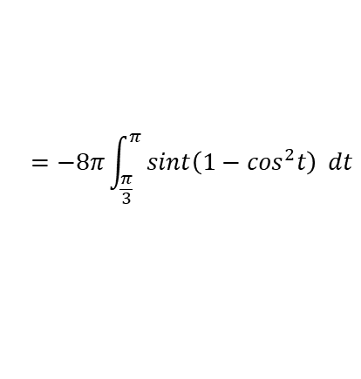
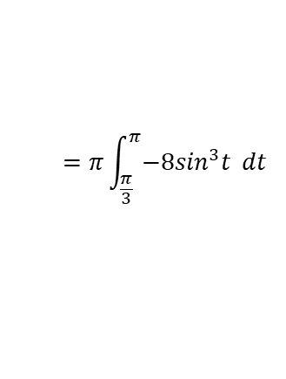
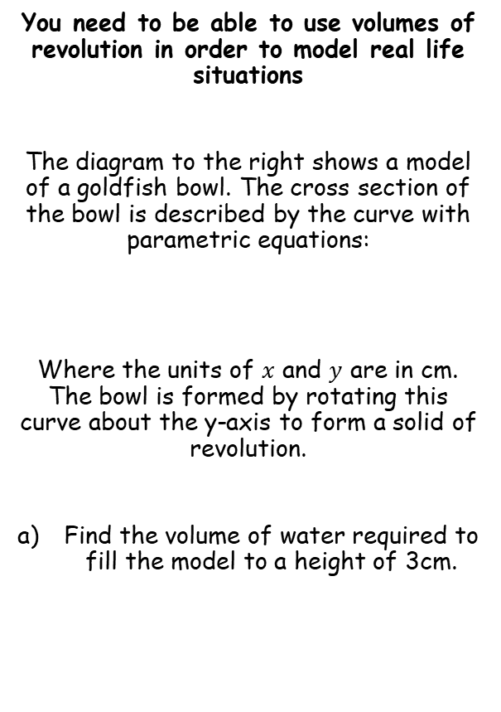
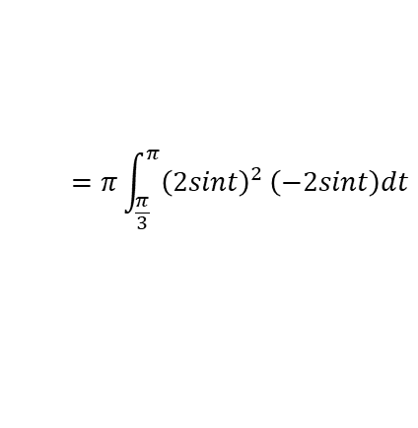

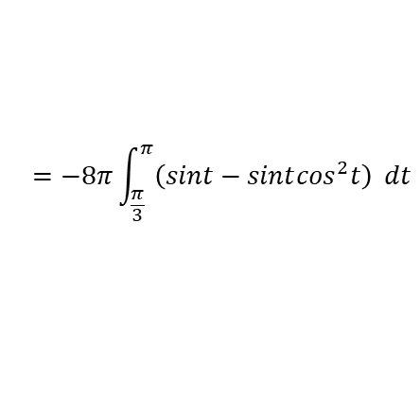
Volumes of Revolution
$$V=π\int_{a}^{b}{y^{2}} dx$$
$$V=π\int_{t=q}^{t=p}{y^{2}} \frac{dx}{dt}dt$$
$$V=π\int_{a}^{b}{x^{2}} dy$$
$$V=π\int_{t=q}^{t=p}{x^{2}} \frac{dy}{dt}dt$$
You need to be able to use volumes of revolution in order to model real life situations
The diagram to the right shows a model of a goldfish bowl. The cross section of the bowl is described by the curve with parametric equations:
Where the units of $x$ and $y$ are in cm. The bowl is formed by rotating this curve about the y-axis to form a solid of revolution.
Find the volume of water required to fill the model to a height of 3cm.
$$V=π\int_{t=q}^{t=p}{x^{2}} \frac{dy}{dt}dt$$
Sub in limits and expressions
$$=π\int_{\frac{π}{3}}^{π}{{\left(2sint\right)}^{2}}\left(−2sint\right)dt$$
Simplify
$$=π\int_{\frac{π}{3}}^{π}{−8\sin^{3}t} dt$$
We need to find a way to integrate this – try writing using identities we know (experience helps with this)
$x=2sint,$ $y=2cost+2$, $\frac{π}{6}≤t≤\frac{11π}{6}$
$$=−8π\int_{\frac{π}{3}}^{π}{sint\left(1−\cos^{2}t\right)} dt$$
Expand
$$=−8π\int_{\frac{π}{3}}^{π}{\left(sint−sint\cos^{2}t\right)} dt$$
Limits of $t=\left[\frac{π}{3},π\right]$
$$\frac{dy}{dt}=−2sint$$
4D

Slide 6




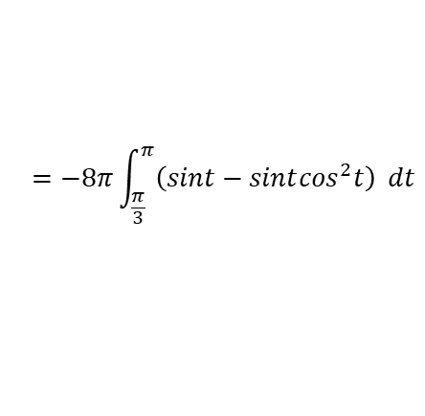

Volumes of Revolution
$$V=π\int_{a}^{b}{y^{2}} dx$$
$$V=π\int_{t=q}^{t=p}{y^{2}} \frac{dx}{dt}dt$$
$$V=π\int_{a}^{b}{x^{2}} dy$$
$$V=π\int_{t=q}^{t=p}{x^{2}} \frac{dy}{dt}dt$$
You need to be able to use volumes of revolution in order to model real life situations
The diagram to the right shows a model of a goldfish bowl. The cross section of the bowl is described by the curve with parametric equations:
Where the units of $x$ and $y$ are in cm. The bowl is formed by rotating this curve about the y-axis to form a solid of revolution.
Find the volume of water required to fill the model to a height of 3cm.
$$=−8π\int_{\frac{π}{3}}^{π}{\left(sint−sint\cos^{2}t\right)} dt$$
Both terms can now be integrated!
$$=−8π{\left[−cost+{\frac{1}{3}cos}^{3}t\right]}_{\frac{π}{3}}^{π}$$
$$y=\cos^{3}t$$
Rewrite if it helps
$x=2sint,$ $y=2cost+2$, $\frac{π}{6}≤t≤\frac{11π}{6}$
$$y={\left(cost\right)}^{3}$$
Differentiate
$$\frac{dy}{dt}={3\left(cost\right)}^{2}(−sint)$$
Rewrite
$$\frac{dy}{dt}=−3sint\cos^{2}t$$
This is 3 times what we want, so we need to divide the original ’guess’ by 3
Limits of $t=\left[\frac{π}{3},π\right]$
$$\frac{dy}{dt}=−2sint$$
4D

Slide 7





Volumes of Revolution
$$V=π\int_{a}^{b}{y^{2}} dx$$
$$V=π\int_{t=q}^{t=p}{y^{2}} \frac{dx}{dt}dt$$
$$V=π\int_{a}^{b}{x^{2}} dy$$
$$V=π\int_{t=q}^{t=p}{x^{2}} \frac{dy}{dt}dt$$
You need to be able to use volumes of revolution in order to model real life situations
The diagram to the right shows a model of a goldfish bowl. The cross section of the bowl is described by the curve with parametric equations:
Where the units of $x$ and $y$ are in cm. The bowl is formed by rotating this curve about the y-axis to form a solid of revolution.
Find the volume of water required to fill the model to a height of 3cm.
$$=−8π\int_{\frac{π}{3}}^{π}{\left(sint−sint\cos^{2}t\right)} dt$$
Both terms can now be integrated!
$$=−8π{\left[−cost+{\frac{1}{3}cos}^{3}t\right]}_{\frac{π}{3}}^{π}$$
Sub in limits and subtract
$$=−8π\left(\left(−cosπ+{\frac{1}{3}cos}^{3}π\right)−\left(−cos\frac{π}{3}+{\frac{1}{3}cos}^{3}\frac{π}{3}\right)\right)$$
Work out terms
$x=2sint,$ $y=2cost+2$, $\frac{π}{6}≤t≤\frac{11π}{6}$
$$=−8π\left(\left(1−\frac{1}{3}\right)−\left(−\frac{1}{2}+\frac{1}{24}\right)\right)$$
Work out the inner part
$$=−8π\left(\frac{9}{8}\right)$$
The 8s cancel out
$$=−9π$$
We want the absolute value
$$\frac{dy}{dt}=−2sint$$
$$=9π {cm}^{3}$$
Limits of $t=\left[\frac{π}{3},π\right]$
4D

Slide 8


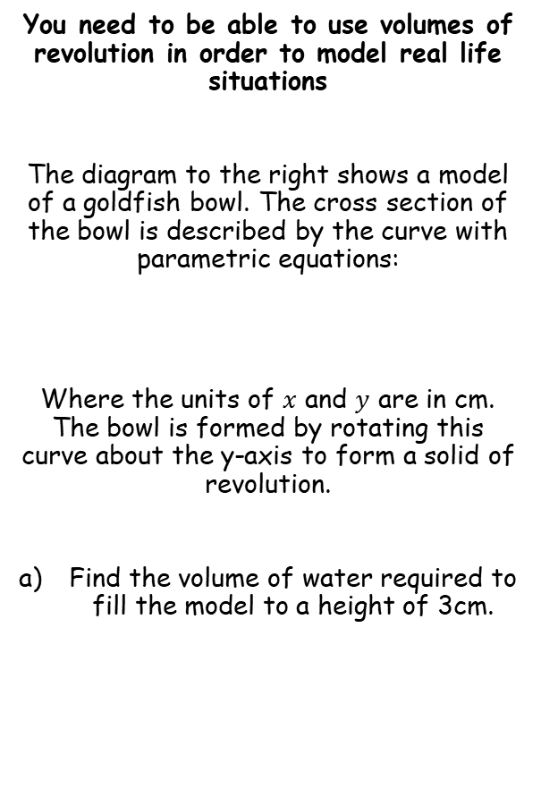


Volumes of Revolution
$$V=π\int_{a}^{b}{y^{2}} dx$$
$$V=π\int_{t=q}^{t=p}{y^{2}} \frac{dx}{dt}dt$$
$$V=π\int_{a}^{b}{x^{2}} dy$$
$$V=π\int_{t=q}^{t=p}{x^{2}} \frac{dy}{dt}dt$$
You need to be able to use volumes of revolution in order to model real life situations
The diagram to the right shows a model of a goldfish bowl. The cross section of the bowl is described by the curve with parametric equations:
Where the units of $x$ and $y$ are in cm. The bowl is formed by rotating this curve about the y-axis to form a solid of revolution.
Find the volume of water required to fill the model to a height of 3cm.
$$y$$
When $t=\frac{π}{3}$
$$3$$
$$O$$
$$x$$
$x=2sint,$ $y=2cost+2$, $\frac{π}{6}≤t≤\frac{11π}{6}$
4cm
You can use volume scale factor here:
The diameter will be multiplied by 12
So the volume will be multiplied by 12³
$$=9π×{12}^{3}$$
$$=9π {cm}^{3}$$
$=48900 cm^{3}$ (3sf)
b) The real bowl has a diameter of 48cm. Find the volume of water needed to fill it to the corresponding height
4D

