Slide 1
4.4) Modelling with volumes of revolution

Slide 2
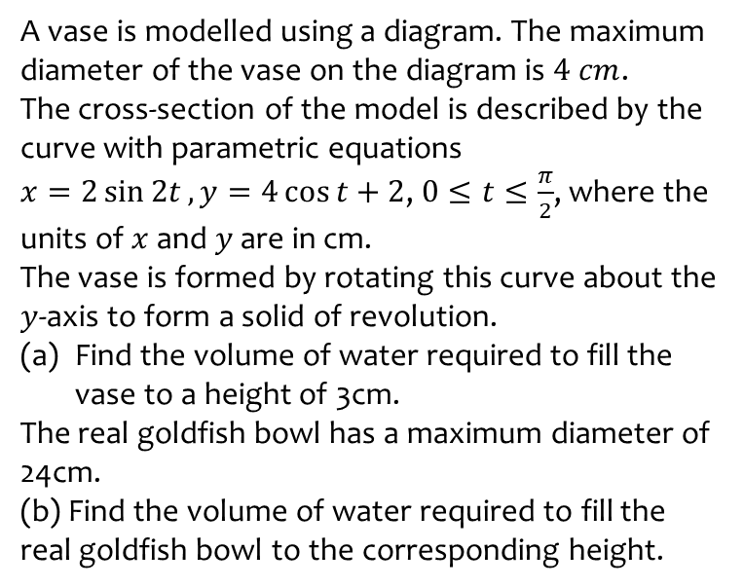
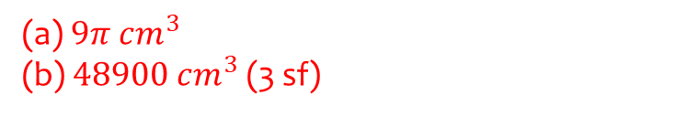
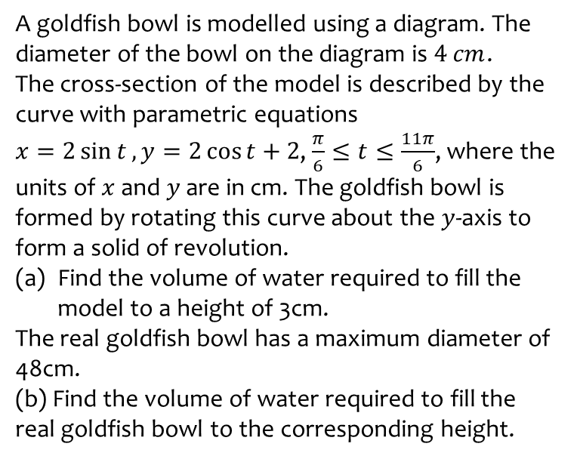
Worked example
Your turn
A vase is modelled using a diagram. The maximum diameter of the vase on the diagram is $4 cm$.
The cross-section of the model is described by the curve with parametric equations
$x=2\sin{2t}, y=4\cos{t}+2$, $0≤t≤\frac{π}{2}$, where the units of $x$ and $y$ are in cm.
The vase is formed by rotating this curve about the $y$-axis to form a solid of revolution.
Find the volume of water required to fill the vase to a height of 3cm.
The real goldfish bowl has a maximum diameter of 24cm.
(b) Find the volume of water required to fill the real goldfish bowl to the corresponding height.
A goldfish bowl is modelled using a diagram. The diameter of the bowl on the diagram is $4 cm$.
The cross-section of the model is described by the curve with parametric equations
$x=2\sin{t}, y=2\cos{t}+2$, $\frac{π}{6}≤t≤\frac{11π}{6}$, where the units of $x$ and $y$ are in cm. The goldfish bowl is formed by rotating this curve about the $y$-axis to form a solid of revolution.
Find the volume of water required to fill the model to a height of 3cm.
The real goldfish bowl has a maximum diameter of 48cm.
(b) Find the volume of water required to fill the real goldfish bowl to the corresponding height.
(a) $9π$ $cm^{3}$
(b) $48900 cm^{3}$ (3 sf)

