Slide 1
4.4) Expressions relating to the roots of a polynomial

Slide 2
Worked example
Your turn
A quadratic equation has roots $α$ and $β$. Given that $α+β=3$ and $αβ=4$, find:
(a) $\frac{1}{α}+\frac{1}{β}$ (b) $α^{2}β^{2}$ (c) $α^{2}+β^{2}$ (d) $α^{3}+β^{3}$
A quadratic equation has roots $α$ and $β$. Given that $α+β=4$ and $αβ=3$, find:
(a) $\frac{1}{α}+\frac{1}{β}$ (b) $α^{2}β^{2}$ (c) $α^{2}+β^{2}$ (d) $α^{3}+β^{3}$
(a) $\frac{4}{3}$
(b) $9$
(c) $10$
(d) $28$

Slide 3
Worked example
Your turn
A quadratic equation has roots $α$ and $β$. Given that $α+β=3$ and $αβ=4$, find:
(a) $(α+3)(β+3)$
(b) $\left(α^{2}−5\right)\left(β^{2}−5\right)$
A quadratic equation has roots $α$ and $β$. Given that $α+β=4$ and $αβ=3$, find:
(a) $(α+5)(β+5)$
(b) $\left(α^{2}−3\right)\left(β^{2}−3\right)$
(a) $48$
(b) $−12$

Slide 4
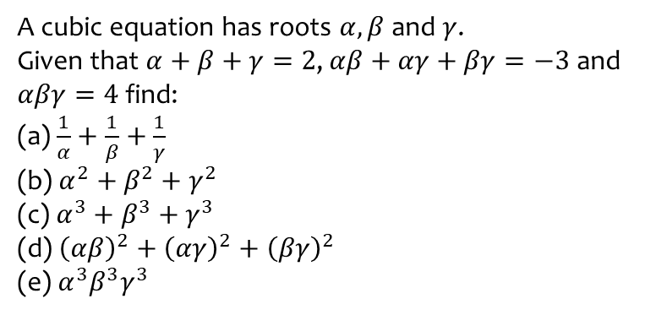
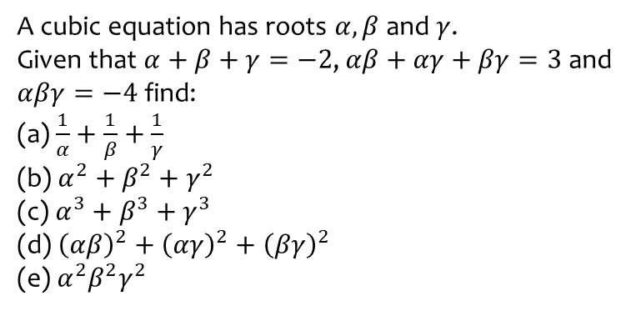
Worked example
Your turn
A cubic equation has roots $α,β$ and $γ$.
Given that $α+β+γ=−2$,$αβ+αγ+βγ=3$ and $αβγ=−4$ find:
(a) $\frac{1}{α}+\frac{1}{β}+\frac{1}{γ}$
(b) $α^{2}+β^{2}+γ^{2}$
(c) $α^{3}+β^{3}+γ^{3}$
(d) ${\left(αβ\right)}^{2}+{\left(αγ\right)}^{2}+{\left(βγ\right)}^{2}$
(e) $α^{2}β^{2}γ^{2}$
A cubic equation has roots $α,β$ and $γ$.
Given that $α+β+γ=2$,$αβ+αγ+βγ=−3$ and $αβγ=4$ find:
(a) $\frac{1}{α}+\frac{1}{β}+\frac{1}{γ}$
(b) $α^{2}+β^{2}+γ^{2}$
(c) $α^{3}+β^{3}+γ^{3}$
(d) ${\left(αβ\right)}^{2}+{\left(αγ\right)}^{2}+{\left(βγ\right)}^{2}$
(e) $α^{3}β^{3}γ^{3}$
(a) $−\frac{3}{4}$
(b) $10$
(c) $38$
(d) $−7$
(e) $64$

Slide 5
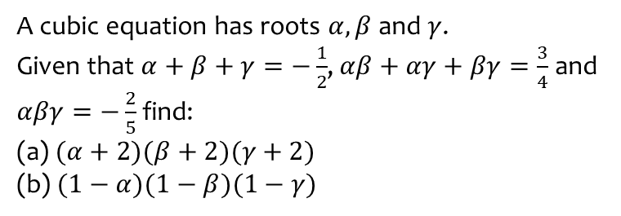
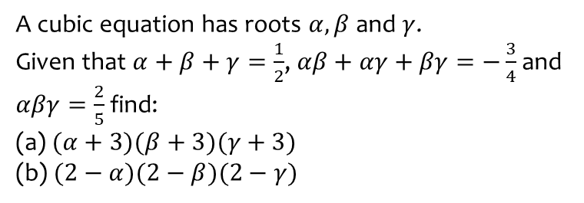
Worked example
Your turn
A cubic equation has roots $α,β$ and $γ$.
Given that $α+β+γ=\frac{1}{2}$,$αβ+αγ+βγ=−\frac{3}{4}$ and $αβγ=\frac{2}{5}$ find:
(a) $(α+3)(β+3)(γ+3)$
(b) $(2−α)(2−β)(2−γ)$
A cubic equation has roots $α,β$ and $γ$.
Given that $α+β+γ=−\frac{1}{2}$,$αβ+αγ+βγ=\frac{3}{4}$ and $αβγ=−\frac{2}{5}$ find:
(a) $(α+2)(β+2)(γ+2)$
(b) $(1−α)(1−β)(1−γ)$
(a) $\frac{71}{10}$
(b) $\frac{53}{20}$

Slide 6
Worked example
Your turn
A cubic equation has roots $α,β$ and $γ$.
Given that $α+β+γ=\frac{1}{2}$,$αβ+αγ+βγ=−\frac{3}{4}$ and $αβγ=\frac{2}{5}$ find ${\left(αβ\right)}^{3}+{\left(αγ\right)}^{3}+{\left(βγ\right)}^{3}$
A cubic equation has roots $α,β$ and $γ$.
Given that $α+β+γ=−\frac{1}{2}$,$αβ+αγ+βγ=\frac{3}{4}$ and $αβγ=−\frac{2}{5}$ find ${\left(αβ\right)}^{3}+{\left(αγ\right)}^{3}+{\left(βγ\right)}^{3}$
$$\frac{723}{1600}$$

Slide 7
Worked example
Your turn
The three roots of a cubic equation are $α,β$ and $γ$. Given that $αβγ=5$, $αβ+βγ+γα=−4$ and
$α+β+γ=3$, find the value of
$$\left(α+2\right)\left(β+2\right)(γ+2)$$
The three roots of a cubic equation are $α,β$ and $γ$. Given that $αβγ=4$, $αβ+βγ+γα=−5$ and
$α+β+γ=3$, find the value of
$$\left(α+3\right)\left(β+3\right)(γ+3)$$
$$43$$

Slide 8
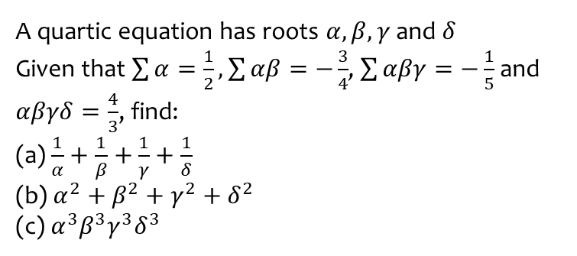
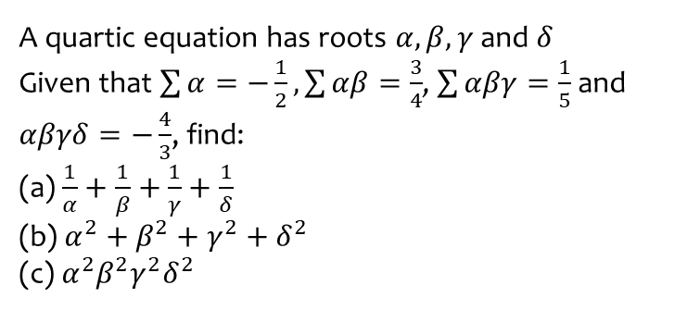
Worked example
Your turn
A quartic equation has roots $α,β,γ$ and $δ$
Given that $\sum{α}=−\frac{1}{2}, \sum{αβ}=\frac{3}{4}$, $\sum{αβγ}=\frac{1}{5}$ and $αβγδ=−\frac{4}{3}$, find:
(a) $\frac{1}{α}+\frac{1}{β}+\frac{1}{γ}+\frac{1}{δ}$
(b) $α^{2}+β^{2}+γ^{2}+δ^{2}$
(c) $α^{2}β^{2}γ^{2}δ^{2}$
A quartic equation has roots $α,β,γ$ and $δ$
Given that $\sum{α}=\frac{1}{2}, \sum{αβ}=−\frac{3}{4}$, $\sum{αβγ}=−\frac{1}{5}$ and $αβγδ=\frac{4}{3}$, find:
(a) $\frac{1}{α}+\frac{1}{β}+\frac{1}{γ}+\frac{1}{δ}$
(b) $α^{2}+β^{2}+γ^{2}+δ^{2}$
(c) $α^{3}β^{3}γ^{3}δ^{3}$
(a) $−\frac{3}{20}$
(b) $\frac{7}{4}$
(c) $\frac{64}{27}$

Slide 9
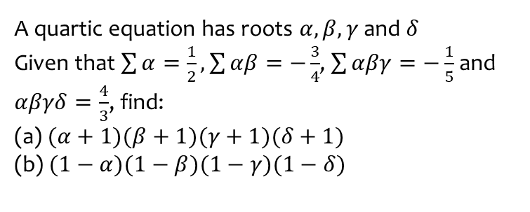
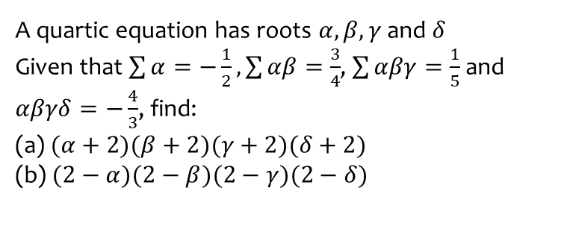
Worked example
Your turn
A quartic equation has roots $α,β,γ$ and $δ$
Given that $\sum{α}=−\frac{1}{2}, \sum{αβ}=\frac{3}{4}$, $\sum{αβγ}=\frac{1}{5}$ and $αβγδ=−\frac{4}{3}$, find:
(a) $(α+2)(β+2)(γ+2)(δ+2)$
(b) $(2−α)(2−β)(2−γ)(2−δ)$
A quartic equation has roots $α,β,γ$ and $δ$
Given that $\sum{α}=\frac{1}{2}, \sum{αβ}=−\frac{3}{4}$, $\sum{αβγ}=−\frac{1}{5}$ and $αβγδ=\frac{4}{3}$, find:
(a) $(α+1)(β+1)(γ+1)(δ+1)$
(b) $(1−α)(1−β)(1−γ)(1−δ)$
(a) $\frac{113}{60}$
(b) $\frac{77}{60}$

Slide 10
Worked example
Your turn
A quartic equation has roots $α,β,γ$ and $δ$
Given that $\sum{α}=−\frac{1}{2}, \sum{αβ}=\frac{3}{4}$, $\sum{αβγ}=\frac{1}{5}$ and $αβγδ=−\frac{4}{3}$, find
$${\left(αβ\right)}^{2}+{\left(αγ\right)}^{2}+{\left(αδ\right)}^{2}+{\left(βγ\right)}^{2}+{\left(βδ\right)}^{2}+{\left(γδ\right)}^{2}$$
A quartic equation has roots $α,β,γ$ and $δ$
Given that $\sum{α}=\frac{1}{2}, \sum{αβ}=−\frac{3}{4}$, $\sum{αβγ}=−\frac{1}{5}$ and $αβγδ=\frac{4}{3}$, find
$${\left(αβ\right)}^{2}+{\left(αγ\right)}^{2}+{\left(αδ\right)}^{2}+{\left(βγ\right)}^{2}+{\left(βδ\right)}^{2}+{\left(γδ\right)}^{2}$$
$$\frac{823}{240}$$

Slide 11
Worked example
Your turn
A quartic equation has roots $α,β,γ$ and $δ$
Given that $\sum{α}=−\frac{1}{2}, \sum{αβ}=\frac{3}{4}$, $\sum{αβγ}=\frac{1}{5}$ and $αβγδ=−\frac{4}{3}$, find
$${\left(αβγ\right)}^{2}+{\left(αβδ\right)}^{2}+{\left(αγδ\right)}^{2}+{\left(βγδ\right)}^{2}$$
A quartic equation has roots $α,β,γ$ and $δ$
Given that $\sum{α}=\frac{1}{2}, \sum{αβ}=−\frac{3}{4}$, $\sum{αβγ}=−\frac{1}{5}$ and $αβγδ=\frac{4}{3}$, find
$${\left(αβγ\right)}^{2}+{\left(αβδ\right)}^{2}+{\left(αγδ\right)}^{2}+{\left(βγδ\right)}^{2}$$
$$\frac{51}{25}$$

