Slide 1
4.3) Roots of a quartic equation

Slide 2
Worked example
Your turn
$α, β,γ,$ and$δ$ are the roots of the quartic equation $x^{4}−3x^{3}−2x^{2}+x−4=0$
Find the values of:
(a) $α+β+γ+δ$
(b) $αβ+αγ+αδ+βγ+βδ+γδ$
(c)$αβγ+αβδ+αγδ+βγδ$
(d) $αβγδ$
(e) $\frac{1}{α}+\frac{1}{β}+\frac{1}{γ}+\frac{1}{δ}$
(f) $α^{2}β^{2}γ^{2}δ^{2}$
$α, β,γ,$ and$δ$ are the roots of the quartic equation $x^{4}+3x^{3}+2x^{2}−x+4=0$
Find the values of:
(a) $α+β+γ+δ$
(b) $αβ+αγ+αδ+βγ+βδ+γδ$
(c)$αβγ+αβδ+αγδ+βγδ$
(d) $αβγδ$
(e) $\frac{1}{α}+\frac{1}{β}+\frac{1}{γ}+\frac{1}{δ}$
(f) $α^{3}β^{3}γ^{3}δ^{3}$
$$\text{(}\text{a}\text{) }−3$$
$$\text{(}\text{b}\text{) }2$$
$$\text{(}\text{c}\text{) }1$$
$\text{(}\text{d}\text{) }$ $4$
(e) $\frac{1}{4}$
(f) $64$

Slide 3
Worked example
Your turn
The roots of a quartic equation
$$ax^{4}+bx^{3}+cx^{2}+dx+e=0$$
are $α=\frac{2}{3}, β=\frac{1}{2}, γ=2$ and $δ=−\frac{3}{2}$
Find integer values of $a, b$ and $c$
The roots of a quartic equation
$$ax^{4}+bx^{3}+cx^{2}+dx+e=0$$
are $α=−\frac{3}{2}, β=−\frac{1}{2}, γ=−2$ and $δ=\frac{2}{3}$
Find integer values of $a, b$ and $c$
$$a=12, b=40, c=25, d=−20, e=−12$$

Slide 4
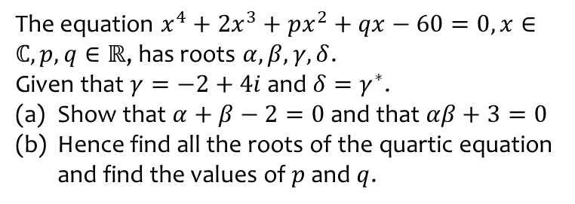
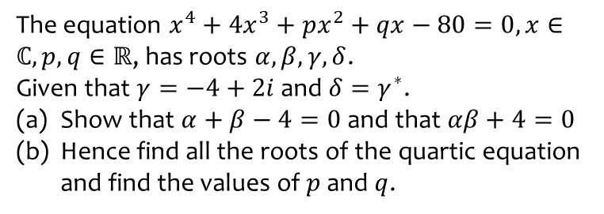
Worked example
Your turn
The equation $x^{4}+4x^{3}+px^{2}+qx−80=0, x∈ℂ, p,q∈ℝ$, has roots $α, β,γ,δ$.
Given that $γ=−4+2i$ and $δ=γ^{∗}$.
Show that $α+β−4=0$ and that $αβ+4=0$
Hence find all the roots of the quartic equation and find the values of $p$ and $q$.
The equation $x^{4}+2x^{3}+px^{2}+qx−60=0, x∈ℂ, p,q∈ℝ$, has roots $α, β,γ,δ$.
Given that $γ=−2+4i$ and $δ=γ^{∗}$.
Show that $α+β−2=0$ and that $αβ+3=0$
Hence find all the roots of the quartic equation and find the values of $p$ and $q$.
Shown
$p=9, q=−52$

