Slide 1
4.2) Volumes of revolution around the $y$-axis

Slide 2
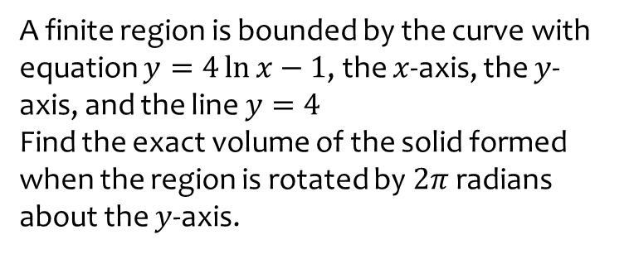
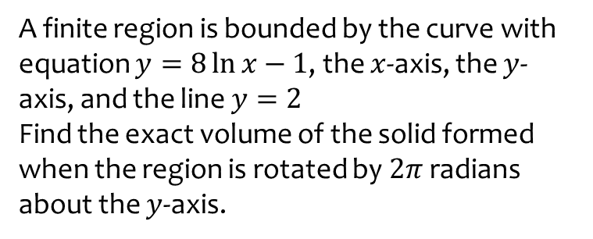
Worked example
Your turn
A finite region is bounded by the curve with equation $y=8\ln{x}−1$, the $x$-axis, the $y$-axis, and the line $y=2$
Find the exact volume of the solid formed when the region is rotated by $2π$ radians about the $y$-axis.
A finite region is bounded by the curve with equation $y=4\ln{x}−1$, the $x$-axis, the $y$-axis, and the line $y=4$
Find the exact volume of the solid formed when the region is rotated by $2π$ radians about the $y$-axis.
$$2π\sqrt{e}(e^{2}−1)$$

Slide 3
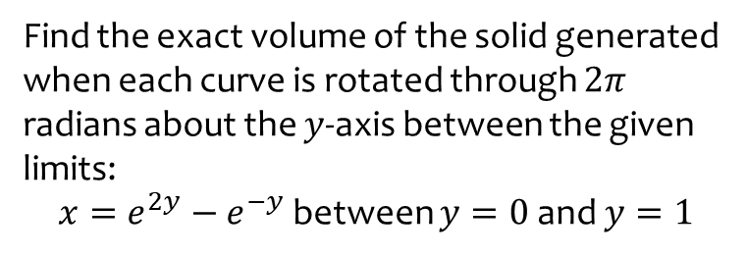
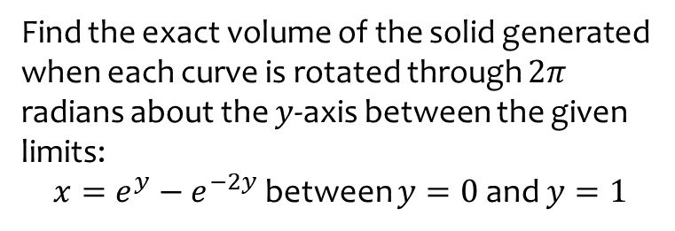
Worked example
Your turn
Find the exact volume of the solid generated when each curve is rotated through $2π$ radians about the $y$-axis between the given limits:
$x=e^{y}−e^{−2y}$ between $y=0$ and $y=1$
Find the exact volume of the solid generated when each curve is rotated through $2π$ radians about the $y$-axis between the given limits:
$x=e^{2y}−e^{−y}$ between $y=0$ and $y=1$
$$\frac{π}{4}\left(e^{2}−1\right)$$

Slide 4
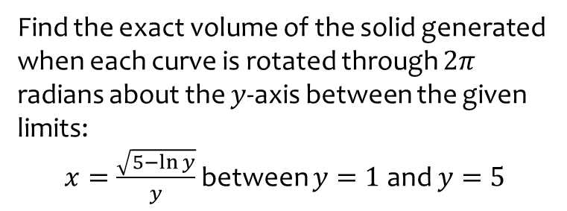
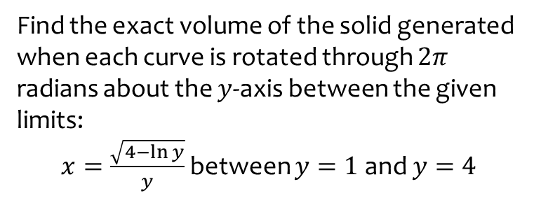
Worked example
Your turn
Find the exact volume of the solid generated when each curve is rotated through $2π$ radians about the $y$-axis between the given limits:
$x=\frac{\sqrt{4−\ln{y}}}{y}$ between $y=1$ and $y=4$
Find the exact volume of the solid generated when each curve is rotated through $2π$ radians about the $y$-axis between the given limits:
$x=\frac{\sqrt{5−\ln{y}}}{y}$ between $y=1$ and $y=5$
$$\frac{π}{5}\left(\ln{5}+16\right)$$

Slide 5
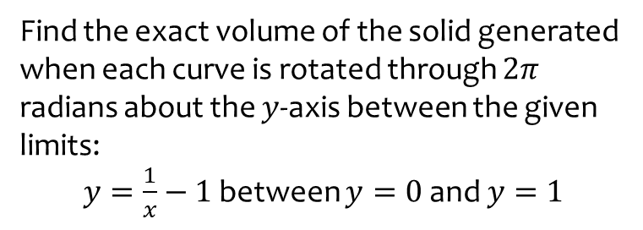
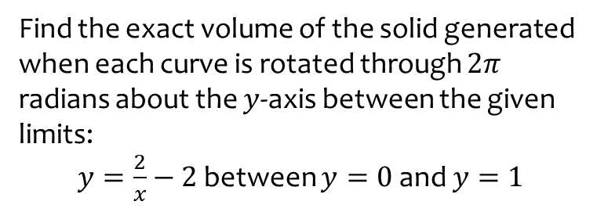
Worked example
Your turn
Find the exact volume of the solid generated when each curve is rotated through $2π$ radians about the $y$-axis between the given limits:
$y=\frac{2}{x}−2$ between $y=0$ and $y=1$
Find the exact volume of the solid generated when each curve is rotated through $2π$ radians about the $y$-axis between the given limits:
$y=\frac{1}{x}−1$ between $y=0$ and $y=1$
$$\frac{π}{2}$$

Slide 6
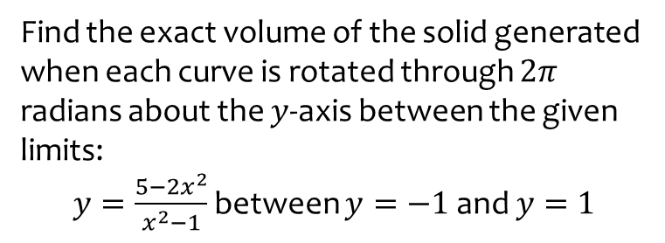
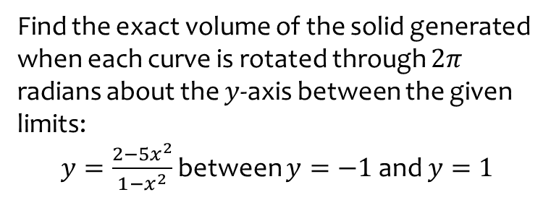
Worked example
Your turn
Find the exact volume of the solid generated when each curve is rotated through $2π$ radians about the $y$-axis between the given limits:
$y=\frac{2−5x^{2}}{1−x^{2}}$ between $y=−1$ and $y=1$
Find the exact volume of the solid generated when each curve is rotated through $2π$ radians about the $y$-axis between the given limits:
$y=\frac{5−2x^{2}}{x^{2}−1}$ between $y=−1$ and $y=1$
$$π(2+3\ln{3})$$

Slide 7
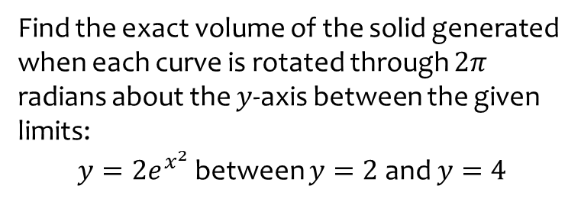
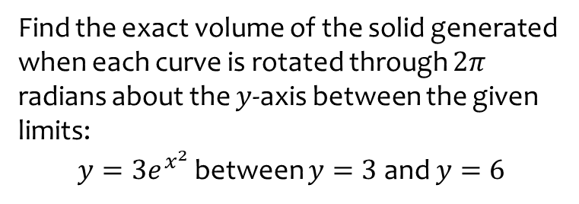
Worked example
Your turn
Find the exact volume of the solid generated when each curve is rotated through $2π$ radians about the $y$-axis between the given limits:
$y=3e^{x^{2}}$ between $y=3$ and $y=6$
Find the exact volume of the solid generated when each curve is rotated through $2π$ radians about the $y$-axis between the given limits:
$y=2e^{x^{2}}$ between $y=2$ and $y=4$
$$π(4\ln{2}−2)$$

Slide 8
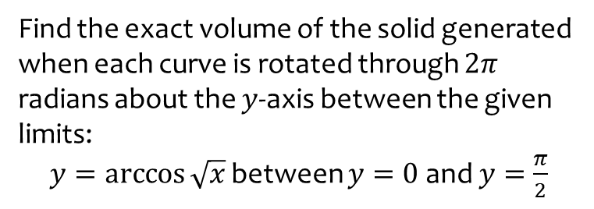
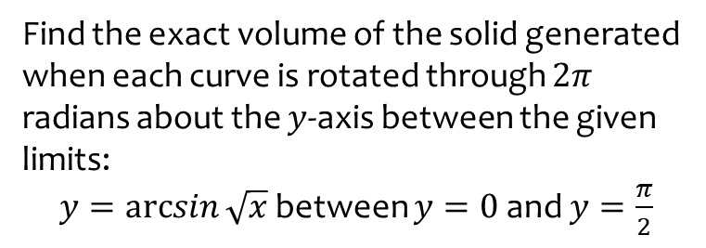
Worked example
Your turn
Find the exact volume of the solid generated when each curve is rotated through $2π$ radians about the $y$-axis between the given limits:
$y=\arcsin{\sqrt{x}}$ between $y=0$ and $y=\frac{π}{2}$
Find the exact volume of the solid generated when each curve is rotated through $2π$ radians about the $y$-axis between the given limits:
$y=\arccos{\sqrt{x}}$ between $y=0$ and $y=\frac{π}{2}$
$$\frac{3π^{2}}{16}$$

Slide 9
Worked example
Your turn
A finite region is bounded b the curve with equation $x=\frac{1}{3y+1}$, the $y$-axis and the lines $y=1$ and $y=b$. The region is rotated through $2π$ radians about the $y$-axis to generate a solid of revolution. Given that the volume of this solid is $\frac{π}{60}$, find $b$
A finite region is bounded b the curve with equation $x=\frac{1}{2y+1}$, the $y$-axis and the lines $y=1$ and $y=b$. The region is rotated through $2π$ radians about the $y$-axis to generate a solid of revolution. Given that the volume of this solid is $\frac{π}{10}$, find $b$
$$b=\frac{13}{4}$$

