Slide 1
Volumes of
Revolution
Twitter: @Owen134866
www.mathsfreeresourcelibrary.com

Slide 2










Prior Knowledge Check
Evaluate:
a)
b)
c)
3) The region R is bounded by the curve $y={4x}^{2}+5$, the x-axis and the lines $x=2$ and $x=4$. The region is rotated through $2π$ radians about the x-axis. Find the volume of the object generated.
$$\int_{0}^{3}{x^{2}{\left({3x}^{3}−6\right)}^{2} dx}$$
$$15633$$
$$\int_{\frac{π}{6}}^{\frac{π}{2}}{\cos^{2}x dx}$$
$$\frac{π}{6}−\frac{\sqrt{3}}{8}$$
$$\frac{59566π}{15}$$
$$\int_{0}^{2}{x^{2}e^{−2x} dx}$$
$$\frac{1−13e^{−4}}{4}$$
2) Find the area of the region bounded by the curve $y=\frac{1}{2}\sec^{4}x$, the x-axis, the y-axis and the line $x=1$
$$1.41$$

Slide 3
Teachings for
Exercise 4A

Slide 4

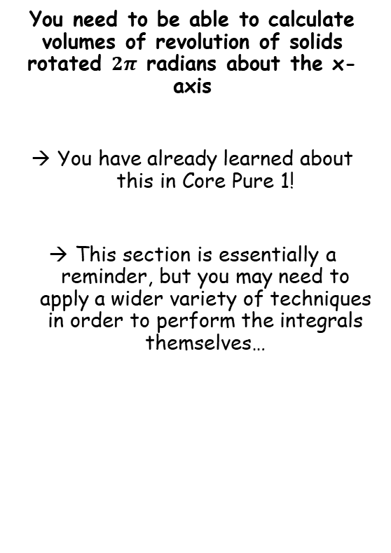
Volumes of Revolution
$$V=π\int_{a}^{b}{y^{2}} dx$$
You need to be able to calculate volumes of revolution of solids rotated $2π$ radians about the x-axis
You have already learned about this in Core Pure 1!
This section is essentially a reminder, but you may need to apply a wider variety of techniques in order to perform the integrals themselves…
4A

Slide 5





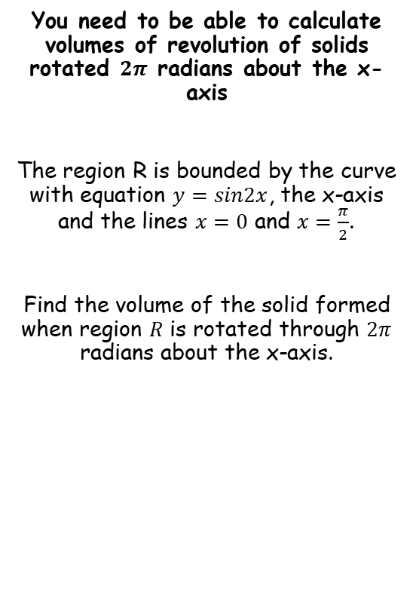









Volumes of Revolution
$$V=π\int_{a}^{b}{y^{2}} dx$$
You need to be able to calculate volumes of revolution of solids rotated $2π$ radians about the x-axis
The region R is bounded by the curve with equation $y=sin2x$, the x-axis and the lines $x=0$ and $x=\frac{π}{2}$.
Find the volume of the solid formed when region $R$ is rotated through $2π$ radians about the x-axis.
$$V=π\int_{a}^{b}{y^{2}} dx$$
Sub in the limits and the function. Remember the whole function needs to be squared!
$$=π\int_{0}^{\frac{π}{2}}{{\left(sin2x\right)}^{2}} dx$$
Square the bracket (there will often be more to do than this!)
$$=π\int_{0}^{\frac{π}{2}}{\sin^{2}2x} dx$$
If it cannot be integrated easily, find a way to change it using rules you know…
$$=π\int_{0}^{\frac{π}{2}}{\frac{1}{2}\left(1−cos4x\right)} dx$$
Take out $\frac{1}{2}$ from the integral
$$=\frac{1}{2}π\int_{0}^{\frac{π}{2}}{\left(1−cos4x\right)}dx$$
Integrate and use a square bracket
$$cos2x=1−2\sin^{2}x$$
$$=\frac{1}{2}π{\left[x−\frac{1}{4}sin4x\right]}_{0}^{\frac{π}{2}}$$
Add $2\sin^{2}x$, subtract $cos2x$
Sub in limits and subtract
$$2\sin^{2}x=1−cos2x$$
Divide by 2
$$=\frac{1}{2}π\left(\left(\left(\frac{π}{2}\right)−\frac{1}{4}sin4\left(\frac{π}{2}\right)\right)−\left(\left(0\right)−\frac{1}{4}sin4\left(0\right)\right)\right)$$
$$\sin^{2}x=\frac{1}{2}\left(1−cos2x\right)$$
Double the angles
Calculate
$$\sin^{2}2x=\frac{1}{2}\left(1−cos4x\right)$$
$$=\frac{π^{2}}{4}$$
4A

Slide 6
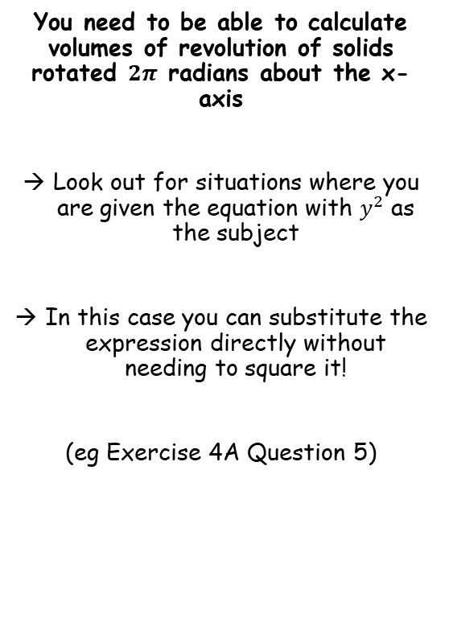
Volumes of Revolution
$$V=π\int_{a}^{b}{y^{2}} dx$$
You need to be able to calculate volumes of revolution of solids rotated $2π$ radians about the x-axis
Look out for situations where you are given the equation with $y^{2}$ as the subject
In this case you can substitute the expression directly without needing to square it!
(eg Exercise 4A Question 5)
4A

Slide 7
Teachings for
Exercise 4B

Slide 8
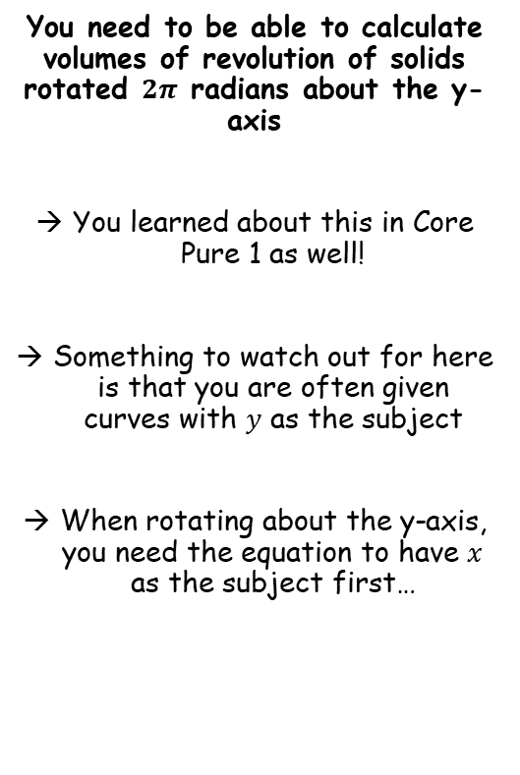

Volumes of Revolution
$$V=π\int_{a}^{b}{y^{2}} dx$$
$$V=π\int_{a}^{b}{x^{2}} dy$$
You need to be able to calculate volumes of revolution of solids rotated $2π$ radians about the y-axis
You learned about this in Core Pure 1 as well!
Something to watch out for here is that you are often given curves with $y$ as the subject
When rotating about the y-axis, you need the equation to have $x$ as the subject first…
4B

Slide 9





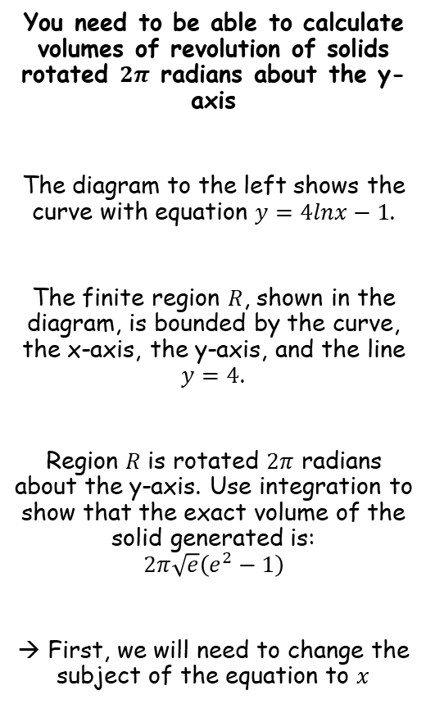









Volumes of Revolution
$$V=π\int_{a}^{b}{y^{2}} dx$$
$$V=π\int_{a}^{b}{x^{2}} dy$$
You need to be able to calculate volumes of revolution of solids rotated $2π$ radians about the y-axis
The diagram to the left shows the curve with equation $y=4lnx−1$.
The finite region $R$, shown in the diagram, is bounded by the curve, the x-axis, the y-axis, and the line $y=4$.
Region $R$ is rotated $2π$ radians about the y-axis. Use integration to show that the exact volume of the solid generated is:
$$2π\sqrt{e}\left(e^{2}−1\right)$$
→ First, we will need to change the subject of the equation to $x$
$$y=4lnx−1$$
$$y$$
$$y=4lnx−1$$
Rearrange
$$\frac{y+1}{4}=lnx$$
$$4$$
Inverse natural logarithm
$$e^{\frac{y+1}{4}}=x$$
$$R$$
$$O$$
$$x$$
$$V=π\int_{a}^{b}{x^{2}} dy$$
Sub in our expression for $x$
$$=π\int_{0}^{4}{{\left(e^{\frac{y+1}{4}}\right)}^{2}} dy$$
Square using ${\left(x^{n}\right)}^{m}=x^{nm}$
$$=π\int_{0}^{4}{e^{\frac{y+1}{2}}} dy$$
Write as separate powers of $e$
$$=π\int_{0}^{4}{e^{\frac{y}{2}}e^{\frac{1}{2}}} dy$$
Since $e^{\frac{1}{2}}$ is a constant, it can be factored out
$$=πe^{\frac{1}{2}}\int_{0}^{4}{e^{\frac{y}{2}}} dy$$
4B

Slide 10


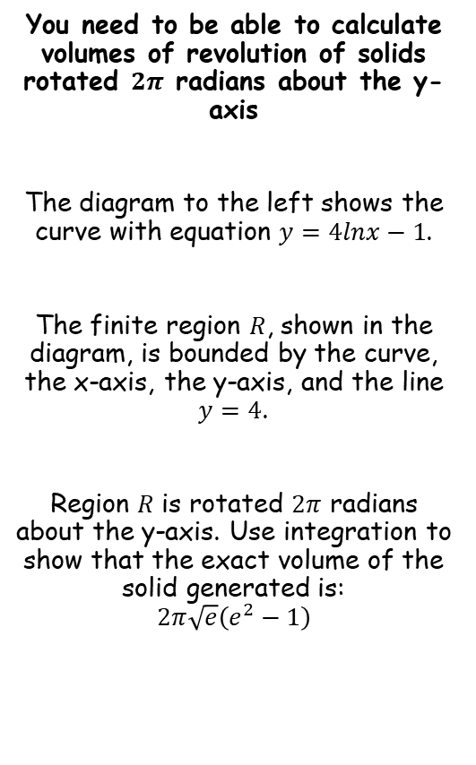




Volumes of Revolution
$$V=π\int_{a}^{b}{y^{2}} dx$$
$$V=π\int_{a}^{b}{x^{2}} dy$$
You need to be able to calculate volumes of revolution of solids rotated $2π$ radians about the y-axis
The diagram to the left shows the curve with equation $y=4lnx−1$.
The finite region $R$, shown in the diagram, is bounded by the curve, the x-axis, the y-axis, and the line $y=4$.
Region $R$ is rotated $2π$ radians about the y-axis. Use integration to show that the exact volume of the solid generated is:
$$2π\sqrt{e}\left(e^{2}−1\right)$$
$$y=4lnx−1$$
$$y$$
$$y=4lnx−1$$
Rearrange
$$\frac{y+1}{4}=lnx$$
$$4$$
Inverse natural logarithm
$$e^{\frac{y+1}{4}}=x$$
$$R$$
$$O$$
$$x$$
$$=πe^{\frac{1}{2}}\int_{0}^{4}{e^{\frac{y}{2}}} dy$$
Integrate and use a square bracket
$$=πe^{\frac{1}{2}}{\left[2e^{\frac{y}{2}}\right]}_{0}^{4}$$
The 2 can be factored out
$$=2πe^{\frac{1}{2}}{\left[e^{\frac{y}{2}}\right]}_{0}^{4}$$
Sub in limits and subtract
$$=2πe^{\frac{1}{2}}\left(e^{\frac{(4)}{2}}−e^{\frac{(0)}{2}}\right)$$
Simplify inside the bracket
$$=2πe^{\frac{1}{2}}\left(e^{2}−1\right)$$
Rewrite the $e^{\frac{1}{2}}$ term
$$=2π\sqrt{e}\left(e^{2}−1\right)$$
4B

