Slide 1
4.1) Volumes of revolution around the $x$-axis

Slide 2
Worked example
Your turn
A finite region is bounded by the curve with equation $y=\sin{4x}$, the $x$-axis and $x=\frac{π}{4}$. Find the volume of the solid formed when the region is rotated through $2π$ radians about the $x$-axis.
A finite region is bounded by the curve with equation $y=\sin{2x}$, the $x$-axis and $x=\frac{π}{2}$. Find the volume of the solid formed when the region is rotated through $2π$ radians about the $x$-axis.
$$\frac{π^{2}}{4}$$

Slide 3
Worked example
Your turn
A finite region is bounded by the curve with equation $y=1−2\sin{x}$ ($0<x<π$) and the $x$-axis.
Find the exact volume of the solid formed when the region is rotated through $2π$ radians about the $x$-axis.
A finite region is bounded by the curve with equation $y=1−2\cos{x}$ ($0<x<π$) and the $x$-axis.
Find the volume of the solid formed when the region is rotated through $2π$ radians about the $x$-axis.
$$π\left(4π+3\sqrt{3}\right)$$

Slide 4
Worked example
Your turn
Find the exact volume of the solid generated when each curve is rotated through $2π$ radians about the $x$-axis between the given limits:
$y=\sqrt{\frac{3\sin{x}}{2+\cos{x}}}$ between $x=0$ and $x=\frac{π}{2}$
Find the exact volume of the solid generated when each curve is rotated through $2π$ radians about the $x$-axis between the given limits:
$y=\sqrt{\frac{4\sin{x}}{1+\cos{x}}}$ between $x=0$ and $x=\frac{π}{2}$
$$4π\ln{2}$$

Slide 5
Worked example
Your turn
Using integration by parts, find the exact volume of the solid generated when each curve is rotated through $2π$ radians about the $x$-axis between the given limits:
$y=\frac{\sqrt{\ln{x}}}{x^{2}}$ between $x=1$ and $x=2$
Using integration by parts, find the exact volume of the solid generated when each curve is rotated through $2π$ radians about the $x$-axis between the given limits:
$y=\sqrt{x}\sec{x}$ between $x=0$ and $x=\frac{π}{4}$
$$\frac{π}{4}\left(π−\ln{4}\right)$$

Slide 6
Worked example
Your turn
A finite region is bounded by the curve with equation $y=\frac{3}{10\left(2+5x\right)}$, the $x$-axis, and the lines $x=1$ and $x=−2$.
Find the exact volume of the solid formed when the region is rotated through $360°$ about the $x$-axis.
A finite region is bounded by the curve with equation $y=\frac{10}{3\left(5+2x\right)}$, the $x$-axis, and the lines $x=−1$ and $x=2$.
Find the exact volume of the solid formed when the region is rotated through $360°$ about the $x$-axis.
$$\frac{100π}{81}$$

Slide 7
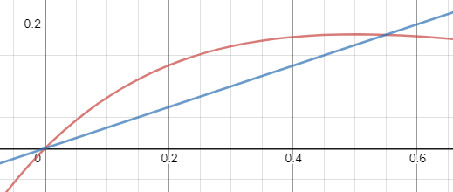
Worked example
Your turn
A finite region is bounded by the curve with equation $y=xe^{−2x}$ and the line $y=\frac{1}{3}x$
Find the volume of the solid formed when the region is rotated through $360°$ about the $x$-axis.
A finite region is bounded by the curve with equation $y=xe^{−x}$ and the line $y=\frac{1}{4}x$
Find the volume of the solid formed when the region is rotated through $360°$ about the $x$-axis.
$0.237$ (3 sf)
Graphs used with permission from DESMOS: https://www.desmos.com/

