Slide 1
4) Roots of polynomials
4.1) Roots of a quadratic equation
4.2) Roots of a cubic equation
4.3) Roots of a quartic equation
4.4) Expressions relating to the roots of a polynomial
4.5) Linear transformations of roots

Slide 2
4.1) Roots of a quadratic equation
Chapter CONTENTS

Slide 3
Worked example
Your turn
The roots of the quadratic equation
$2x^{2}+5x+4=0$ are $α$ and $β$. Without solving the equation, find the values of:
(a) $α+β$ (b) $αβ$ (c) $\frac{1}{α}+\frac{1}{β}$ (d) $α^{2}+β^{2}$
The roots of the quadratic equation
$2x^{2}−5x−4=0$ are $α$ and $β$. Without solving the equation, find the values of:
(a) $α+β$ (b) $αβ$ (c) $\frac{1}{α}+\frac{1}{β}$ (d) $α^{2}+β^{2}$
(a) $\frac{5}{2}$
(b) $−2$
(c) $−\frac{5}{4}$
(d) $\frac{41}{4}$

Slide 4
Worked example
Your turn
The roots of the quadratic equation
$6x^{2}+9x−2=0$ are $α$ and $β$. Without solving the equation, find the value of $α^{3}+β^{3}$
The roots of the quadratic equation
$6x^{2}−9x+2=0$ are $α$ and $β$. Without solving the equation, find the value of $α^{3}+β^{3}$
$$\frac{15}{8}$$

Slide 5
Worked example
Your turn
The roots of a quadratic equation
$ax^{2}+bx+c=0$ are $α=\frac{3}{2}$ and $β=−\frac{5}{4}$.
Find integer values for $a, b$ and $c$
The roots of a quadratic equation
$ax^{2}+bx+c=0$ are $α=−\frac{3}{2}$ and $β=\frac{5}{4}$.
Find integer values for $a, b$ and $c$
$$a=8, b=2, c=−15$$

Slide 6
Worked example
Your turn
The equation $ax^{2}+6x+c=0$, where $a$ and $c$ are real constants, has roots $α$ and $α^{∗}$.
Given that $Re\left(α\right)=1$ and $Im\left(α\right)=4i$, find the values of $a$ and $c$
The equation $ax^{2}+8x+c=0$, where $a$ and $c$ are real constants, has roots $α$ and $α^{∗}$.
Given that $Re\left(α\right)=2$ and $Im\left(α\right)=3i$, find the values of $a$ and $c$
$$a=−2, c=−26$$

Slide 7
4.2) Roots of a cubic equation
Chapter CONTENTS

Slide 8
Worked example
Your turn
$α, β$ and $γ$ are the roots of the cubic equation
$2x^{3}−3x^{2}+4x−2=0$.
Without solving the equation, find the values of:
(a) $α+β+γ$ (b) $αβ+βγ+γα$ (c) $αβγ$ (d) $\frac{1}{α}+\frac{1}{β}+\frac{1}{γ}$
$α, β$ and $γ$ are the roots of the cubic equation
$2x^{3}+3x^{2}−4x+2=0$.
Without solving the equation, find the values of:
(a) $α+β+γ$ (b) $αβ+βγ+γα$ (c) $αβγ$ (d) $\frac{1}{α}+\frac{1}{β}+\frac{1}{γ}$
$$\text{(}\text{a}\text{) }−\frac{3}{2}$$
$$\text{(}\text{b}\text{) }−2$$
$$\text{(}\text{c}\text{) }−1$$
$$\text{(}\text{d}\text{) }2$$

Slide 9
Worked example
Your turn
$α, β$ and $γ$ are the roots of the cubic equation
$2x^{3}−3x^{2}+4x−6=0$.
Without solving the equation, find the values of $α^{2}β^{2}γ^{2}$ and${ α}^{3}β^{3}γ^{3}$
$α, β$ and $γ$ are the roots of the cubic equation
$2x^{3}+3x^{2}−4x+4=0$.
Without solving the equation, find the values of $α^{2}β^{2}γ^{2}$ and${ α}^{3}β^{3}γ^{3}$
$α^{2}β^{2}γ^{2}=4$ and ${ α}^{3}β^{3}γ^{3}=−8$

Slide 10
Worked example
Your turn
The roots of a cubic equation
$ax^{3}+bx^{2}+cx+d=0$ are
$α=1−3i$, $β=1+3i$ and $γ=3$.
Find integers values for $a,b,c$ and $d$.
The roots of a cubic equation
$ax^{3}+bx^{2}+cx+d=0$ are
$α=1−2i$, $β=1+2i$ and $γ=2$.
Find integers values for $a,b,c$ and $d$.
$$a=1, b=−4, c=9, d=−10$$

Slide 11
Worked example
Your turn
The roots of a cubic equation
$ax^{3}+bx^{2}+cx+d=0$ are
$α=\frac{2}{3}$, $β=\frac{1}{3}$ and $γ=1$.
Find integers values for $a,b,c$ and $d$.
The roots of a cubic equation
$ax^{3}+bx^{2}+cx+d=0$ are
$α=\frac{3}{2}$, $β=\frac{1}{2}$ and $γ=1$.
Find integers values for $a,b,c$ and $d$.
$$a=4, b=−12, c=11, d=−3$$

Slide 12
Worked example
Your turn
The cubic equation $x^{3}−42x^{2}+336x−512=0$ has roots $α, kα,$and $k^{2}α$ for some real constant $k$. Find the values of $α$ and $k$
The cubic equation $x^{3}−14x^{2}+56x−64=0$ has roots $α, kα,$and $k^{2}α$ for some real constant $k$. Find the values of $α$ and $k$
$α=2, k=2$ or$α=8, k=\frac{1}{2}$

Slide 13
4.3) Roots of a quartic equation
Chapter CONTENTS

Slide 14
Worked example
Your turn
$α, β,γ,$ and$δ$ are the roots of the quartic equation $x^{4}−3x^{3}−2x^{2}+x−4=0$
Find the values of:
(a) $α+β+γ+δ$
(b) $αβ+αγ+αδ+βγ+βδ+γδ$
(c)$αβγ+αβδ+αγδ+βγδ$
(d) $αβγδ$
(e) $\frac{1}{α}+\frac{1}{β}+\frac{1}{γ}+\frac{1}{δ}$
(f) $α^{2}β^{2}γ^{2}δ^{2}$
$α, β,γ,$ and$δ$ are the roots of the quartic equation $x^{4}+3x^{3}+2x^{2}−x+4=0$
Find the values of:
(a) $α+β+γ+δ$
(b) $αβ+αγ+αδ+βγ+βδ+γδ$
(c)$αβγ+αβδ+αγδ+βγδ$
(d) $αβγδ$
(e) $\frac{1}{α}+\frac{1}{β}+\frac{1}{γ}+\frac{1}{δ}$
(f) $α^{3}β^{3}γ^{3}δ^{3}$
$$\text{(}\text{a}\text{) }−3$$
$$\text{(}\text{b}\text{) }2$$
$$\text{(}\text{c}\text{) }1$$
$\text{(}\text{d}\text{) }$ $4$
(e) $\frac{1}{4}$
(f) $64$

Slide 15
Worked example
Your turn
The roots of a quartic equation
$$ax^{4}+bx^{3}+cx^{2}+dx+e=0$$
are $α=\frac{2}{3}, β=\frac{1}{2}, γ=2$ and $δ=−\frac{3}{2}$
Find integer values of $a, b$ and $c$
The roots of a quartic equation
$$ax^{4}+bx^{3}+cx^{2}+dx+e=0$$
are $α=−\frac{3}{2}, β=−\frac{1}{2}, γ=−2$ and $δ=\frac{2}{3}$
Find integer values of $a, b$ and $c$
$$a=12, b=40, c=25, d=−20, e=−12$$

Slide 16
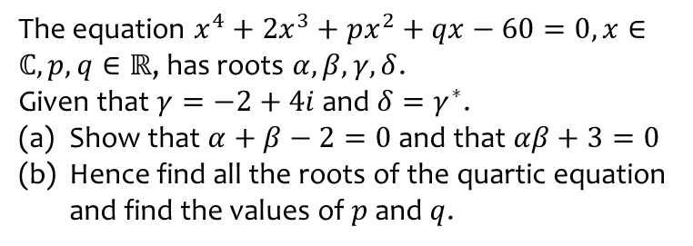
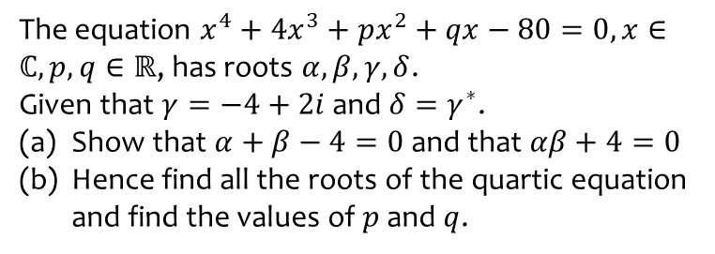
Worked example
Your turn
The equation $x^{4}+4x^{3}+px^{2}+qx−80=0, x∈ℂ, p,q∈ℝ$, has roots $α, β,γ,δ$.
Given that $γ=−4+2i$ and $δ=γ^{∗}$.
Show that $α+β−4=0$ and that $αβ+4=0$
Hence find all the roots of the quartic equation and find the values of $p$ and $q$.
The equation $x^{4}+2x^{3}+px^{2}+qx−60=0, x∈ℂ, p,q∈ℝ$, has roots $α, β,γ,δ$.
Given that $γ=−2+4i$ and $δ=γ^{∗}$.
Show that $α+β−2=0$ and that $αβ+3=0$
Hence find all the roots of the quartic equation and find the values of $p$ and $q$.
Shown
$p=9, q=−52$

Slide 17
4.4) Expressions relating to the roots of a polynomial
Chapter CONTENTS

Slide 18
Worked example
Your turn
A quadratic equation has roots $α$ and $β$. Given that $α+β=3$ and $αβ=4$, find:
(a) $\frac{1}{α}+\frac{1}{β}$ (b) $α^{2}β^{2}$ (c) $α^{2}+β^{2}$ (d) $α^{3}+β^{3}$
A quadratic equation has roots $α$ and $β$. Given that $α+β=4$ and $αβ=3$, find:
(a) $\frac{1}{α}+\frac{1}{β}$ (b) $α^{2}β^{2}$ (c) $α^{2}+β^{2}$ (d) $α^{3}+β^{3}$
(a) $\frac{4}{3}$
(b) $9$
(c) $10$
(d) $28$

Slide 19
Worked example
Your turn
A quadratic equation has roots $α$ and $β$. Given that $α+β=3$ and $αβ=4$, find:
(a) $(α+3)(β+3)$
(b) $\left(α^{2}−5\right)\left(β^{2}−5\right)$
A quadratic equation has roots $α$ and $β$. Given that $α+β=4$ and $αβ=3$, find:
(a) $(α+5)(β+5)$
(b) $\left(α^{2}−3\right)\left(β^{2}−3\right)$
(a) $48$
(b) $−12$

Slide 20
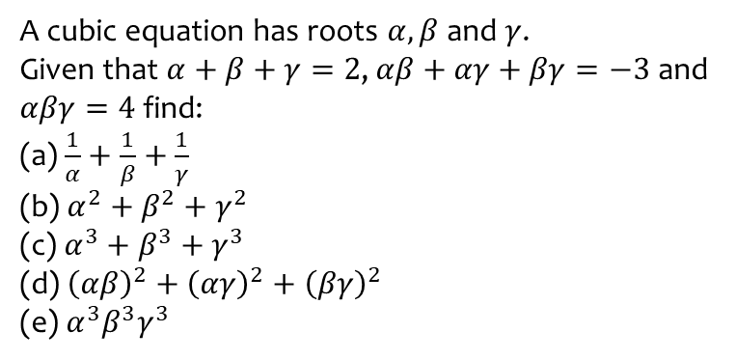
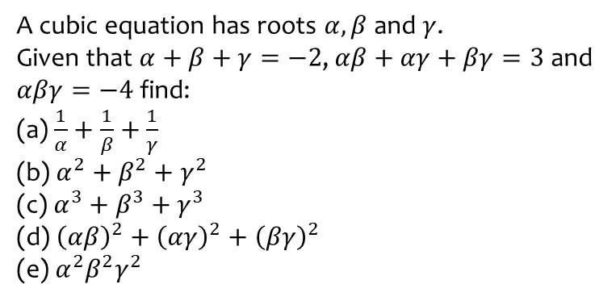
Worked example
Your turn
A cubic equation has roots $α,β$ and $γ$.
Given that $α+β+γ=−2$,$αβ+αγ+βγ=3$ and $αβγ=−4$ find:
(a) $\frac{1}{α}+\frac{1}{β}+\frac{1}{γ}$
(b) $α^{2}+β^{2}+γ^{2}$
(c) $α^{3}+β^{3}+γ^{3}$
(d) ${\left(αβ\right)}^{2}+{\left(αγ\right)}^{2}+{\left(βγ\right)}^{2}$
(e) $α^{2}β^{2}γ^{2}$
A cubic equation has roots $α,β$ and $γ$.
Given that $α+β+γ=2$,$αβ+αγ+βγ=−3$ and $αβγ=4$ find:
(a) $\frac{1}{α}+\frac{1}{β}+\frac{1}{γ}$
(b) $α^{2}+β^{2}+γ^{2}$
(c) $α^{3}+β^{3}+γ^{3}$
(d) ${\left(αβ\right)}^{2}+{\left(αγ\right)}^{2}+{\left(βγ\right)}^{2}$
(e) $α^{3}β^{3}γ^{3}$
(a) $−\frac{3}{4}$
(b) $10$
(c) $38$
(d) $−7$
(e) $64$

Slide 21
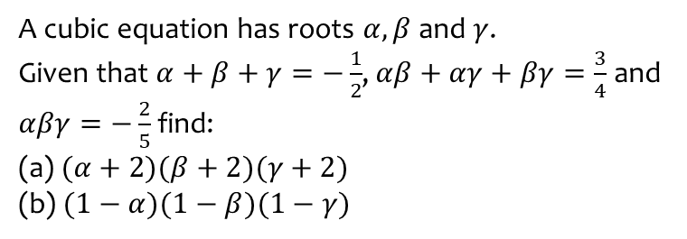
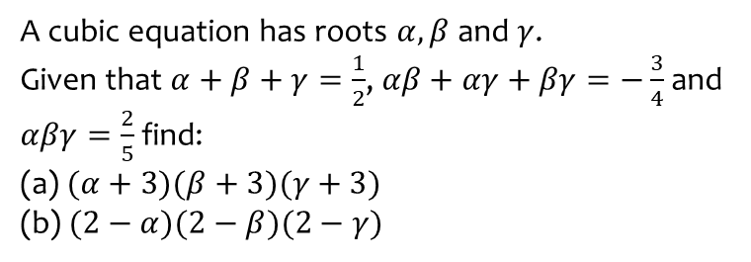
Worked example
Your turn
A cubic equation has roots $α,β$ and $γ$.
Given that $α+β+γ=\frac{1}{2}$,$αβ+αγ+βγ=−\frac{3}{4}$ and $αβγ=\frac{2}{5}$ find:
(a) $(α+3)(β+3)(γ+3)$
(b) $(2−α)(2−β)(2−γ)$
A cubic equation has roots $α,β$ and $γ$.
Given that $α+β+γ=−\frac{1}{2}$,$αβ+αγ+βγ=\frac{3}{4}$ and $αβγ=−\frac{2}{5}$ find:
(a) $(α+2)(β+2)(γ+2)$
(b) $(1−α)(1−β)(1−γ)$
(a) $\frac{71}{10}$
(b) $\frac{53}{20}$

Slide 22
Worked example
Your turn
A cubic equation has roots $α,β$ and $γ$.
Given that $α+β+γ=\frac{1}{2}$,$αβ+αγ+βγ=−\frac{3}{4}$ and $αβγ=\frac{2}{5}$ find ${\left(αβ\right)}^{3}+{\left(αγ\right)}^{3}+{\left(βγ\right)}^{3}$
A cubic equation has roots $α,β$ and $γ$.
Given that $α+β+γ=−\frac{1}{2}$,$αβ+αγ+βγ=\frac{3}{4}$ and $αβγ=−\frac{2}{5}$ find ${\left(αβ\right)}^{3}+{\left(αγ\right)}^{3}+{\left(βγ\right)}^{3}$
$$\frac{723}{1600}$$

Slide 23
Worked example
Your turn
The three roots of a cubic equation are $α,β$ and $γ$. Given that $αβγ=5$, $αβ+βγ+γα=−4$ and
$α+β+γ=3$, find the value of
$$\left(α+2\right)\left(β+2\right)(γ+2)$$
The three roots of a cubic equation are $α,β$ and $γ$. Given that $αβγ=4$, $αβ+βγ+γα=−5$ and
$α+β+γ=3$, find the value of
$$\left(α+3\right)\left(β+3\right)(γ+3)$$
$$43$$

Slide 24
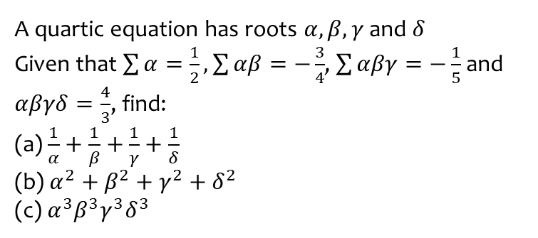
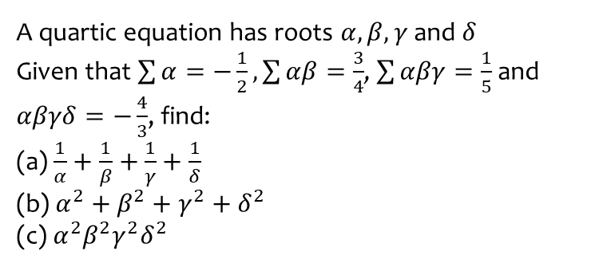
Worked example
Your turn
A quartic equation has roots $α,β,γ$ and $δ$
Given that $\sum{α}=−\frac{1}{2}, \sum{αβ}=\frac{3}{4}$, $\sum{αβγ}=\frac{1}{5}$ and $αβγδ=−\frac{4}{3}$, find:
(a) $\frac{1}{α}+\frac{1}{β}+\frac{1}{γ}+\frac{1}{δ}$
(b) $α^{2}+β^{2}+γ^{2}+δ^{2}$
(c) $α^{2}β^{2}γ^{2}δ^{2}$
A quartic equation has roots $α,β,γ$ and $δ$
Given that $\sum{α}=\frac{1}{2}, \sum{αβ}=−\frac{3}{4}$, $\sum{αβγ}=−\frac{1}{5}$ and $αβγδ=\frac{4}{3}$, find:
(a) $\frac{1}{α}+\frac{1}{β}+\frac{1}{γ}+\frac{1}{δ}$
(b) $α^{2}+β^{2}+γ^{2}+δ^{2}$
(c) $α^{3}β^{3}γ^{3}δ^{3}$
(a) $−\frac{3}{20}$
(b) $\frac{7}{4}$
(c) $\frac{64}{27}$

Slide 25
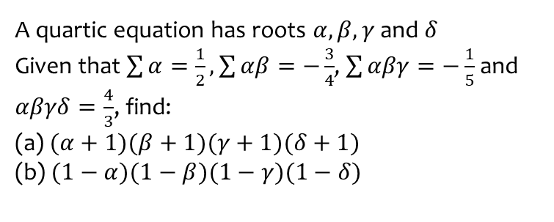
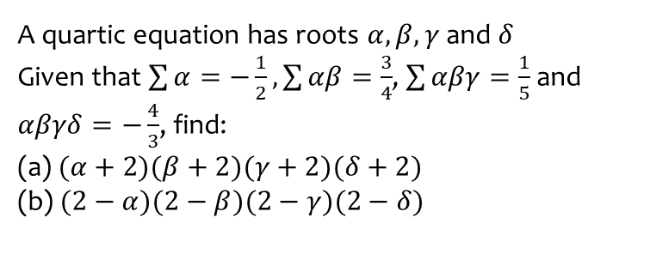
Worked example
Your turn
A quartic equation has roots $α,β,γ$ and $δ$
Given that $\sum{α}=−\frac{1}{2}, \sum{αβ}=\frac{3}{4}$, $\sum{αβγ}=\frac{1}{5}$ and $αβγδ=−\frac{4}{3}$, find:
(a) $(α+2)(β+2)(γ+2)(δ+2)$
(b) $(2−α)(2−β)(2−γ)(2−δ)$
A quartic equation has roots $α,β,γ$ and $δ$
Given that $\sum{α}=\frac{1}{2}, \sum{αβ}=−\frac{3}{4}$, $\sum{αβγ}=−\frac{1}{5}$ and $αβγδ=\frac{4}{3}$, find:
(a) $(α+1)(β+1)(γ+1)(δ+1)$
(b) $(1−α)(1−β)(1−γ)(1−δ)$
(a) $\frac{113}{60}$
(b) $\frac{77}{60}$

Slide 26
Worked example
Your turn
A quartic equation has roots $α,β,γ$ and $δ$
Given that $\sum{α}=−\frac{1}{2}, \sum{αβ}=\frac{3}{4}$, $\sum{αβγ}=\frac{1}{5}$ and $αβγδ=−\frac{4}{3}$, find
$${\left(αβ\right)}^{2}+{\left(αγ\right)}^{2}+{\left(αδ\right)}^{2}+{\left(βγ\right)}^{2}+{\left(βδ\right)}^{2}+{\left(γδ\right)}^{2}$$
A quartic equation has roots $α,β,γ$ and $δ$
Given that $\sum{α}=\frac{1}{2}, \sum{αβ}=−\frac{3}{4}$, $\sum{αβγ}=−\frac{1}{5}$ and $αβγδ=\frac{4}{3}$, find
$${\left(αβ\right)}^{2}+{\left(αγ\right)}^{2}+{\left(αδ\right)}^{2}+{\left(βγ\right)}^{2}+{\left(βδ\right)}^{2}+{\left(γδ\right)}^{2}$$
$$\frac{823}{240}$$

Slide 27
Worked example
Your turn
A quartic equation has roots $α,β,γ$ and $δ$
Given that $\sum{α}=−\frac{1}{2}, \sum{αβ}=\frac{3}{4}$, $\sum{αβγ}=\frac{1}{5}$ and $αβγδ=−\frac{4}{3}$, find
$${\left(αβγ\right)}^{2}+{\left(αβδ\right)}^{2}+{\left(αγδ\right)}^{2}+{\left(βγδ\right)}^{2}$$
A quartic equation has roots $α,β,γ$ and $δ$
Given that $\sum{α}=\frac{1}{2}, \sum{αβ}=−\frac{3}{4}$, $\sum{αβγ}=−\frac{1}{5}$ and $αβγδ=\frac{4}{3}$, find
$${\left(αβγ\right)}^{2}+{\left(αβδ\right)}^{2}+{\left(αγδ\right)}^{2}+{\left(βγδ\right)}^{2}$$
$$\frac{51}{25}$$

Slide 28
4.5) Linear transformations of roots
Chapter CONTENTS

Slide 29
Worked example
Your turn
The quadratic equation $x^{2}+3x−10=0$ has roots $α$ and $β$.
Without finding the roots, determine the equation with roots $α−2$ and $β−2$
The quadratic equation $x^{2}−3x−10=0$ has roots $α$ and $β$.
Without finding the roots, determine the equation with roots $α−1$ and $β−1$
$$w^{2}−w−12=0$$

Slide 30
Worked example
Your turn
The cubic equation $x^{3}+2x^{2}−3x+4=0$
has roots $α, β$ and $γ$. Find the equation of the polynomial with roots:
$3α, 3β$ and $3γ$
The cubic equation $x^{3}−2x^{2}+3x−4=0$
has roots $α, β$ and $γ$. Find the equation of the polynomial with roots:
$2α, 2β$ and $2γ$
$$w^{3}−4w^{2}+12w−32=0$$

Slide 31
Worked example
Your turn
The cubic equation $x^{3}+2x^{2}−3x+4=0$
has roots $α, β$ and $γ$. Find the equation of the polynomial with roots:
$α−2, β−2$ and $γ−2$
The cubic equation $x^{3}−2x^{2}+3x−4=0$
has roots $α, β$ and $γ$. Find the equation of the polynomial with roots:
$α+3, β+3$ and $γ+3$
$$w^{3}−11w^{2}+42w−58=0$$

Slide 32
Worked example
Your turn
The cubic equation $x^{3}+2x^{2}−4=0$ has roots $α, β,γ,δ$. Find the equation with roots $(2α+1)$, $\left(2β+1\right)$, $\left(2γ+1\right)$ and $(2δ+1)$
The cubic equation $x^{3}−2x^{2}+4=0$ has roots $α, β,γ,δ$. Find the equation with roots $(3α−1)$, $\left(3β−1\right)$, $\left(3γ−1\right)$ and $(3δ−1)$
$$w^{3}−3w^{2}−9w+103=0$$

Slide 33
Worked example
Your turn
The quartic equation $x^{4}+3x^{3}−x^{2}−15x−1=0$
has roots $α, β, γ$ and $δ$. Find the equation of the polynomial with roots:
$(3α−1)$, $\left(3β−1\right)$, $\left(3γ−1\right)$ and $(3δ−1)$
The quartic equation $x^{4}−3x^{3}+15x+1=0$
has roots $α, β, γ$ and $δ$. Find the equation of the polynomial with roots:
$(2α+1)$, $\left(2β+1\right)$, $\left(2γ+1\right)$ and $(2δ+1)$
$$w^{4}−10w^{3}+24w^{2}+98w−97=0$$

