Slide 1
Teachings for
Exercise 3D

Slide 2
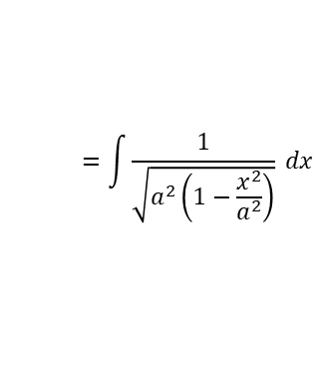


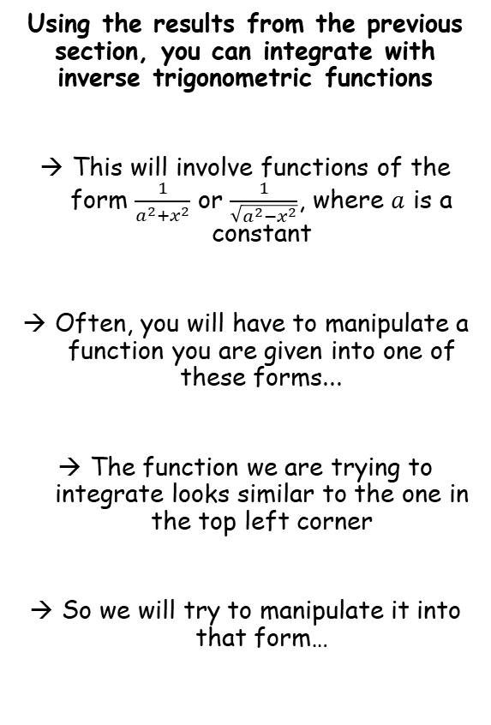





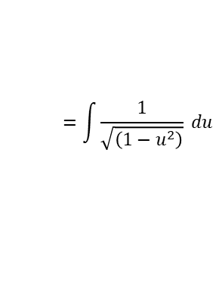

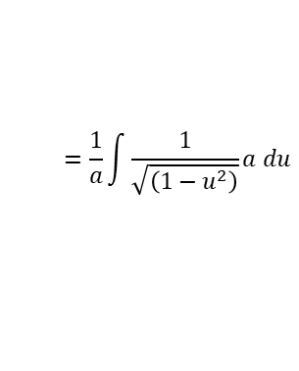


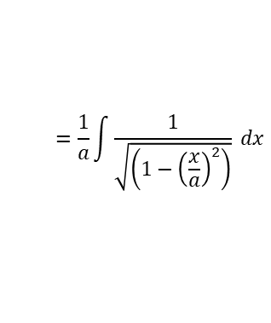

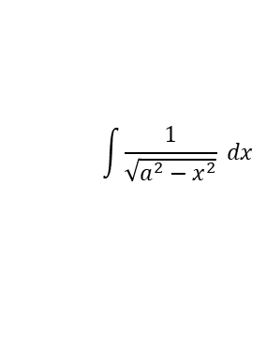
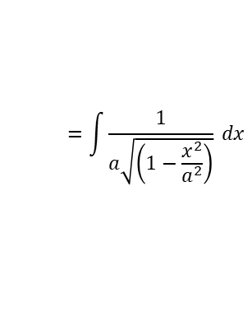


Methods in Calculus
$$\frac{d}{dx}\left(arcsinx\right)=\frac{1}{\sqrt{1−x^{2}}}$$
$$\frac{d}{dx}\left(arctanx\right)=\frac{1}{1+x^{2}}$$
$$\frac{d}{dx}\left(arccosx\right)=−\frac{1}{\sqrt{1−x^{2}}}$$
Using the results from the previous section, you can integrate with inverse trigonometric functions
This will involve functions of the form $\frac{1}{a^{2}+x^{2}}$ or $\frac{1}{\sqrt{a^{2}−x^{2}}}$, where $a$ is a constant
Often, you will have to manipulate a function you are given into one of these forms...
The function we are trying to integrate looks similar to the one in the top left corner
So we will try to manipulate it into that form…
$$\int{\frac{1}{\sqrt{a^{2}−x^{2}}} dx}$$
Factorise $a^{2}$ out (inside the root sign)
$$=\int{\frac{1}{\sqrt{a^{2}\left(1−\frac{x^{2}}{a^{2}}\right)}} dx}$$
Simplify the $\sqrt{a^{2}}$ part
$$=\int{\frac{1}{a\sqrt{\left(1−\frac{x^{2}}{a^{2}}\right)}} dx}$$
Take $\frac{1}{a}$ out of the integral as a factor
$$=\frac{1}{a}\int{\frac{1}{\sqrt{\left(1−{\left(\frac{x}{a}\right)}^{2}\right)}} dx}$$
Use the substitution $u=\frac{x}{a}$
$\frac{du}{dx}=\frac{1}{a}$
$$=\frac{1}{a}\int{\frac{1}{\sqrt{\left(1−u^{2}\right)}}a du}$$
$$a du=dx$$
Simplify the $a$ terms
$$=\int{\frac{1}{\sqrt{\left(1−u^{2}\right)}} du}$$
Use the inverse of the rule above (don’t forget +c)
$$=arcsinu+c$$
Replace $u$ using the substitution we used earlier
$$=arcsin\left(\frac{x}{a}\right)+c$$
3D

Slide 3
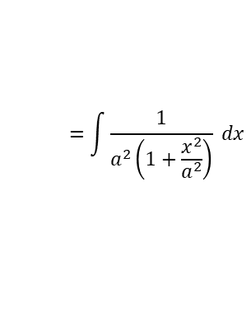


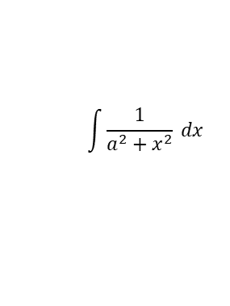





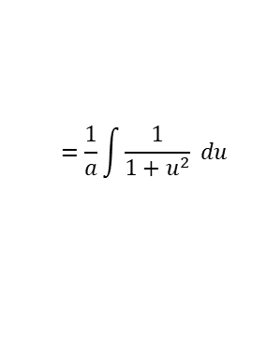

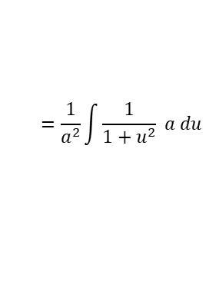

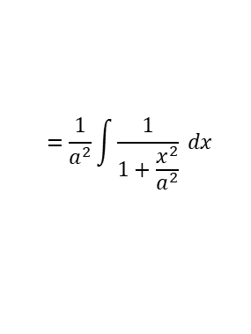

Methods in Calculus
$$\frac{d}{dx}\left(arcsinx\right)=\frac{1}{\sqrt{1−x^{2}}}$$
$$\frac{d}{dx}\left(arctanx\right)=\frac{1}{1+x^{2}}$$
$$\frac{d}{dx}\left(arccosx\right)=−\frac{1}{\sqrt{1−x^{2}}}$$
Looks a bit like this…
→ This is our target
Using the results from the previous section, you can integrate with inverse trigonometric functions
Find the integral:
$$\int{\frac{1}{a^{2}+x^{2}} dx}$$
Factorise $a^{2}$ out on the denominator
$$=\int{\frac{1}{a^{2}\left(1+\frac{x^{2}}{a^{2}}\right)} dx}$$
Take $\frac{1}{a^{2}}$ out as a factor
$$=\frac{1}{a^{2}}\int{\frac{1}{1+\frac{x^{2}}{a^{2}}} dx}$$
$$\int{\frac{1}{a^{2}+x^{2}} dx}$$
Use the substitution $u=\frac{x}{a}$
$\frac{du}{dx}=\frac{1}{a}$
$$=\frac{1}{a^{2}}\int{\frac{1}{1+u^{2}} a du}$$
$$a du=dx$$
Simplify the $a$ terms
The results you have just seen are given in the formula booklet, but you also need to know how to derive them!
$$=\frac{1}{a}\int{\frac{1}{1+u^{2}} du}$$
Integrate using the reverse of the rule above
$$=\frac{1}{a}arctanu+c$$
Replace $u$ using the substitution we used earlier
$$=\frac{1}{a}arctan\left(\frac{x}{a}\right)+c$$
3D

Slide 4
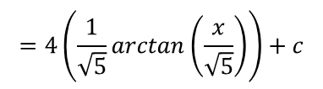

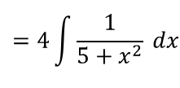
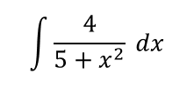
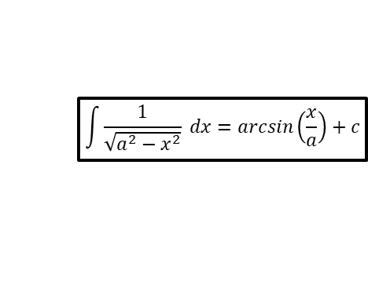


Methods in Calculus
$$\int{\frac{1}{\sqrt{a^{2}−x^{2}}} dx}=arcsin\left(\frac{x}{a}\right)+c$$
$$\int{\frac{1}{a^{2}+x^{2}} dx}=\frac{1}{a}arctan\left(\frac{x}{a}\right)+c$$
Using the results from the previous section, you can integrate with inverse trigonometric functions
Find $\int{\frac{4}{5+x^{2}} dx}$
$$\int{\frac{4}{5+x^{2}} dx}$$
Take 4 out as a factor
$$=4\int{\frac{1}{5+x^{2}} dx}$$
Use the pattern above. In this case, $a=\sqrt{5}$
$$=4\left(\frac{1}{\sqrt{5}}arctan\left(\frac{x}{\sqrt{5}}\right)\right)+c$$
3D

Slide 5


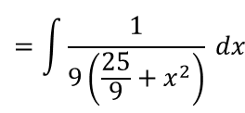

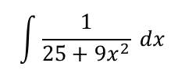


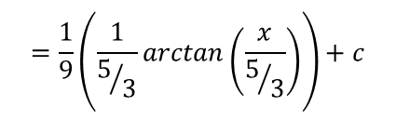
Methods in Calculus
$$\int{\frac{1}{\sqrt{a^{2}−x^{2}}} dx}=arcsin\left(\frac{x}{a}\right)+c$$
$$\int{\frac{1}{a^{2}+x^{2}} dx}=\frac{1}{a}arctan\left(\frac{x}{a}\right)+c$$
$$\int{\frac{1}{25+{9x}^{2}} dx}$$
Using the results from the previous section, you can integrate with inverse trigonometric functions
Find $\int{\frac{1}{25+{9x}^{2}} dx}$
Take out 9 as a factor on the denominator
$$=\int{\frac{1}{9\left(\frac{25}{9}+x^{2}\right)} dx}$$
Take out $\frac{1}{9}$ as a factor from the integral
$$=\frac{1}{9}\int{\frac{1}{\frac{25}{9}+x^{2}} dx}$$
Use the rule above with $a=\frac{5}{3}$
$$=\frac{1}{9}\left(\frac{1}{5/3}arctan\left(\frac{x}{5/3}\right)\right)+c$$
Simplify
$$=\frac{1}{15}arctan\left(\frac{3x}{5}\right)+c$$
3D

Slide 6
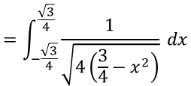



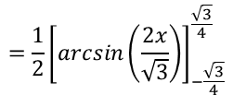

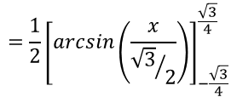
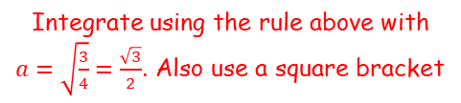
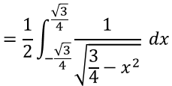
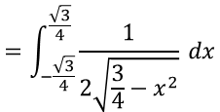

Methods in Calculus
$$\int{\frac{1}{\sqrt{a^{2}−x^{2}}} dx}=arcsin\left(\frac{x}{a}\right)+c$$
$$\int{\frac{1}{a^{2}+x^{2}} dx}=\frac{1}{a}arctan\left(\frac{x}{a}\right)+c$$
$$\int_{−\frac{\sqrt{3}}{4}}^{\frac{\sqrt{3}}{4}}{\frac{1}{\sqrt{3−{4x}^{2}}} dx}$$
Using the results from the previous section, you can integrate with inverse trigonometric functions
Evaluate the following, leaving your answer in terms of $π$.
Take out 4 as a factor on the denominator
$$=\int_{−\frac{\sqrt{3}}{4}}^{\frac{\sqrt{3}}{4}}{\frac{1}{\sqrt{4\left(\frac{3}{4}−x^{2}\right)}} dx}$$
$$\sqrt{4}=2$$
$$=\int_{−\frac{\sqrt{3}}{4}}^{\frac{\sqrt{3}}{4}}{\frac{1}{2\sqrt{\frac{3}{4}−x^{2}}} dx}$$
$$\int_{−\frac{\sqrt{3}}{4}}^{\frac{\sqrt{3}}{4}}{\frac{1}{\sqrt{3−{4x}^{2}}} dx}$$
We can now take out $\frac{1}{2}$ as a factor from the integral
$$=\frac{1}{2}\int_{−\frac{\sqrt{3}}{4}}^{\frac{\sqrt{3}}{4}}{\frac{1}{\sqrt{\frac{3}{4}−x^{2}}} dx}$$
Integrate using the rule above with $a=\sqrt{\frac{3}{4}}=\frac{\sqrt{3}}{2}$. Also use a square bracket
$$=\frac{1}{2}{\left[arcsin\left(\frac{x}{{\sqrt{3}}/2}\right)\right]}_{−\frac{\sqrt{3}}{4}}^{\frac{\sqrt{3}}{4}}$$
Simplify
$$=\frac{1}{2}{\left[arcsin\left(\frac{2x}{\sqrt{3}}\right)\right]}_{−\frac{\sqrt{3}}{4}}^{\frac{\sqrt{3}}{4}}$$
3D

Slide 7
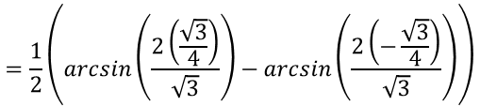
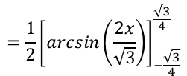



Methods in Calculus
$$\int{\frac{1}{\sqrt{a^{2}−x^{2}}} dx}=arcsin\left(\frac{x}{a}\right)+c$$
$$\int{\frac{1}{a^{2}+x^{2}} dx}=\frac{1}{a}arctan\left(\frac{x}{a}\right)+c$$
Using the results from the previous section, you can integrate with inverse trigonometric functions
Evaluate the following, leaving your answer in terms of $π$.
$$=\frac{1}{2}{\left[arcsin\left(\frac{2x}{\sqrt{3}}\right)\right]}_{−\frac{\sqrt{3}}{4}}^{\frac{\sqrt{3}}{4}}$$
Sub in limits and subtract
$$=\frac{1}{2}\left(arcsin\left(\frac{2\left(\frac{\sqrt{3}}{4}\right)}{\sqrt{3}}\right)−arcsin\left(\frac{2\left(−\frac{\sqrt{3}}{4}\right)}{\sqrt{3}}\right)\right)$$
The fractions can be simplified
$$\int_{−\frac{\sqrt{3}}{4}}^{\frac{\sqrt{3}}{4}}{\frac{1}{\sqrt{3−{4x}^{2}}} dx}$$
$$=\frac{1}{2}\left(arcsin\left(\frac{1}{2}\right)−arcsin\left(−\frac{1}{2}\right)\right)$$
Calculate the inner part
$$=\frac{1}{2}\left(\frac{π}{6}−\left(−\frac{π}{6}\right)\right)$$
Calculate
$$=\frac{π}{6}$$
3D

Slide 8





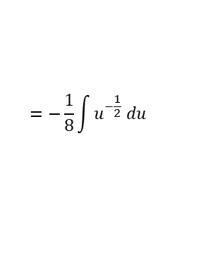
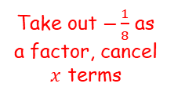

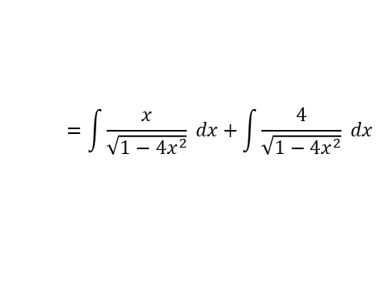
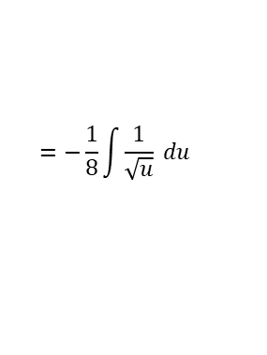

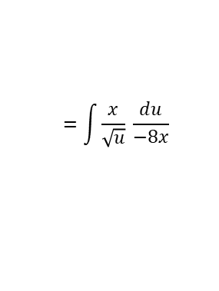


Methods in Calculus
$$\int{\frac{1}{\sqrt{a^{2}−x^{2}}} dx}=arcsin\left(\frac{x}{a}\right)+c$$
$$\int{\frac{1}{a^{2}+x^{2}} dx}=\frac{1}{a}arctan\left(\frac{x}{a}\right)+c$$
Using the results from the previous section, you can integrate with inverse trigonometric functions
Find $\int{\frac{x+4}{\sqrt{1−{4x}^{2}}} dx}$
In some cases you will need to split a fraction into several terms and integrate each in a different way…
$$=\int{\frac{x}{\sqrt{1−{4x}^{2}}} dx+\int{\frac{4}{\sqrt{1−{4x}^{2}}} dx}}$$
Using the substitution $u=1−{4x}^{2}$
$$=\int{\frac{x}{\sqrt{u}} \frac{du}{−8x}}$$
Take out $−\frac{1}{8}$ as a factor, cancel $x$ terms
$$u=1−{4x}^{2}$$
Differentiate
$$=−\frac{1}{8}\int{\frac{1}{\sqrt{u}} du}$$
$$\frac{du}{dx}=−8x$$
Rearrange
Rewrite for integration
$$\frac{du}{−8x}=dx$$
$$=−\frac{1}{8}\int{u^{−\frac{1}{2}} du}$$
$$=−\frac{1}{8}\left(\frac{u^{\frac{1}{2}}}{1/2}\right)+c$$
Integrate
Simplify
$$=−\frac{1}{4}u^{\frac{1}{2}}+c$$
Replace $u$ with the expression in $x$
$$=−\frac{1}{4}{\left(1−{4x}^{2}\right)}^{\frac{1}{2}}+c$$
3D

Slide 9
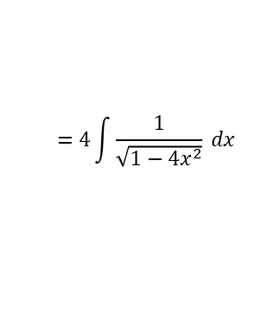

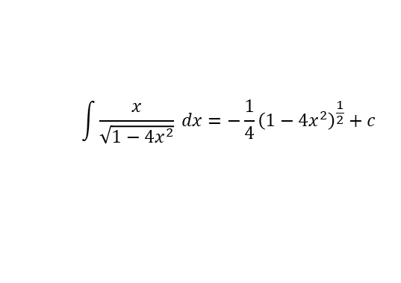

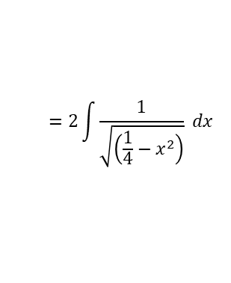
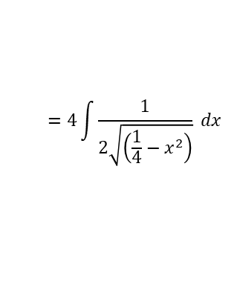
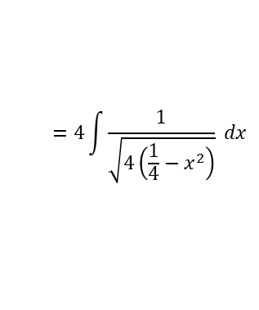
Methods in Calculus
$$\int{\frac{1}{\sqrt{a^{2}−x^{2}}} dx}=arcsin\left(\frac{x}{a}\right)+c$$
$$\int{\frac{1}{a^{2}+x^{2}} dx}=\frac{1}{a}arctan\left(\frac{x}{a}\right)+c$$
Using the results from the previous section, you can integrate with inverse trigonometric functions
Find $\int{\frac{x+4}{\sqrt{1−{4x}^{2}}} dx}$
In some cases you will need to split a fraction into several terms and integrate each in a different way…
$$=\int{\frac{x}{\sqrt{1−{4x}^{2}}} dx+\int{\frac{4}{\sqrt{1−{4x}^{2}}} dx}}$$
Take 4 out as a factor from the integral
$$=4\int{\frac{1}{\sqrt{1−{4x}^{2}}} dx}$$
$$\int{\frac{x}{\sqrt{1−{4x}^{2}}} dx=−\frac{1}{4}{\left(1−{4x}^{2}\right)}^{\frac{1}{2}}+c }$$
Take out 4 as a factor inside the square root
$$=4\int{\frac{1}{\sqrt{4\left(\frac{1}{4}−x^{2}\right)}} dx}$$
Simplify as $\sqrt{4}=2$
$$=4\int{\frac{1}{2\sqrt{\left(\frac{1}{4}−x^{2}\right)}} dx}$$
The $\frac{1}{2}$ can now be factored out of the integral
$$=2\int{\frac{1}{\sqrt{\left(\frac{1}{4}−x^{2}\right)}} dx}$$
3D

Slide 10
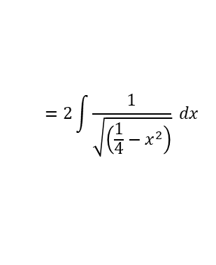
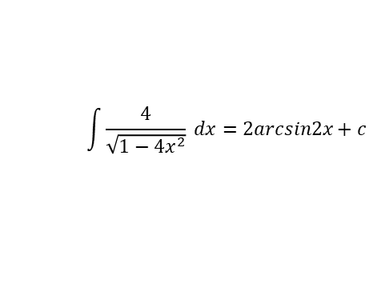


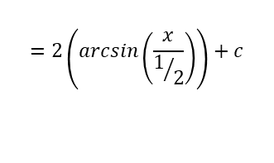
Methods in Calculus
$$\int{\frac{1}{\sqrt{a^{2}−x^{2}}} dx}=arcsin\left(\frac{x}{a}\right)+c$$
$$\int{\frac{1}{a^{2}+x^{2}} dx}=\frac{1}{a}arctan\left(\frac{x}{a}\right)+c$$
Using the results from the previous section, you can integrate with inverse trigonometric functions
Find $\int{\frac{x+4}{\sqrt{1−{4x}^{2}}} dx}$
In some cases you will need to split a fraction into several terms and integrate each in a different way…
$$=\int{\frac{x}{\sqrt{1−{4x}^{2}}} dx+\int{\frac{4}{\sqrt{1−{4x}^{2}}} dx}}$$
$$=2\int{\frac{1}{\sqrt{\left(\frac{1}{4}−x^{2}\right)}} dx}$$
$$\int{\frac{x}{\sqrt{1−{4x}^{2}}} dx=−\frac{1}{4}{\left(1−{4x}^{2}\right)}^{\frac{1}{2}}+c }$$
Integrate using the rule above, with $a=\frac{1}{2}$
$$=2\left(arcsin\left(\frac{x}{1/2}\right)\right)+c$$
$$\int{\frac{4}{\sqrt{1−{4x}^{2}}} dx=2arcsin2x+c}$$
Simplify
$$=2arcsin2x+c$$
3D

Slide 11


Methods in Calculus
$$\int{\frac{1}{\sqrt{a^{2}−x^{2}}} dx}=arcsin\left(\frac{x}{a}\right)+c$$
$$\int{\frac{1}{a^{2}+x^{2}} dx}=\frac{1}{a}arctan\left(\frac{x}{a}\right)+c$$
Using the results from the previous section, you can integrate with inverse trigonometric functions
Find $\int{\frac{x+4}{\sqrt{1−{4x}^{2}}} dx}$
In some cases you will need to split a fraction into several terms and integrate each in a different way…
$$=\int{\frac{x}{\sqrt{1−{4x}^{2}}} dx+\int{\frac{4}{\sqrt{1−{4x}^{2}}} dx}}$$
Replace with the integrals we calculated
$$=−\frac{1}{4}{\left(1−{4x}^{2}\right)}^{\frac{1}{2}}+2arcsin2x+c$$
(you only need to include $c$ once!)
$$\int{\frac{x}{\sqrt{1−{4x}^{2}}} dx=−\frac{1}{4}{\left(1−{4x}^{2}\right)}^{\frac{1}{2}}+c }$$
$$\int{\frac{4}{\sqrt{1−{4x}^{2}}} dx=2arcsin2x+c}$$
3D

