Slide 1
3.4) Integrating with inverse trigonometric functions

Slide 2
Worked example
Your turn
Use an appropriate substitution to show that:
$$\int{\frac{1}{1+x^{2}}dx}=\arctan{x}+C$$
$$\int{\frac{−1}{\sqrt{1−x^{2}}}dx}=\arccos{x}+C$$
Use an appropriate substitution to show that:
$$\int{\frac{1}{1−x^{2}}dx}=\arcsin{x}+C$$
Proof

Slide 3
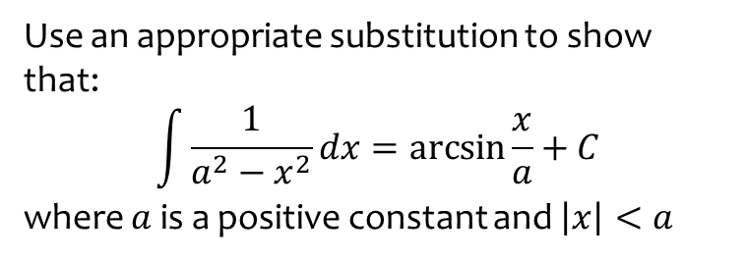
Worked example
Your turn
Use an appropriate substitution to show that:
$$\int{\frac{1}{a^{2}−x^{2}}dx}=\arcsin{\frac{x}{a}}+C$$
where $a$ is a positive constant and $\left|x\right|<a$
Use an appropriate substitution to show that:
$$\int{\frac{1}{a^{2}+x^{2}}dx}=\frac{1}{a}\arctan\left(\frac{x}{a}\right)+C, a>0, \left|x\right|<a$$
Proof

Slide 4
Worked example
Your turn
Find:
$$\int{\frac{3}{2+x^{2}}dx}$$
Find:
$$\int{\frac{4}{5+x^{2}}dx}$$
$$\frac{4}{\sqrt{5}}\arctan\left(\frac{x}{\sqrt{5}}\right)+c$$

Slide 5
Worked example
Your turn
Find:
$$\int{\frac{1}{49+16x^{2}}dx}$$
Find:
$$\int{\frac{1}{25+9x^{2}}dx}$$
$$\frac{1}{15}\arctan\left(\frac{3x}{5}\right)+c$$

Slide 6
Worked example
Your turn
Find:
$$\int_{−1}^{2}{\frac{1}{\sqrt{21−3x^{2}}}}dx$$
Find:
$$\int_{−\frac{\sqrt{3}}{4}}^{\frac{\sqrt{3}}{4}}{\frac{1}{\sqrt{3−4x^{2}}}}dx$$
$$\frac{π}{6}$$

Slide 7
Worked example
Your turn
Find:
$$\int{\frac{x+9}{\sqrt{1−9x^{2}}}dx}$$
Find:
$$\int{\frac{x+4}{\sqrt{1−4x^{2}}}dx}$$
$$\frac{1}{4}\sqrt{1−4x^{2}}+2\arcsin{2x}+c$$

Slide 8
Worked example
Your turn
Find:
$$\int{\frac{6x−5}{3+x^{2}}dx}$$
Find:
$$\int{\frac{8x−3}{4+x^{2}}dx}$$
$$4\ln{(4+x^{2})}−\frac{3}{2}\arctan\left(\frac{x}{2}\right)+c$$

Slide 9
Worked example
Your turn
Find:
$$\int{\frac{3x−1}{\sqrt{5−4x^{2}}}dx}$$
Find:
$$\int{\frac{4x−1}{\sqrt{6−5x^{2}}}dx}$$
$$−\frac{4}{5}\sqrt{6−5x^{2}}−\frac{1}{\sqrt{5}}\arcsin\left(\sqrt{\frac{5}{6}}x\right)+c$$

