Slide 1
Teachings for
Exercise 3B

Slide 2





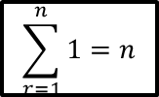

Series
$$\sum_{r=1}^{n}{1}=n$$
$$\sum_{r=1}^{n}{r}=\frac{1}{2}n(n+1)$$
$$\sum_{r=1}^{n}{r^{2}}=\frac{n(n+1)(2n+1)}{6}$$
$$\sum_{r=1}^{n}{r}=\frac{n(n+1)}{2}$$
$$\sum_{r=1}^{n}{r^{3}}=\frac{n^{2}}{4}{\left(n+1\right)}^{2}$$
You need to be able to calculate the sum of a sequence based on powers of 2 and 3
The sum of a sequence of squared numbers is given as follows:
And the formula for the sum of a sequence of cubes is:
You will see proofs for these in chapter 8!
$$\sum_{r=1}^{n}{r^{2}}$$
$$=\frac{n(n+1)(2n+1)}{6}$$
$$or \frac{n}{6}(n+1)(2n+1)$$
$$\sum_{r=1}^{n}{r^{3}}$$
$$=\frac{n^{2}{\left(n+1\right)}^{2}}{4}$$
$$or \frac{n^{2}}{4}{\left(n+1\right)}^{2}$$
3B

Slide 3
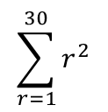
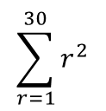
Series
$$\sum_{r=1}^{n}{1}=n$$
$$\sum_{r=1}^{n}{r}=\frac{1}{2}n(n+1)$$
$$\sum_{r=1}^{n}{r^{2}}=\frac{n(n+1)(2n+1)}{6}$$
$$\sum_{r=1}^{n}{r}=\frac{n(n+1)}{2}$$
$$\sum_{r=1}^{n}{r^{3}}=\frac{n^{2}}{4}{\left(n+1\right)}^{2}$$
$$\sum_{r=1}^{30}{r^{2}}$$
You need to be able to calculate the sum of a sequence based on powers of 2 and 3
Evaluate:
Write out the formula for a squared sequence
$$=\frac{n(n+1)(2n+1)}{6}$$
Sub in n = 30 as we want 30 terms
$$\sum_{r=1}^{30}{r^{2}}$$
$$=\frac{(30)(30+1)(2(30)+1)}{6}$$
Simplify the numerator (if necessary!)
$$=\frac{(30)(31)(61)}{6}$$
Calculate
$$=9455$$
3B
5D

Slide 4
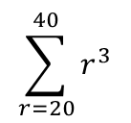
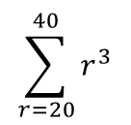
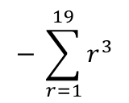
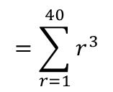
Series
$$\sum_{r=1}^{n}{1}=n$$
$$\sum_{r=1}^{n}{r}=\frac{1}{2}n(n+1)$$
$$\sum_{r=1}^{n}{r^{2}}=\frac{n(n+1)(2n+1)}{6}$$
$$\sum_{r=1}^{n}{r}=\frac{n(n+1)}{2}$$
$$\sum_{r=1}^{n}{r^{3}}=\frac{n^{2}}{4}{\left(n+1\right)}^{2}$$
Write it as one sum subtract another
You need to be able to calculate the sum of a sequence based on powers of 2 and 3
Evaluate:
Remember for this one you need the sum of the first 40 terms, subtract the first 19 terms!
$$\sum_{r=20}^{40}{r^{3}}$$
$$=\sum_{r=1}^{40}{r^{3}}$$
$$− \sum_{r=1}^{19}{r^{3}}$$
Write out the formula for the cubed sequence twice
$$\sum_{r=20}^{40}{r^{3}}$$
$$=\frac{n^{2}{\left(n+1\right)}^{2}}{4}$$
$$− \frac{n^{2}{\left(n+1\right)}^{2}}{4}$$
Sub in 40 for the first and 19 for the second
$$=\frac{{(40)}^{2}{\left(40+1\right)}^{2}}{4}$$
$$− \frac{{(19)}^{2}{\left(19+1\right)}^{2}}{4}$$
Calculate
$$=672400$$
$$− 36100$$
Finish the sum!
$$=636300$$
3B

Slide 5
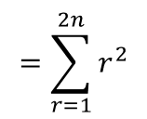
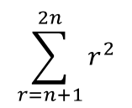
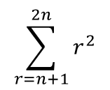
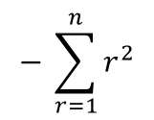
Series
$$\sum_{r=1}^{n}{1}=n$$
$$\sum_{r=1}^{n}{r}=\frac{1}{2}n(n+1)$$
$$\sum_{r=1}^{n}{r^{2}}=\frac{n(n+1)(2n+1)}{6}$$
$$\sum_{r=1}^{n}{r}=\frac{n(n+1)}{2}$$
$$\sum_{r=1}^{n}{r^{3}}=\frac{n^{2}}{4}{\left(n+1\right)}^{2}$$
$$\sum_{r=n+1}^{2n}{r^{2}}$$
$$=\sum_{r=1}^{2n}{r^{2}}$$
$$− \sum_{r=1}^{n}{r^{2}}$$
You need to be able to calculate the sum of a sequence based on powers of 2 and 3
Find:
This one is more algebraic but you still approach it the same way!
The first value we put in the sequence will be ‘n + 1’
The final value we put in will be ‘2n’
So we want the sum of the first ‘2n’ terms, subtract the first ‘n’ terms (same as if we were using numbers!)
Write out the formula twice
$$=\frac{n(n+1)(2n+1)}{6}$$
$$− \frac{n(n+1)(2n+1)}{6}$$
$$\sum_{r=n+1}^{2n}{r^{2}}$$
Sub ‘2n’ into the first and ‘n’ into the second
$$=\frac{2n(2n+1)(4n+1)}{6}$$
$$− \frac{n(n+1)(2n+1)}{6}$$
You can write this as one fraction
$$=\frac{2n\left(2n+1\right)\left(4n+1\right)−n(n+1)(2n+1)}{6}$$
This is the key step – you can factorise as n(2n+1) is common to both terms!
$$[$$
$$]$$
$$=$$
$$n(2n+1)$$
$$2\left(4n+1\right)$$
$$− (n+1)$$
$$6$$
Expand the terms in the square bracket
$$[$$
$$]$$
$$=$$
$$n(2n+1)$$
$$8n + 2$$
$$− n − 1$$
$$6$$
Simplify the square bracket (which can now be written as a ‘normal’ bracket!)
$$=$$
$$n(2n+1)$$
$$(7n +1)$$
$$6$$
The factorising step is crucial here – otherwise you will end up trying to factorise a cubic which can take a long time!
3B

Slide 6
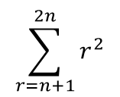
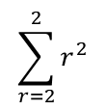
Series
$$\sum_{r=1}^{n}{1}=n$$
$$\sum_{r=1}^{n}{r}=\frac{1}{2}n(n+1)$$
$$\sum_{r=1}^{n}{r^{2}}=\frac{n(n+1)(2n+1)}{6}$$
$$\sum_{r=1}^{n}{r}=\frac{n(n+1)}{2}$$
$$\sum_{r=1}^{n}{r^{3}}=\frac{n^{2}}{4}{\left(n+1\right)}^{2}$$
$$\sum_{r=n+1}^{2n}{r^{2}=\frac{n(2n+1)(7n+1)}{6}}$$
You need to be able to calculate the sum of a sequence based on powers of 2 and 3
Find:
Verify that the result is correct for n = 1, 2 and 3
(This can show the formula is working, although in reality isn’t a proof in itself!)
If n = 1
$$\sum_{r=n+1}^{2n}{r^{2}}$$
$$\sum_{r=2}^{2}{r^{2}}$$
$$\frac{n(2n+1)(7n+1)}{6}$$
$$=\frac{n(2n+1)(7n+1)}{6}$$
$$=\frac{1(2+1)(7+1)}{6}$$
The first number we put in is 2, which is also the last number we put in
$$=\frac{24}{6}$$
Sequence →
$$4$$
$$=4$$
So the numbers in the sequence just add up to 4!
→ Let’s check the formula!
3B

Slide 7
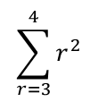
Series
$$\sum_{r=1}^{n}{1}=n$$
$$\sum_{r=1}^{n}{r}=\frac{1}{2}n(n+1)$$
$$\sum_{r=1}^{n}{r^{2}}=\frac{n(n+1)(2n+1)}{6}$$
$$\sum_{r=1}^{n}{r}=\frac{n(n+1)}{2}$$
$$\sum_{r=1}^{n}{r^{3}}=\frac{n^{2}}{4}{\left(n+1\right)}^{2}$$
$$\sum_{r=n+1}^{2n}{r^{2}=\frac{n(2n+1)(7n+1)}{6}}$$
You need to be able to calculate the sum of a sequence based on powers of 2 and 3
Find:
Verify that the result is correct for n = 1, 2 and 3
(This can show the formula is working, although in reality isn’t a proof in itself!)
If n = 2
$$\sum_{r=n+1}^{2n}{r^{2}}$$
$$\sum_{r=3}^{4}{r^{2}}$$
$$\frac{n(2n+1)(7n+1)}{6}$$
$$=\frac{n(2n+1)(7n+1)}{6}$$
$$=\frac{2(4+1)(14+1)}{6}$$
The first number we put in is 3, and the last number we put in in 4
$$=\frac{150}{6}$$
Sequence →
$$9, 16$$
$$=25$$
So the numbers in the sequence add up to 25
→ Let’s check the formula!
3B

Slide 8
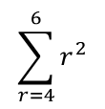
Series
$$\sum_{r=1}^{n}{1}=n$$
$$\sum_{r=1}^{n}{r}=\frac{1}{2}n(n+1)$$
$$\sum_{r=1}^{n}{r^{2}}=\frac{n(n+1)(2n+1)}{6}$$
$$\sum_{r=1}^{n}{r}=\frac{n(n+1)}{2}$$
$$\sum_{r=1}^{n}{r^{3}}=\frac{n^{2}}{4}{\left(n+1\right)}^{2}$$
$$\sum_{r=n+1}^{2n}{r^{2}=\frac{n(2n+1)(7n+1)}{6}}$$
You need to be able to calculate the sum of a sequence based on powers of 2 and 3
Find:
Verify that the result is correct for n = 1, 2 and 3
(This can show the formula is working, although in reality isn’t a proof in itself!)
If n = 3
$$\sum_{r=n+1}^{2n}{r^{2}}$$
$$\sum_{r=4}^{6}{r^{2}}$$
$$\frac{n(2n+1)(7n+1)}{6}$$
$$=\frac{n(2n+1)(7n+1)}{6}$$
$$=\frac{3(6+1)(21+1)}{6}$$
The first number we put in is 4, and the last number we put in in 6
$$=\frac{462}{6}$$
Sequence →
$$16, 25, 36$$
$$=77$$
So the numbers in the sequence add up to 77
→ Let’s check the formula!
So the formula seems to be working fine!
3B

Slide 9

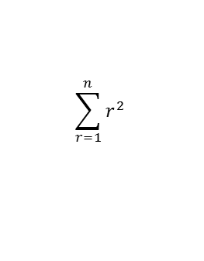
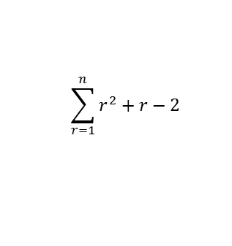
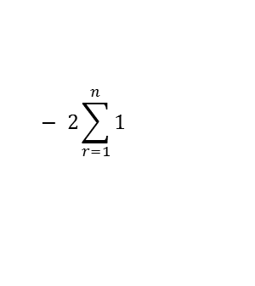
Series
$$\sum_{r=1}^{n}{1}=n$$
$$\sum_{r=1}^{n}{r}=\frac{1}{2}n(n+1)$$
$$\sum_{r=1}^{n}{r^{2}}=\frac{n(n+1)(2n+1)}{6}$$
$$\sum_{r=1}^{n}{r}=\frac{n(n+1)}{2}$$
$$\sum_{r=1}^{n}{r^{3}}=\frac{n^{2}}{4}{\left(n+1\right)}^{2}$$
You need to be able to use all you have learnt to calculate the sum of a more complex series, made up of several terms
Show that:
$$\sum_{r=1}^{n}{r^{2}+r−2}$$
Write as separate sums
$$\sum_{r=1}^{n}{r^{2}}$$
$$+ \sum_{r=1}^{n}{r}$$
$$− 2\sum_{r=1}^{n}{1}$$
Write the formula for each part in terms of n
$$\sum_{r=1}^{n}{r^{2}+r−2}=\frac{n}{3}(n+4)(n−1)$$
$$=\frac{n(n+1)(2n+1)}{6}$$
$$+ \frac{n(n+1)}{2}$$
$$− 2n$$
Write all with a common denominator
$$=\frac{n(n+1)(2n+1)}{6}$$
$$+ \frac{3n(n+1)}{6}$$
$$− \frac{12n}{6}$$
$$2n$$
$${(n}^{2}+ 3n−4)$$
Group up
$$=$$
$$6$$
$$=\frac{n\left(n+1\right)\left(2n+1\right)+3n\left(n+1\right)−12n}{6}$$
Divide numerator and denominator by 2
‘Clever factorisation’
$${(n}^{2}+ 3n−4)$$
$$[$$
$$]$$
$$n$$
$$n$$
$$=$$
$$=$$
$$(n+1)(2n+1)$$
$$+ 3(n+1)$$
$$− 12$$
$$3$$
$$6$$
Factorise!
$$]$$
Expand brackets
$$[$$
$$n$$
$$n$$
$${2n}^{2}+3n+1$$
$$=$$
$$(n+4)(n−1)$$
$$=$$
$$+ 3n+3$$
$$− 12$$
$$3$$
$$6$$
$$n$$
Group terms
$$=$$
$${(2n}^{2}+ 6n−8)$$
$$6$$
Take the factor 2 out of the bracket
$${(n}^{2}+ 3n−4)$$
$$=$$
$$2n$$
$$6$$
3B

Slide 10
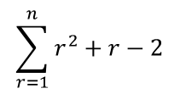
Series
$$\sum_{r=1}^{n}{1}=n$$
$$\sum_{r=1}^{n}{r}=\frac{1}{2}n(n+1)$$
$$\sum_{r=1}^{n}{r^{2}}=\frac{n(n+1)(2n+1)}{6}$$
$$\sum_{r=1}^{n}{r}=\frac{n(n+1)}{2}$$
$$\sum_{r=1}^{n}{r^{3}}=\frac{n^{2}}{4}{\left(n+1\right)}^{2}$$
You need to be able to use all you have learnt to calculate the sum of a more complex series, made up of several terms
Show that:
Hence, calculate the sum of the series:
4 + 10 + 18 + 28 + 40 … … … + 418
$$\sum_{r=1}^{n}{r^{2}+r−2}$$
$$r=1$$
$${\left(1\right)}^{2}+\left(1\right)−2$$
$$=0$$
$$\sum_{r=1}^{n}{r^{2}+r−2}=\frac{n}{3}(n+4)(n−1)$$
$$r=2$$
$${\left(2\right)}^{2}+\left(2\right)−2$$
$$=4$$
$$r=3$$
$${\left(3\right)}^{2}+\left(3\right)−2$$
$$=10$$
$$r=4$$
$${\left(4\right)}^{2}+\left(4\right)−2$$
$$=18$$
$$r= ?$$
$$r^{2}+r−2$$
$$=418$$
You can see that this formula gives us the sequence we are trying to find the sum of!
(The 0 at the start will not affect the sum so can be ignored!)
We need to know how many terms there are, so have to find the value for r which gives a term with a value of 418…
3B

Slide 11
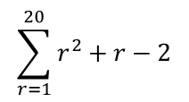
Series
$$\sum_{r=1}^{n}{1}=n$$
$$\sum_{r=1}^{n}{r}=\frac{1}{2}n(n+1)$$
$$\sum_{r=1}^{n}{r^{2}}=\frac{n(n+1)(2n+1)}{6}$$
$$\sum_{r=1}^{n}{r}=\frac{n(n+1)}{2}$$
$$\sum_{r=1}^{n}{r^{3}}=\frac{n^{2}}{4}{\left(n+1\right)}^{2}$$
You need to be able to use all you have learnt to calculate the sum of a more complex series, made up of several terms
Show that:
Hence, calculate the sum of the series:
4 + 10 + 18 + 28 + 40 … … … + 418
$$r^{2}+r−2=418$$
Subtract 418
$$r^{2}+r−420=0$$
Factorise
$$(r−20)(r+21)=0$$
$$\sum_{r=1}^{n}{r^{2}+r−2}=\frac{n}{3}(n+4)(n−1)$$
2 answers, only 1 is possible though!
$$r=20 or −21$$
So we are finding the sum of the first 20 terms of the sequence!
$$\sum_{r=1}^{20}{r^{2}+r−2}$$
We can use the formula we were given!
$$=\frac{n}{3}(n+4)(n−1)$$
Sub in n = 20
$$=\frac{20}{3}(20+4)(20−1)$$
Calculate
$$=3040$$
3B

Slide 12

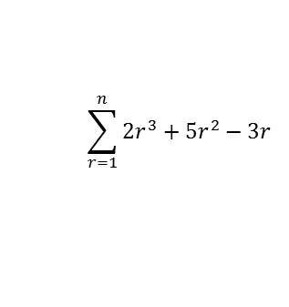
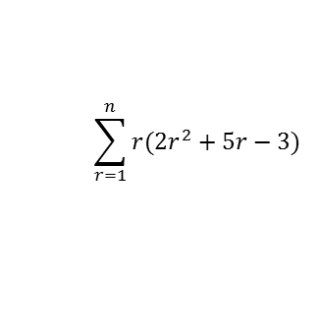
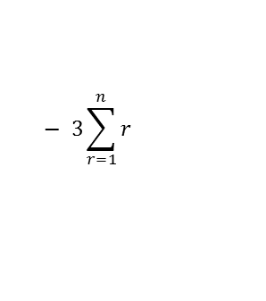
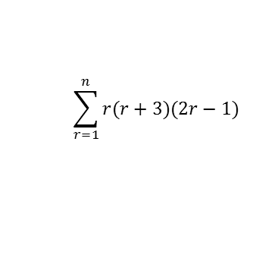
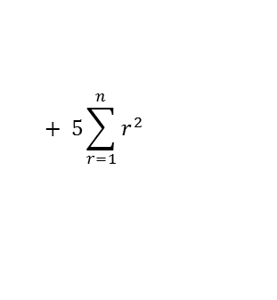
Series
$$\sum_{r=1}^{n}{1}=n$$
$$\sum_{r=1}^{n}{r}=\frac{1}{2}n(n+1)$$
$$\sum_{r=1}^{n}{r^{2}}=\frac{n(n+1)(2n+1)}{6}$$
$$\sum_{r=1}^{n}{r}=\frac{n(n+1)}{2}$$
$$\sum_{r=1}^{n}{r^{3}}=\frac{n^{2}}{4}{\left(n+1\right)}^{2}$$
You need to be able to use all you have learnt to calculate the sum of a more complex series, made up of several terms
Find a formula for the sum of the series:
$$=\frac{2n^{2}{\left(n+1\right)}^{2}}{4}$$
$$+ \frac{5n(n+1)(2n+1)}{6}$$
$$− \frac{3n(n+1)}{2}$$
Write with the same denominator
$$=\frac{3n^{2}{\left(n+1\right)}^{2}}{6}$$
$$+ \frac{5n(n+1)(2n+1)}{6}$$
$$− \frac{9n(n+1)}{6}$$
$$\sum_{r=1}^{n}{r(r+3)(2r−1)}$$
Combine
$$=\frac{3n^{2}{\left(n+1\right)}^{2}+5n\left(n+1\right)\left(2n+1\right)−9n(n+1)}{6}$$
Expand the bracket
‘Clever factorisation’
$$[$$
$$]$$
$$\sum_{r=1}^{n}{r({2r}^{2}+5r−3)}$$
$$n(n+1)$$
$$3n(n+1)$$
$$+ 5(2n+1)$$
$$− 9$$
$$=$$
$$6$$
Expand the bracket again
Expand the inner brackets
$$[$$
$$]$$
$$n(n+1)$$
$$3n^{2}+3n$$
$$+ 10n+5$$
$$− 9$$
$$\sum_{r=1}^{n}{{2r}^{3}+{5r}^{2}−3r}$$
$$=$$
$$6$$
Simplify (you should also factorise if possible)
Write as 3 separate sums
$$=\frac{ n(n+1)(3n^{2}+13n−4)}{6}$$
$$2\sum_{r=1}^{n}{r^{3}}$$
$$+ 5\sum_{r=1}^{n}{r^{2}}$$
$$− 3\sum_{r=1}^{n}{r}$$
Write using the formulae above. Remember to include the coefficients!
$$=\frac{2n^{2}{\left(n+1\right)}^{2}}{4}$$
$$+ \frac{5n(n+1)(2n+1)}{6}$$
$$− \frac{3n(n+1)}{2}$$
3B

Slide 13
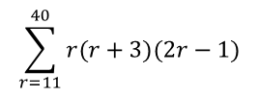
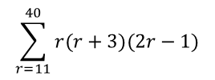
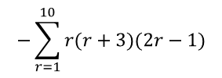
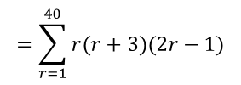
Series
$$\sum_{r=1}^{n}{1}=n$$
$$\sum_{r=1}^{n}{r}=\frac{1}{2}n(n+1)$$
$$\sum_{r=1}^{n}{r^{2}}=\frac{n(n+1)(2n+1)}{6}$$
$$\sum_{r=1}^{n}{r}=\frac{n(n+1)}{2}$$
$$\sum_{r=1}^{n}{r^{3}}=\frac{n^{2}}{4}{\left(n+1\right)}^{2}$$
You need to be able to use all you have learnt to calculate the sum of a more complex series, made up of several terms
Find a formula for the sum of the series:
Hence, calculate the following:
Write as one sum subtract another
$$\sum_{r=11}^{40}{r(r+3)(2r−1)}$$
$$=\sum_{r=1}^{40}{r(r+3)(2r−1)}$$
$$−\sum_{r=1}^{10}{r(r+3)(2r−1)}$$
$$\sum_{r=1}^{n}{r(r+3)(2r−1)}$$
Write the formulae out twice, one for each sum!
$$=\frac{ n(n+1)(3n^{2}+13n−4)}{6}$$
$$− \frac{ n(n+1)(3n^{2}+13n−4)}{6}$$
$$=\frac{ n(n+1)(3n^{2}+13n−4)}{6}$$
Sub in 40 and 10
$$=\frac{ 40(41)(5316)}{6}$$
$$− \frac{ 10(11)(426)}{6}$$
Calculate!
$$=1,445,230$$
$$\sum_{r=11}^{40}{r(r+3)(2r−1)}$$
3B

Slide 14
Series
$$\sum_{r=1}^{n}{1}=n$$
$$\sum_{r=1}^{n}{r}=\frac{1}{2}n(n+1)$$
$$\sum_{r=1}^{n}{r^{2}}=\frac{n(n+1)(2n+1)}{6}$$
$$\sum_{r=1}^{n}{r}=\frac{n(n+1)}{2}$$
$$\sum_{r=1}^{n}{r^{3}}=\frac{n^{2}}{4}{\left(n+1\right)}^{2}$$
The formula for squareds and cubes are given on the exam!
3B

