Slide 1
3.2) Sums of squares and cubes

Slide 2
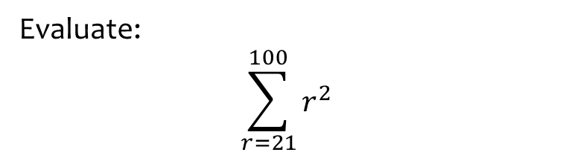

Worked example
Your turn
Evaluate:
$$\sum_{r=1}^{100}{r^{2}}$$
$$\sum_{r=20}^{50}{r^{2}}$$
Evaluate:
$$\sum_{r=21}^{100}{r^{2}}$$
$$335480$$

Slide 3
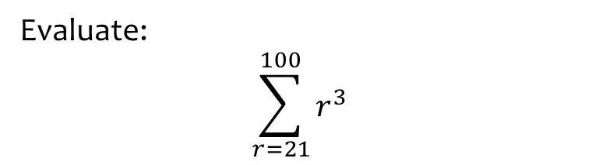

Worked example
Your turn
Evaluate:
$$\sum_{r=1}^{100}{r^{3}}$$
$$\sum_{r=20}^{50}{r^{3}}$$
Evaluate:
$$\sum_{r=21}^{100}{r^{3}}$$
$$25458400$$

Slide 4
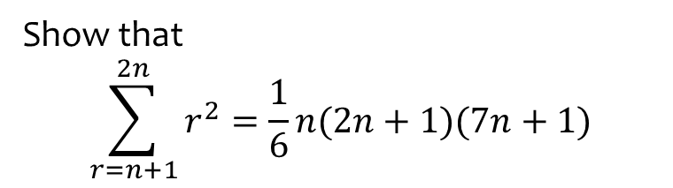
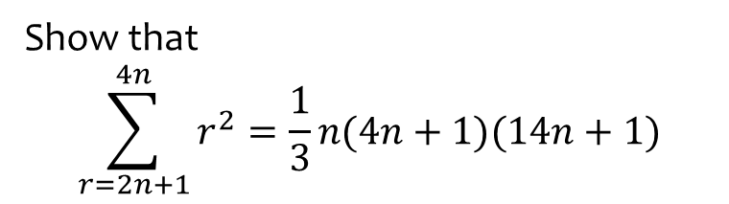
Worked example
Your turn
Show that
$$\sum_{r=2n+1}^{4n}{r^{2}}=\frac{1}{3}n(4n+1)(14n+1)$$
Show that
$$\sum_{r=n+1}^{2n}{r^{2}}=\frac{1}{6}n(2n+1)(7n+1)$$
Shown

Slide 5
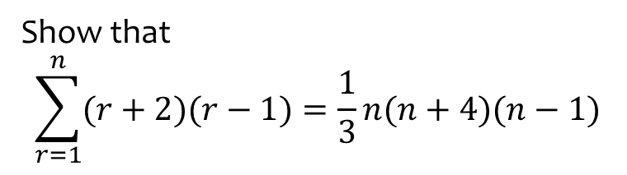
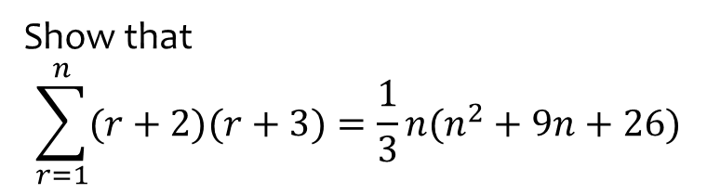
Worked example
Your turn
Show that
$$\sum_{r=1}^{n}{(r+2)(r+3)}=\frac{1}{3}n(n^{2}+9n+26)$$
Show that
$$\sum_{r=1}^{n}{(r+2)(r−1)}=\frac{1}{3}n(n+4)(n−1)$$
Shown

Slide 6
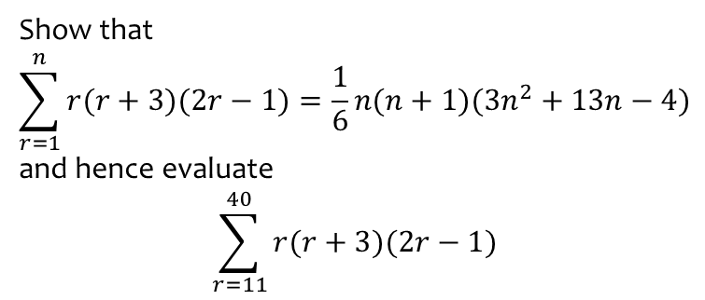
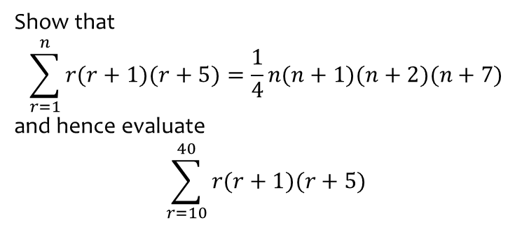

Worked example
Your turn
Show that
$$\sum_{r=1}^{n}{r(r+1)(r+5)}=\frac{1}{4}n(n+1)(n+2)(n+7)$$
and hence evaluate
$$\sum_{r=10}^{40}{r(r+1)(r+5)}$$
Show that
$$\sum_{r=1}^{n}{r(r+3)(2r−1)}=\frac{1}{6}n(n+1)(3n^{2}+13n−4)$$
and hence evaluate
$$\sum_{r=11}^{40}{r(r+3)(2r−1)}$$
Shown
$$1445230$$

Slide 7
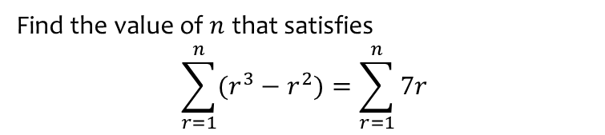
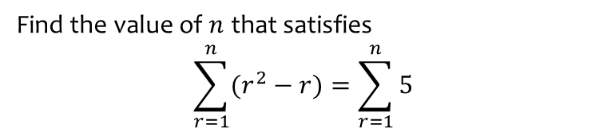
Worked example
Your turn
Find the value of $n$ that satisfies
$$\sum_{r=1}^{n}{(r^{2}−r)}=\sum_{r=1}^{n}{5}$$
Find the value of $n$ that satisfies
$$\sum_{r=1}^{n}{(r^{3}−r^{2})}=\sum_{r=1}^{n}{7r}$$
$$n=4$$

