Slide 1
Teachings for
Exercise 3B

Slide 2
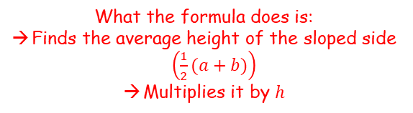







Methods in Calculus
You need to be able to calculate the mean value of a function on a given interval $\left[a,b\right]$
Consider the area of a trapezium
The rectangle given will have the same area as the trapezium
$$\frac{1}{2}\left(a+b\right)$$
$$b$$
Mean height
$$a$$
$$h$$
$$h$$
$$Area=\frac{1}{2}\left(a+b\right)h$$
What the formula does is:
Finds the average height of the sloped side $\left(\frac{1}{2}(a+b)\right)$
Multiplies it by $h$
If we wanted to find the mean height, we could divide the area of the shape by $h$…
3B

Slide 3

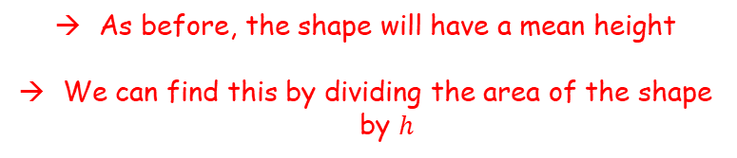
Methods in Calculus
You need to be able to calculate the mean value of a function on a given interval $\left[a,b\right]$
If the curved line was a section of a graph, the mean height would be the mean value of all the points in that interval
(remember this is basically an infinite number of points!)
Consider a shape with a curved side
as shown…
$$b$$
Mean height
$$a$$
$$h$$
As before, the shape will have a mean height
We can find this by dividing the area of the shape by $h$
3B

Slide 4





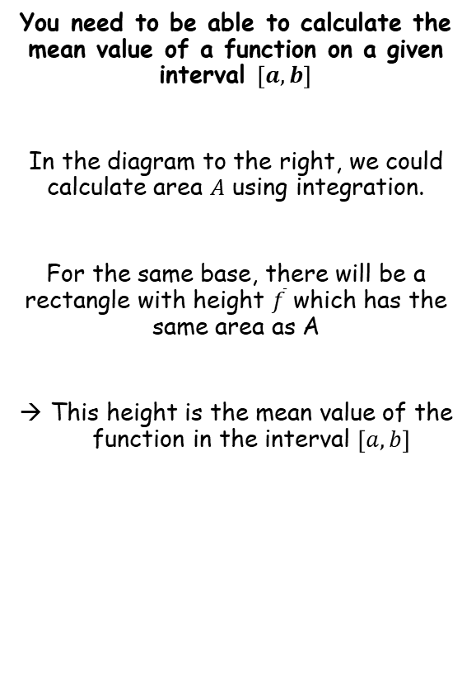








Methods in Calculus
$$y=f(x)$$
$$y$$
You need to be able to calculate the mean value of a function on a given interval $\left[a,b\right]$
In the diagram to the right, we could calculate area $A$ using integration.
For the same base, there will be a rectangle with height $\overline{f}$ which has the same area as A
This height is the mean value of the function in the interval $\left[a,b\right]$
$$A$$
$$\overline{f}$$
$$O$$
$$x$$
$$a$$
$$b$$
$$b−a$$
$$=\int_{a}^{b}{f\left(x\right) dx}$$
$$\left(b−a\right)\overline{f}$$
Divide both sides by $\left(b−a\right)$
$$=\frac{1}{b−a}\int_{a}^{b}{f\left(x\right) dx}$$
The mean value of $f(x)$ is sometimes written as $\overline{f}$, $\overline{y}$ or $y_{m}$
$$\overline{f}$$
3B

Slide 5










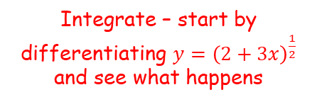




Methods in Calculus
$$\overline{f}=\frac{1}{b−a}\int_{a}^{b}{f\left(x\right) dx}$$
You need to be able to calculate the mean value of a function on a given interval $\left[a,b\right]$
Find the mean value of $f\left(x\right)=\frac{4}{\sqrt{2+3x}}$ in the interval $\left[2,6\right]$.
$$\overline{f}=\frac{1}{b−a}\int_{a}^{b}{f\left(x\right) dx}$$
Sub in the values of $a$ and $b$, and the function
$$=\frac{1}{6−2}\int_{2}^{6}{\frac{4}{\sqrt{2+3x}}dx}$$
Simplify the fraction
$$=\frac{1}{4}\int_{2}^{6}{\frac{4}{\sqrt{2+3x}}dx}$$
You can take the 4 on the numerator out as a factor (which cancels the $\frac{1}{4}$)
$$y={\left(2+3x\right)}^{\frac{1}{2}}$$
Differentiate using the chain rule
$$=\int_{2}^{6}{\frac{1}{\sqrt{2+3x}}dx}$$
$$\frac{dy}{dx}={\frac{1}{2}\left(2+3x\right)}^{−\frac{1}{2}}(3)$$
Simplify
Rewrite if it helps
$$=\int_{2}^{6}{{\left(2+3x\right)}^{−\frac{1}{2}} dx}$$
$$\frac{dy}{dx}={\frac{3}{2}\left(2+3x\right)}^{−\frac{1}{2}}$$
Integrate – start by differentiating $y={\left(2+3x\right)}^{\frac{1}{2}}$ and see what happens
This is $\frac{3}{2}$ times what we want, so multiply the original expression by $\frac{2}{3}$
$$={\left[\frac{2}{3}{\left(2+3x\right)}^{\frac{1}{2}}\right]}_{2}^{6}$$
3B

Slide 6


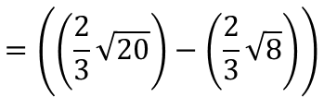
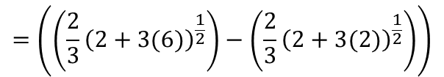

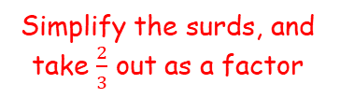
Methods in Calculus
$$\overline{f}=\frac{1}{b−a}\int_{a}^{b}{f\left(x\right) dx}$$
You need to be able to calculate the mean value of a function on a given interval $\left[a,b\right]$
Find the mean value of $f\left(x\right)=\frac{4}{\sqrt{2+3x}}$ in the interval $\left[2,6\right]$.
$$={\left[\frac{2}{3}{\left(2+3x\right)}^{\frac{1}{2}}\right]}_{2}^{6}$$
Sub in limits and subtract
$$=\left(\left(\frac{2}{3}{\left(2+3(6)\right)}^{\frac{1}{2}}\right)−\left(\frac{2}{3}{\left(2+3(2)\right)}^{\frac{1}{2}}\right)\right)$$
Write as roots
$$=\left(\left(\frac{2}{3}\sqrt{20}\right)−\left(\frac{2}{3}\sqrt{8}\right)\right)$$
Simplify the surds, and take $\frac{2}{3}$ out as a factor
$$=\frac{2}{3}\left(2\sqrt{5}−2\sqrt{2}\right)$$
Take out 2 as a factor
$$=\frac{4}{3}\left(\sqrt{5}−\sqrt{2}\right)$$
3B

Slide 7


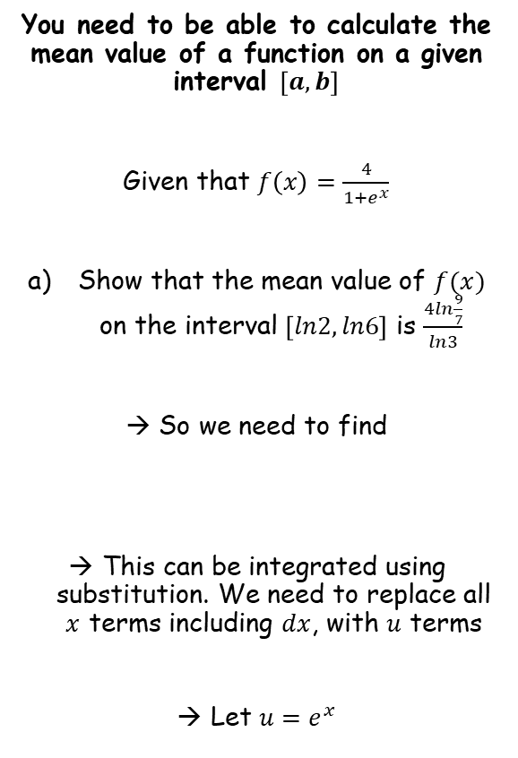





Methods in Calculus
$$\overline{f}=\frac{1}{b−a}\int_{a}^{b}{f\left(x\right) dx}$$
You need to be able to calculate the mean value of a function on a given interval $\left[a,b\right]$
Given that $f\left(x\right)=\frac{4}{1+e^{x}}$
Show that the mean value of $f(x)$ on the interval $\left[ln2, ln6\right]$ is $\frac{4ln\frac{9}{7}}{ln3}$
→ So we need to find
This can be integrated using substitution. We need to replace all $x$ terms including $dx$, with $u$ terms
Let $u=e^{x}$
$$u=e^{x}$$
Differentiate
$$\frac{du}{dx}=e^{x}$$
Multiply by $dx$ and divide by $e^{x}$
$$\frac{du}{e^{x}}=dx$$
From the first line, we know that $u=e^{x}$
$$\frac{du}{u}=dx$$
$$\int_{ln2}^{ln6}{\frac{4}{1+e^{x}} dx}$$
3B

Slide 8




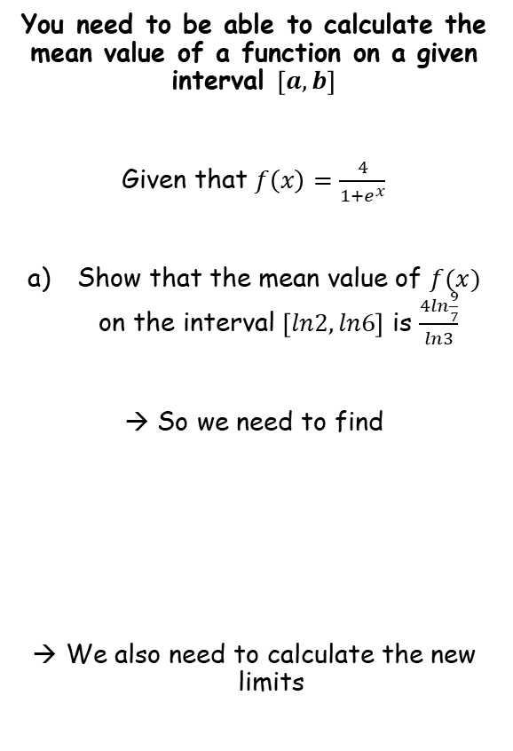







Methods in Calculus
$$\overline{f}=\frac{1}{b−a}\int_{a}^{b}{f\left(x\right) dx}$$
You need to be able to calculate the mean value of a function on a given interval $\left[a,b\right]$
Given that $f\left(x\right)=\frac{4}{1+e^{x}}$
Show that the mean value of $f(x)$ on the interval $\left[ln2, ln6\right]$ is $\frac{4ln\frac{9}{7}}{ln3}$
→ So we need to find
We also need to calculate the new limits
$$u=e^{x}$$
$$x=ln2$$
$$x=ln6$$
$$u=e^{ln2}$$
$e^{ln}$ cancels
$$u=e^{ln6}$$
$e^{ln}$ cancels
$$u=2$$
$$u=6$$
$$\int_{ln2}^{ln6}{\frac{4}{1+e^{x}} dx}$$
$$u=e^{x}$$
$$\frac{du}{u}=dx$$
3B

Slide 9






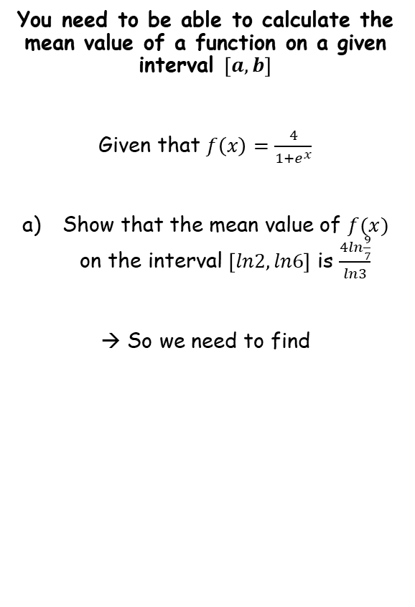

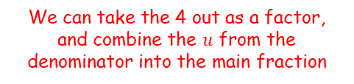





Methods in Calculus
$$\overline{f}=\frac{1}{b−a}\int_{a}^{b}{f\left(x\right) dx}$$
You need to be able to calculate the mean value of a function on a given interval $\left[a,b\right]$
Given that $f\left(x\right)=\frac{4}{1+e^{x}}$
Show that the mean value of $f(x)$ on the interval $\left[ln2, ln6\right]$ is $\frac{4ln\frac{9}{7}}{ln3}$
→ So we need to find
$$\int_{ln2}^{ln6}{\frac{4}{1+e^{x}} dx}$$
Replace terms using the various things we just calculated
$$=\int_{2}^{6}{\frac{4}{1+u} \frac{du}{u}}$$
We can take the 4 out as a factor, and combine the $u$ from the denominator into the main fraction
$$=4\int_{2}^{6}{\frac{1}{u(1+u)} du}$$
To make this integratable, we will need to use partial fractions…
$$\frac{1}{u(1+u)}=\frac{A}{u}+\frac{B}{(1+u)}$$
$$=\frac{1}{u}−\frac{1}{(1+u)}$$
Rewrite right side
$$\int_{ln2}^{ln6}{\frac{4}{1+e^{x}} dx}$$
$$\frac{1}{u(1+u)}=\frac{A(1+u)}{u(1+u)}+\frac{Bu}{u(1+u)}$$
Numerators must be equal
$$u=e^{x}$$
$$\frac{du}{u}=dx$$
$$1=A(1+u)+Bu$$
$$u=2,6$$
If $u=0$
$$\text{If} u=−1$$
$$1=A$$
$$−1=B$$
3B

Slide 10






Methods in Calculus
$$\overline{f}=\frac{1}{b−a}\int_{a}^{b}{f\left(x\right) dx}$$
You need to be able to calculate the mean value of a function on a given interval $\left[a,b\right]$
Given that $f\left(x\right)=\frac{4}{1+e^{x}}$
Show that the mean value of $f(x)$ on the interval $\left[ln2, ln6\right]$ is $\frac{4ln\frac{9}{7}}{ln3}$
→ So we need to find
$$\int_{ln2}^{ln6}{\frac{4}{1+e^{x}} dx}$$
Replace terms using the various things we just calculated
$$=\int_{2}^{6}{\frac{4}{1+u} \frac{du}{u}}$$
We can take the 4 out as a factor, and combine the $u$ from the denominator into the main fraction
$$=4\int_{2}^{6}{\frac{1}{u(1+u)} du}$$
Write using the partial fractions we just calculated
$$=4\int_{2}^{6}{\left(\frac{1}{u}−\frac{1}{1+u}\right)du}$$
Integrate and use a square bracket
$$=4{\left[lnu−ln\left(1+u\right)\right]}_{2}^{6}$$
Combine terms using the division law
$$\int_{ln2}^{ln6}{\frac{4}{1+e^{x}} dx}$$
$$=4{\left[ln\frac{u}{1+u}\right]}_{2}^{6}$$
Sub in values and subtract
$$=4\left(ln\frac{6}{7}−ln\frac{2}{3}\right)$$
$$u=e^{x}$$
$$\frac{du}{u}=dx$$
Combine again using the division law
$$=4\left(ln\frac{6/7}{2/3}\right)$$
$$u=2,6$$
Simplify
$$=4\left(ln\frac{9}{7}\right)$$
3B

Slide 11






Methods in Calculus
$$\overline{f}=\frac{1}{b−a}\int_{a}^{b}{f\left(x\right) dx}$$
You need to be able to calculate the mean value of a function on a given interval $\left[a,b\right]$
Given that $f\left(x\right)=\frac{4}{1+e^{x}}$
Show that the mean value of $f(x)$ on the interval $\left[ln2, ln6\right]$ is $\frac{4ln\frac{9}{7}}{ln3}$
→ So we need to find
$$\overline{f}=\frac{1}{b−a}\int_{a}^{b}{f\left(x\right) dx}$$
Replace the function as well as the values of $a$ and $b$
$$=\frac{1}{ln6−ln2}\int_{ln2}^{ln6}{\frac{4}{1+e^{x}} dx}$$
Simplify the left fraction using the division law. The right part we just worked out…
$$=\frac{1}{ln3}4ln\frac{9}{7}$$
$$=\frac{4ln\frac{9}{7}}{ln3}$$
Simplify
$$\int_{ln2}^{ln6}{\frac{4}{1+e^{x}} dx}$$
$$u=e^{x}$$
$$\frac{du}{u}=dx$$
$$u=2,6$$
$$\int_{ln2}^{ln6}{\frac{4}{1+e^{x}} dx=4ln\frac{9}{7}}$$
3B

Slide 12


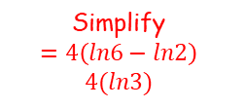
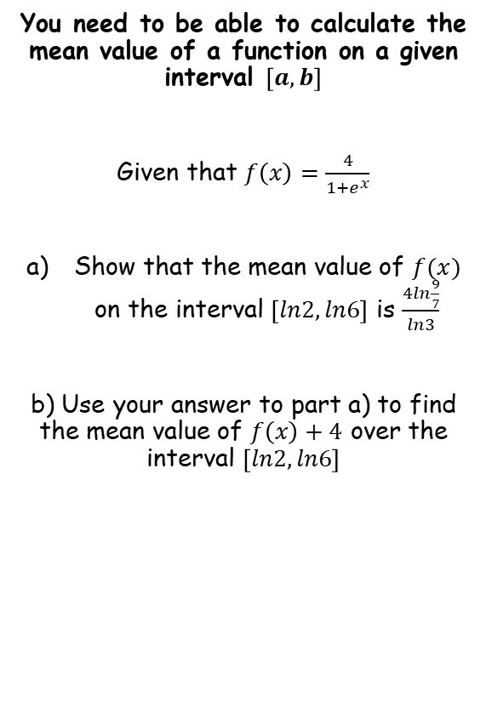






Methods in Calculus
$$\overline{f}=\frac{1}{b−a}\int_{a}^{b}{f\left(x\right) dx}$$
You need to be able to calculate the mean value of a function on a given interval $\left[a,b\right]$
Given that $f\left(x\right)=\frac{4}{1+e^{x}}$
Show that the mean value of $f(x)$ on the interval $\left[ln2, ln6\right]$ is $\frac{4ln\frac{9}{7}}{ln3}$
b) Use your answer to part a) to find the mean value of $f\left(x\right)+4$ over the interval $\left[ln2,ln6\right]$
$$\int_{ln2}^{ln6}{f\left(x\right)+4 dx}$$
Replace $f(x)$
$$=\int_{ln2}^{ln6}{\left(\frac{4}{1+e^{x}}+4\right)dx}$$
Write as two separate integrals
$$=\int_{ln2}^{ln6}{\left(\frac{4}{1+e^{x}}\right)dx+}\int_{ln2}^{ln6}{\left(4\right)dx}$$
We already know the value of the first part from a)
$$=4ln\frac{9}{7}+\int_{ln2}^{ln6}{\left(4\right)dx}$$
Integrate the right part and use a square bracket
$$=4ln\frac{9}{7}+{\left[4x\right]}_{ln2}^{ln6}$$
Sub in limits and subtract
$$=4ln\frac{9}{7}+\left\lfloor 4ln6−4ln2\right\rfloor$$
Simplify
$$=4\left(ln6−ln2\right)$$
$$4(ln3)$$
$$=4ln\frac{9}{7}+4ln3$$
3B

Slide 13




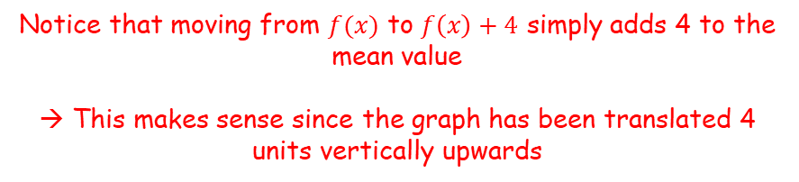


Methods in Calculus
$$\overline{f}=\frac{1}{b−a}\int_{a}^{b}{f\left(x\right) dx}$$
You need to be able to calculate the mean value of a function on a given interval $\left[a,b\right]$
Given that $f\left(x\right)=\frac{4}{1+e^{x}}$
Show that the mean value of $f(x)$ on the interval $\left[ln2, ln6\right]$ is $\frac{4ln\frac{9}{7}}{ln3}$
b) Use your answer to part a) to find the mean value of $f\left(x\right)+4$ over the interval $\left[ln2,ln6\right]$
$$\overline{f}=\frac{1}{b−a}\int_{a}^{b}{f\left(x\right) dx}$$
Sub in $f(x)$ and the values of $a$ and $b$
$$=\frac{1}{ln6−ln2}\int_{ln2}^{ln6}{f\left(x\right)+4 dx}$$
Simplify left fraction, and we know the value of the integral
$$=\frac{1}{ln3}\left(4ln\frac{9}{7}+4ln3\right)$$
Simplify
$$=\frac{4ln\frac{9}{7}}{ln3}+4$$
Notice that moving from $f(x)$ to $f\left(x\right)+4$ simply adds 4 to the mean value
→ This makes sense since the graph has been translated 4 units vertically upwards
$$\int_{ln2}^{ln6}{f\left(x\right)+4 dx}=4ln\frac{9}{7}+4ln3$$
3B

Slide 14
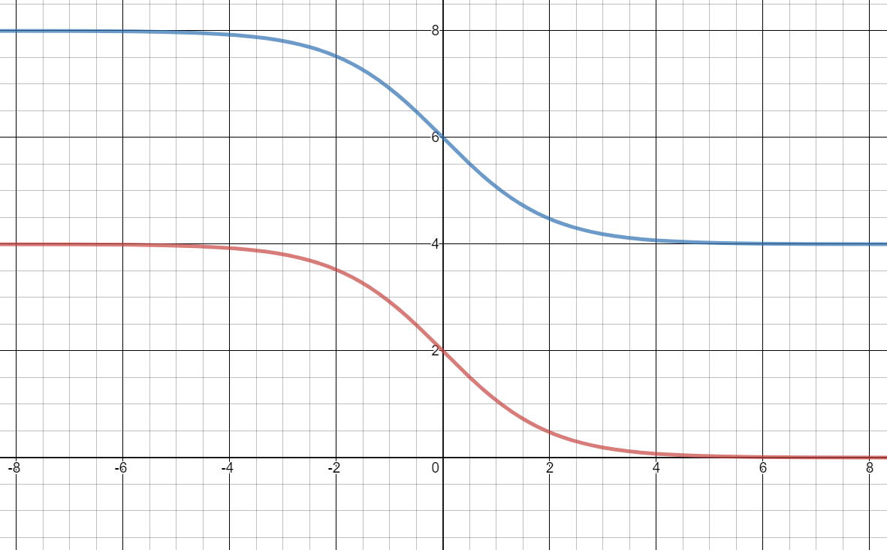


Methods in Calculus
$$\overline{f}=\frac{1}{b−a}\int_{a}^{b}{f\left(x\right) dx}$$
You need to be able to calculate the mean value of a function on a given interval $\left[a,b\right]$
Given that $f\left(x\right)=\frac{4}{1+e^{x}}$
Show that the mean value of $f(x)$ on the interval $\left[ln2, ln6\right]$ is $\frac{4ln\frac{9}{7}}{ln3}$
b) Use your answer to part a) to find the mean value of $f\left(x\right)+4$ over the interval $\left[ln2,ln6\right]$
$$y=f\left(x\right)+4$$
$$y=f\left(x\right)$$
3B

Slide 15
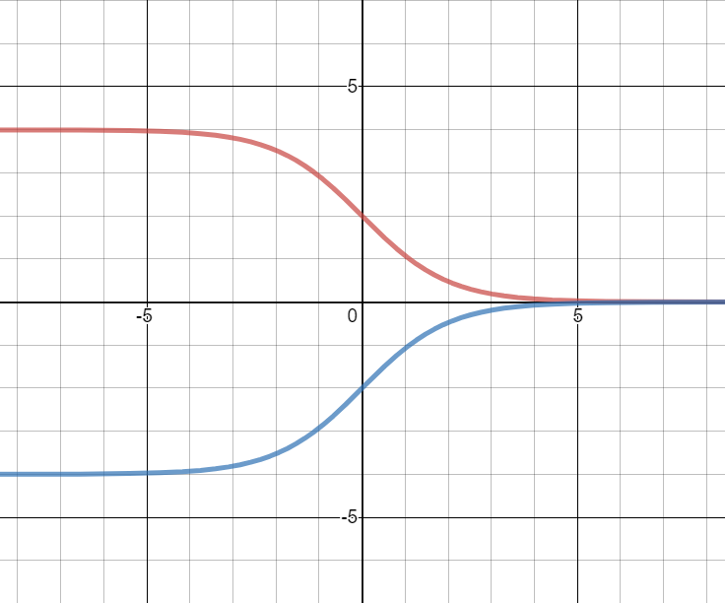

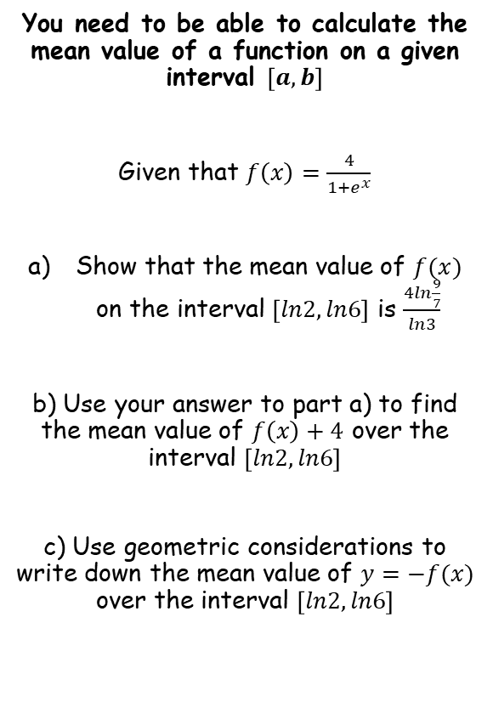

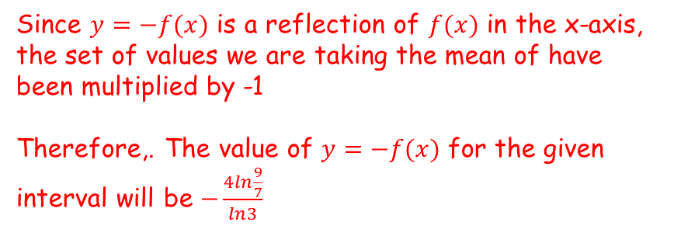
Methods in Calculus
$$\overline{f}=\frac{1}{b−a}\int_{a}^{b}{f\left(x\right) dx}$$
You need to be able to calculate the mean value of a function on a given interval $\left[a,b\right]$
Given that $f\left(x\right)=\frac{4}{1+e^{x}}$
Show that the mean value of $f(x)$ on the interval $\left[ln2, ln6\right]$ is $\frac{4ln\frac{9}{7}}{ln3}$
b) Use your answer to part a) to find the mean value of $f\left(x\right)+4$ over the interval $\left[ln2,ln6\right]$
c) Use geometric considerations to write down the mean value of $y=−f(x)$ over the interval $\left[ln2,ln6\right]$
Since $y=−f(x)$ is a reflection of $f(x)$ in the x-axis, the set of values we are taking the mean of have been multiplied by -1
Therefore,. The value of $y=−f(x)$ for the given interval will be $−\frac{4ln\frac{9}{7}}{ln3}$
$$y=f\left(x\right)$$
$$y=−f\left(x\right)$$
3B

Slide 16




Methods in Calculus
$$\overline{f}=\frac{1}{b−a}\int_{a}^{b}{f\left(x\right) dx}$$
You need to be able to calculate the mean value of a function on a given interval $\left[a,b\right]$
In general:
If the function $f(x)$ has mean value $\overline{f}$ over the interval $\left[a,b\right]$, and $k$ is a real constant, then:
→ $f\left(x\right)+k$ has a mean value of $\overline{f}+k$ over the interval $\left[a,b\right]$
(Since all the values in the interval have increased by $k$)
→ $kf\left(x\right)$ has a mean value of $k\overline{f}$ over the interval $\left[a,b\right]$
(Since all the values in the interval have been multiplied by $k$)
→ $−f\left(x\right)$ has a mean value of $−\overline{f}$ over the interval $\left[a,b\right]$
(Since all the values in the interval have been multiplied by -1)
IMPORTANT: Since $f(−x)$, $f(kx)$ and $f(x+k)$ affect a graph horizontally, similar rules cannot be applied to them
→ This is because the interval $\left[a,b\right]$ would remain unchanged and the section of the graph there would now be different
3B

