Slide 1
3.2) The mean value of a function

Slide 2
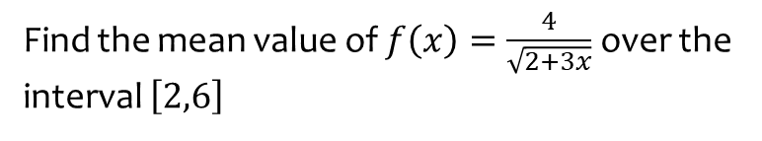
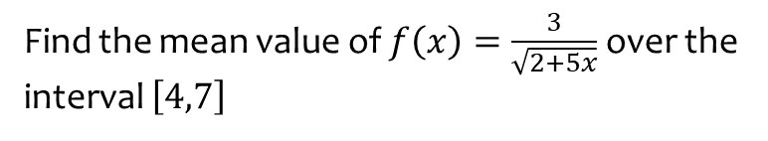

Worked example
Your turn
Find the mean value of $f\left(x\right)=\frac{3}{\sqrt{2+5x}}$ over the interval $\left[4,7\right]$
Find the mean value of $f\left(x\right)=\frac{4}{\sqrt{2+3x}}$ over the interval $\left[2,6\right]$
$$\frac{4}{3}\left(\sqrt{5}−\sqrt{2}\right)$$

Slide 3
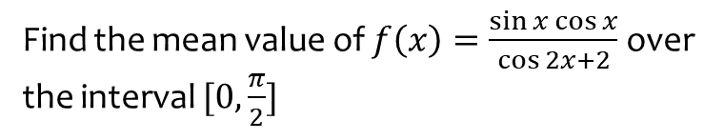
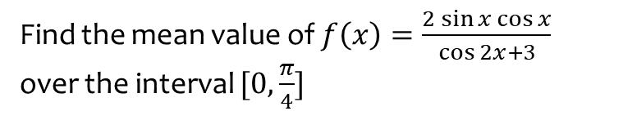

Worked example
Your turn
Find the mean value of $f\left(x\right)=\frac{2\sin{x}\cos{x}}{\cos{2x}+3}$ over the interval $[0,\frac{π}{4}]$
Find the mean value of $f\left(x\right)=\frac{\sin{x}\cos{x}}{\cos{2x}+2}$ over the interval $[0,\frac{π}{2}]$
$$\frac{\ln{3}}{2π}$$

Slide 4
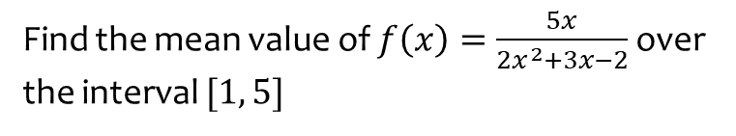
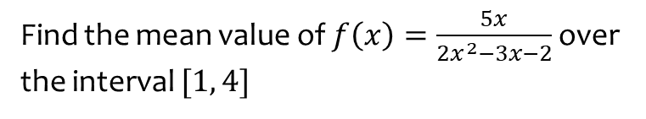

Worked example
Your turn
Find the mean value of $f\left(x\right)=\frac{5x}{2x^{2}−3x−2}$over the interval $[1, 4]$
Find the mean value of $f\left(x\right)=\frac{5x}{2x^{2}+3x−2}$over the interval $[1, 5]$
$$\frac{1}{4}\ln{\frac{49}{3}}$$

Slide 5
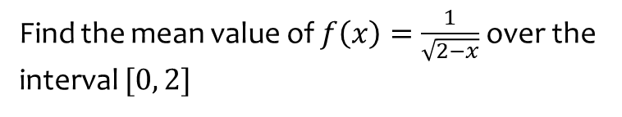
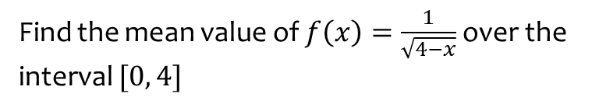
Worked example
Your turn
Find the mean value of $f\left(x\right)=\frac{1}{\sqrt{4−x}}$over the interval $[0, 4]$
Find the mean value of $f\left(x\right)=\frac{1}{\sqrt{2−x}}$over the interval $[0, 2]$
$$\sqrt{2}$$

Slide 6
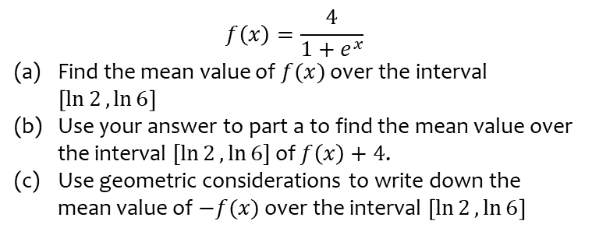
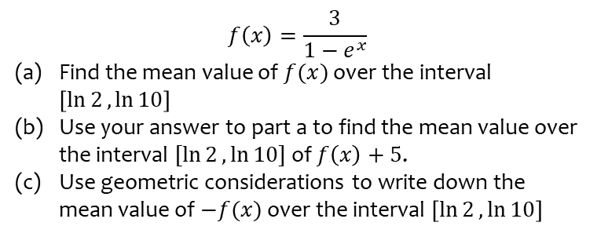
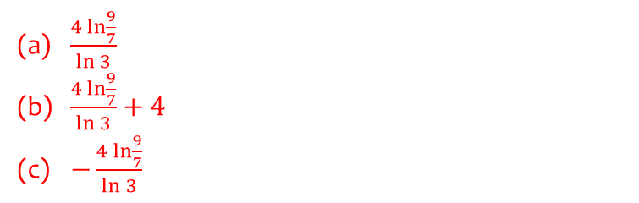
Worked example
Your turn
$$f\left(x\right)=\frac{3}{1−e^{x}}$$
Find the mean value of $f(x)$ over the interval $\left[\ln{2},\ln{10}\right]$
Use your answer to part a to find the mean value over the interval $[\ln{2},\ln{10}]$ of $f\left(x\right)+5$.
Use geometric considerations to write down the mean value of $−f(x)$ over the interval $\left[\ln{2},\ln{10}\right]$
$$f\left(x\right)=\frac{4}{1+e^{x}}$$
Find the mean value of $f(x)$ over the interval $\left[\ln{2},\ln{6}\right]$
Use your answer to part a to find the mean value over the interval $[\ln{2},\ln{6}]$ of $f\left(x\right)+4$.
Use geometric considerations to write down the mean value of $−f(x)$ over the interval $\left[\ln{2},\ln{6}\right]$
$\frac{4\ln{\frac{9}{7}}}{\ln{3}}$
$\frac{4\ln{\frac{9}{7}}}{\ln{3}}+4$
$−\frac{4\ln{\frac{9}{7}}}{\ln{3}}$

