Slide 1
Series
Twitter: @Owen134866
www.mathsfreeresourcelibrary.com

Slide 2

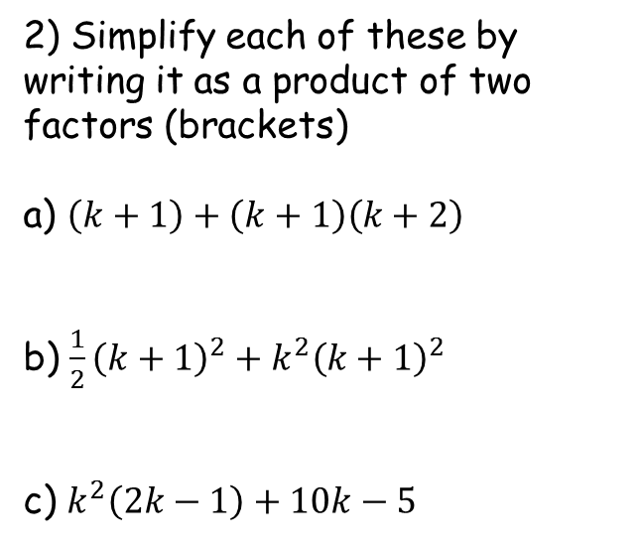

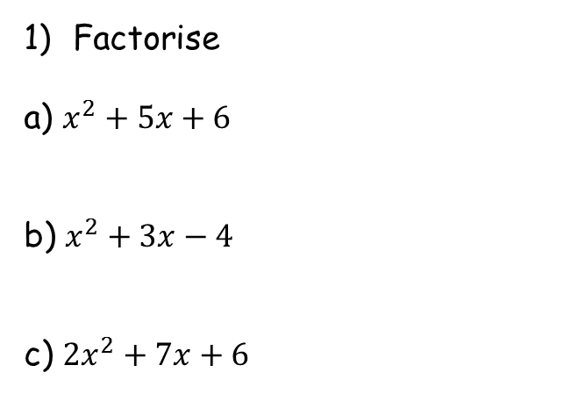




Prior Knowledge Check
Factorise
a) $x^{2}+5x+6$
b) $x^{2}+3x−4$
c) ${2x}^{2}+7x+6$
2) Simplify each of these by writing it as a product of two factors (brackets)
a) $\left(k+1\right)+\left(k+1\right)\left(k+2\right)$
b) $\frac{1}{2}{\left(k+1\right)}^{2}+k^{2}{\left(k+1\right)}^{2}$
c) $k^{2}\left(2k−1\right)+10k−5$
$$=(x+2)(x+3)$$
$$=(k+1)(k+3)$$
$$=(x+4)(x−1)$$
$$=\frac{1}{2}{\left(k+1\right)}^{2}(1+{2k}^{2})$$
$$=(2x+3)(x+2)$$
$$= (2k−1)(k^{2}+5)$$

Slide 3
Teachings for
Exercise 3A

Slide 4

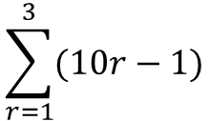

Series
You can use the sigma notation to write the sum of a series clearly and concisely
The last value we put into the sequence formula (put in every integer in between as well!)
$$\sum_{r=1}^{3}{(10r−1)}$$
The sequence of numbers we are finding the sum of
The first value we put into the sequence formula
$$=9+19+29$$
$$=57$$
3A

Slide 5

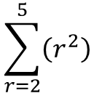

Series
You can use the sigma notation to write the sum of a series clearly and concisely
The last value we put into the sequence formula (put in every integer in between as well!)
$$\sum_{r=2}^{5}{\left(r^{2}\right)}$$
The sequence of numbers we are finding the sum of
$$=4+9+16+25$$
The first value we put into the sequence formula
$$=54$$
3A

Slide 6
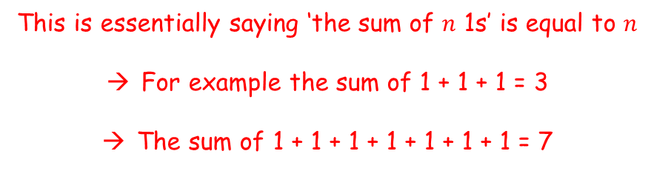
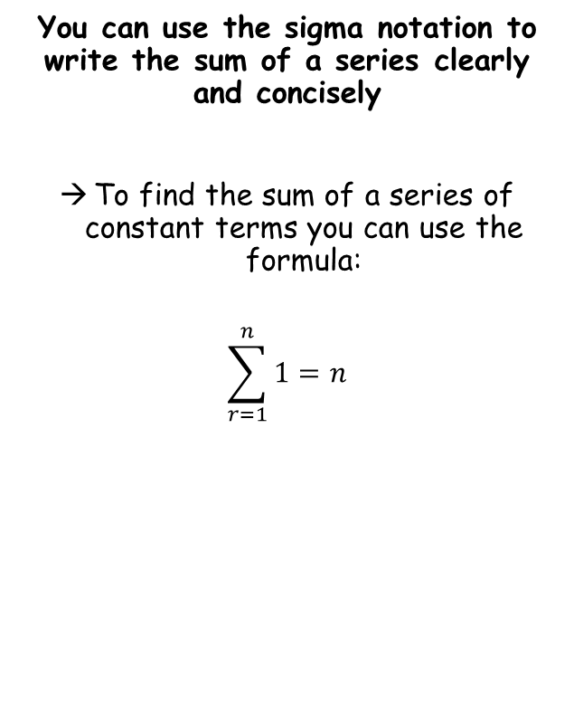
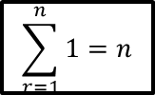
Series
$$\sum_{r=1}^{n}{1}=n$$
You can use the sigma notation to write the sum of a series clearly and concisely
To find the sum of a series of constant terms you can use the formula:
$$\sum_{r=1}^{n}{1}=n$$
This is essentially saying ‘the sum of $n$ 1s’ is equal to $n$
For example the sum of 1 + 1 + 1 = 3
The sum of 1 + 1 + 1 + 1 + 1 + 1 + 1 = 7
3A

Slide 7
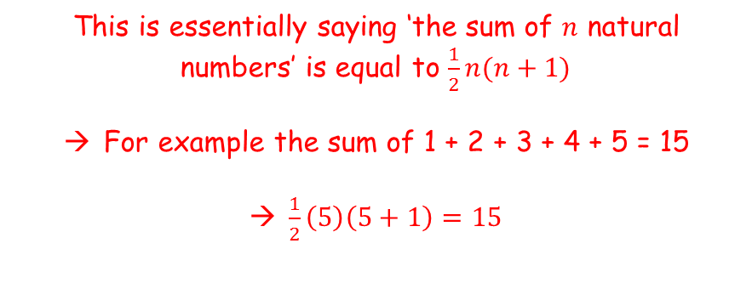
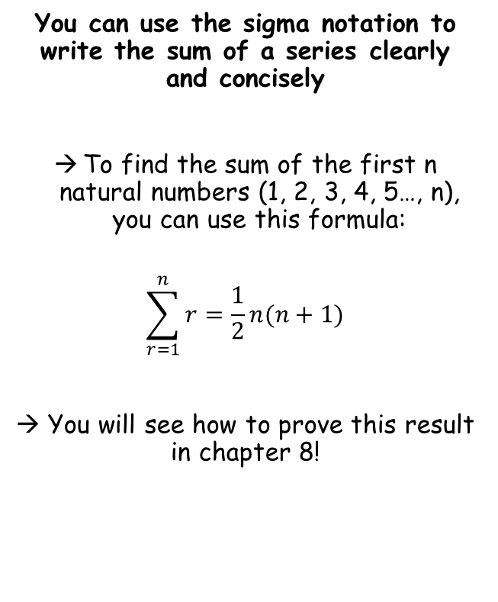

Series
$$\sum_{r=1}^{n}{1}=n$$
$$\sum_{r=1}^{n}{r}=\frac{1}{2}n(n+1)$$
You can use the sigma notation to write the sum of a series clearly and concisely
To find the sum of the first n natural numbers (1, 2, 3, 4, 5…, n), you can use this formula:
$$\sum_{r=1}^{n}{r}=\frac{1}{2}n(n+1)$$
→ You will see how to prove this result in chapter 8!
This is essentially saying ‘the sum of $n$ natural numbers’ is equal to $\frac{1}{2}n(n+1)$
For example the sum of 1 + 2 + 3 + 4 + 5 = 15
$\frac{1}{2}\left(5\right)\left(5+1\right)=15$
3A

Slide 8

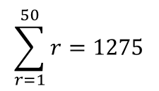
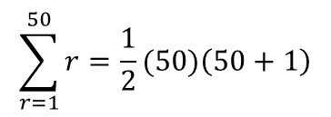
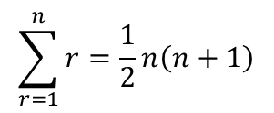


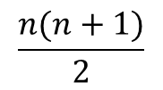
Series
$$\sum_{r=1}^{n}{1}=n$$
$$\sum_{r=1}^{n}{r}=\frac{1}{2}n(n+1)$$
$$\sum_{r=1}^{n}{r}=\frac{n(n+1)}{2}$$
You can use the sigma notation to write the sum of a series clearly and concisely
Calculate the sum of the series indicated below:
$$\sum_{r=1}^{n}{r}=\frac{1}{2}n\left(n+1\right)$$
We want the sum of the first 50 terms, so n = 50
$$\sum_{r=1}^{50}{r}=\frac{1}{2}(50)\left(50+1\right)$$
$$\sum_{r=1}^{50}{r}$$
Calculate
$$\sum_{r=1}^{50}{r}=1275$$
$$\frac{1}{2}n(n+1)$$
$$\frac{n(n+1)}{2}$$
It is fine (and sometimes easier) to use the formula in this form!
3A

Slide 9
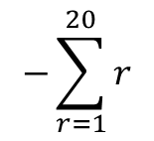
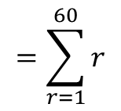
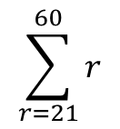
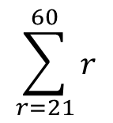
Series
$$\sum_{r=1}^{n}{1}=n$$
$$\sum_{r=1}^{n}{r}=\frac{1}{2}n(n+1)$$
$$\sum_{r=1}^{n}{r}=\frac{n(n+1)}{2}$$
The sum of the numbers from 21 to 60…
You can use the sigma notation to write the sum of a series clearly and concisely
Calculate the sum of the series indicated below:
0
10
20
30
40
50
60
-
$$\sum_{r=21}^{60}{r}$$
… Will be equal to the sum of the numbers from 1 to 60, subtract the numbers from 1 to 20…
The notation will look like this…
Notice the number here will always be one less than the one at the start!
$$\sum_{r=21}^{60}{r}$$
$$=\sum_{r=1}^{60}{r}$$
$$−\sum_{r=1}^{20}{r}$$
This is asking you to find the sum of the numbers from 21 to 60
Sum from 21 to 60
Sum from 1 to 60
Sum from 1 to 20
3A

Slide 10
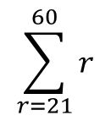
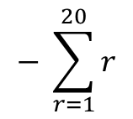

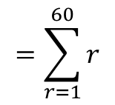
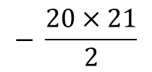
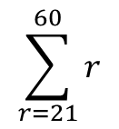
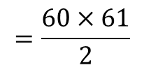
Series
$$\sum_{r=1}^{n}{1}=n$$
$$\sum_{r=1}^{n}{r}=\frac{1}{2}n(n+1)$$
$$\sum_{r=1}^{n}{r}=\frac{n(n+1)}{2}$$
You can use the sigma notation to write the sum of a series clearly and concisely
Calculate the sum of the series indicated below:
$$\sum_{r=21}^{60}{r}$$
$$=\sum_{r=1}^{60}{r}$$
$$− \sum_{r=1}^{20}{r}$$
Sub in values for each part
$$\sum_{r=21}^{60}{r}$$
$$\sum_{r=21}^{60}{r}$$
$$=\frac{60×61}{2}$$
$$− \frac{20×21}{2}$$
Calculate
$$=1620$$
This is asking you to find the sum of the numbers from 21 to 60
So the sum of the numbers from 21 to 60 is 1620!
3A

Slide 11
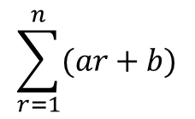


Series
$$\sum_{r=1}^{n}{1}=n$$
$$\sum_{r=1}^{n}{r}=\frac{1}{2}n(n+1)$$
$$\sum_{r=1}^{n}{r}=\frac{n(n+1)}{2}$$
You need to be able to split up parts of a sequence and sum them separately
You can split up series sums of the form:
into 2 separate ‘series sums’ as follows:
This allows you to then use the sum formulae for the sequence overall!
$$\sum_{r=1}^{n}{(ar+b)}$$
$$a\sum_{r=1}^{n}{r}$$
$$+ b\sum_{r=1}^{n}{1}$$
3A

Slide 12



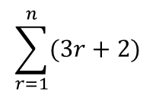




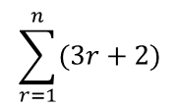








Series
$$\sum_{r=1}^{n}{1}=n$$
$$\sum_{r=1}^{n}{r}=\frac{1}{2}n(n+1)$$
$$\sum_{r=1}^{n}{r}=\frac{n(n+1)}{2}$$
You need to be able to split up parts of a sequence and sum them separately
Show that:
Can be written as:
$$\sum_{r=1}^{n}{(3r+2)}$$
If we wrote out the first few terms of this sequence…
$$\sum_{r=1}^{n}{(3r+2)}$$
$$=\left(3×1+2\right)$$
$$+ \left(3×2+2\right)$$
$$+ \left(3×3+2\right)$$
$$+ \left(3×4+2\right)………$$
This is equal to the sum of the multiplied terms, added to the sum of the 2s
$$=\left(3×1\right)$$
$$+ \left(3×2\right)$$
$$+ \left(3×3\right)$$
$$+ \left(3×4\right)$$
$$+ \left(2+2+2+2\right) ……$$
We can ‘factorise’ the 3 out of the multiplied terms and factorise a 2 from the added terms…
$$3\sum_{r=1}^{n}{r}$$
$$+ 2\sum_{r=1}^{n}{1}$$
$$=3×\left(1+2+3+4\right)………$$
$$+ 2\left(1+1+1+1\right)………$$
This is 3 multiplied by the sum of the first ‘n’ numbers represented by the formula ‘r’
This is 2 multiplied by ‘n’ 1s
$$3\sum_{r=1}^{n}{r}$$
$$+ 2\sum_{r=1}^{n}{1}$$
3A

Slide 13

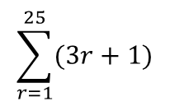

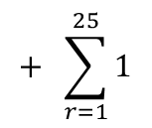

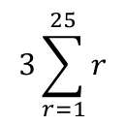

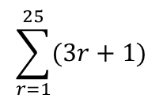

Series
$$\sum_{r=1}^{n}{1}=n$$
$$\sum_{r=1}^{n}{r}=\frac{1}{2}n(n+1)$$
$$\sum_{r=1}^{n}{r}=\frac{n(n+1)}{2}$$
$$\sum_{r=1}^{25}{(3r+1)}$$
You need to be able to split up parts of a sequence and sum them separately
Evaluate:
You need to split this up and sum the parts separately!
Split into two separate parts as you have seen
$$3\sum_{r=1}^{25}{r}$$
$$+ \sum_{r=1}^{25}{1}$$
$$\sum_{r=1}^{25}{(3r+1)}$$
Write the formulae for the sums. Remember the 3 at the start of the first one!
→ We will also have ‘n’ lots of 1
$$=\frac{3n(n+1)}{2}$$
$$+ n(1)$$
Sub in n = 25 (25 terms to add up)
$$=\frac{3(25)(25+1)}{2}$$
$$+ 25(1)$$
Calculate
$$=1000$$
So the first 25 terms of the sequence with the formula (3r + 1) will add up to 1000!
3A

Slide 14


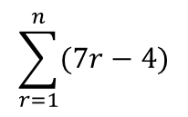
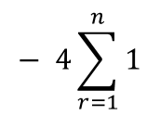



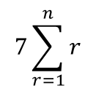

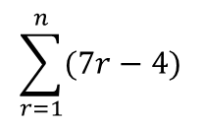



Series
$$\sum_{r=1}^{n}{1}=n$$
$$\sum_{r=1}^{n}{r}=\frac{1}{2}n(n+1)$$
$$\sum_{r=1}^{n}{r}=\frac{n(n+1)}{2}$$
$$\sum_{r=1}^{n}{(7r−4)}$$
You need to be able to split up parts of a sequence and sum them separately
Show that:
In this case you should proceed as normal, but use ‘n’ instead!
Split up as two separate sums
$$7\sum_{r=1}^{n}{r}$$
$$− 4\sum_{r=1}^{n}{1}$$
$$\sum_{r=1}^{n}{(7r−4)}$$
Remember the 7 on the first expression!
→ We also have n lots of 4
$$= \frac{n}{2}\left(7n−1\right)$$
$$=\frac{7n(n+1)}{2}$$
$$− 4n$$
Write ‘4n’ as fraction over 2 (for grouping)
$$=\frac{7n(n+1)}{2}$$
$$− \frac{8n}{2}$$
The sum of the first ‘n’ terms of this sequence
Is given by this formula, where ‘n’ is the number of terms
$$=\frac{7n\left(n+1\right)−8n}{2}$$
Group terms
Expand the bracket
$$=\frac{7n^{2}+7n−8n}{2}$$
$$=\frac{7n^{2}−n}{2}$$
Group terms
The two expressions are equivalent!
Factorise
$$=\frac{n(7n−1)}{2}$$
3A

Slide 15
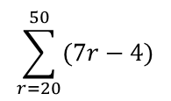

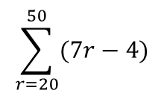





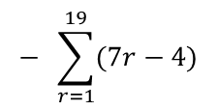
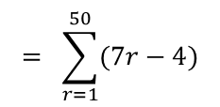

Series
$$\sum_{r=1}^{n}{1}=n$$
$$\sum_{r=1}^{n}{r}=\frac{1}{2}n(n+1)$$
$$\sum_{r=1}^{n}{r}=\frac{n(n+1)}{2}$$
Write as one sum subtract another
You need to be able to split up parts of a sequence and sum them separately
Show that:
Hence, calculate the value of:
Here, you can use the formula you’re given – remember that this will be the sum of the first 50 terms subtract the sum of the first 19!
$$\sum_{r=20}^{50}{(7r−4)}$$
$$= \sum_{r=1}^{50}{(7r−4)}$$
$$− \sum_{r=1}^{19}{(7r−4)}$$
Write the formula separately for each sum
$$=\frac{n(7n−1)}{2}$$
$$− \frac{n(7n−1)}{2}$$
Sub 50 into the first and 19 into the second
$$\sum_{r=1}^{n}{(7r−4)}$$
$$= \frac{n}{2}\left(7n−1\right)$$
$$=\frac{50(7(50)−1)}{2}$$
$$− \frac{19(7(19)−1)}{2}$$
Calculate each
$$=8725$$
$$− 1254$$
$$\sum_{r=20}^{50}{(7r−4)}$$
Calculate
$$=7471$$
3A

